Slide 1

LAB 23
January 2025

Slide 2
CONTENTS
01
Synchronizing Processes with Events
02
Achieved Outcomes
Testing the Register Design

Slide 3
Synchronizing Processes with Events and Simulating the test
01

Slide 4




1. Synchronizing Processes with Events
01
Resolving an Undefined Process Execution Order (Race) Condition. Working in the lab23-event directory, perform the following:
Simulate the existing event_m_1.sv source.
Examine the order in which processes trigger events, wait for events and receive events.
It is very likely that one process will wait for an event after it has occurred and thus will not report that it saw the event.
Notes:
IC: Integrated Circuit

Slide 5
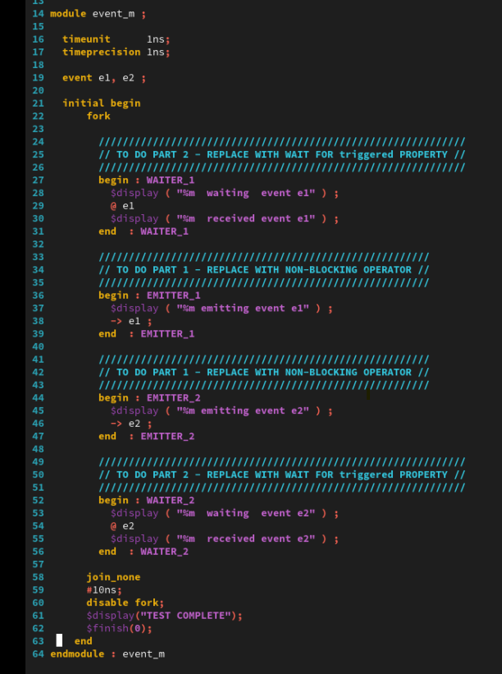
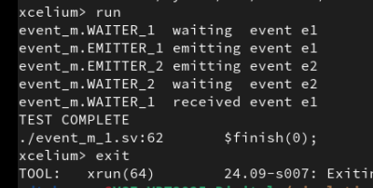
2. Simulating the test
01
result
Notes:
IC: Integrated Circuit

Slide 6
1. Synchronizing Processes with Events
01
Resolving an Undefined Process Execution Order (Race) Condition. Working in the lab23-event directory, perform the following:
Modify the event_m_1.sv source to use the nonblocking event trigger and again simulate it.
Examine the order in which processes trigger events, wait for events and receive events.
As the events do not actually occur until the NBA region, both processes are waiting for their events before the events actually occur, so both processes report seeing their event.
Notes:
IC: Integrated Circuit

Slide 7
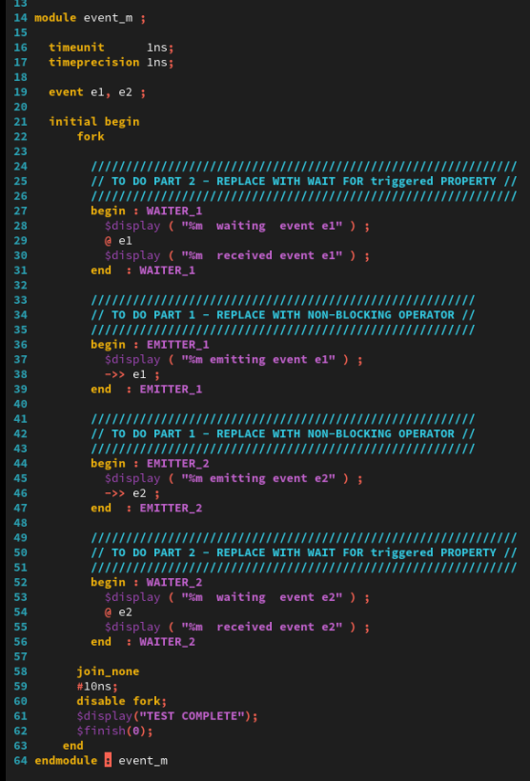
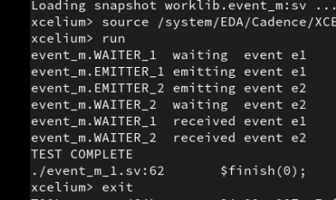
2. Simulating the test
01
result
Notes:
IC: Integrated Circuit

Slide 8
1. Synchronizing Processes with Events
01
Resolving an Undefined Process Execution Order (Race) Condition. Working in the lab23-event directory, perform the following:
Modify the event_m_1.sv source to again use the blocking event trigger, but this time replace the @ event guard with an asynchronous wait(...) for the triggered state of the event. Simulate the test again.
Examine the order in which processes trigger events, wait for events and receive events.
Events can trigger before a process waits for it, but if the processes instead wait for the triggered property, they will both report seeing the event because the triggered property of the event persists until the end of the timeslice.
Notes:
IC: Integrated Circuit

Slide 9
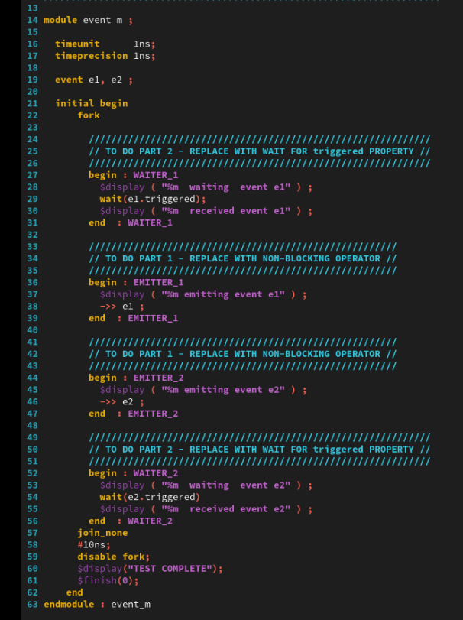
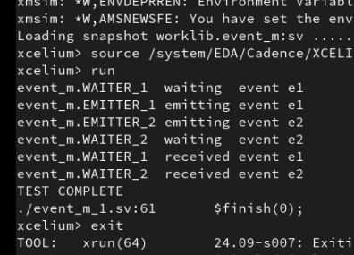
2. Simulating the test
01
result
Notes:
IC: Integrated Circuit

Slide 10
Achieved Outcomes.
02

Slide 11
3. Achieved Outcomes
01
Understand the specification and to use blocking and nonblocking event triggers.
Notes:
IC: Integrated Circuit

Slide 12

THANK YOU!

