Slide 1

LAB 3
January 2025

Slide 2
CONTENTS
01
Specification
02
Creating the Counter Design
03
Testing the Counter Design
04
Achieved Outcomes.
Testing the Register Design

Slide 3
Specification
01

Slide 4




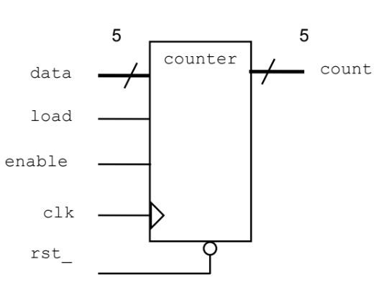
1. Specification
01
data and count are both 5-bit logic vectors.
rst_ is asynchronous and active low.
The counter is clocked on the rising edge of clk.
If load is high, the counter is loaded from the input data.
Otherwise, if enable is high, count is incremented.
Otherwise, count is unchanged.
I/O interface
Notes:
IC: Integrated Circuit

Slide 5
Creating the Counter Design
02

Slide 6
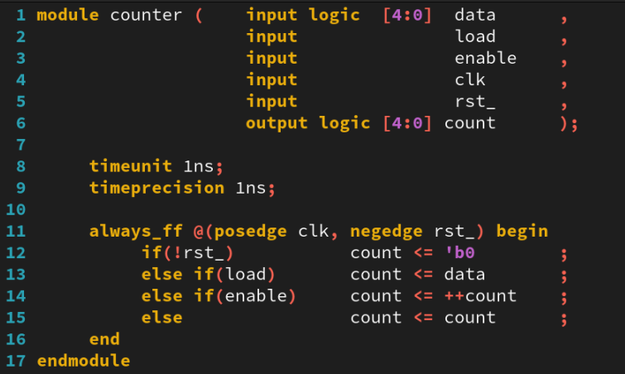
2. Creating the Counter Design
01
Working in the lab03-count directory, perform the following:
Create a new file called counter.sv, containing a module named counter.
Write the counter model using the following SystemVerilog and Verilog constructs:
always_ff procedural block.
timeunit and timeprecision.
Verilog2001 ANSI-C port declarations.
Notes:
IC: Integrated Circuit

Slide 7
Testing the Counter Design
03

Slide 8
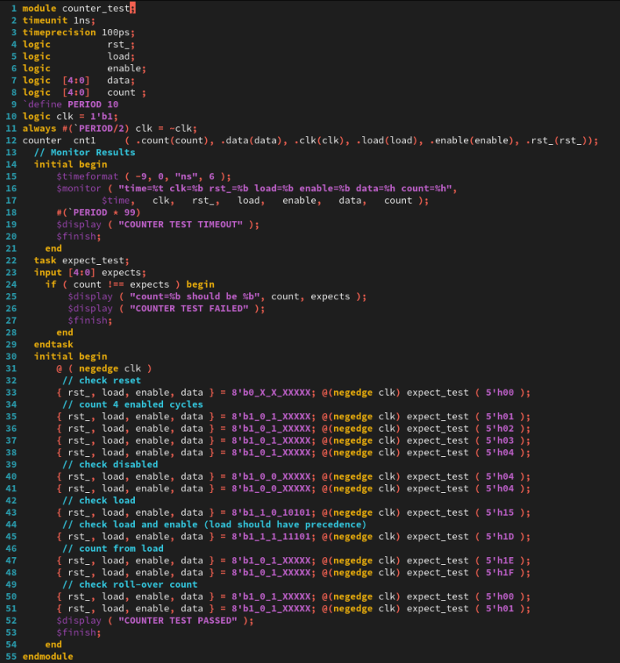
3. Testing the Counter Design
01
A testbench is provided in the file counter_test.sv. Simulate the testbench and counter design.
Notes:
IC: Integrated Circuit

Slide 9
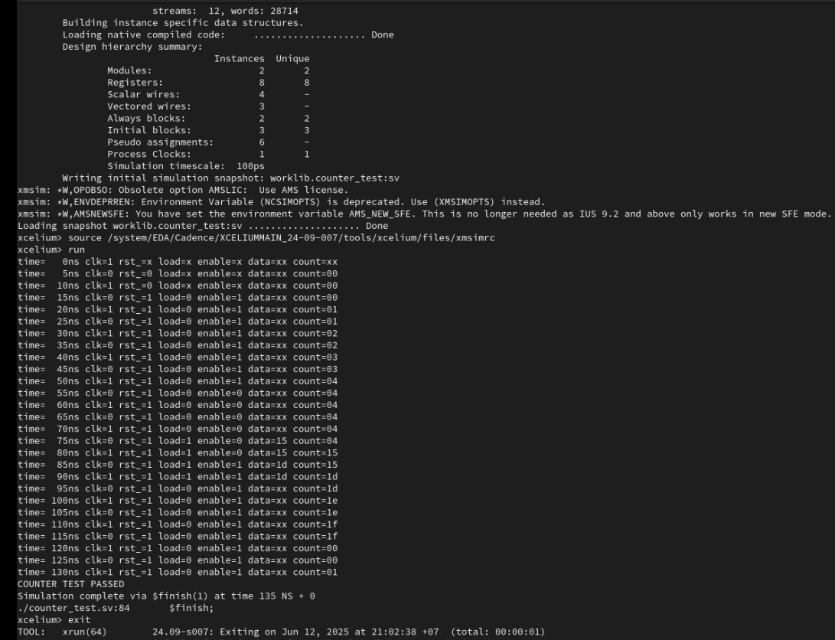
3. Testing the Counter Design
01
Run Command
xrun counter.sv counter_test.sv ( Batch Mode)
The result as below:
Notes:
IC: Integrated Circuit

Slide 10
Achieved Outcomes.
04

Slide 11
4. Achieved Outcomes
01
Understand the specification and create a simple loadable, enabled counter design using SystemVerilog and Verilog-2001 constructs and test it using the supplied testbench.
Notes:
IC: Integrated Circuit

Slide 12

THANK YOU!

