Slide 1

LAB 7
January 2025

Slide 2
CONTENTS
01
Specification
02
Creating the Memory Interface Design
03
Testing the Memory Interface Design
04
Achieved Outcomes.
Testing the Register Design

Slide 3
Specification
01

Slide 4




1. Specification
01
Adding the Memory Interface
Copy your Memory design (mem.sv), testbench (mem_test.sv) and top-level module (top.sv) from lab06-mem into lab07-intf.
Define the Memory interface in a new file and declarations for the addr, data_in, data_out, read and write signals.
Edit your Memory design and testbench by updating the port list with an interface port and referencing the interface signals via the interface port name.
Modify the top-level module to make an instantiation of the interface and connect this to the Memory design and testbench instances.
Rerun your memory test to check that the interface is working correctly. Add a clock input port to your interface. Remove the clock ports from your Memory design and testbench modules. Update your interface instance to map the clk signal to the clock port. Rerun your memory test to check the interface port is working correctly.
Add modports to the interface to define directional information for both the design and testbench. Reference the modports in your design and testbench port list. Rerun your memory test to check that the modports work correctly.
Redefine the write_mem() and read_mem() tasks as interface methods:
Move the task declarations into the interface.
Update the testbench to reference the tasks via the interface.
Update your testbench modport to allow access to the interface methods via an import statement.
Rerun your memory test.
Notes:
IC: Integrated Circuit

Slide 5
Creating the Memory Interface Design
02

Slide 6
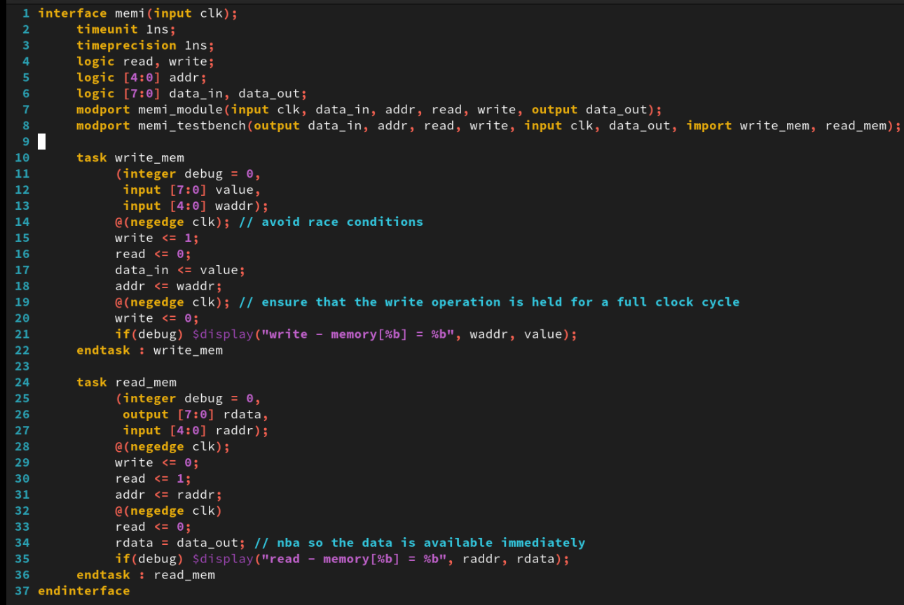
2. Creating the Memory Interface Design
01
mem_if.sv
Notes:
IC: Integrated Circuit

Slide 7
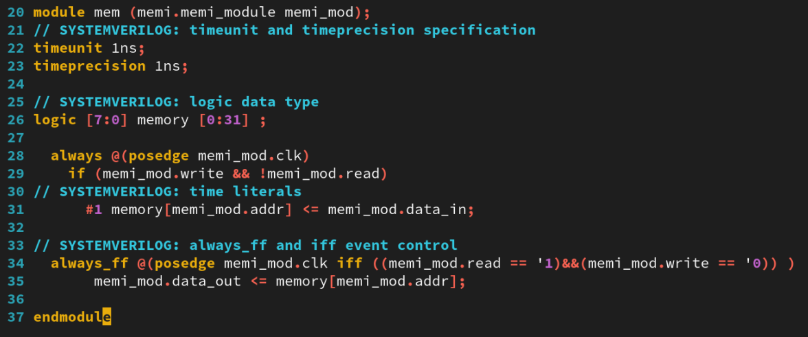
2. Creating the Memory Interface Design
01
mem.sv
Notes:
IC: Integrated Circuit

Slide 8
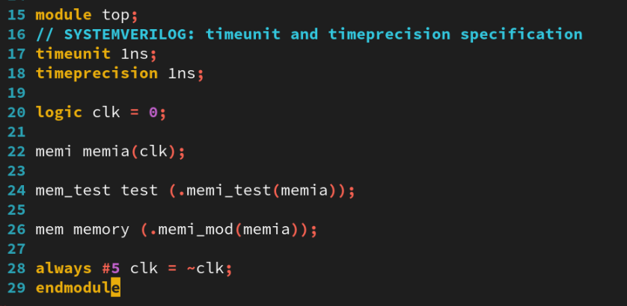
2. Creating the Memory Interface Design
01
top.sv
Notes:
IC: Integrated Circuit

Slide 9
Testing the Memory Interface Design
03

Slide 10
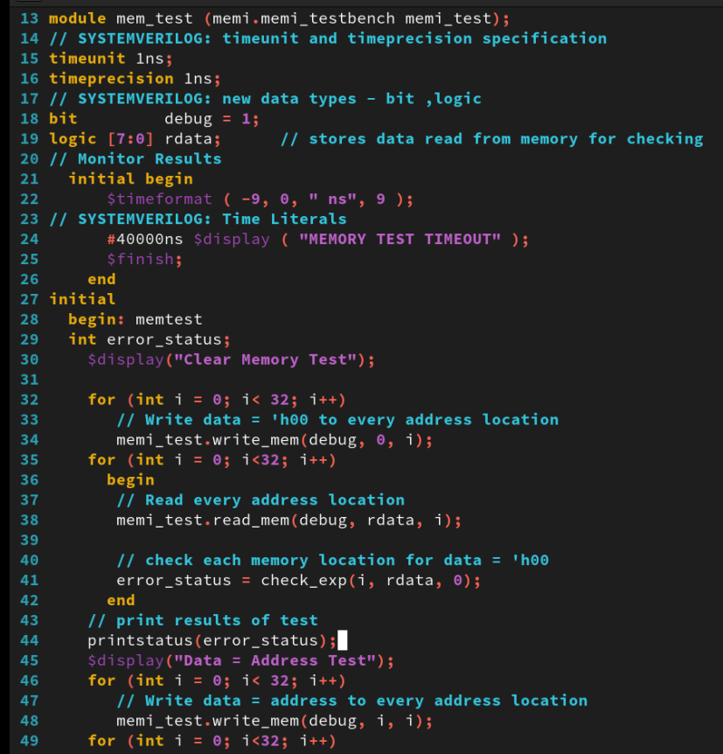
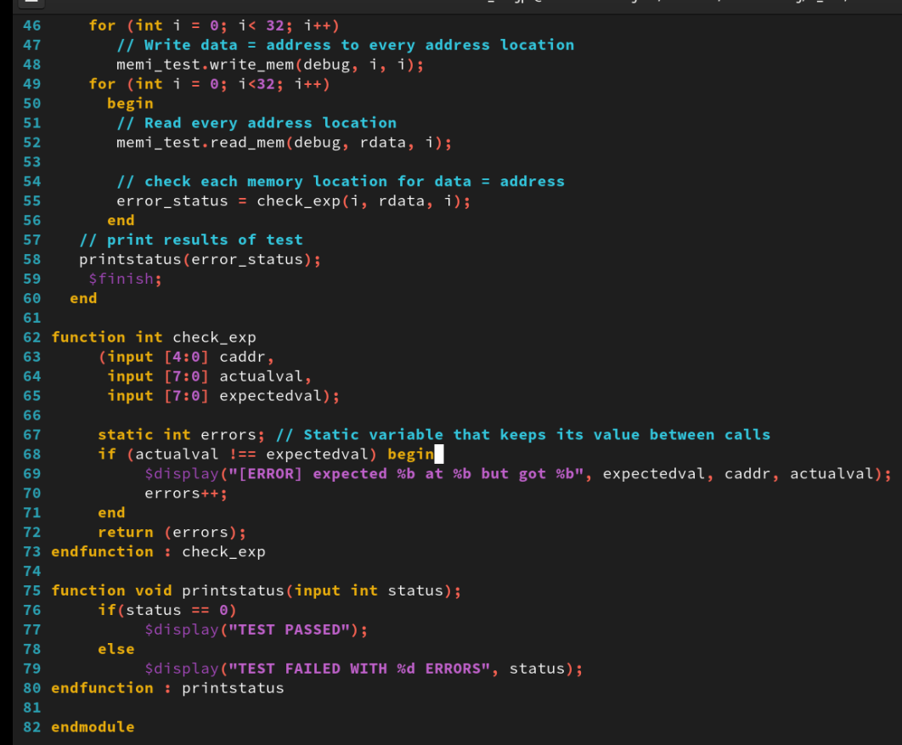
3. Testing the Memory Interface Design
01
mem_test.sv
Notes:
IC: Integrated Circuit

Slide 11
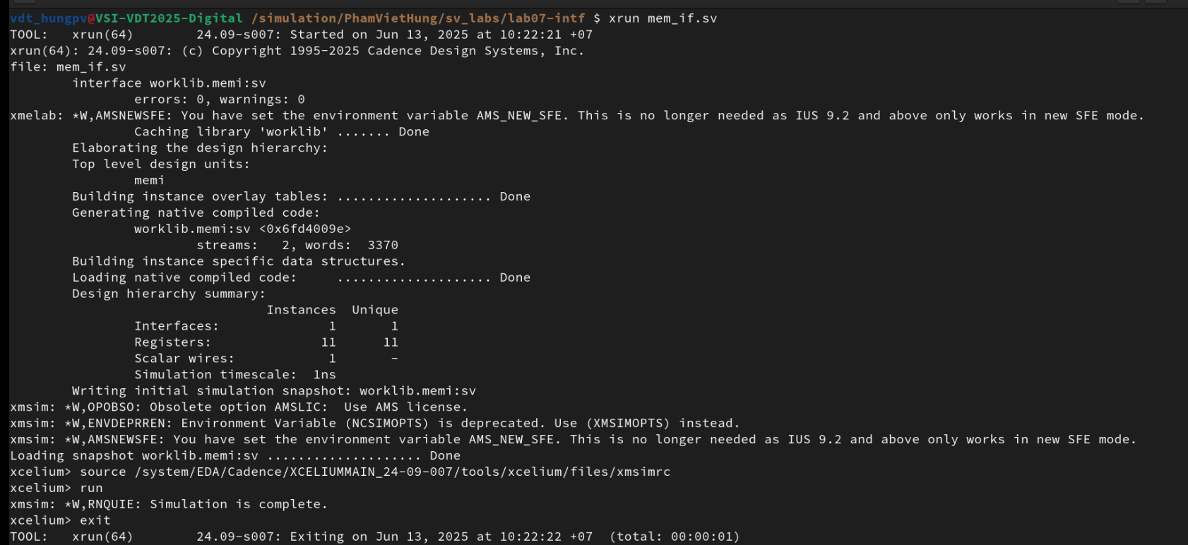
3. Testing the Memory Interface Design
01
Run Command
xrun mem_if.sv
The result as below:
Notes:
IC: Integrated Circuit

Slide 12
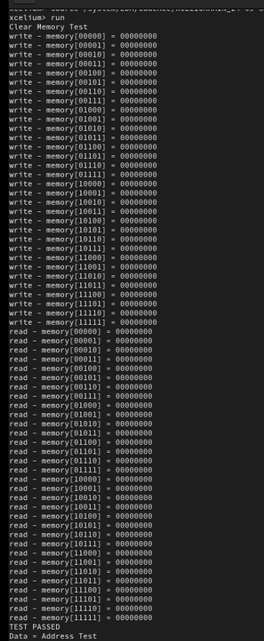
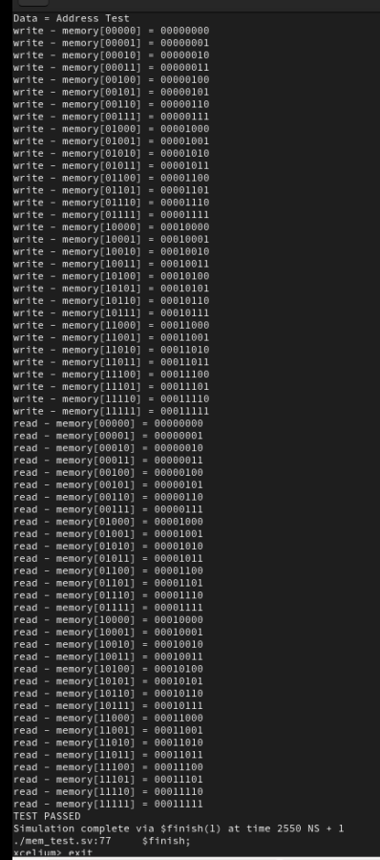
3. Testing the Memory Interface Design
01
Run Command
xrun mem.sv mem_test.sv top.sv
The result as below:
Notes:
IC: Integrated Circuit

Slide 13
Achieved Outcomes.
04

Slide 14
4. Achieved Outcomes
01
Understand the specification and to use a SystemVerilog interface with ports, modports and methods.
Modify the Memory testbench and design to connect via a SystemVerilog interface.
Notes:
IC: Integrated Circuit

Slide 15

THANK YOU!

