Slide 1

LAB 9
January 2025

Slide 2
CONTENTS
01
Specification
02
Creating the Simple Clocking Block Design
03
Testing the Simple Clocking Block Design
04
Achieved Outcomes.
Testing the Register Design

Slide 3
Specification
01

Slide 4

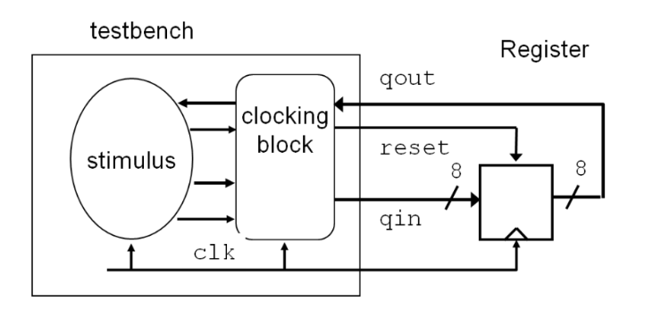



1. Specification
01
The register is 8-bit rising-edge triggered, with asynchronous, active low reset.
I/O interface
Notes:
IC: Integrated Circuit

Slide 5
Creating the Simple Clocking Block Design
02

Slide 6
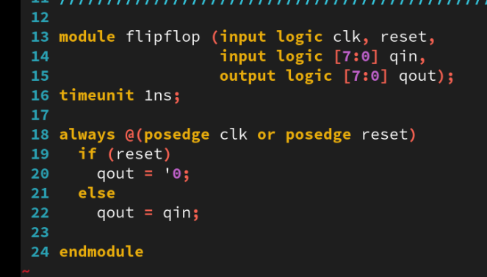
2. Creating the Simple Clocking Block Design
01
Working in the lab09-cb directory, perform the following. The register is supplied in the file flipflop.sv together with a partial testbench in the flipflop_test.sv file.
Notes:
IC: Integrated Circuit

Slide 7
Testing the Simple Clocking Block Design
03

Slide 8
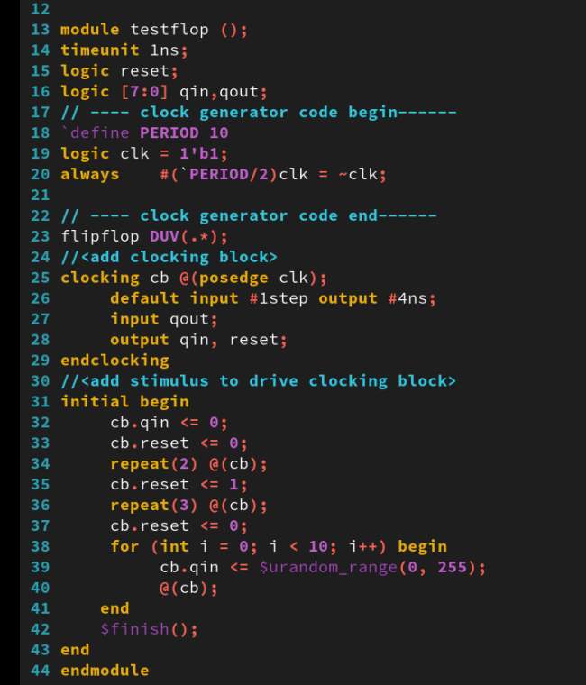
3. Testing the Simple Clocking Block Design
01
Modify the testbench:
Add a clocking block whose clocking event is the rising edge of clk and which uses qin, reset, and qout for the clocking items.
Use default skews of #1step for input and 4ns for output in the clocking block.
Use cycle delays to drive the reset high and then low after 3 clock periods.
Create a loop that drives new data on qin in every cycle via the clocking block.
Notes:
IC: Integrated Circuit

Slide 9
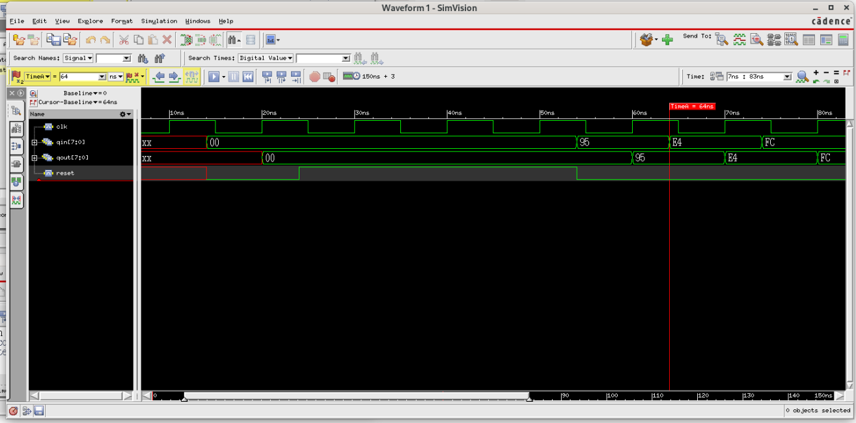
3. Testing the Simple Clocking Block Design
01
Simulate the testbench and register design in GUI mode. View the register and clocking block signals (specifically qout and cb.qout) in a waveform viewer to see the timing behavior of the clocking block.
xrun flipflop.sv flipflop_test.sv -access rwc -gui synchronyze and delay #4ns
drive reset low after 3 cycle clock, synchronyze and delay #4ns delay and sample #1step
Notes:
IC: Integrated Circuit

Slide 10
Achieved Outcomes.
04

Slide 11
4. Achieved Outcomes
01
Understand the specification and to use a testbench for a simple register to explore clocking block behavior.
Simulate the testbench and register design in GUI mode and open waveform for tracing clocking block signals.
Notes:
IC: Integrated Circuit

Slide 12

THANK YOU!

