Slide 1

LAB 12
January 2025

Slide 2
CONTENTS
01
Creating the simple Counter Design
02
Testing the simple Counter Design
03
Achieved Outcomes.
Tegister Design

Slide 3
Creating the simple Counter Design
01

Slide 4




1. Creating the simple Counter Design Using Class Polymorphism and Virtual Methods
01
Work in the lab12-countclass directory with the counter class and its subclasses as follows:
Modify the counter class to declare it as virtual.
Add a next method to the counter class to match the next methods in upcounter and downcounter, so that counter next is overridden by the next methods of the subclasses. Inside the counter next method, simply display a message reporting that you are in the counter class.
Comment out your existing verification code and add new code as follows:
Declare a counter class handle, but do not construct an instance. As the counter class is now virtual, trying to create an instance will generate compiler errors.
Create an instance of upcounter and assign this to the counter handle.
Call next from the counter handle.
Simulate and debug as needed. The next call from the counter handle should call the counter next implementation, even though the handle contains a subclass instance.
Notes:
IC: Integrated Circuit

Slide 5
1. Creating the simple Counter Design Using Class Polymorphism and Virtual Methods
01
Work in the lab12-countclass directory with the counter class and its subclasses as follows:
Modify your verification code as follows:
Declare another upcounter handle and use $cast to copy the upcounter instance from the counter handle to this new upcounter handle.
Add a next call from the new upcounter handle.
Simulate and debug as needed. The next call from the new upcounter handle should call the upcounter next implementation.
Modify your code to declare the next method of the counter class as virtual.
Simulate and debug as needed. Since next is now virtual, you should see that calling next from both the counter handle (containing an upcounter instance) and from an upcounter handle are directed to the upcounter next implementation.
Notes:
IC: Integrated Circuit

Slide 6
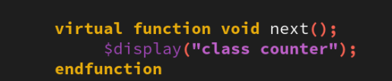
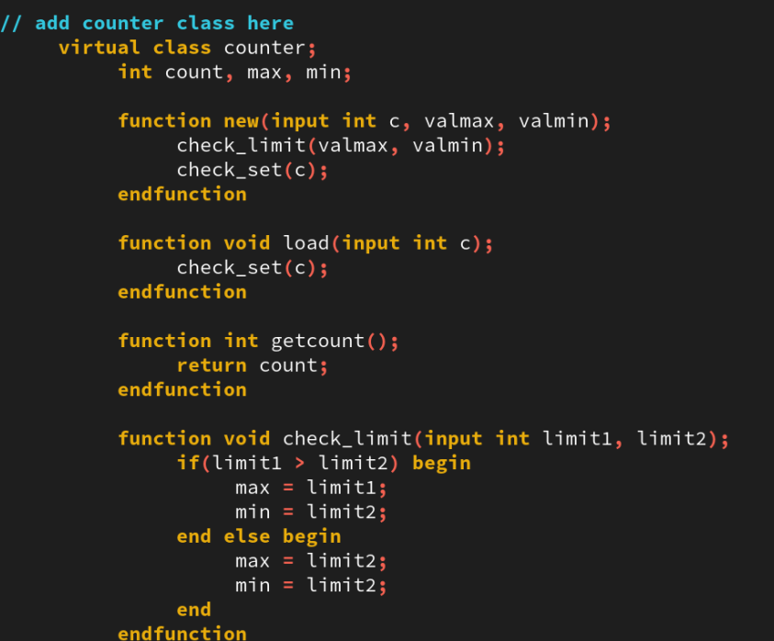
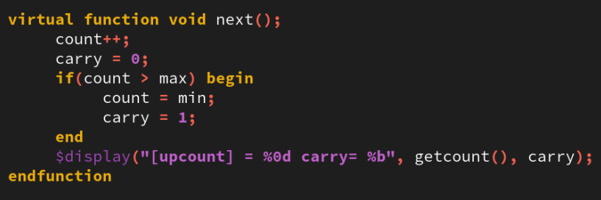
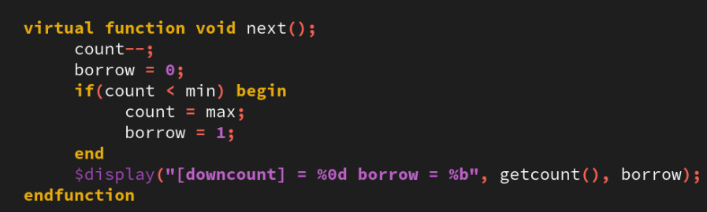
1. Creating the simple Counter Design Using Class Polymorphism and Virtual Methods
01
Notes:
IC: Integrated Circuit

Slide 7
Testing the simple Counter Design
02

Slide 8
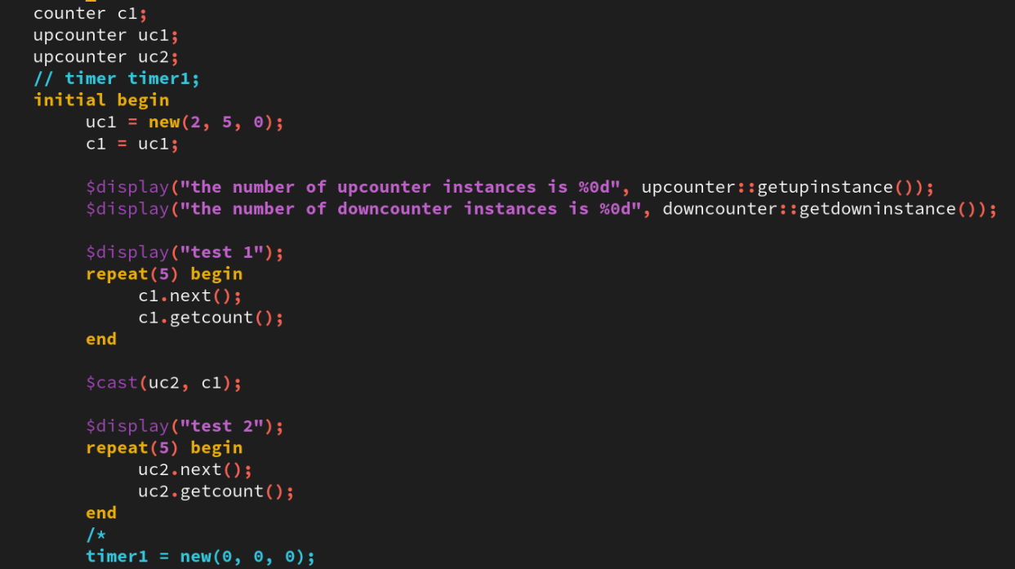


2. Testing the simple Counter Design Using Class Polymorphism and Virtual Methods
01
test features as specification above
Notes:
IC: Integrated Circuit

Slide 9
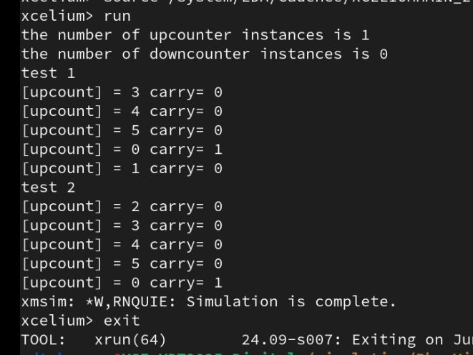
2. Testing the simple Counter Design Using Class Polymorphism and Virtual Methods
01
result of test
Notes:
IC: Integrated Circuit

Slide 10
Achieved Outcomes.
03

Slide 11
4. Achieved Outcomes
01
Create a simple counter design using the following SystemVerilog object-oriented design features:
Class declarations, with explicit constructors and instances
Inheritance
Static properties and methods
Aggregate classes (classes with properties of other class types)
Using Class Polymorphism and Virtual Methods
Notes:
IC: Integrated Circuit

Slide 12

THANK YOU!

