Slide 1

LAB 14
January 2025

Slide 2
CONTENTS
01
Creating the Memory Interface Design
02
Testing the Memory Interface Design
03
Achieved Outcomes
Testing the Register Design

Slide 3
Creating the Memory Interface Design
01

Slide 4




1. Creating the Memory Interface Design
01
Working in the lab13-memrnd directory, perform the following.
Copy your files from lab13-memclass to lab14-memvif.
Add another Memory interface port to your testbench. Copy the Random Data Test and add a call to configure so the second test drives the new memory interface port.
Add new Memory and interface instances to the top module and connect to the testbench.
top
testbench
VIR IF
DUT
mem_test1
interface
VIR IF
mem_test2
VIR IF
Notes:
IC: Integrated Circuit

Slide 5
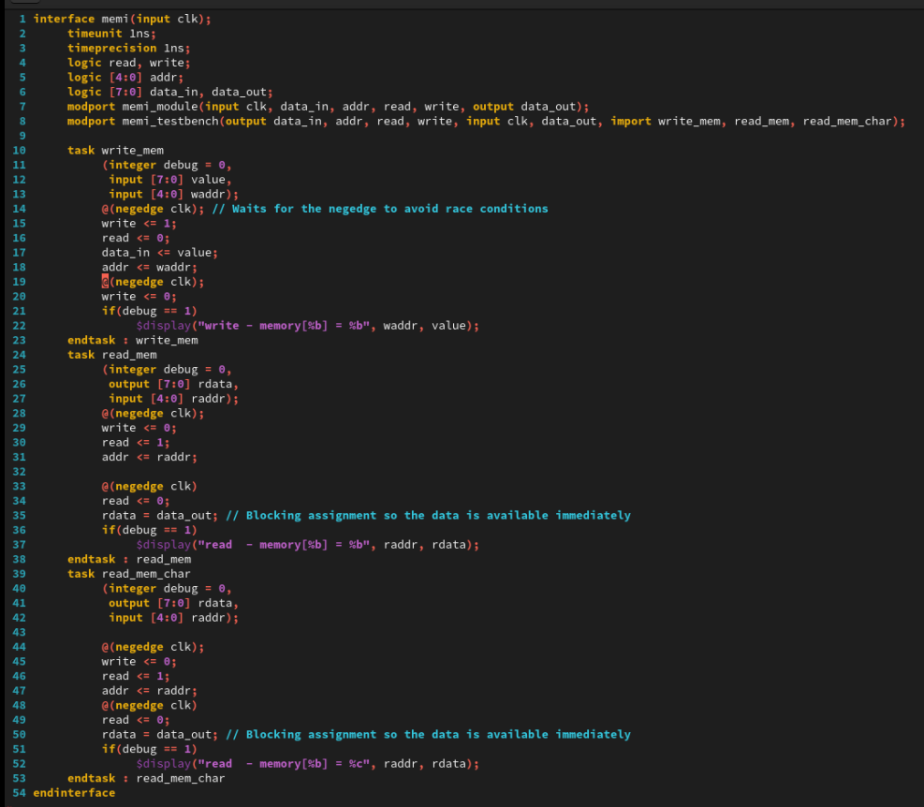
2. Creating the Memory Interface Design
01
mem_if.sv
Notes:
IC: Integrated Circuit

Slide 6
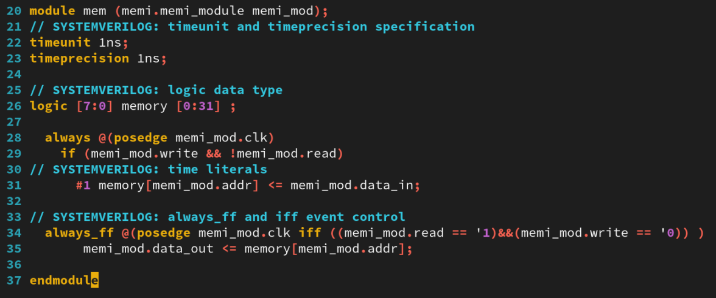
2. Creating the Memory Interface Design
01
mem.sv
Notes:
IC: Integrated Circuit

Slide 7
Testing the Memory Interface Design
02

Slide 8
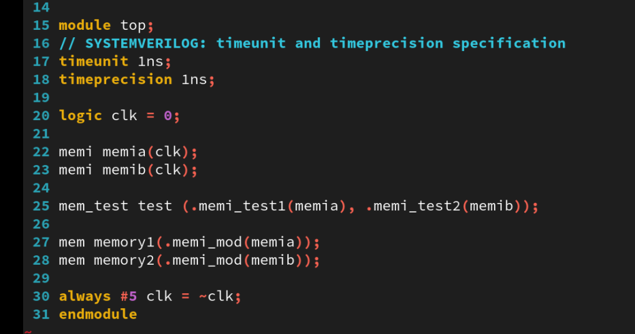
2. Creating the Memory Interface Design
01
top.sv
Notes:
IC: Integrated Circuit

Slide 9
2. Testing the Memory Interface Design
01
Modify your Memory testbench to add a virtual interface of the correct type as a class property.
Move the read_mem and write_mem tasks into the class declaration. Modify the tasks to access class properties directly (both should only have a single debug argument). You will need to declare an additional, non-random class property to hold the read data value.
Modify your write_mem and read_mem class methods to access the interface signals via the virtual interface.
Define a new class method called configure, which takes an input virtual interface argument and assigns it to your virtual interface property.
Modify your verification code to insert a configure call between the class construction and randomization. Use configure to set the virtual interface property to the interface port of the testbench module. Simulate and debug as needed. Remember the default value of a virtual interface is null, so if you do not assign the virtual interface before use, you will “null pointer dereference” errors in simulation.
Remove the “Clearing the memory” and “Data = Address” tests. Modify your Random Data test to call the simulation tasks from a class instance. Simulate and debug as needed.
Simulate and debug as needed to check whether your testbench is driving both memory instances.
Notes:
IC: Integrated Circuit

Slide 10
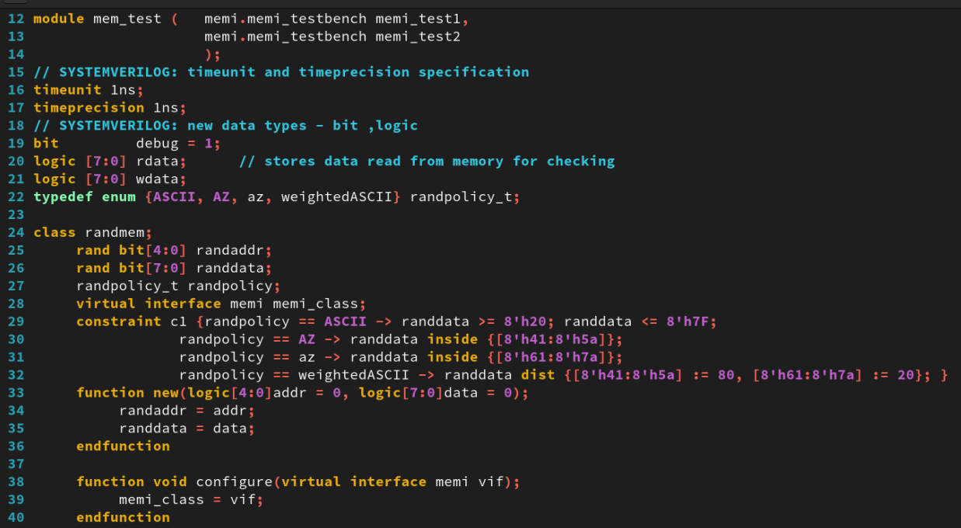
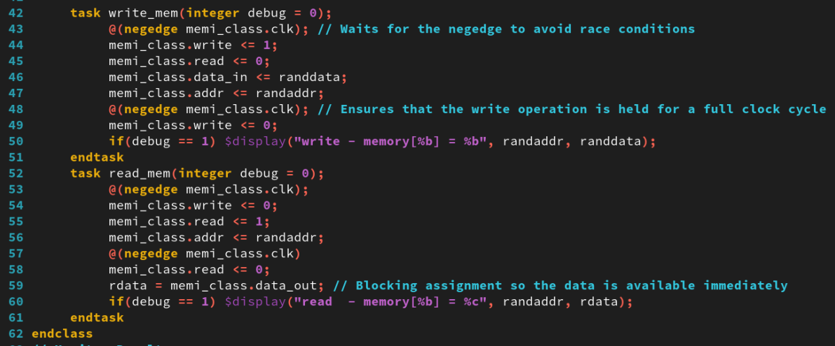
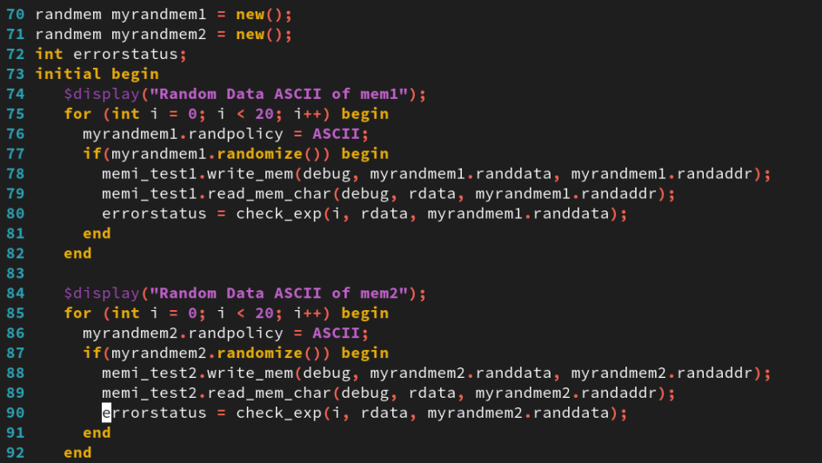
2. Testing the Memory Interface Design
01
example test
example test
Notes:
IC: Integrated Circuit

Slide 11
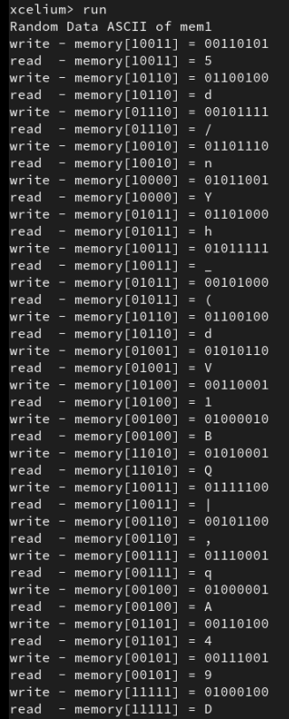
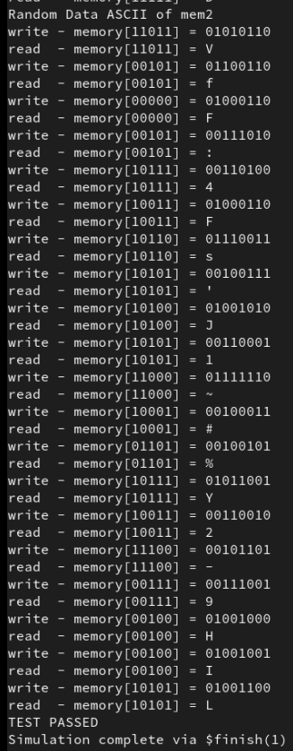
2. Testing the Memory Interface Design
01
Run Command
xrun mem_if.sv
xrun mem.sv mem_test.sv top.sv
The result as below:
Notes:
IC: Integrated Circuit

Slide 12
Achieved Outcomes.
03

Slide 13
3. Achieved Outcomes
01
Understand the specification and modify your Memory testbench to use SystemVerilog class-based randomization with constraints.
To use virtual interface class properties and connect these to multiple instances of memories.
Notes:
IC: Integrated Circuit

Slide 14

THANK YOU!

