Slide 1

LAB 5
January 2025

Slide 2
CONTENTS
01
Specification
02
Creating the ALU Design
03
Testing the ALU Design
04
Achieved Outcomes.
Testing the Register Design

Slide 3
Specification
01

Slide 4




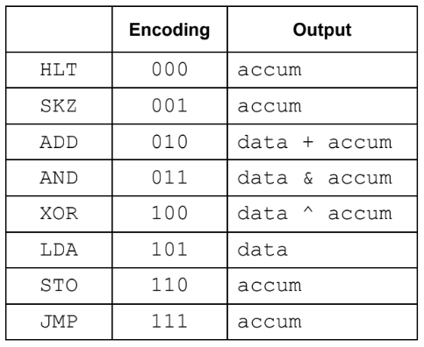
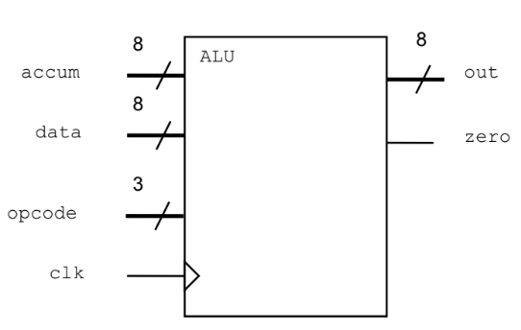
1. Specification
01
accum, data and out are all 8-bit logic vectors. opcode is a 3-bit logic vector for the CPU operation code as defined in Lab 5: Modeling a Sequence Controller.
zero is a single bit, asynchronous output with the value of 1 when accum equals 0. Otherwise, zero is 0.
out is synchronized to the negative edge of clk and takes the following values depending on opcode.
I/O interface
Notes:
IC: Integrated Circuit

Slide 5
Creating the ALU Design
02

Slide 6
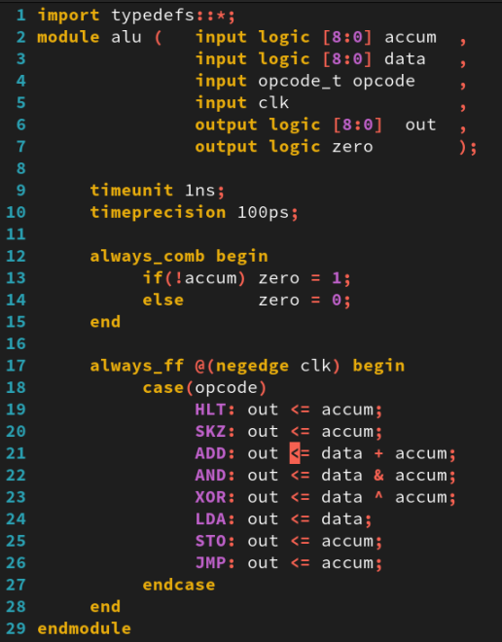
2. Creating the ALU Design
01
Working in the lab05-alu directory, perform the following:
Copy your typedefs.sv package, containing the opcode type declaration, from the Controller lab.
Create a new file called alu.sv, containing a module named alu.
Write the ALU model using the following SystemVerilog and Verilog constructs:
import for the package.
Verilog2001 ANSI-C port declarations
timeunit and timeprecision
always_comb procedural block to generate zero
always_ff procedural block to generate out
typedefs.sv alu.sv
Notes:
IC: Integrated Circuit

Slide 7
Testing the ALU Design
03

Slide 8
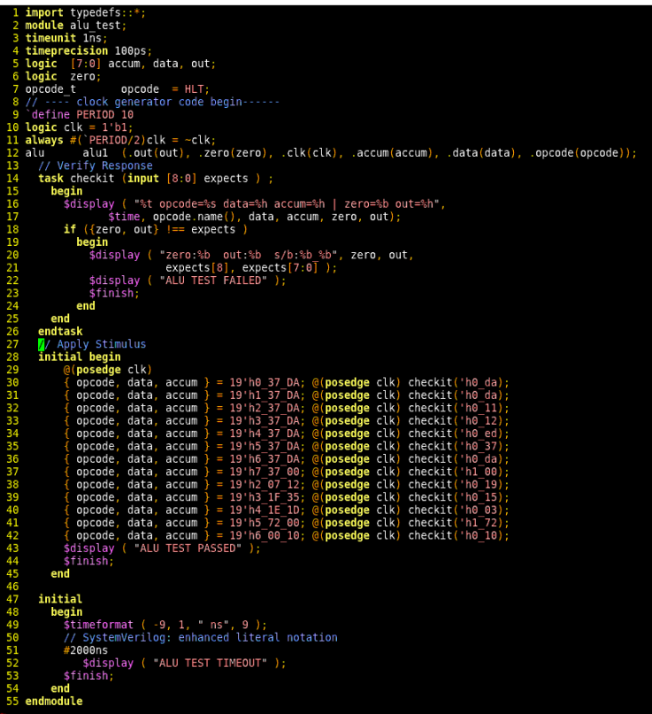
3. Testing the ALU Design
01
Check that your package containing the opcode type declarations is imported into alu_test.sv.
Simulate the testbench and controller design. Debug your ALU as required until you see the following message: ALU TEST PASSED
Notes:
IC: Integrated Circuit

Slide 9
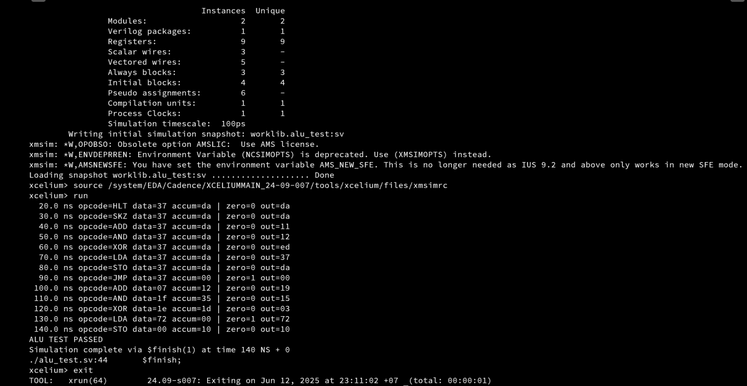
3. Testing the ALU Design
01
Run Command
xrun typedefs.sv
xrun alu.sv alu_test.sv
The result as below:
Notes:
IC: Integrated Circuit

Slide 10
Achieved Outcomes.
04

Slide 11
4. Achieved Outcomes
01
Understand the specification and to use SystemVerilog user-defined types, procedural statements, and
operators to model an ALU and test it using the supplied testbench.
Notes:
IC: Integrated Circuit

Slide 12

THANK YOU!

