Slide 1

LAB 6
January 2025

Slide 2
CONTENTS
01
Specification
02
Creating the Memory Design
03
Testing the Memory Design
04
Achieved Outcomes.
Testing the Register Design

Slide 3
Specification
01

Slide 4




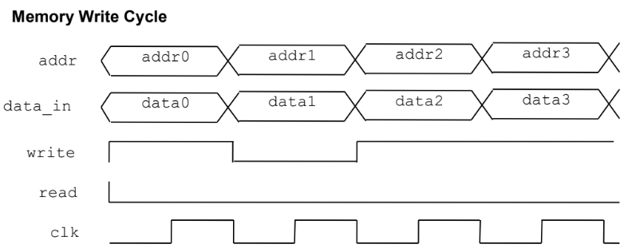
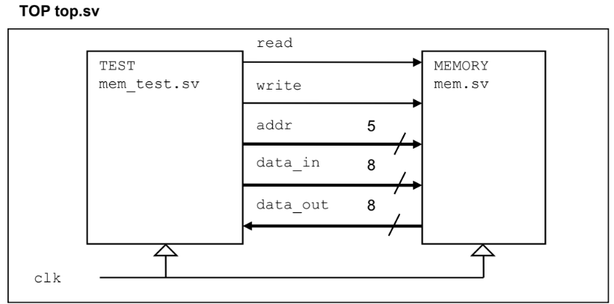
1. Specification
01
addr is a 5-bit logic vector. data_in and data_out are both 8-bit logic vectors. read, write, and clk are logic.
Memory write: data_in is written to memory[addr] on the positive edge of clk when write=1.
I/O interface
Notes:
IC: Integrated Circuit

Slide 5
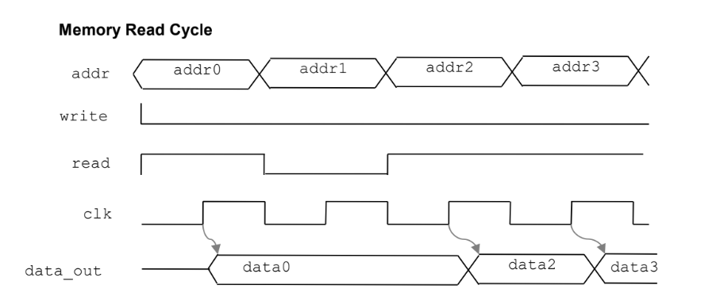
1. Specification
01
Memory read: data_out is assigned from memory[addr] on the positive edge of clk when read=1.
read and write should never be simultaneously high.
Notes:
IC: Integrated Circuit

Slide 6
Creating the Memory Design
02

Slide 7
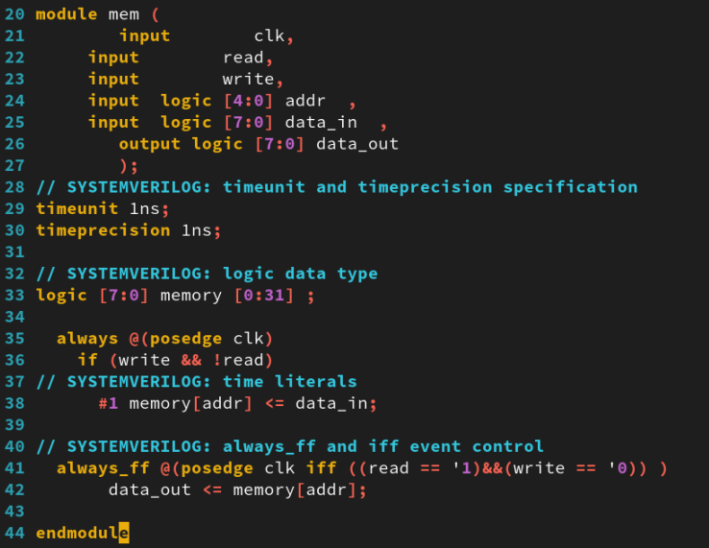
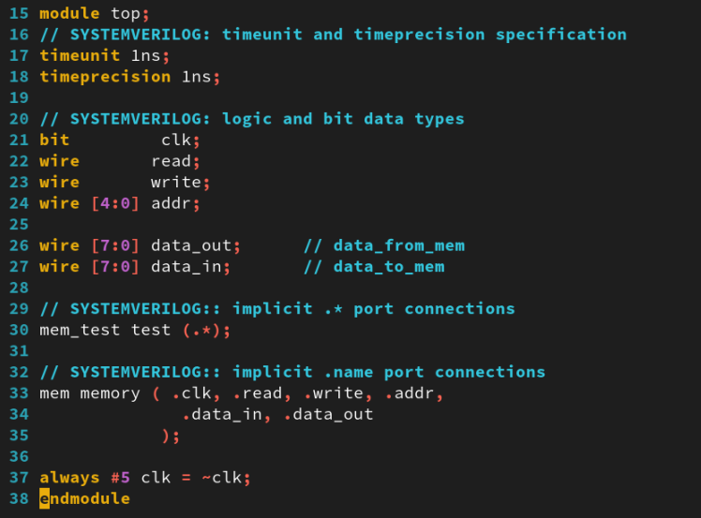
2. Creating the Memory Design
01
Working in the lab06-mem directory, perform the following:
For this lab, the memory design is already written (mem.sv).
mem.sv top.sv
Notes:
IC: Integrated Circuit

Slide 8
Testing the Memory Design
03

Slide 9
3. Testing the Memory Design
01
You are going to complete the memory testbench in the mem_test.sv file.
You will be using the following SystemVerilog subprogram constructs:
void function.
Argument passing by name (.name(name)).
Default formal arguments with default values.
Declare a task (write_mem) to write to the memory as follows:
Define input arguments for the address and data values.
Assign addr, and data_in from the arguments, and drive read and write synchronized to the clock. Hint: drive signals on the inactive clock edge to avoid race conditions.
Define an input argument debug with a default value of 0. If debug = 1, display the write address and data values.
Notes:
IC: Integrated Circuit

Slide 10
3. Testing the Memory Design
01
Declare a task (read_mem) to read the memory as follows:
Define an input argument for the address value and an output argument for the read data. Remember to use blocking assignment for assigning read data to output argument, so that assignment is complete upon return to the caller.
Assign addr from the argument, and drive read and write, synchronized to the clock. Hint: drive signals on the inactive clock edge to avoid race conditions.
Assign the output data argument from data_out at an appropriate time. There is a short propagation delay between the rising edge of clk and data_out updating.
Input argument debug with a default value of 0. If debug = 1, display the read address and data values.
Complete the “Clearing the Memory” test by writing zero to every address location, and then reading back and checking the data read matches the data written.
Complete the “Data = Address” test by writing data equal to the address to every address location, and then reading back and checking the data read matches the data written.
Write a void function (printstatus) with an input argument status which indicates the number of errors encountered in the tests. If status = 0, the test passed.
Notes:
IC: Integrated Circuit

Slide 11
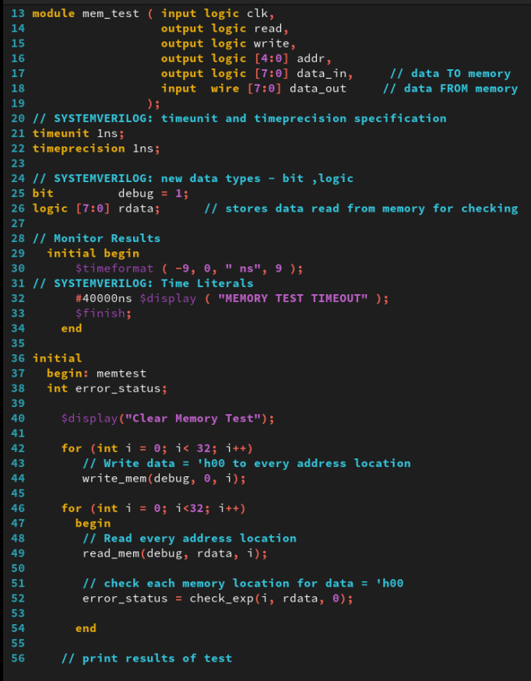
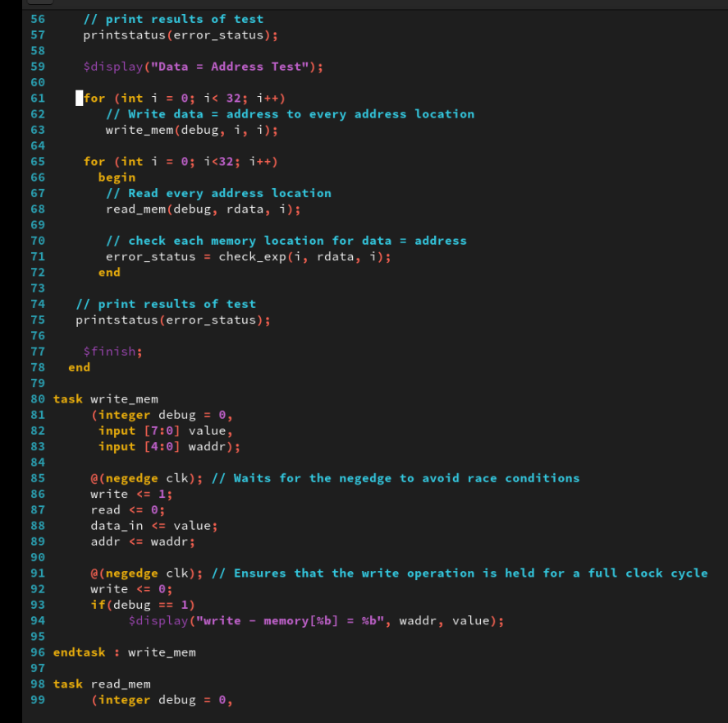
3. Testing the Memory Design
01
mem_test.sv
Notes:
IC: Integrated Circuit

Slide 12
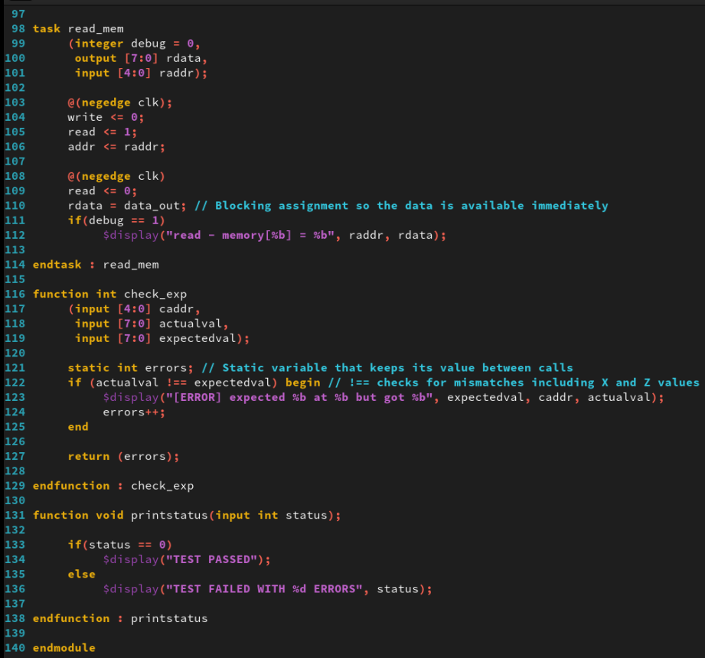
3. Testing the Memory Design
01
mem_test.sv
Notes:
IC: Integrated Circuit

Slide 13
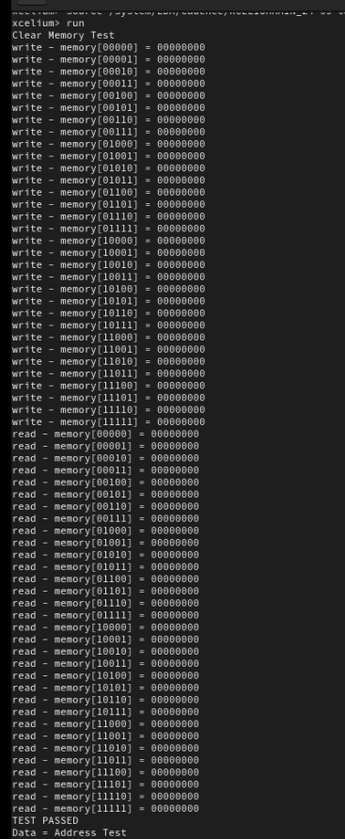
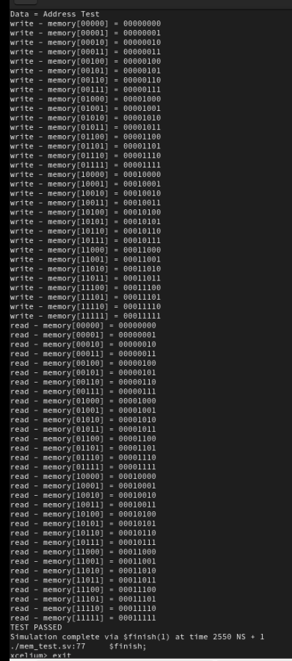
3. Testing the Memory Design
01
Run Command
xrun mem.sv mem_test.sv top.sv
The result as below:
Notes:
IC: Integrated Circuit

Slide 14
Achieved Outcomes.
04

Slide 15
4. Achieved Outcomes
01
Understand the specification and create stimulus tasks using SystemVerilog subprogram enhancements and verify the supplied memory design.
To use SystemVerilog subprogram enhancements to test a memory module.
Notes:
IC: Integrated Circuit

Slide 16

THANK YOU!

