Slide 1

LAB 8
January 2025

Slide 2
CONTENTS
01
Specification
02
Creating the RISC CPU Design
03
Testing the RISC CPU Design
04
Achieved Outcomes.
Testing the Register Design

Slide 3
Specification
01

Slide 4




1. Specification
01
The CPU architecture is as follows:
The Program Counter (counter) provides the program address.
The MUX (scale_mux) selects between the program address or the address field of the instruction.
The Memory (memory) accepts data and provides instructions and data.
The Instruction Register (register) accepts instructions from the memory.
The Accumulator Register (register) accepts data from the ALU.
The ALU (alu) accepts memory and accumulator data and the opcode field of the instruction and provides new data to the accumulator and memory.
If all components of the CPU are working properly, it will:
Fetch an instruction from the memory.
Decode the instruction.
Fetch a data operand from memory if required by the instruction.
Execute the instruction, processing mathematical operations, if required.
Store results back into either the memory or the accumulator.
This process is repeated for every instruction in a program until an HLT instruction is found.
I/O interface
Notes:
IC: Integrated Circuit

Slide 5
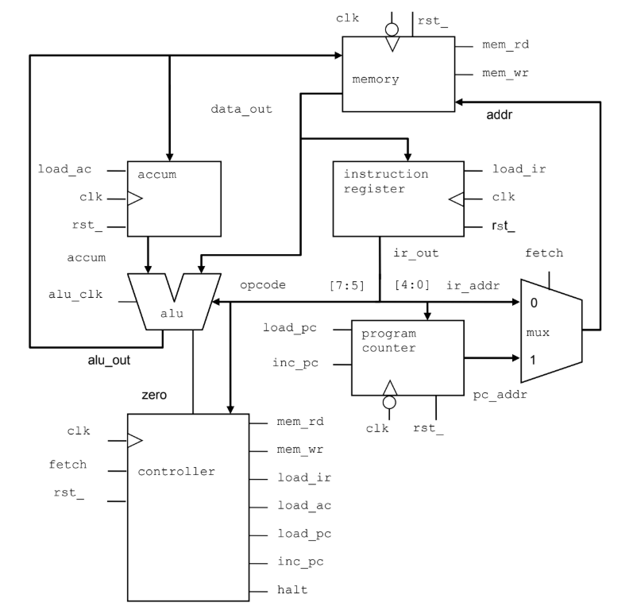
1. Specification
01
I/O interface
Notes:
IC: Integrated Circuit

Slide 6
Creating the RISC CPU Design
02

Slide 7
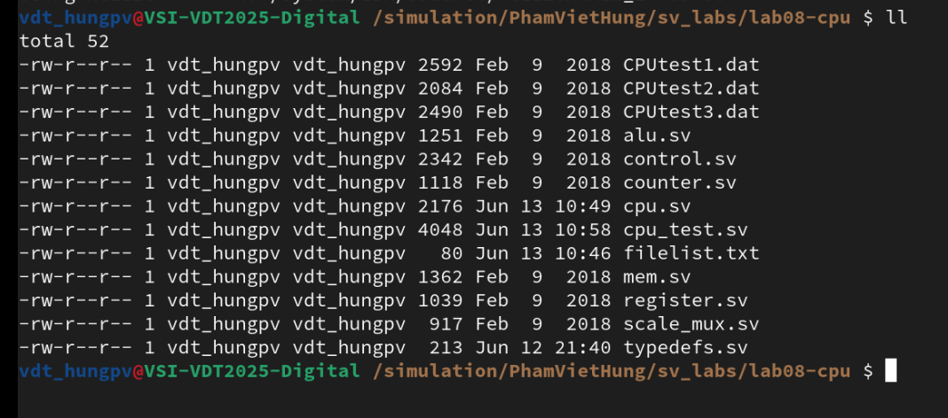
2. Creating the RISC CPU Design
01
Assembling the CPU Model
Working in the lab08-cpu directory, perform the following.
Review the cpu.sv file, containing the cpu module declaration, which instantiates and connects all the components of the CPU.
Copy all the components from the sv_src directory into lab08-cpu. If you did not complete all the previous labs, you can find components in the sv_src/files directory.
Make sure that your package containing the enumerated type declaration for opcode_t is also copied into lab08-cpu, and make sure the package is imported into the cpu module.
Notes:
IC: Integrated Circuit

Slide 8
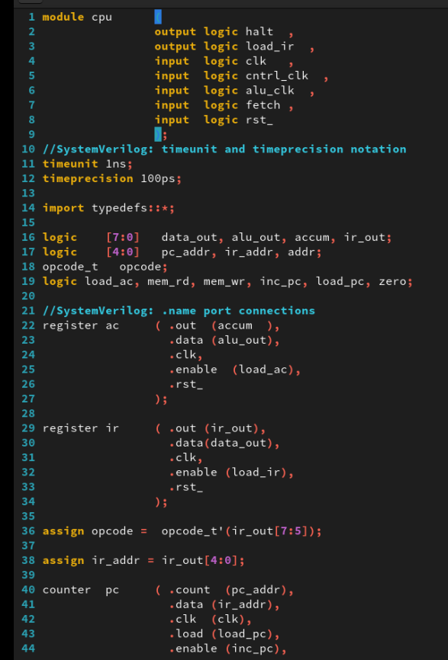
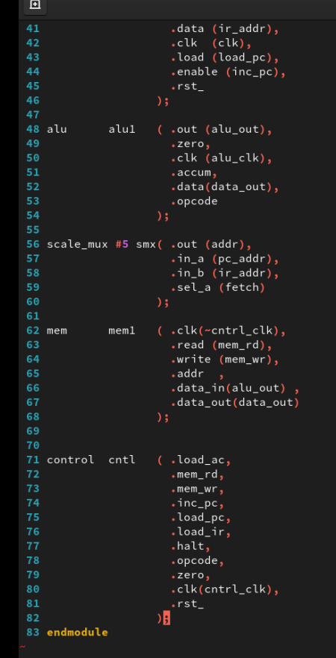
2. Creating the RISC CPU Design
01
cpu.sv
Notes:
IC: Integrated Circuit

Slide 9
Testing the RISC CPU Design
03

Slide 10
3. Testing the RISC CPU Design
01
Reviewing the CPU Testbench
Review the supplied testbench in the file cpu_test.sv. The testbench verifies your CPU design using three diagnostic programs as follows:
The testbench displays a message requesting the number of the diagnostic program and waits for user input.
When the user enters a test number and continues the simulation, the testbench loads the specified test microcode, resets the CPU and outputs debug messages while it waits for the CPU to indicate the end of test by asserting the halt signal.
When halt is received, the testbench verifies that the Program Counter address is correct for the given test. If the address is incorrect, the test fails.
The testbench then re-displays the request for test message, and again waits for user input.
Notes:
IC: Integrated Circuit

Slide 11
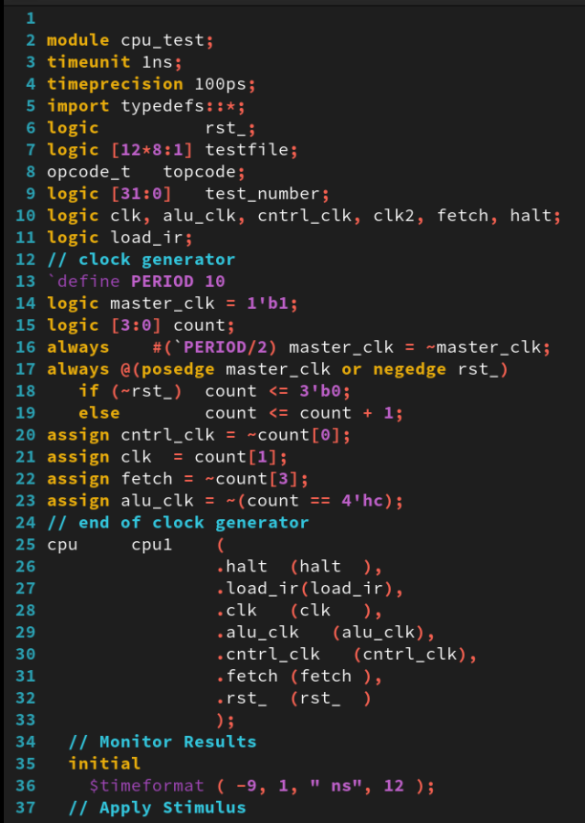
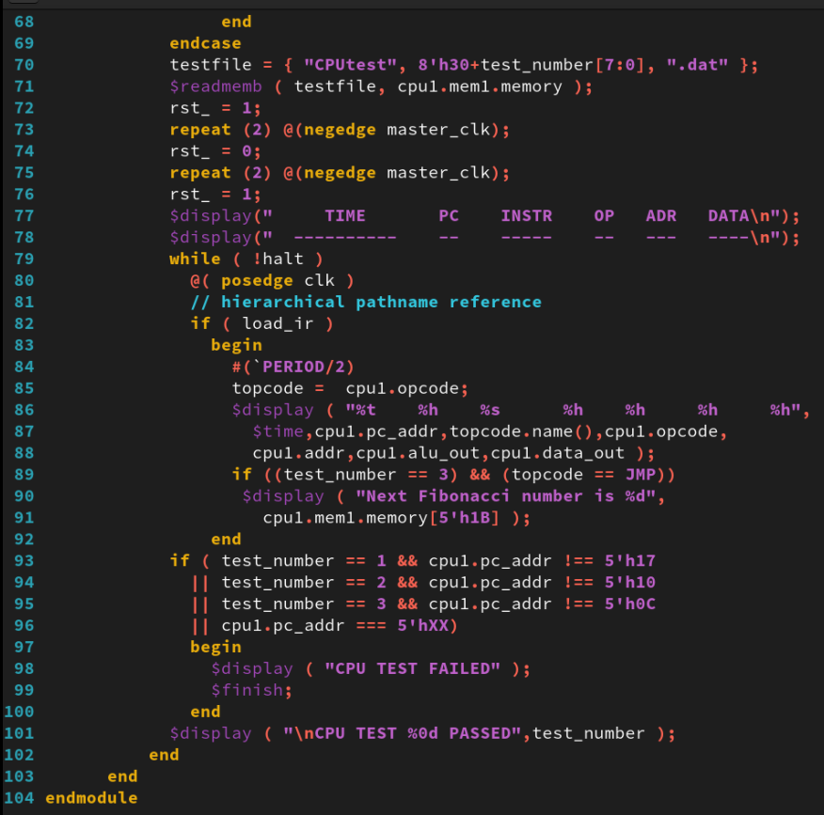
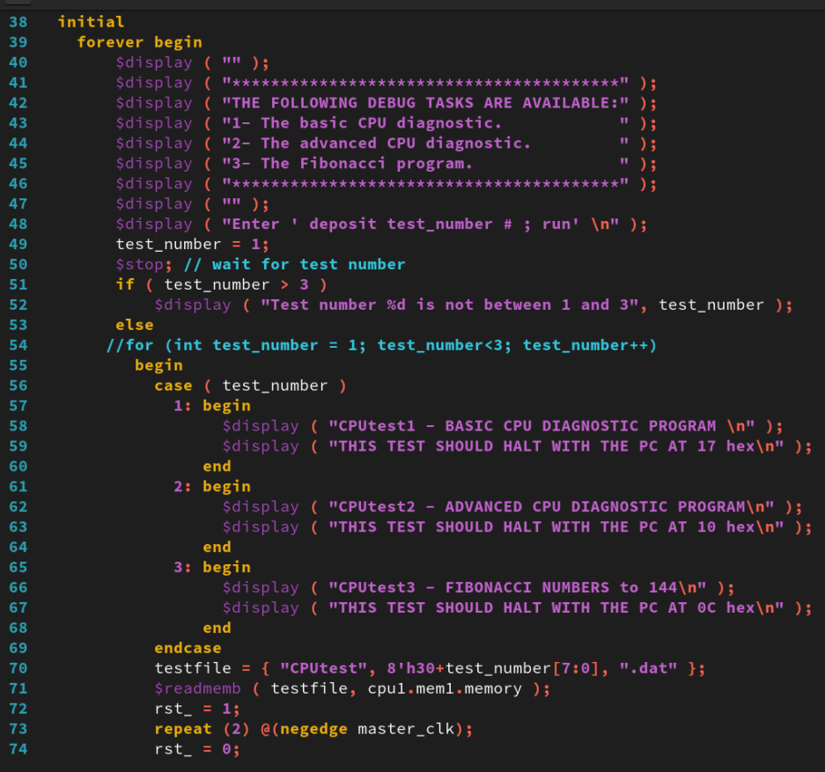
3. Testing the RISC CPU Design
01
cpu_test.sv
Notes:
IC: Integrated Circuit

Slide 12
3. Testing the RISC CPU Design
01
CPU Diagnostic Programs
CPUtest1.dat – Basic Diagnostic Test: This program tests several of the VeriRISC instructions. If all the instructions execute correctly, the CPU will encounter an HLT instruction at Program Counter address (cpu.pc_addr) 0x17. If the CPU halts at some other address, examine the CPUtest1.dat program file to determine which instruction failed. This file is well commented so you can see what is supposed to happen.
CPUtest2.dat – Advanced Diagnostic Test: This program loads and runs the advanced diagnostic program, which tests additional VeriRISC instructions. If all the instructions execute correctly, the CPU will encounter an HLT instruction at Program Counter address (cpu.pc_addr) 0x10. If the CPU halts at some other address, examine the CPUtest2.dat file to determine which instruction failed.
CPUtest3.dat – The Fibonacci Calculator: This test loads and runs a program that calculates the Fibonacci number sequence from 0 to 144 and stores the results in memory. If all the instructions execute correctly, the CPU will encounter an HLT instruction at Program Counter address (cpu.pc_addr) 0x0C. If the CPU halts at some other address, examine the CPUtest3.dat file to determine which instruction failed.
Notes:
IC: Integrated Circuit

Slide 13
3. Testing the RISC CPU Design
01
Testing the CPU
xrun typedefs.sv
Compile and simulate the CPU design and testbench. You might find it easier to list all the files and simulation options in a text file and pass the file into the simulator using the –f xrun option:
xrun -f filelist.txt -access rwc
You will also need the -access rwc simulator option to set the test number.
Enter the following commands when you get the prompt:
ncsim> deposit test_number 1; run
ncsim> deposit test_number 2; run
ncsim> deposit test_number 3; run
Notes:
IC: Integrated Circuit

Slide 14
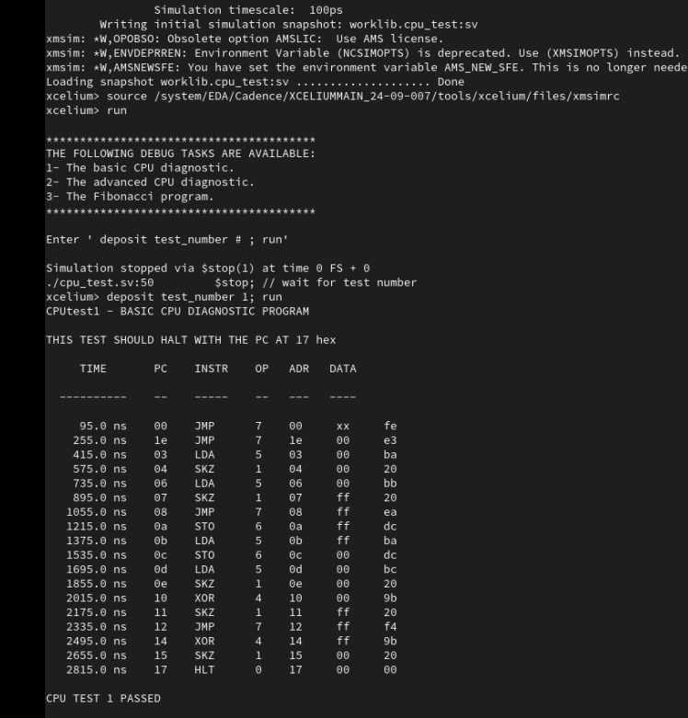
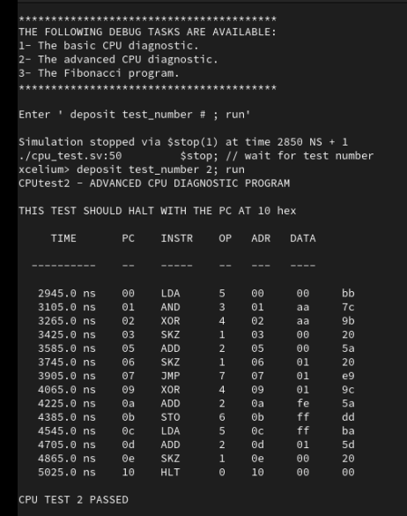
3. Testing the RISC CPU Design
01
test 1 test 2
Notes:
IC: Integrated Circuit

Slide 15
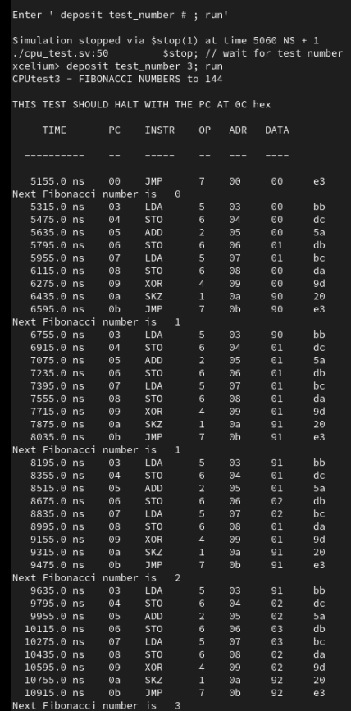
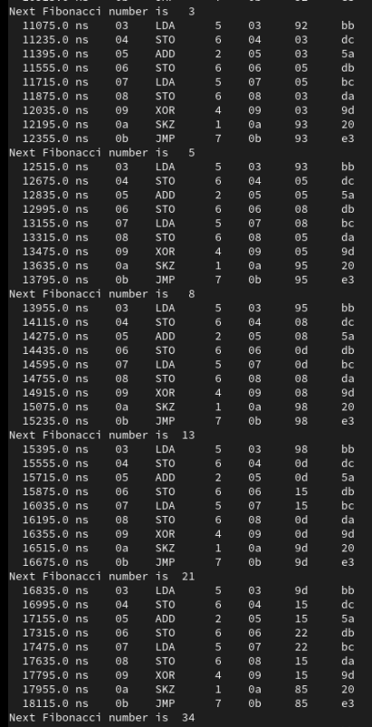
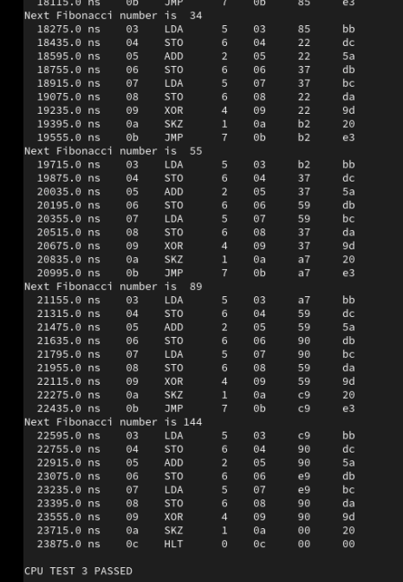
3. Testing the RISC CPU Design
01
test 3
Notes:
IC: Integrated Circuit

Slide 16
Achieved Outcomes.
04

Slide 17
4. Achieved Outcomes
01
Understand the specification and assemble the blocks of the CPU using SystemVerilog connectivity enhancements,
Test the design using the supplied testbench and diagnostic programs.
Notes:
IC: Integrated Circuit

Slide 18

THANK YOU!

