Slide 1

LAB 1
January 2025

Slide 2
CONTENTS
01
Specification
02
Creating the Register Design
03
Testing the Register Design
04
Achieved Outcomes.
Testing the Register Design

Slide 3
Specification
01

Slide 4




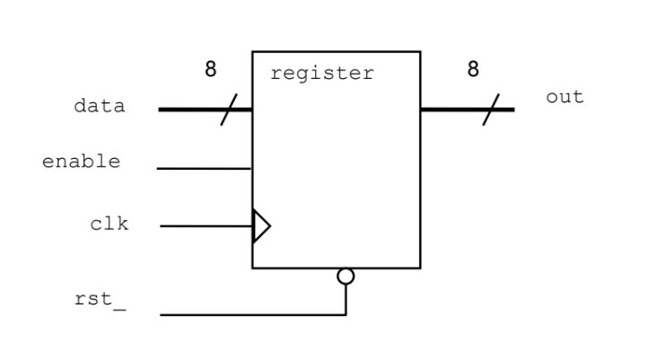
1. Specification
01
data and out are both 8-bit logic vectors.
rst_ is asynchronous and active low.
The register is clocked on the rising edge of clk.
If enable is high, the input data is passed to the output out.
Otherwise, the current value of out is retained in the register.
I/O interface
Notes:
IC: Integrated Circuit

Slide 5
Creating the Register Design
02

Slide 6
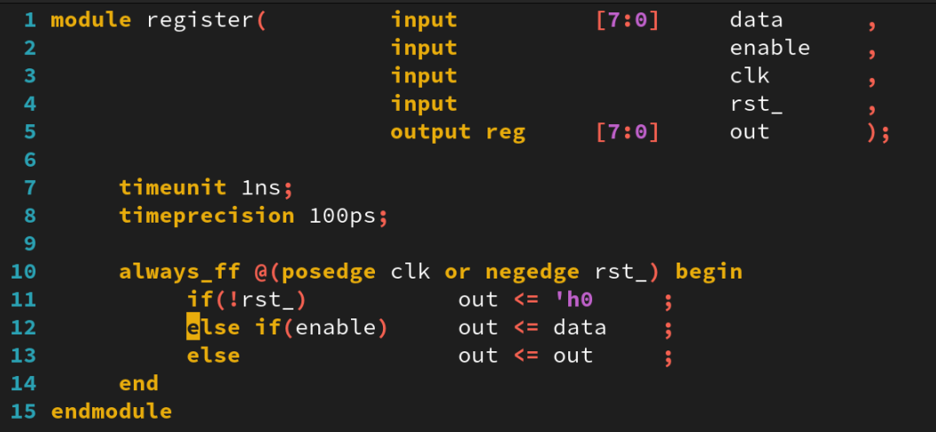
2. Creating the Register Design
01
Work in the lab01-reg directory:
Create a new file called register.sv, containing a module named register.
Write the register model using the following SystemVerilog constructs:
always_ff procedural block.
timeunit and timeprecision.
Verilog2001 ANSI-C port declarations.
Notes:
IC: Integrated Circuit

Slide 7
Testing the Register Design
03

Slide 8
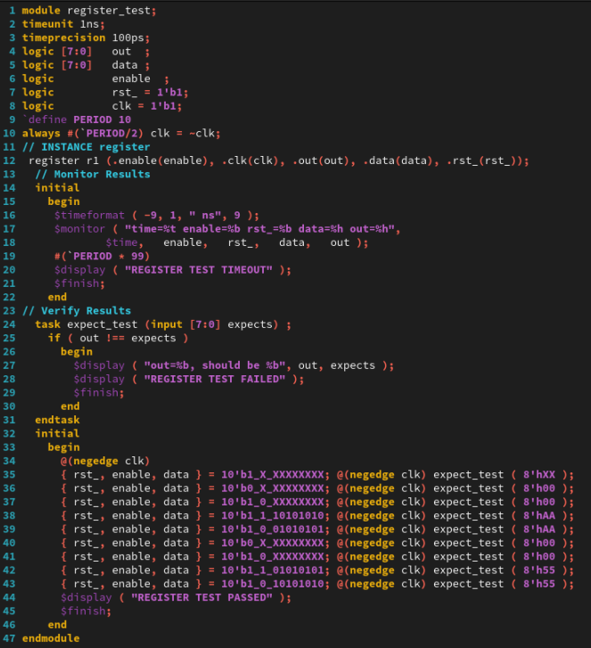
3. Testing the Register Design
01
A testbench is provided in the file register_test.sv. Simulate the testbench and register design.
Notes:
IC: Integrated Circuit

Slide 9
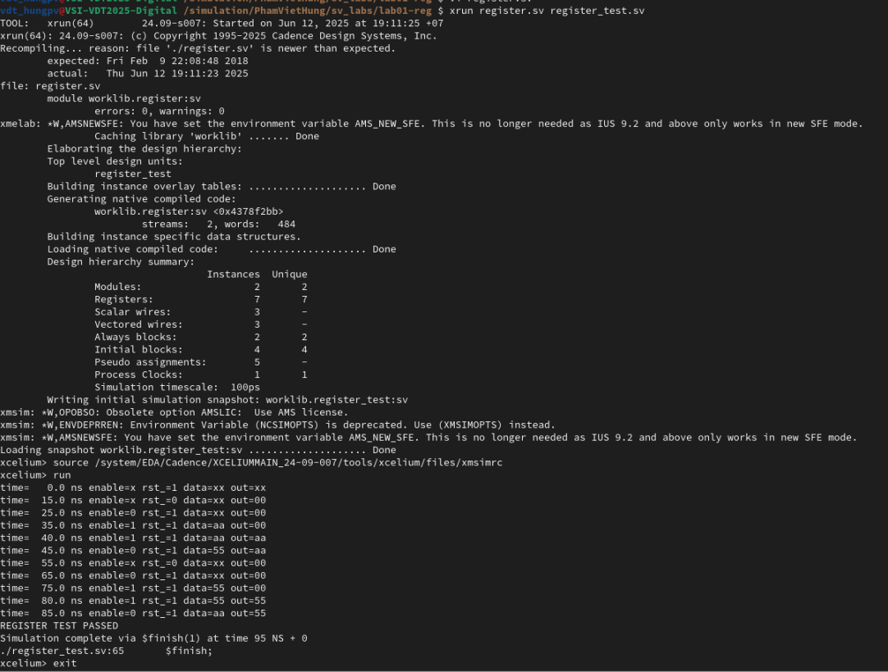
3. Testing the Register Design
01
Run Command
xrun register.sv register_test.sv ( Batch Mode)
The result as below:
Notes:
IC: Integrated Circuit

Slide 10
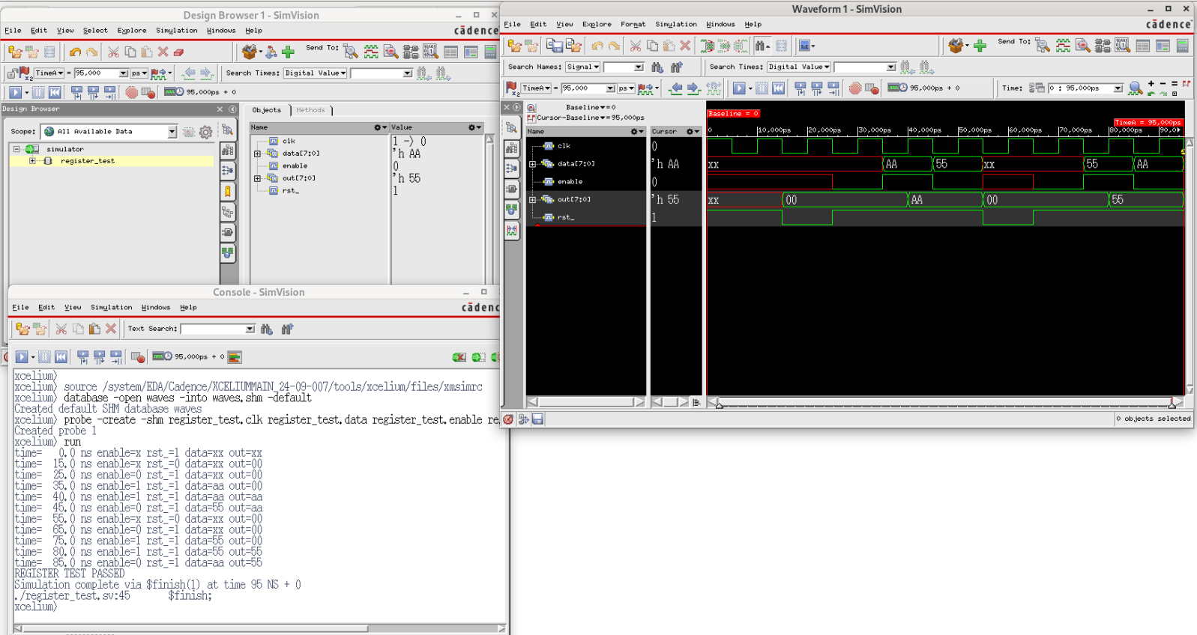
3. Testing the Register Design
02
Run Command
xrun register.sv register_test.sv -gui -access +rwc ( GUI Mode)
The result as below:
Notes:
IC: Integrated Circuit

Slide 11
Achieved Outcomes.
04

Slide 12
4. Achieved Outcomes
01
Understand the specification and create a simple register design using SystemVerilog and Verilog-2001 constructs and test it using the supplied testbench.
Notes:
IC: Integrated Circuit

Slide 13

THANK YOU!

