Slide 1

LAB 10
January 2025

Slide 2
CONTENTS
01
Creating the Memory Interface Design
02
Testing the Memory Interface Design
03
Achieved Outcomes
Testing the Register Design

Slide 3
Creating the Memory Interface Design
01

Slide 4




1. Creating the Memory Interface Design
01
Working in the lab10-memrnd directory, perform the following.
Copy your Memory design,interface and top-level module from lab07- intf into lab10-memrnd.
Add new task into mem_if.sv
top
TB
DUT
interface
Notes:
IC: Integrated Circuit

Slide 5
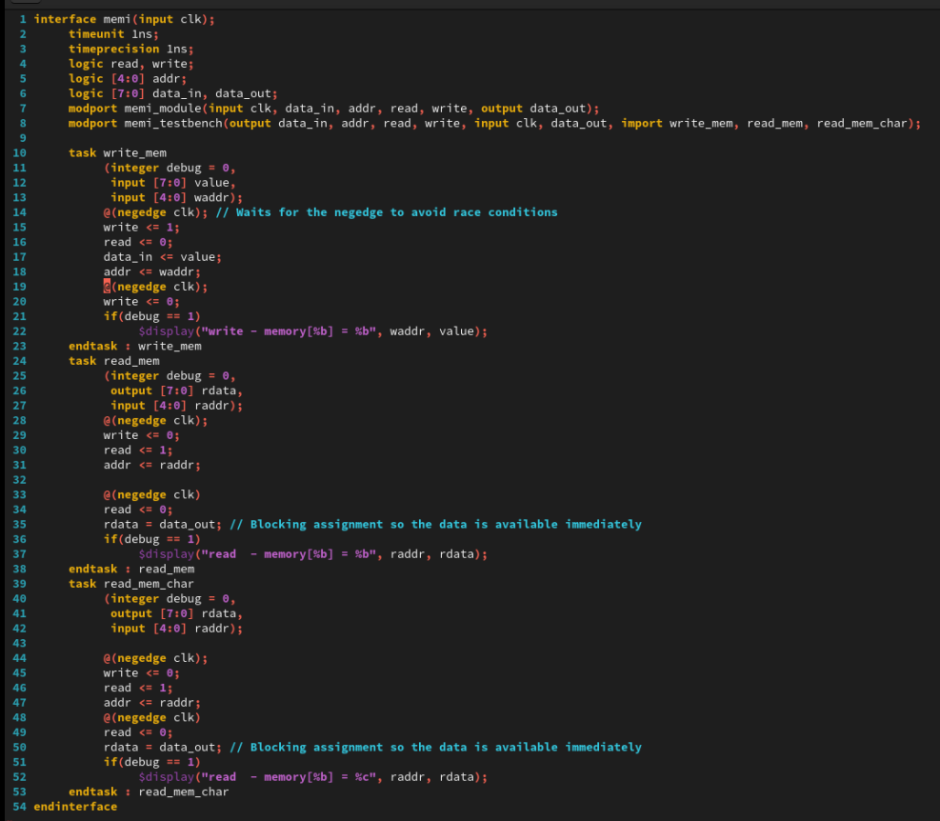
2. Creating the Memory Interface Design
01
mem_if.sv
Notes:
IC: Integrated Circuit

Slide 6
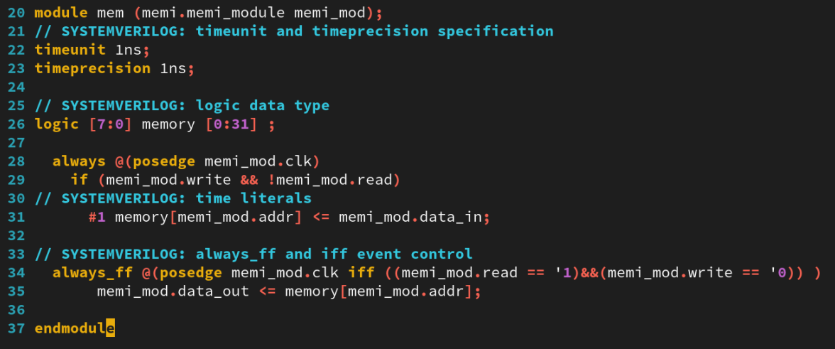
2. Creating the Memory Interface Design
01
mem.sv
Notes:
IC: Integrated Circuit

Slide 7
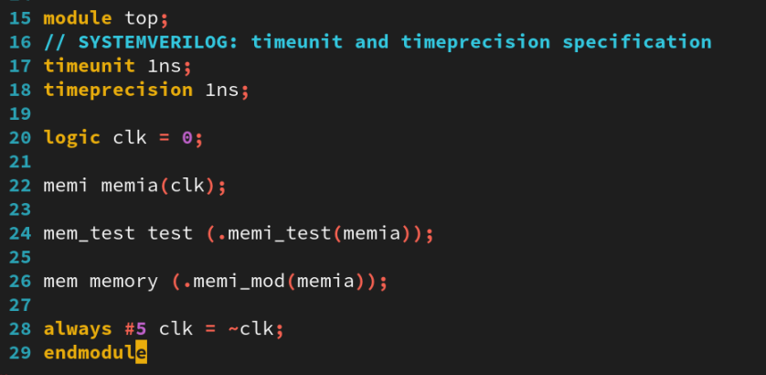
2. Creating the Memory Interface Design
01
top.sv
Notes:
IC: Integrated Circuit

Slide 8
Testing the Memory Interface Design
02

Slide 9
2. Testing the Memory Interface Design
01
Modifying the Memory Testbench
Add a new “Random Data” test to your testbench to write and check random data for every address. Simulate the design to confirm the randomization.
Add a constraint to limit data to be a printable ASCII character (8'h20 - 8'h7F). Modify your read and write memory debug messages to print the character generated (use the %c format specifier). Check your constraint in simulation.
Add a constraint to limit data to be A-Z or a-z (8'h41-8'h5a, 8'h61-8'h7a). Check your constraint in simulation.
Apply weights to the constraints so that 80% of the time, randomization chooses an uppercase letter and 20% of the time it chooses a lowercase letter. Check your constraint in simulation.
Notes:
IC: Integrated Circuit

Slide 10
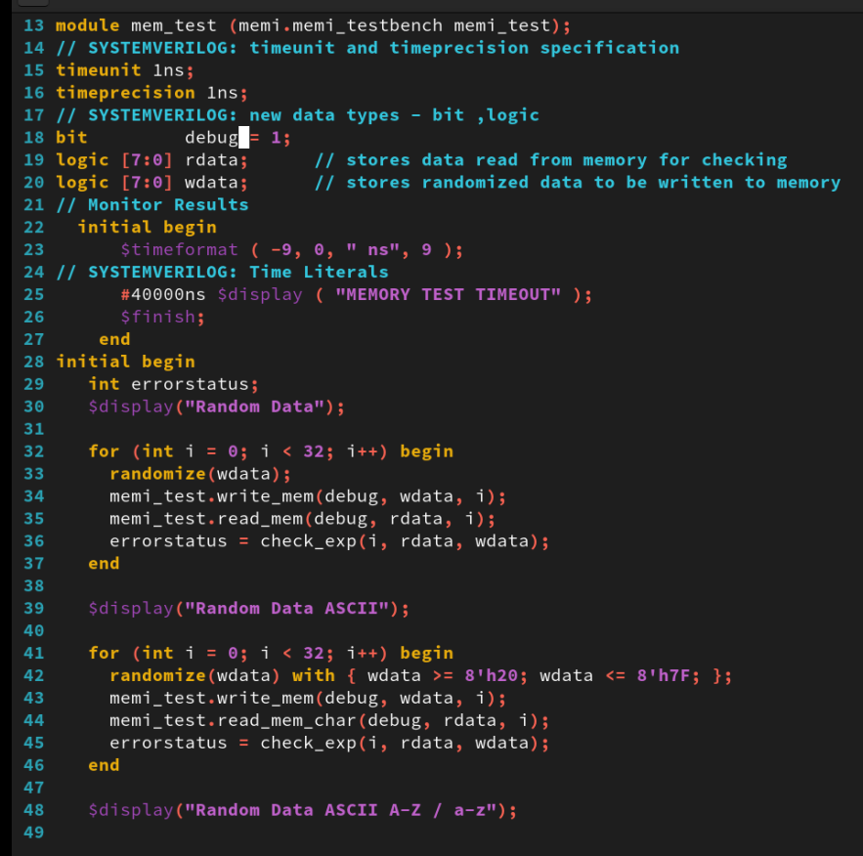
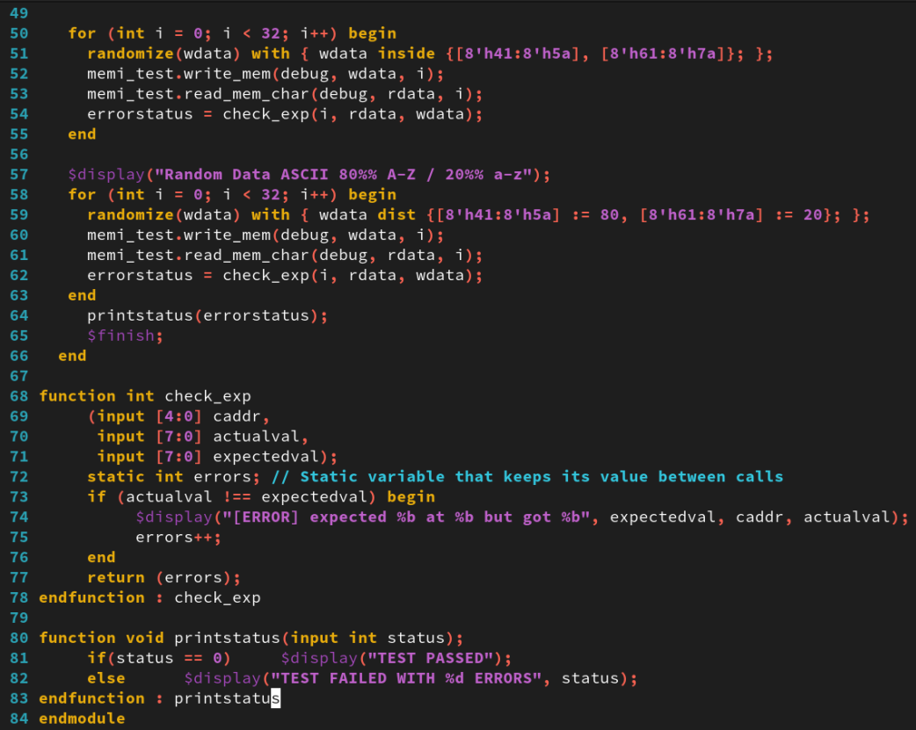
2. Testing the Memory Interface Design
01
mem_test.sv
Notes:
IC: Integrated Circuit

Slide 11
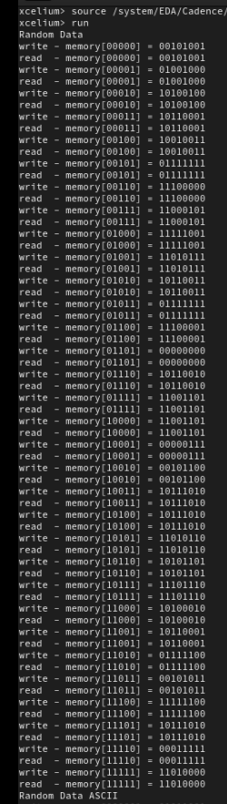
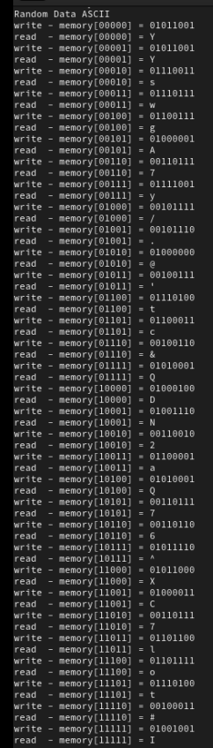
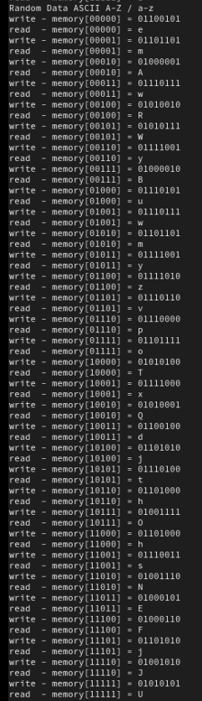
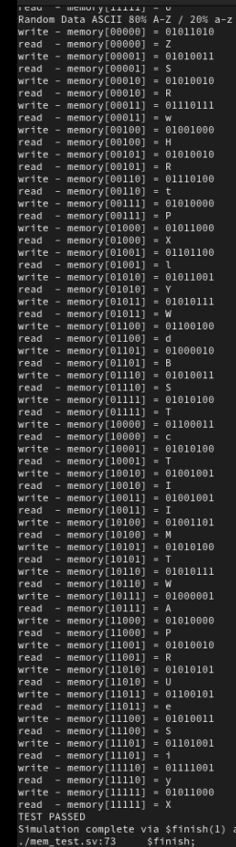
2. Testing the Memory Interface Design
01
Run Command
xrun mem_if.sv
xrun mem.sv mem_test.sv top.sv
The result as below:
Notes:
IC: Integrated Circuit

Slide 12
Achieved Outcomes.
03

Slide 13
3. Achieved Outcomes
01
Understand the specification and modify your Memory testbench to use constrained scope-based randomization
for data and address values.
Notes:
IC: Integrated Circuit

Slide 14

THANK YOU!

