Slide 1

LAB 13
January 2025

Slide 2
CONTENTS
01
Creating the Memory Interface Design
02
Testing the Memory Interface Design
03
Achieved Outcomes
Testing the Register Design

Slide 3
Creating the Memory Interface Design
01

Slide 4




1. Creating the Memory Interface Design
01
Working in the lab13-memrnd directory, perform the following.
Copy your Memory design, testbench, interface and top-level module from lab10-memrnd into lab13-memclass.
top
TB
DUT
interface
Notes:
IC: Integrated Circuit

Slide 5
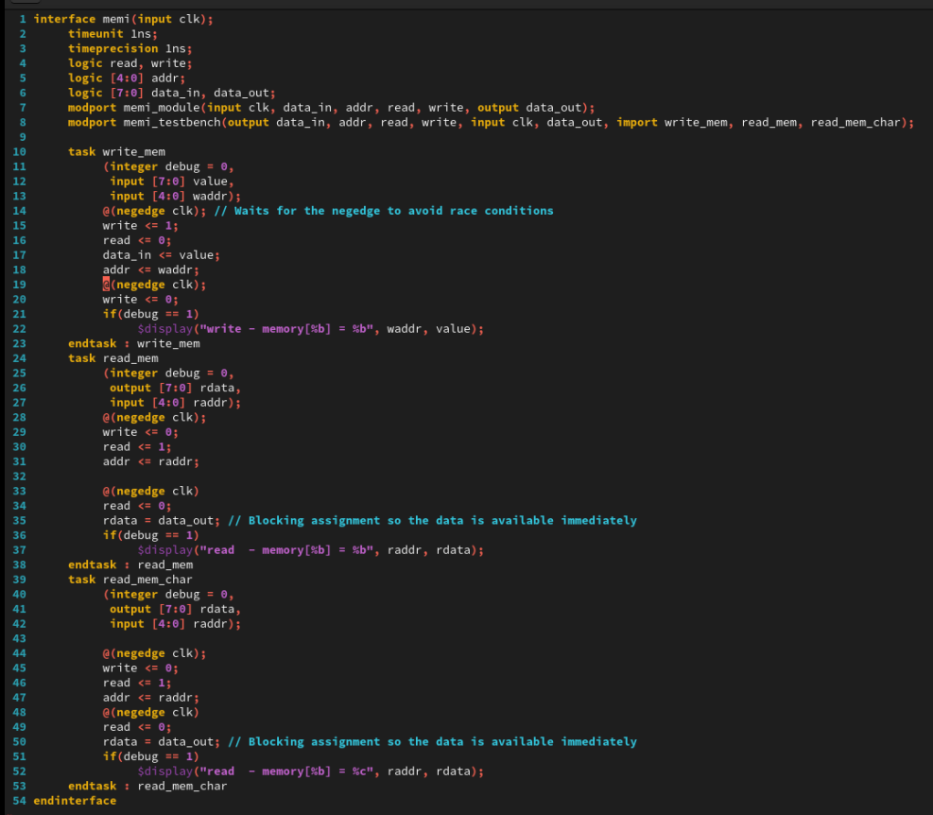
2. Creating the Memory Interface Design
01
mem_if.sv
Notes:
IC: Integrated Circuit

Slide 6
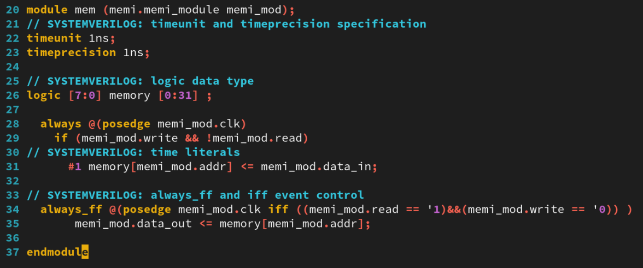
2. Creating the Memory Interface Design
01
mem.sv
Notes:
IC: Integrated Circuit

Slide 7
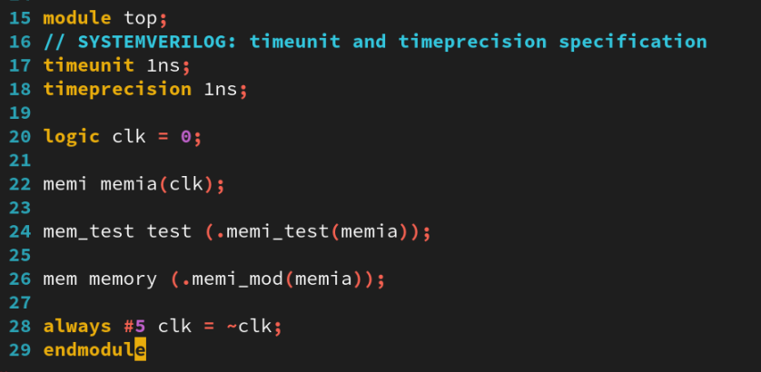
2. Creating the Memory Interface Design
01
top.sv
Notes:
IC: Integrated Circuit

Slide 8
Testing the Memory Interface Design
02

Slide 9
2. Testing the Memory Interface Design
01
Modifying the Memory Testbench
Modify your Memory testbench to declare a class with two random properties for address and data. Declare the properties as bit arrays and use a rand or randc keyword.
Add an explicit constructor with arguments to initialize the address and data properties.
Modify the Random Data test to use the class randomize() method to randomize the address and data properties. Write and read the memory using the properties. Simulate and debug as needed.
Add a constraint block to your class to limit data to be a printable ASCII character(8'h20 - 8'h7F). Check your constraint in simulation.
Add a constraint to limit data to be A-Z or a-z (8'h41-8'h5a, 8'h61-8'h7a). Check your constraint in simulation.
Apply weights to the constraints so that 80% of the time randomization chooses an uppercase letter and 20% of the time, it chooses a lowercase letter. Check your constraint in simulation.
Add a property to the class to conditionally control the randomization constraints. A control property like this is known as a policy or control knob. Declare the property as an enum type with appropriate values. Use conditional constraints to select one of the following constraints based on the property value:
a. A printable ASCII character
b. An uppercase character A-Z
c. A lowercase character a-z
d. Either an uppercase (80% probability) or lowercase (20% probability) character
Simulate and debug as needed.
Notes:
IC: Integrated Circuit

Slide 10
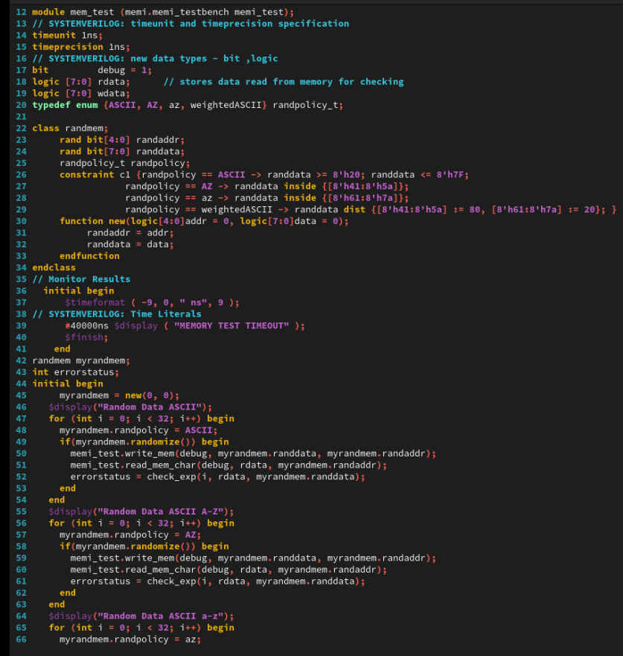
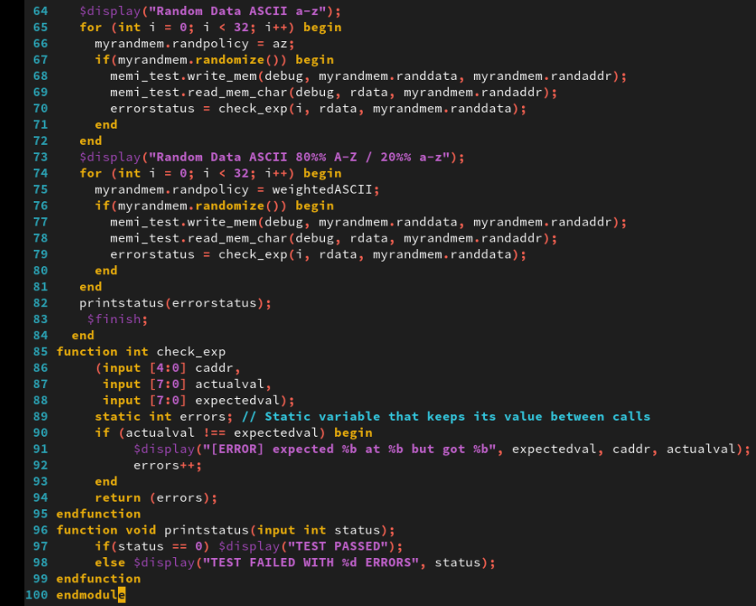
2. Testing the Memory Interface Design
01
mem_test.sv
Notes:
IC: Integrated Circuit

Slide 11
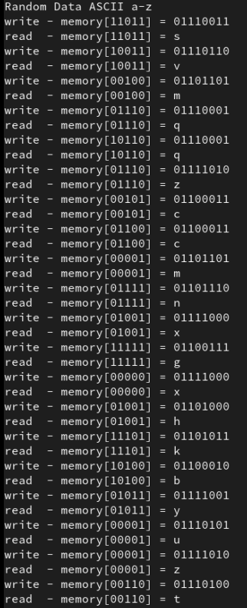
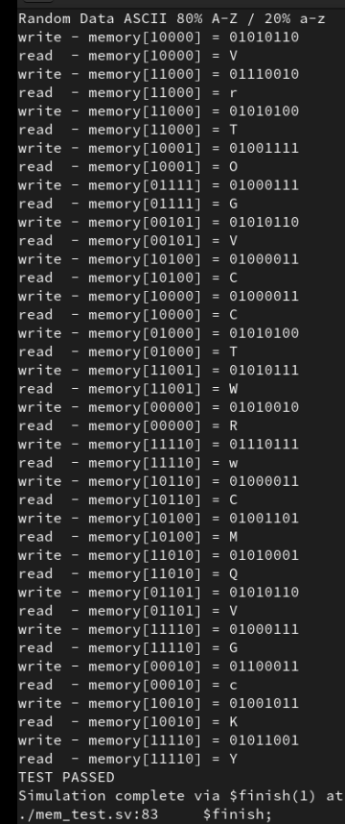
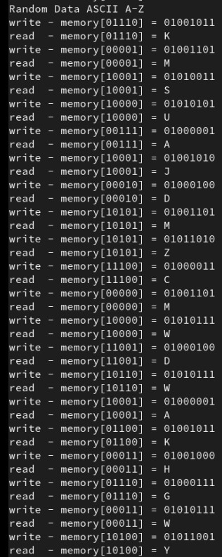
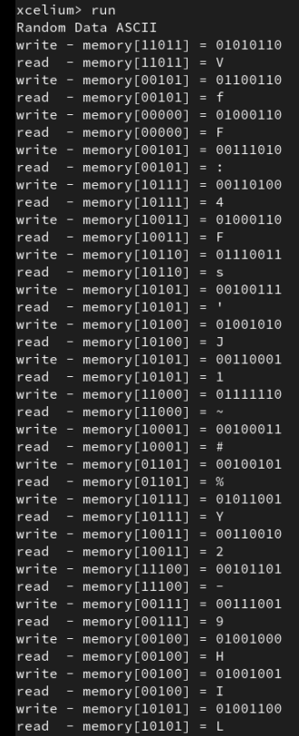
2. Testing the Memory Interface Design
01
Run Command
xrun mem_if.sv
xrun mem.sv mem_test.sv top.sv
The result as below:
Notes:
IC: Integrated Circuit

Slide 12
Achieved Outcomes.
03

Slide 13
3. Achieved Outcomes
01
Understand the specification and modify your Memory testbench to use SystemVerilog class-based randomization with constraints.
Notes:
IC: Integrated Circuit

Slide 14

THANK YOU!

