Slide 1

LAB 2
January 2025

Slide 2
CONTENTS
01
Specification
02
Creating the MUX Design
03
Testing the MUX Design
04
Achieved Outcomes.
Testing the Register Design

Slide 3
Specification
01

Slide 4




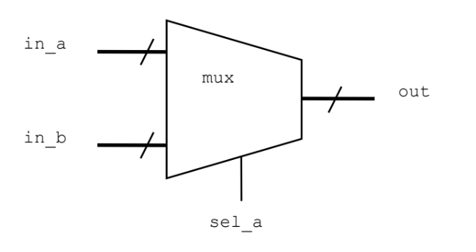
1. Specification
01
in_a, in_b and out are all logic vectors.
The MUX width is parameterized with a default value of 1.
If sel_a is 1’b1, input in_a is passed to the output.
If sel_a is 1’b0, input in_b is passed to the output.
I/O interface
Notes:
IC: Integrated Circuit

Slide 5
Creating the MUX Design
02

Slide 6
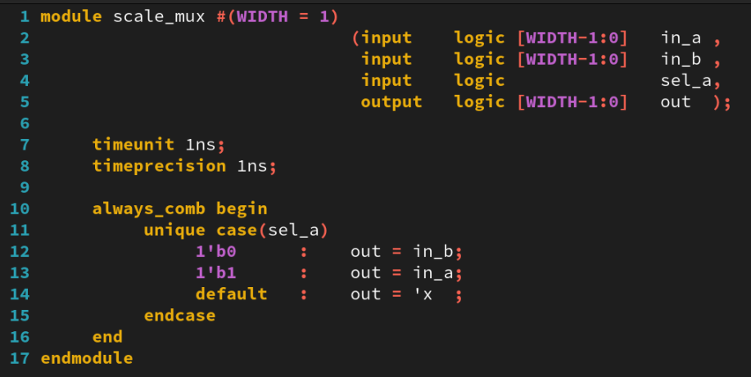
2. Creating the MUX Design
01
Working in the lab02-mux directory, perform the following:
Create a new file called scale_mux.sv, containing a module named scale_mux.
Write the MUX model using the following SystemVerilog and Verilog constructs:
Verilog2001 ANSI-C port declarations.
Parameterize the MUX width and give it a default value of 1.
always_comb procedural block.
timeunit and timeprecision.
unique case construct.
Include a default match that sets the output to unknown.
Notes:
IC: Integrated Circuit

Slide 7
Testing the MUX Design
03

Slide 8
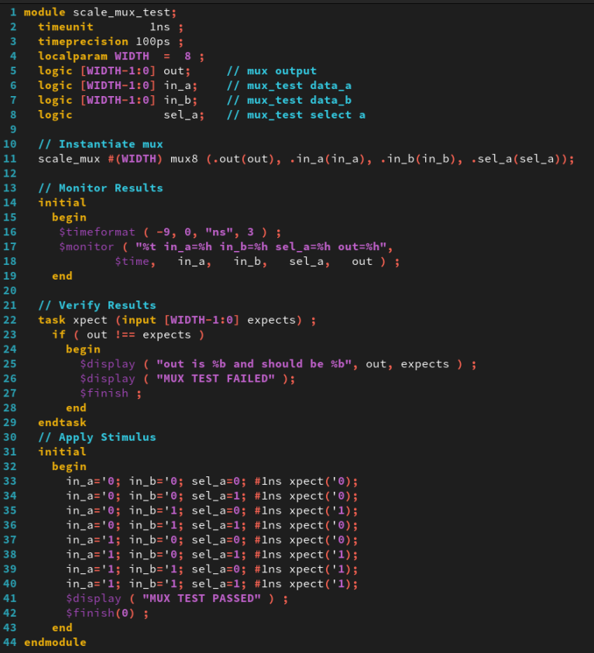
3. Testing the MUX Design
01
A testbench is provided in the scale_mux_test.sv file. Simulate the testbench and MUX design.
Notes:
IC: Integrated Circuit

Slide 9
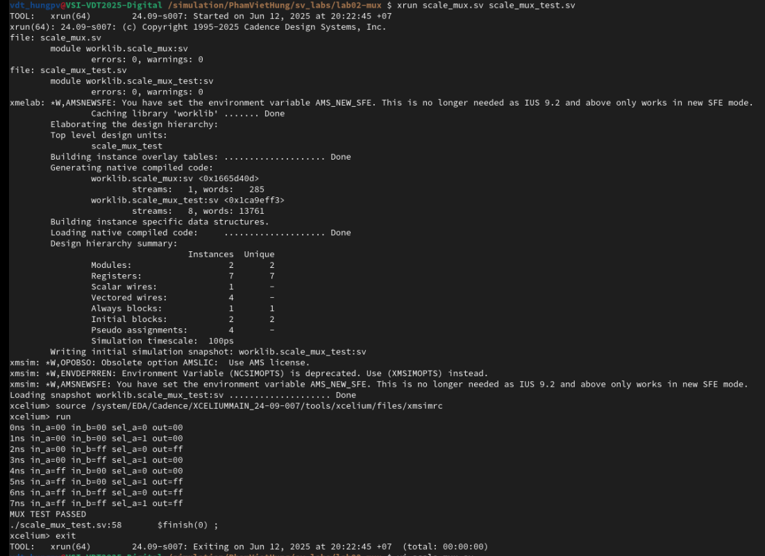
3. Testing the MUX Design
01
Run Command
xrun scale_mux.sv scale_mux_test.sv (Batch mode).
The result as below:
Notes:
IC: Integrated Circuit

Slide 10
Achieved Outcomes.
04

Slide 11
4. Achieved Outcomes
01
Understand the specification and create a simple multiplexor design using SystemVerilog and Verilog-2001 constructs and test it using the supplied testbench.
Notes:
IC: Integrated Circuit

Slide 12

THANK YOU!

