Slide 1

LAB 4
January 2025

Slide 2
CONTENTS
01
Specification
02
Creating the Controller Design
03
Testing the Controller Design
04
Achieved Outcomes.
Testing the Register Design

Slide 3
Specification
01

Slide 4




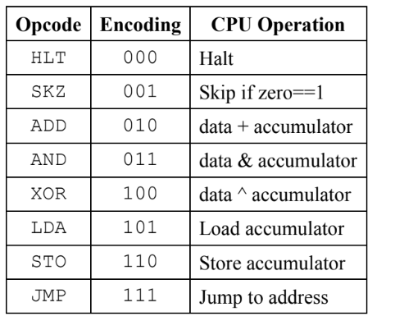
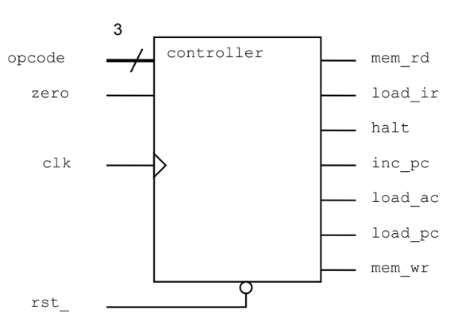
1. Specification
01
The controller is clocked on the rising edge of clk.
rst_ is asynchronous and active low.
opcode is a 3-bit logic input for the CPU operation code as follows:
I/O interface
Notes:
IC: Integrated Circuit

Slide 5
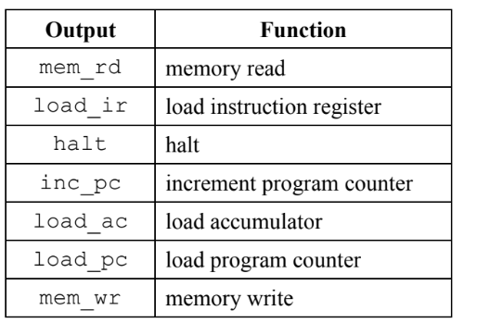
1. Specification
01
zero is a logic input that is 1 when the CPU accumulator is zero and 0 otherwise.
There are 7 logic outputs as follows:
Notes:
IC: Integrated Circuit

Slide 6
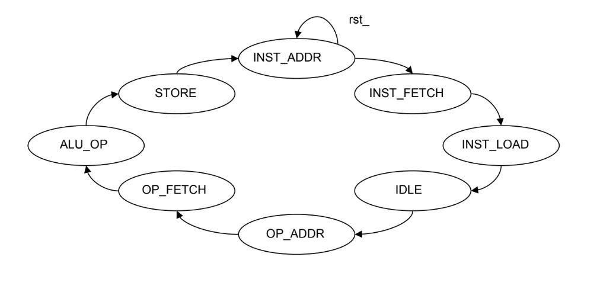
1. Specification
01
The controller has 8 states. State transitions are unconditional, i.e., the controller passes through the same 8-state sequence, from INST_ADDR to STORE, every 8 clk cycles. The reset state is INST_ADDR.
The controller is a Mealy state machine, so the outputs are a function of the current state and also of the opcode and zero inputs.
For example, if the controller is in state ALU_OP, then the output inc_pc is high if opcode is SKZ and zero is high.
Notes:
IC: Integrated Circuit

Slide 7
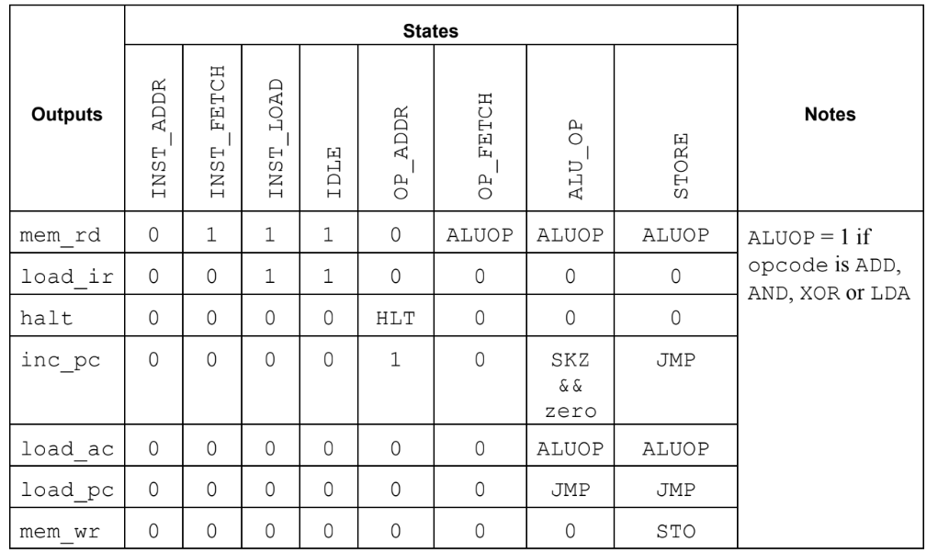
1. Specification
01
The output decode for the controller is as follows:
Notes:
IC: Integrated Circuit

Slide 8
Creating the Controller Design
02

Slide 9
2. Creating the Controller Design
01
Working in the lab04-ctrl directory, perform the following:
Create a new file called typedefs.sv containing a package named typedefs.
In the package, declare an enumerated type for the opcode controller input named opcode_t. Declare opcode_t with an explicit logic vector base type and make sure each value has the right encoding.
In the same package, declare an enumerated type, named state_t, for the controller state. Use an explicit base type and make sure the encoding is correct. We will need these values in the testbench to help verify the design.
Complete the controller definition in the file control.sv using SystemVerilog constructs where possible:
Import the package and use your enumerated type declarations for the input opcode and state variable(s) of the controller input.
Complete the state generation procedure using enumeration methods.
Generate outputs based on the current phase using the table above. Use always_comb and either unique case or unique if constructs. Be sure to include a default match in the case statement.
Notes:
IC: Integrated Circuit

Slide 10
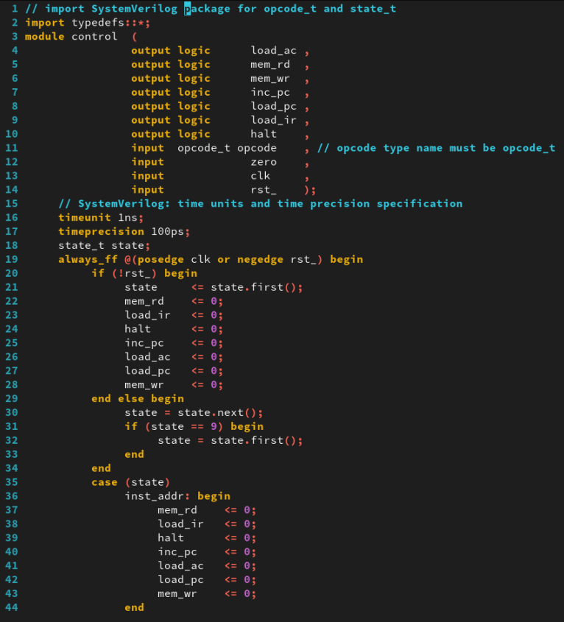
2. Creating the Controller Design
01
typedefs.sv
control.sv
Notes:
IC: Integrated Circuit

Slide 11
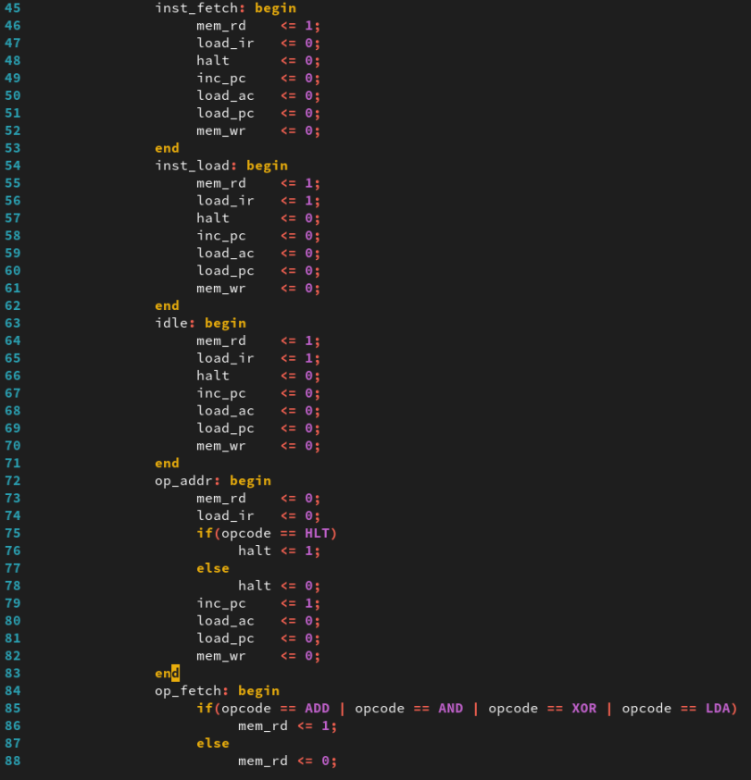
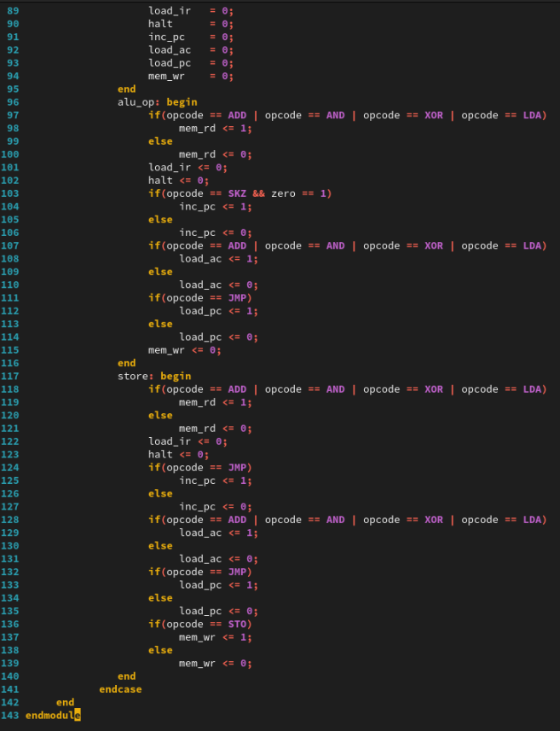
2. Creating the Controller Design
01
control.sv
Notes:
IC: Integrated Circuit

Slide 12
Testing the Controller Design
03

Slide 13
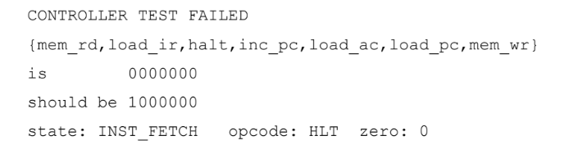
3. Testing the Controller Design
01
Check that your package containing the enumerated type declarations is imported into control_test.sv. If you did not name your enumerated types opcode_t and state_t, then you will need to modify the testbench to use your own type names.
Simulate the testbench and controller design. Make sure you compile your package file before compiling any modules which import the package. You do not need to compile the *.pat files – these are read by the testbench.
If there is a problem with your design, then you should see something similar to the following output:
This tells you that the mem_rd output is 0 when it should be 1 in state INST_FETCH when the opcode input is HLT and zero input is 0.
Debug your controller as required until you see the message: CONTROLLER TEST PASSED
Notes:
IC: Integrated Circuit

Slide 14
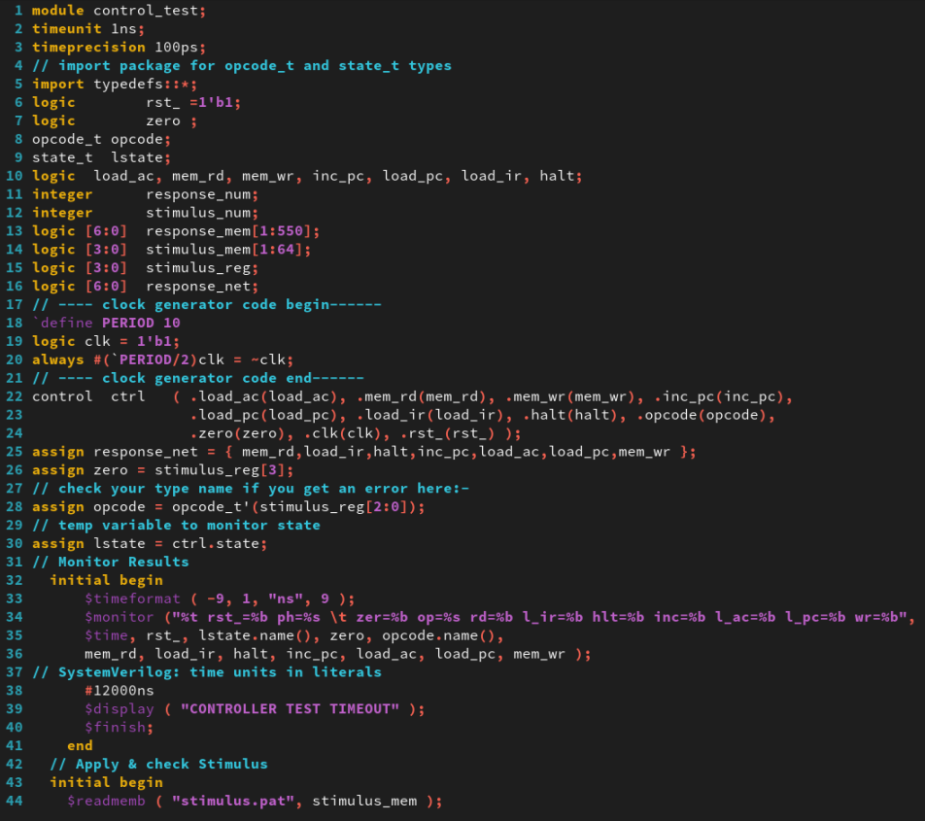
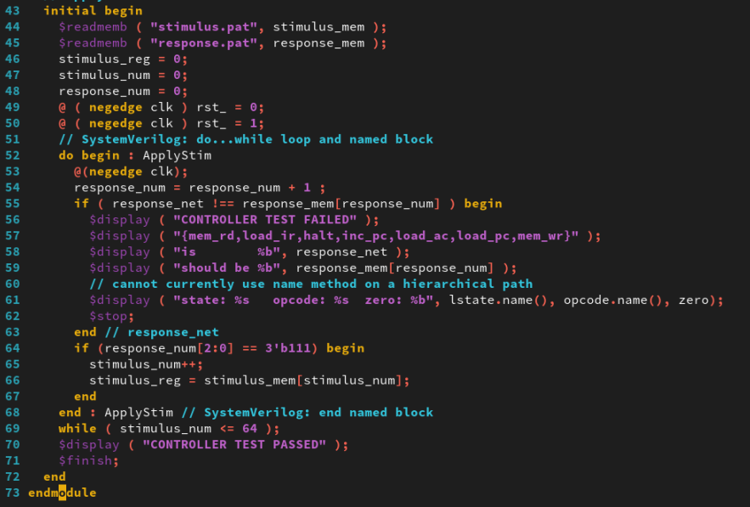
3. Testing the Controller Design
01
control_test.sv
Notes:
IC: Integrated Circuit

Slide 15
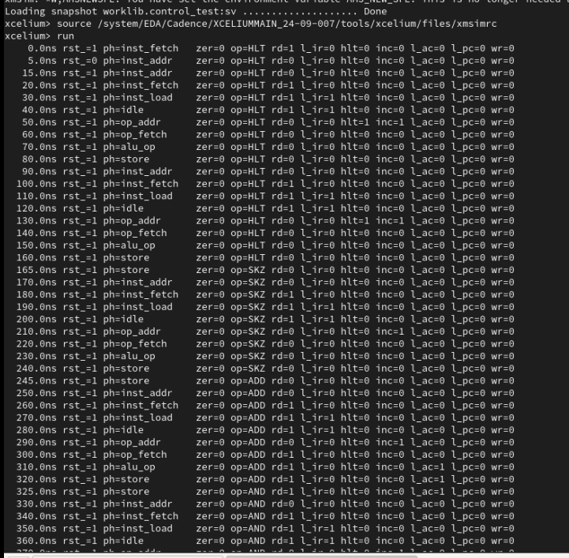
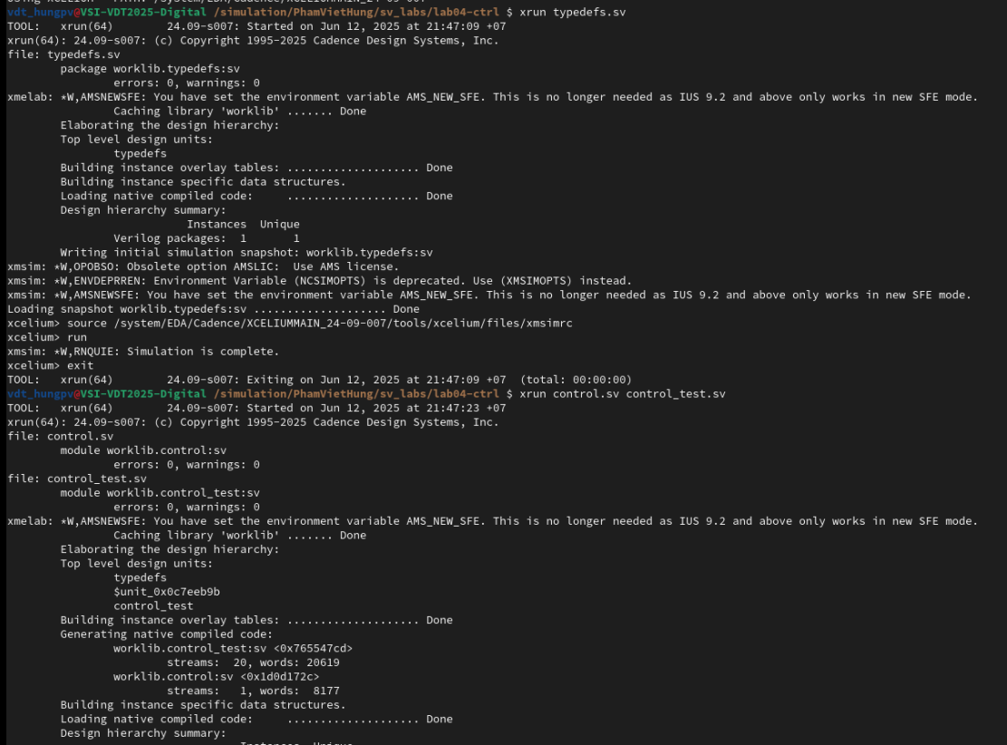
3. Testing the Controller Design
01
Run Command
xrun typedefs.sv
xrun control.sv control_test.sv
The result as below:
...
Notes:
IC: Integrated Circuit

Slide 16
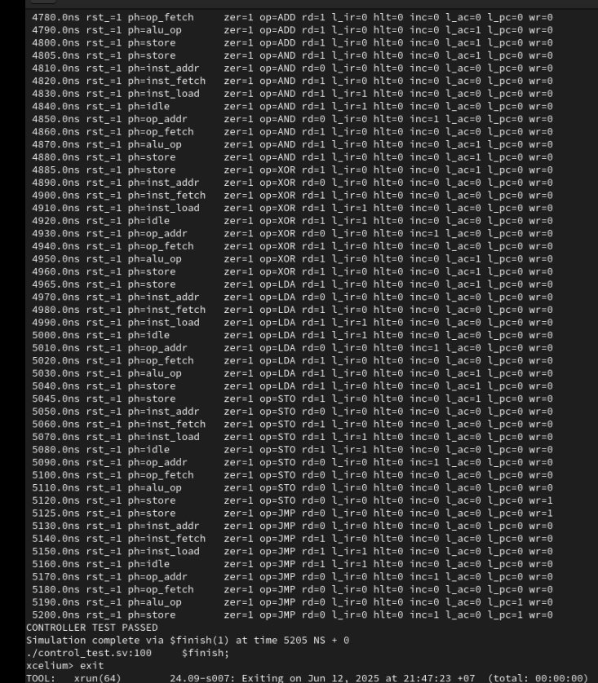
3. Testing the Controller Design
01
...
Notes:
IC: Integrated Circuit

Slide 17
Achieved Outcomes.
04

Slide 18
4. Achieved Outcomes
01
Understand to use SystemVerilog user-defined types, procedural statements, and operators to model a state machine.
Create an FSM Sequence Controller design using SystemVerilog constructs and test it using the supplied testbench.
Notes:
IC: Integrated Circuit

Slide 19

THANK YOU!

