Slide 1

By:
Lean V. Herrera

Slide 2
Oracle EAM enables you to:
Drive maintenance best practices and improve your organization’s performance
Empower all workers with easy to use self-service (Web and mobile) applications
Manage the full asset lifecycle with a complete view of your asset and equipment
Replace costly stand-alone maintenance systems with Oracle’s integration solution
Support compliance and corporate governance with an enterprise perspective

Slide 3
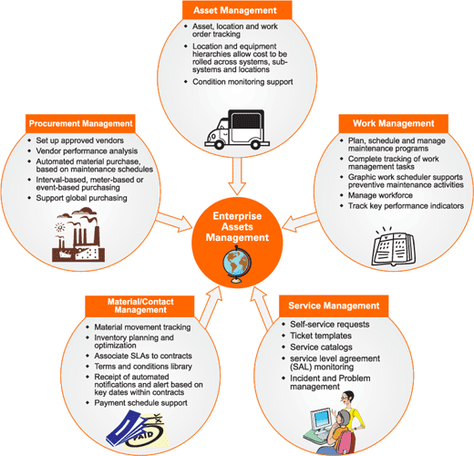

Slide 4
Features
Asset Management
Preventive and Condition-Based Maintenance
Collection Plans
Work Management
Work Order
Planning and Scheduling
Work Execution
Stores Management

Slide 5
Features
Maintenance Cost Management
Budgeting and Forecasting
Role-based Workbench
Flexibility to Support your business

Slide 6
Asset Management
Intuitive Asset Group definition
Flexible asset creation: Manual, template, open interface / business API
Ability to change an asset number without losing its attributes and history
Parent / child asset hierarchy with cost rollup
Support for all types of asset locations: User-defined areas, internal inventory locations, external physical locations, etc.

Slide 7
Fully supported asset moves and asset transfers, preserving asset attribute integrity, maintenance strategy and history
Ability to associate assets to production equipment
Equipment downtime visibility for production planning
Asset check-in / check-out
Users-specified asset operations log

Slide 8
Preventive and Condition-Based Maintenance
Support pre-defined asset maintenance activities (bill materials and routing)
Rule-based preventive maintenance strategy definitions
Support for predictive maintenance with user-defined collection plans

Slide 9
Collection Plans
Pre-defined collection plans
Collection of inspection, Reliability Centered Maintenance(RCM) and downtime, user-defined variables data
Rule-based creation of work request and work orders

Slide 10
Work Management
Streamlined work requests with approval Workflow
Support for services requests initiated in Oracle Services

Slide 11
Work Order
Inspection, lubrication and routine preventive maintenance work orders
Emergency work orders
Pre-planned work orders
Audit trail
User-defined word order type and work order statuses
Word order relationship, including parent / child and follow up work orders

Slide 12
Planning and Scheduling
Planner’s workbench
Preventive maintenance forecast generation and work order implementation
Integration with plant operations
Single-page user interface for work order creation and scheduling
Extensive work scheduling abilities, including part requests, equipment resource scheduling and employee scheduling

Slide 13
Easy parts inventory look up from work orders and from the Maintenance Workbench
Easy workflow configuration for work order approval

Slide 14
Work Execution
Rebuildable component replacement
Work hand-over(ability to hand over uncompleted work to other crews and shifts)
Ability to post work time by work order, project and crew
Flexible work completion process options (for specified work steps and/or work order)
Data capture at work order completion (meter readings, collection plan entries, failure data)

Slide 15
Mass data entry (meter readings, charge time, work order completion, work order close)
Supplier self-managed work operations from iSupplier
CFR 21 Part 11 implemented for work order completion
Maintenance intelligence
Maintenance key performance indicators delivered by Oracle Daily Business Intelligence (ODBI)

Slide 16
Stores Management
Flexible material request and issues process, including one-step issue
Auto material allocation
Available to promise status
Direct acquisitions (description based and non-stock material) , with supplier catalogue support

Slide 17
Maintenance Cost Management
Cost estimation
Actual cost calculation
Cost roll up based on work order relationship or asset hierarchy
Work order cost billing
Word order cost capitalization

Slide 18
Budgeting and Forecasting
Forecasts created form historical work order or project PM schedules
Easy and consistent forecast generation with forecast templates
Optional export forecast data in various format, such as Excel, HTML, PDF

Slide 19
Role-Based Workbench for
Planner
Scheduler
Supervisor
Maintenance User
Wireless Maintenance User
Work Requester

Slide 20
Flexibility to Support for Business
User-defined lookup codes for assets, work requests and work orders
Access security based on responsibility and organization
Open architecture for easy import and export of information
Intuitive and customizable web-based user interface with embedded analytics
Extensive reports and key performance indicators

Slide 21
Real-time reporting
Graphical views and “Drag and Drop” functionality
Graphical workflow tool
Oracle Approvals Management tool for work order approval process

Slide 22
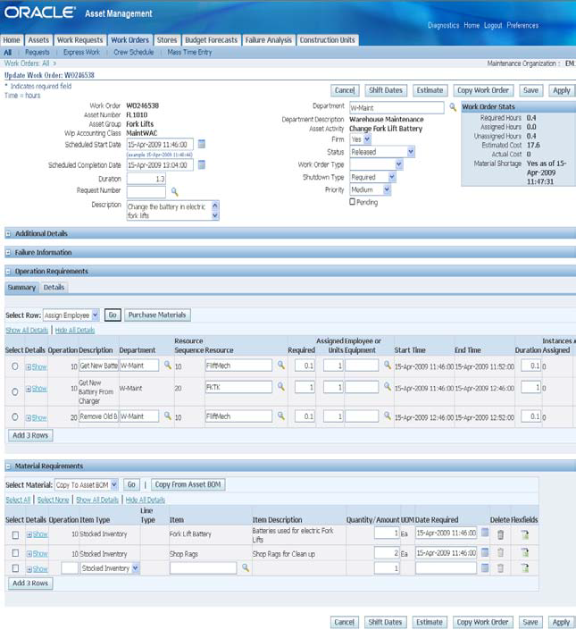

Slide 23
Key Benefits
Drive maintenance best practices and improve your organization’s asset performance
Empower all workers with easy to use self-service (web and mobile) applications
Manage the full asset lifecycle with complete view of your assets and equipment
Support compliance and corporate governance with an enterprise perspective

