Slide 1
Infection Risks of a Samsung Smart Watch
Semester Project Presentation

Slide 2
Project Information
Project Name
Infection Risks of a Samsung Smart watch
Professor:
Aurélien Francillon
Students
Pham Duc Hien
Le Kim Hung

Slide 3

Content
1
HCI Logs
2
Reverse APK
3
Ubertooth One
4
Reverse APK & Firmware
5
GearFit Attack
6
Demo

Slide 4
RISKS IN CONNECTION PROCEDURE

Slide 5
RISKS IN CONNECTION PROCEDURE
Motivations
- The smart watch can only connect to devices using a Samsung application named Gear Fit Manager.
- Then would a device be able to connect to the watch without the vendor-specific application ?

Slide 6
RISKS IN CONNECTION PROCEDURE
Methods and Tools (3 approaches)
- HCI logs: Python Bluetooth libraries (PyBluez [10]), Wireshark, HCI logs
- Reversed apk file: Java decompiler (jdk-gui), adb logs from Android phones
- Ubertooth One: Ubertooth One device ([4] and [5]), Wireshark

Slide 7
HCI Logs Approach
Schema of the connection process
Inquiry
Pairing (Authentication Type)
Conclusions
Service Discovery
RFCOMM Connection
Results
Comments and Conclusions

Slide 8
Schema of the connection process
Inquiry
Pairing
Service Discovery
RFCOMM Connection

Slide 9
Inquiry
Inquiry
Input fixed address of samsung watch: 38:0b:40:24:54:c3

Slide 10
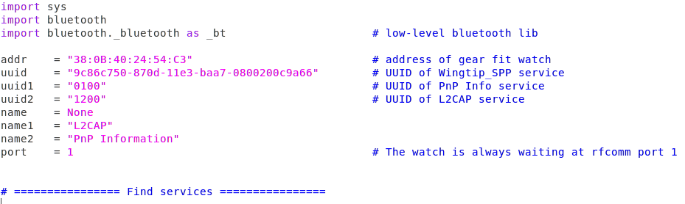
Service Discovery
“9c86c750-870d-11e3-baa7-0800200c9a66” Special value used to access WingTip service on the watch

Slide 11
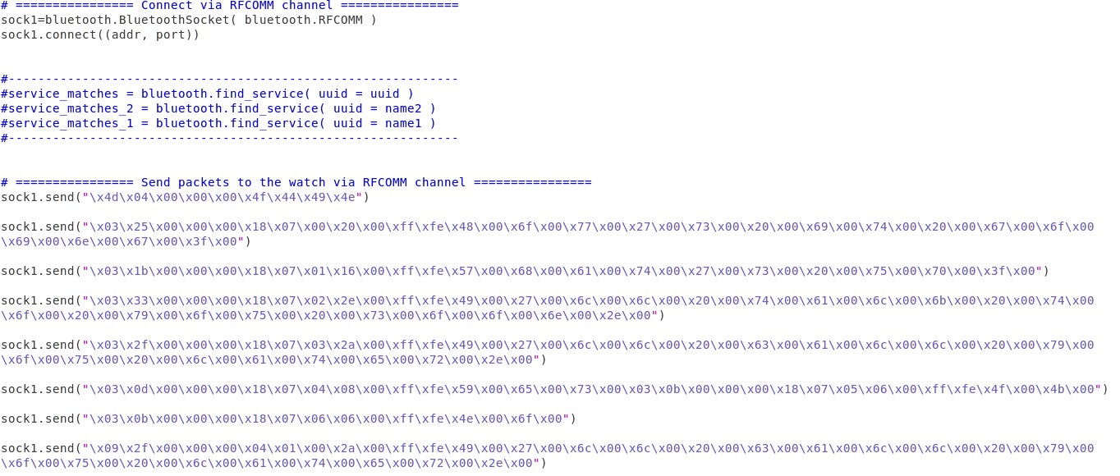
RFCOMM Connection

Slide 12
Pairing (Authentication Type)
Pairing
Phone requests authentication
Phone and Watch exchange IO capability information
Authentication occurs
MITM Protection Required – Dedicated Bonding
IO_Capability: Display Yes/No
No OOB capabilities
Depending on IO capability exchange step

Slide 13
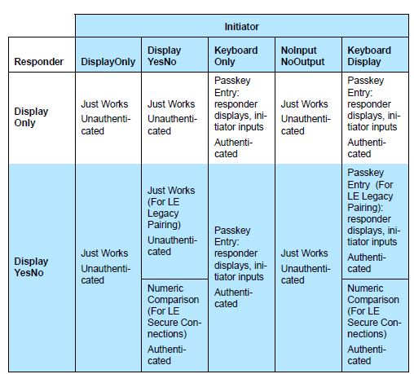
Pairing (Authentication Type)
Authentication Table – Figure taken from [2]
Authentication type was determined based on the IO_Capability parameters
The smart watch and the phone first exchanged their IO capability

Slide 14
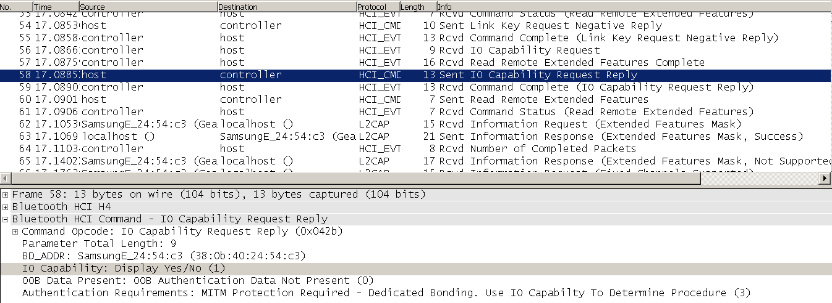
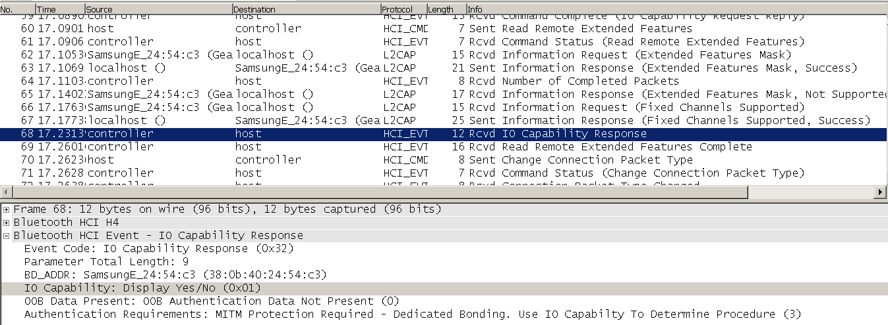
Pairing (Authentication Type)
I/O Capability information sent by the watch
I/O Capability information sent by the phone
Authentication Table – Figure taken from [2]

Slide 15
Comments and Conclusions
Understood the authentication type of the connection between the smart watch and a phone
Used RFCOMM values which were visible in HCI logs but the smart watch kept waiting for a signal from Gear Fit Manager.
Using only HCI logs was not sufficient to attack the communication of Samsung smart watch

Slide 16
Reversed APK File Approach
2.1/ States of Connections
2.2/ Schema
2.2.1/ Connecting (changing from state 0 to state 2)
2.2.2/ Connected (changing from state 2 to state 3)
2.2.3/ Completed Authentication (changing from state 3 to state 4)
2.2.3.1/ Comments and Conclusions

Slide 17

States of Connections
Gear Fit Manager defines states of its connection with the smart watch

Slide 18
Schema
None (State 0)
Completed Authentication (State 4)
Connected (State 3)
Connecting (State 2)

Slide 19
Connecting (changing from state 0 to state 2)
Adb logs - Connecting state
38:0B:40:24:54:C3 was the address of the smart watch
“9c86c750-870d-11e3-baa7-0800200c9a66” was the specific value used to access WingTip service in the smart watch

Slide 20
Completed Authentication (changing from state 3 to state 4)
New information
Comments:
We did not observe that packet through our previous HCI logs approach -> would be our missing information
Functions related to this packet had not been reversed successfully by the tool jd-gui

Slide 21
Ubertooth One Approach
Known drawbacks of the approach
3.1/ Sniffing
3.2/ Key Distribution
3.3/ Potential Risks
3.4/ OK, but why our attempts were not successful?
3.5/ Additional findings

Slide 22
Known drawbacks of the approach
If targeted devices used Out-of-band authentication type, then the techniques would not be efficient
In HCI logs approach, we already found that Samsung smart watch did not use Out-of-band method

Slide 23
Sniffing
Hopping Frequency
Advertising Channels
Results
Comments
Conclusions
Connection Request
Conclusions

Slide 24
Hopping Frequency
Hopping between frequency channels and stay in each channel for a short time to transfer data
BTLE splits the 2.4 GHz ISM band into 40 channels (from 2402 to 2480 GHz)
• 3 Advertising Channels
• 37 Data Channels
• fn = 2402 + 2n MHz
(The numbers taken from [13])

Slide 25
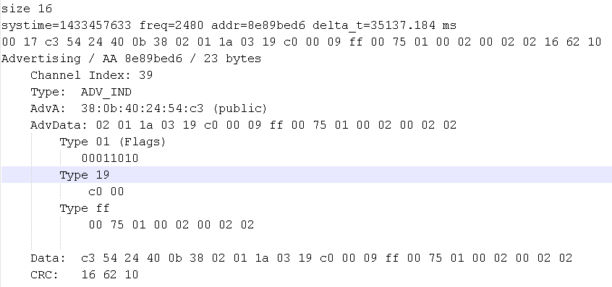
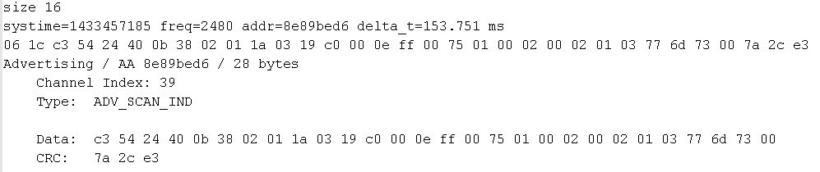
Advertising Channels
Screenshot of ADV_IND (00) packets
Screenshot of ADV_SCAN_IND (06) packets

Slide 26
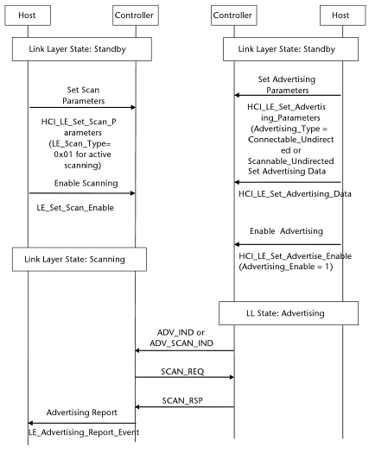
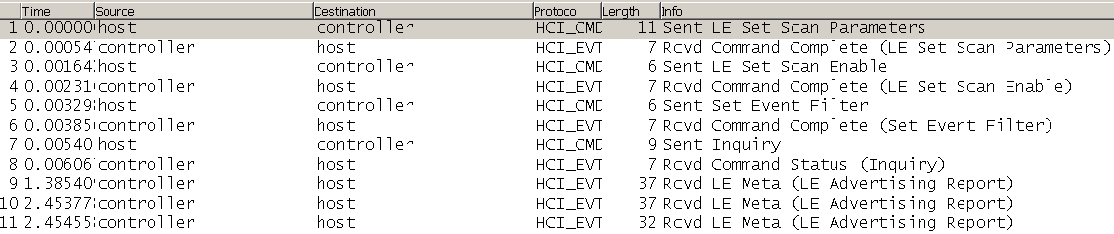
Advertising Channels
Active Scanning - Figure taken from[9]
LE_Set_Scan_Parameters and LE_Set_Scan_Enable commands in HCI logs
Bluetooth Stack of the phone
Bluetooth Stack of the watch

Slide 27
Advertising Channels
Comments and Conclusions
LE_Set_Scan_Parameters and LE_Set_Scan_Enable commands were sent first, then ADV_IND or ADV_SCAN_IND.
Before any pairing: ADV_SCAN_IND
After pairing: ADV_IND – to hide itself from the world

Slide 28
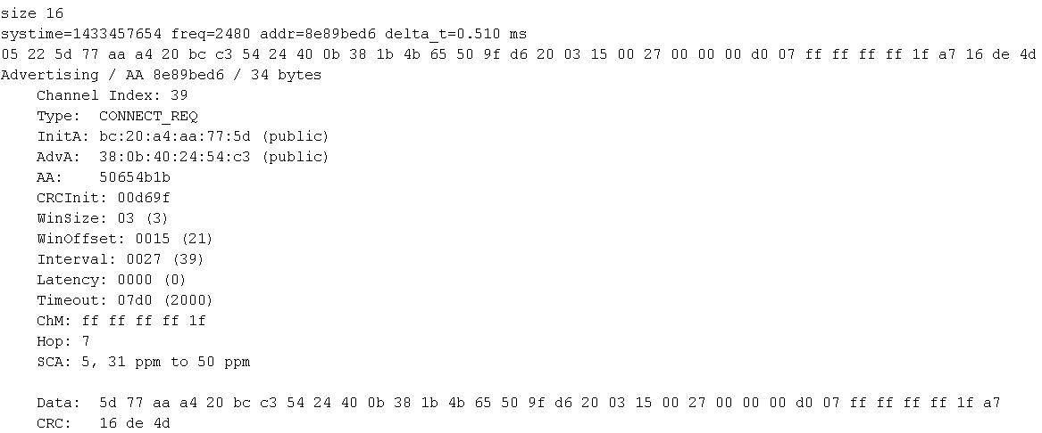
Connection Request
Screenshot of CONNECT_REQ (05) packets
Conclusion
A trivial step because we could occasionally capture the packet
Reason: Ubertooth One device could only sit on 1 advertising channel at a time while CONN_REQ could be sent at any of 3 advertising channels (37, 38 and 39).
CONNECT_REQ packet should be sent to the smart watch
Very important as it defines which channel to start from and also the hopping increment

Slide 29
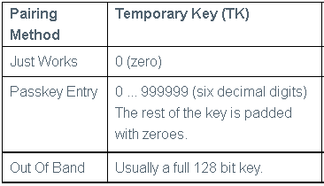
Key Distribution
Relation between the TK and the pairing methods- Figure taken from [3]
Temporary Key (TK) is used to calculate Short-Term Key (STK).
STK is used to encrypt a connection for Long-Term Key (LTK).
LTK is our goal.

Slide 30
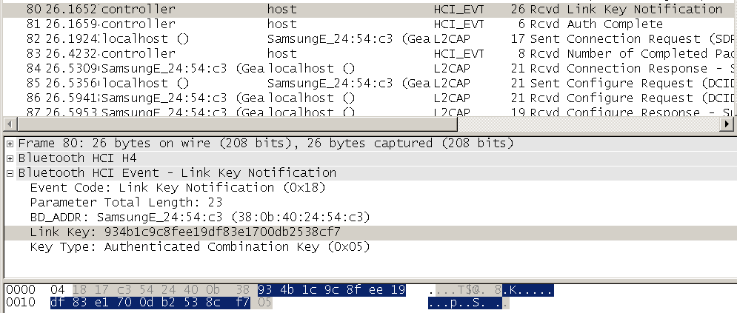
Potential Risks
Risk we found in Bluetooth paper [6]: TK would be brute-forced (plaintext over the air). Then STK and LTK would be found respectively.
Risk we found in our first approach (HCI logs approach): LTK could be found directly from the HCI logs.
LTK could be obtained from Link_Key_Notification event in HCI logs

Slide 31
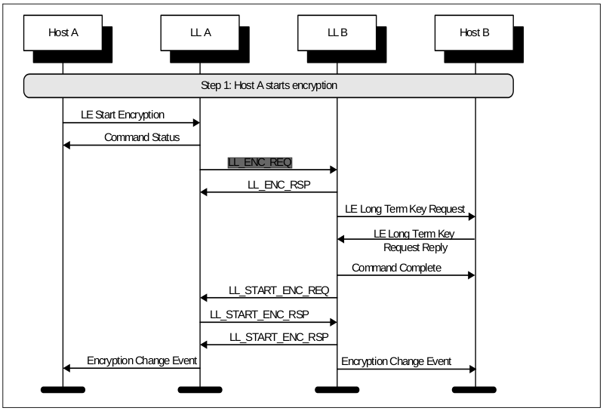
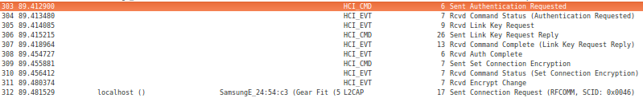
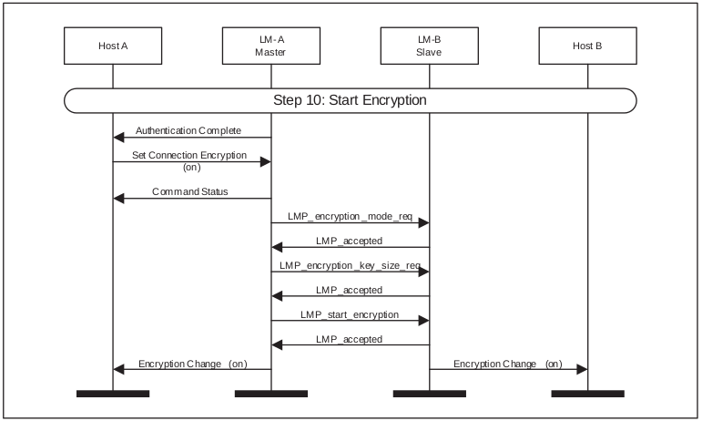
OK, but why our attempts were not successful?
Start Encryption in BTLE - Figure taken from [1],Vol 6, page 114 of 138
Set_Connection_Encryption command in HCI logs
Enable Encryption in Bluetooth Classic - Figure taken from [1],Vol 2,page 906 of 1114
We got errors:
"No LL_ENC_REQ found
No LL_ENC_RSP found
Giving up due to 2 errors"

Slide 32
OK, but why our attempts were not successful?
Conclusions
Despite of being introduced as a Bluetooth Low Energy device, Samsung smart watch actually employed Bluetooth Classic to establish an encryption.
This made potential Bluetooth sniffing attacks into communication of the watch become less feasible than expected.

Slide 33
Additional findings
Ubertooth One Hardware supports Bluetooth Classic sniffing?
Existing Bluetooth Classic sniffing projects?
Bluetooth Classic and Bluetooth LE interoperability?

Slide 34
Additional findings
3.5.2/ Existing Bluetooth Classic sniffing projects?
Projects which use either Ubertooth One hardware [7] or using Universal Software Radio Peripheral (USRP)[8] are lack of frequency hopping supports.
But potential Bluetooth Classing sniffing devices are likely to be created in future.
3.5.1/ Ubertooth One Hardware supports Bluetooth Classic sniffing?
Texas Instrument chip CC2400[11] which can be used as 2.4 GHz radio frequency transceiver for wireless applications.
Hence, the hardware does support Bluetooth Classic sniffing

Slide 35
Additional findings
Bluetooth Classic and Bluetooth LE interoperability?
Types | Requirements of Devices/Applications | Devices/Applications
Only Bluetooth Classic | Devices/Applications which require a stable data rate or quality transmission (like audio transmissions) | Wireless Headphones, Speakers, Audio headsets…
Single Mode Only Bluetooth Low Energy | Devices/Applications which require only transmitting smaller amounts of data and longer usage of battery cells | Heart-rate or blood pressure monitors, text transmitters of watches, tablets…
Dual Mode | Devices/Applications which require communications with other Devices/Applications using Bluetooth classic | Bluetooth Mouse, Keyboards…

Slide 36
RISKS IN APPLICATION AND FIRWARE

Slide 37
Application Layer

Slide 38
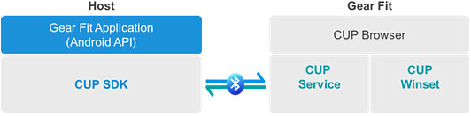
SamSung CUP
Notes:
The first thing I would like introduce is the Companion UI platform, short name in CUP. It is a library allow communicate and display information on GearFit. As the picture show that, we have 2 sides, host side and gearfit side, host side or phone side is an application run on CUP SDK, Gearfit side or watch side contain CUP Brower which have 2 component is CUP service is used to contact with host side, and CUP winset is the set of winget to display such as text view, button….

Slide 39
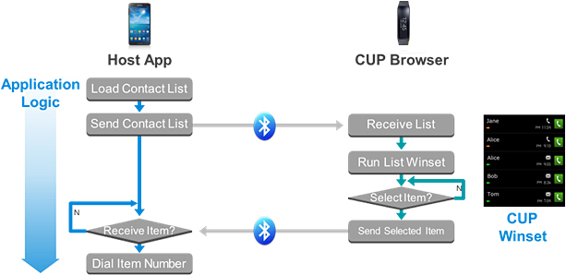
SamSung CUP
Notes:
The CUP process functions as follows:
The host application sends a command to the CUP browser requiring the Browser to display a certain winset.
The CUP Browser displays the winset.
After the user interacts with the winset, the Browser sends the user event back to the host application, which can proceed to the next step.

Slide 40
Understanding Interaction
Collect Android System Log
Know what actually Application do.
Which element in Code is called.
Reverse APK file:
How Application do.
What are special parameters.

Slide 41
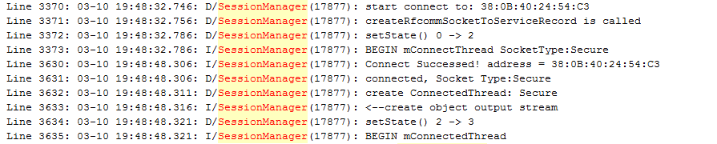
Collect Android System Log
- Using GDB to connect and get system log from Android devices:
Notes:
To understand how phone contact with gearfit via GearFit manager. We use Android Debug Bridge (GDB) which provides a mechanism for collecting and viewing system debug output. From this log file, we can understand which element have responsible for connection and connection process.

Slide 42
Reverse APK file
Basic Approach:
Dex2jar: to general Javacode.
JD-Gui: Display Java source code.
Virtuous Ten Studio:
Automatic tool allow reverse, modify smali code.
Notes:
To understand more clearly, we reverse apk file to know what the phone do exactly to connect to app and how an application install on the app. We have 2 methods are: first, we use Dex2jar to generate java bytecode and use JD-Gui to display these code and Second, we use Virtuous Ten Studio, a automatic tool allow reverse, modify and packacket android code.

Slide 43
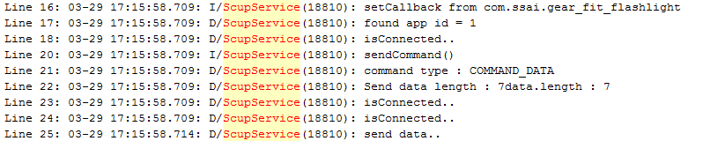
Application Code Not Store On Watch
Application on GearFit only send and receive request from Phone side.
Identify by AppID and Package Name.
Notes:
Base on the log file dump from android phone via adb process and reverse APK file. Filter some critical information about the Scup service which is the main service using to control the installing application process. We can conclude that: Application on GearFit only have responsible to send request and receive response and display these information.

Slide 44
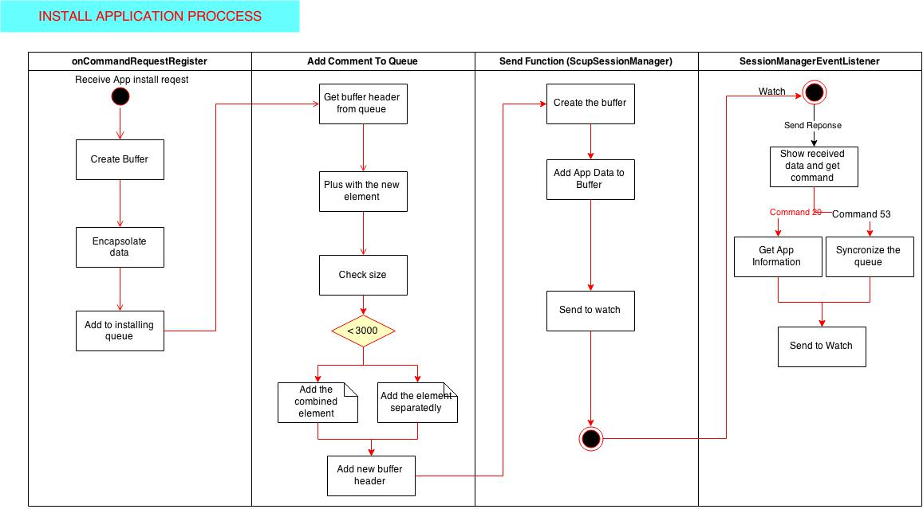
GearFit App Installing Process
Notes:
After receive request for instailling, GearFit Manager create buffer and encapsulate data to send to watch, after that, a header to add before sending. After that phone will receive respose from watch, if success, it will save application information and synchronize queue. Finally send finish to watch.

Slide 45
Firmware Layer

Slide 46
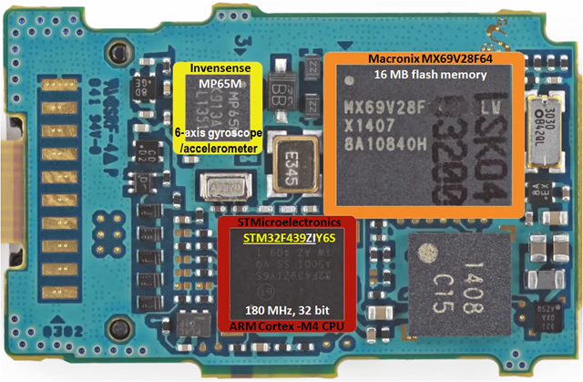
Hardware Overview

Slide 47
Reverse Firmware
Collect Firmware.
Find Entry Point.
Increase coverage by IDA plugin.
Draw Boot Map and Identify vital function.
Notes:
Now we move to Reverse Firmware GearFit:

Slide 48
Collect Firmware
Full firmware contains:
Bootloader: Responsibility for Booting.
Fota: Responsibility for Bluetooth Connection.
WingTip: Responsibility for Application.
Update firmware contains:
WingTip: Responsibility for Application.

Slide 49
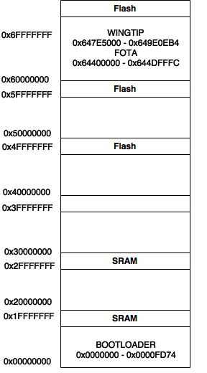
Find Entry Point
Notes:
- After collecting firmware, I reverse to find the entry point and draw a memory map of firware.

Slide 50
IDA Plugin
Using IDAPython that integrates the Python programming language.
Result:
Notes:
While reversing by IDA, to increase the number of found function. I wrote a small Ida plugin to find the code block base on valid address. It will make revesse process easier.

Slide 51
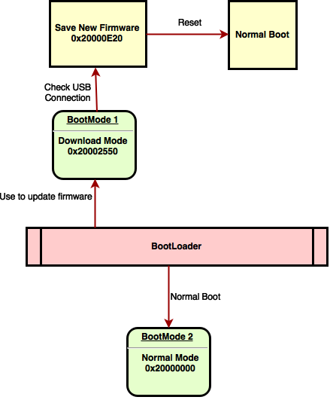
Boot Mode

Slide 52
GearFit Attack
Modification Attack.
Session Hijacking Attack.
Notes:
Finally, we found 2 vulnerability of gear fit,

Slide 53
Modification Attack
Weak point:
GearFit Manager contains update firmware.
Only use checksum while transfering (not check before reading)
Our approach:
Unpack apk file.
Modify update firmware.
Pack again.
Notes:
GearFit Manager contains update firmware that mean new update firmware will be embedded into apk file.
Gearfit only calculate the check sum on buffer data after read from file for ensure data integrity on newwork.

Slide 54
Session Hijacking Attack
Weak point:
Request send to smartwatch is not secure.
Only use AppId and Package Name to identify request.
Our approach:
Implement a new connection class.
Send request to Smartwatch with face AppID.
Notes:
After connect successful to gearfit watch, request from phone send to watch is not secure and it only identify by Appid and Package Name. This parameter is very easy to manipulate.

Slide 55
Future work
Base on Modification Attack:
Disable authentication connection with smartphone.
Add user’s private information (Location, heath, phone message….) into response message to smartphone.
Improve hijack real-time connection by hiding service on phone

Slide 56
DEMO

Slide 57
Thank you for listening

