Slide 1
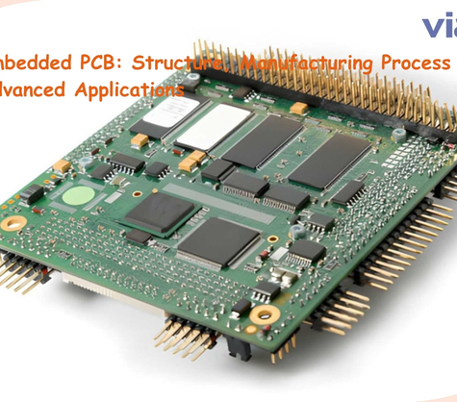

TECHNICAL OVERVIEW
EMBEDDED LINUX
Embedded Linux: Fundamentals and Boot Architecture
Mastering the boot chain, cross-compilation, and system integration
Scope
Focus
Level
System Design
Boot Sequence
Technical
Embedded Linux | Boot Architecture
01 / 14

Slide 2
02
Tạo PPT ngôn ngữ Tiếng Anh về chủ đề: Embedded Linux Overview, C
Agenda: The Embedded Lifecycle
A roadmap through development and boot architecture
01
02
03
04
Architecture Overview
Cross-Compilation
The Boot Chain
Deployment Strategy
Understanding software layers and hardware dependencies.
Host-to-target development workflows and toolchains.
Sequence from ROM code to init and userspace.
Partitioning and managing boot failures.
Technical Competency
By the end, you will understand the embedded boot chain, cross-compilation necessities, and system partitioning strategies.
Embedded Linux | Boot Architecture
02 / 14

Slide 3
03
Tạo PPT ngôn ngữ Tiếng Anh về chủ đề: Embedded Linux Overview, C
The Challenge: Resource Constraints
Building software for specialized, limited-resource silicon
Limited Compute and Storage
Embedded systems lack PC resources, necessitating streamlined boot processes and specialized software toolchains.
Hardware
Tooling
Boot Time
Reliability
Specialized ARM or RISC chips.
Cross-compilation required.
Performance critical.
Zero-failure requirement.
Architecture Strategy
Strategic selection of architecture and build methods to ensure reliability and efficiency.
Embedded Linux | Boot Architecture
03 / 14

Slide 4
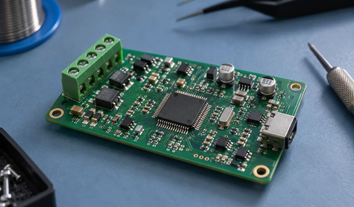

SECTION 1
ARCHITECTURE
Embedded Linux Foundations
The essential synergy between silicon and software layers.
Next Step
Moving to the mechanics of cross-compilation.
Embedded Linux | Boot Architecture
04 / 14

Slide 5
5
Tạo PPT ngôn ngữ Tiếng Anh về chủ đề: Embedded Linux Overview, C
System Architecture Overview
Key functional components of an embedded Linux stack
Bootloader
Linux Kernel
RootFS
Init System
Initial hardware bring-up and kernel loading.
Hardware abstraction and resource management.
Core libraries and essential utilities.
Handoff to userspace services (PID 1).
Drivers
Device Tree
Toolchain
Hardware-specific interface modules.
Configuration metadata for hardware.
Cross-compilation utilities.
Embedded Linux | Boot Architecture
05 / 14

Slide 6
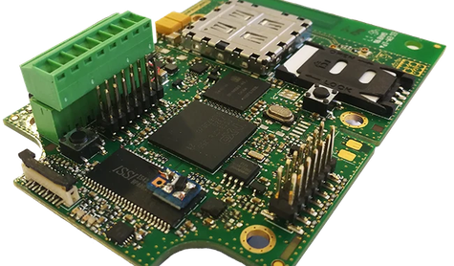
SECTION 2
DEVELOPMENT
Cross-Compilation Workflow
Enabling development on limited target hardware.
Next Step
Examining the boot process chain.
Embedded Linux | Boot Architecture
06 / 14

Slide 7
7
Tạo PPT ngôn ngữ Tiếng Anh về chủ đề: Embedded Linux Overview, C
Cross-Compilation vs. Native
Comparison of development workflows for embedded systems
Cross-Compilation
Native Compilation
Development on x86_64 host targeting ARM/MIPS.
• High performance compilation speed
• Complex toolchain setup
• Essential for production imaging
Compiling software directly on the board.
• Requires high target RAM/Storage
• Exceptionally slow build performance
• Not suitable for kernel or large stacks
The Verdict
Cross-compilation is mandatory for resource-limited targets; native compilation is generally non-viable.
Embedded Linux | Boot Architecture
07 / 14

Slide 8
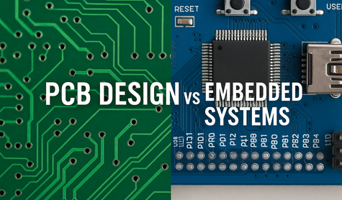
SECTION 3
BOOT SEQUENCE
The Boot Process Chain
Sequential handover of control to Linux.
Next Step
Deep dive into boot stages.
Embedded Linux | Boot Architecture
08 / 14

Slide 9
09
Tạo PPT ngôn ngữ Tiếng Anh về chủ đề: Embedded Linux Overview, C
The Boot Flow Sequence
From initial power-on to user space initiation
01
02
03
04
05
ROM Code
Initial Hardware Init
SPL
Secondary Bootloader
U-Boot
Kernel Payload
Kernel
OS Management
Init (PID 1)
Userspace Start
Boot Chain Stages
Handoff Logic
A multi-stage handover process ensuring hardware is initialized before loading Linux.
Firmware (ROM/SPL) passes control to U-Boot, then to the Linux kernel.
Embedded Linux | Boot Architecture
09 / 14

Slide 10
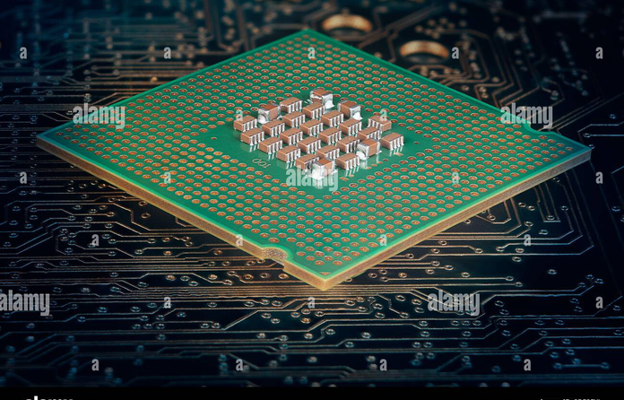

10
CALLOUTS
Boot Stage: U-Boot and Kernel
Bootloader's critical role in hardware initialization
1
Loaders
U-Boot loads kernel/DTB.
2
Arguments
Pass kernel boot args.
3
Handoff
Transfer execution flow.
Embedded Linux | Boot Architecture
10 / 14

Slide 11

11
Tạo PPT ngôn ngữ Tiếng Anh về chủ đề: Embedded Linux Overview, C
Boot Stage: RootFS and Init
Kernel transition to userspace operations
Mounting
Kernel mounts the RootFS partition.
Init PID 1
Kernel execs first userspace binary.
Service Start
OS services initialize fully.
Embedded Linux | Boot Architecture
11 / 14

Slide 12
12
TABLE
Partitioning Strategy
Storing system components effectively on flash storage
Partition | Type | Content | Notes
Bootloader | Raw | SPL / U-Boot | Hardware init
Boot Part | FAT32 | Kernel / DTB | Essential config
RootFS | EXT4 | Libraries / App | Userspace data
Reserved | Raw | Env / Config | Non-filesystem
Layout Strategy
Segregating bootloader, kernel, and filesystem improves update reliability.
Risk
Corrupted partition tables halt booting.
Reference
Standard Embedded Linux Best Practices
Embedded Linux | Boot Architecture
12 / 14

Slide 13
13
Tạo PPT ngôn ngữ Tiếng Anh về chủ đề: Embedded Linux Overview, C
Managing Boot Risks
Primary causes of failure during initialization
Risk | Likelihood | Impact | Owner | Mitigation
DTB Error | M | H | Firmware | Validated schema
RootFS Corrupt | L | H | System | Read-only fs
U-Boot Fail | L | H | Firmware | A/B Partitioning
Power Loss | M | M | Hardware | Watchdog timer
Failure Protocol
If persistent boot failures occur, manual JTAG access or emergency recovery media required.
Embedded Linux | Boot Architecture
13 / 14

Slide 14
14
Tạo PPT ngôn ngữ Tiếng Anh về chủ đề: Embedded Linux Overview, C
Summary and Next Steps
Finalizing the embedded development perspective
The Core Takeaway
Success in embedded Linux depends on robust cross-compilation and a verified, staged boot sequence.
Master Yocto/Buildroot
DTB Debugging
A/B Updates
Automate image creation.
Use JTAG for hardware signals.
Improve update reliability.
Further Learning
Deepen device tree knowledge and kernel debugging skills.
Embedded Linux | Boot Architecture
14 / 14

