Slide 1
Daemon, IPC Overview: PIPE & FIFOs
Presenter: Nguyen Manh Hung
Date: 06/10/2026
Embedded Trainees
1/22

Slide 2

OVERVIEW
1
2
3
4
Daemon
IPC Overview
PIPE
FIFOs
- Concept
- Characteristics
- Method of creation
- List the types of IPC
- Compare IPCs
- Concept
- PIPE size, block, SIGPIPE
- pipe and fork
- shell and pipe
- Concept
- create fifo
- multiple readers/writers
2/22

Slide 3

01
Daemon
Long-lived processes running independently of terminal sessions.
Concept
Characteristics
Method of creation
3/22

Slide 4
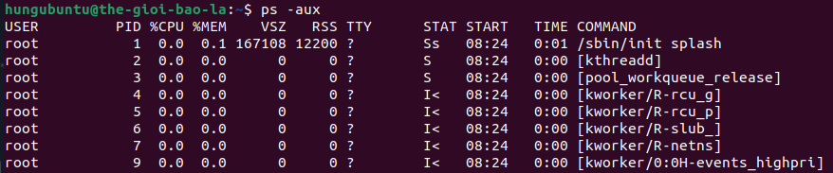

1. Daemon
What is Daemon?
A daemon process is a background process that runs independently of any user control and performs specific tasks for the system.
Characteristics:
Typically runs for extended periods.
Terminal-independent.
There is usually no direct interaction with the user.
There is an IPC or network mechanism to provide the service.
4/22

Slide 5
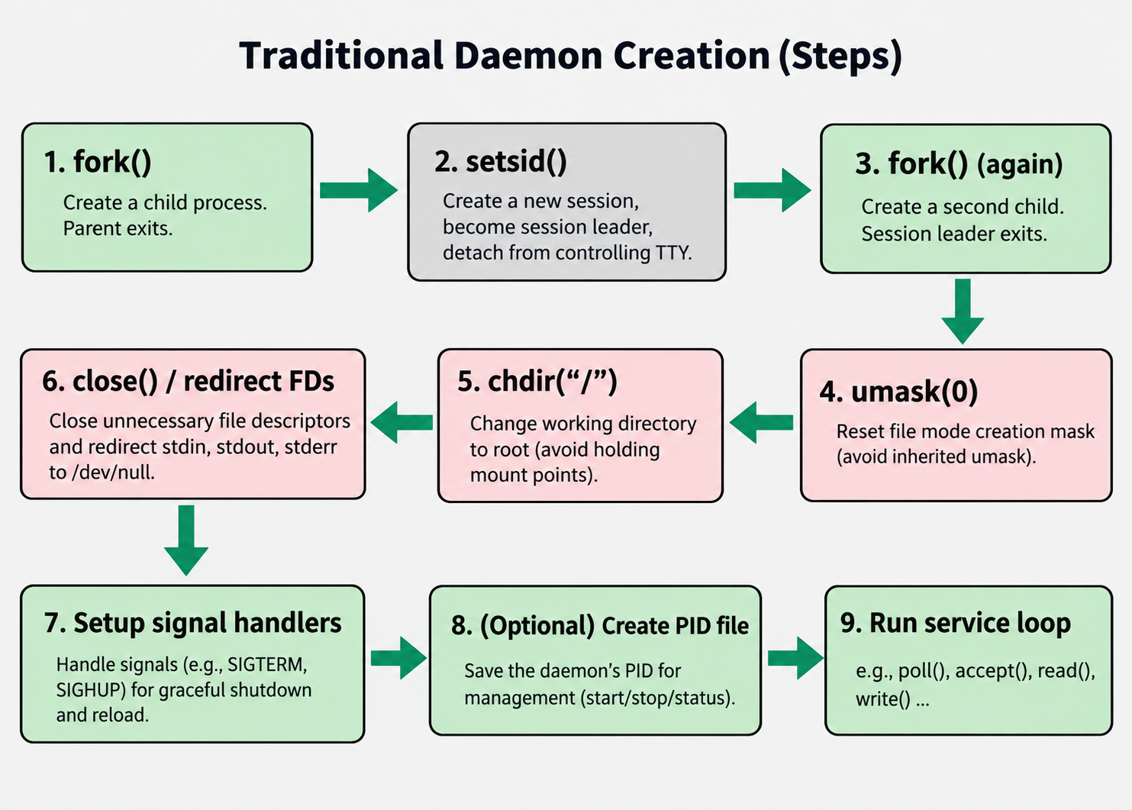
1. Daemon
Traditional steps to create a daemon:
5/22

Slide 6

1. Daemon
Traditional steps to create a daemon: Example code
/* Redirect stdin/stdout/stderr */
int fd = open("/dev/null", O_RDWR);
dup2(fd, STDIN_FILENO);
dup2(fd, STDOUT_FILENO);
dup2(fd, STDERR_FILENO);
/* Unmask file permissions */
umask(0);
/* Change working directory to root */
chdir("/");
/* Open System Logging */
openlog("log_daemon", LOG_PID | LOG_NDELAY, LOG_DAEMON);
}
void init_daemon(void)
{
/* First fork: Detaches the child process from the parent */
pid_t pid = fork();
if (pid > 0)
{
/* parent exits */
_exit(EXIT_SUCCESS);
}
/* Create a new session and process group */
setsid();
/* Second fork: daemon is no longer a session leader,
* so it cannot acquire a controlling terminal. */
pid = fork();
if (pid > 0)
{
/* child 1 exits */
_exit(EXIT_SUCCESS);
}
6/22

Slide 7
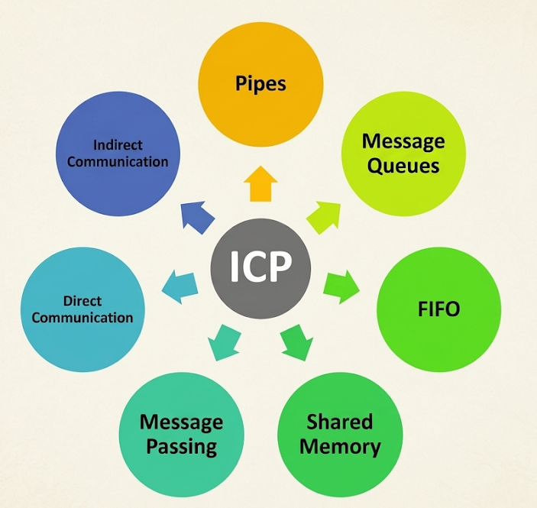
02
IPC Overview
IPC
List the types of IPC
Compare IPCs
7/22

Slide 8

2. IPC Overview
IPC (Inter-Process Communication) refers to mechanisms that allow processes to:
Exchange data (communication)
Synchronize activities (synchronization)
Notify of events (notification)
Why we need IPC?
Information Sharing: Multiple programs need access to identical data or shared files without duplicating them.
Computational Speedup: Breaking a massive task into smaller subtasks running on separate processor cores requires fast data exchange.
Modularity: Complex software uses separate, smaller modular processes that talk to each other cleanly rather than one giant monolithic block.
8/22

Slide 9
2. IPC Overview
IPC tree:
pipe / FIFO
communication
message queue
shared memory
IPC
semaphore
synchronization
mutex
condition variable
notification
signal
9/22

Slide 10
2. IPC Overview
Compare:
Mechanism | Main purpose | Data model | Typical use
Pipe | Data transfer | Byte stream | Parent ↔ child
FIFO | Data transfer | Byte stream | Unrelated processes
Message Queue | Data + command | Message | Command/event
Shared Memory | High-volume data, Fast transfer | Shared memory | Large Sensor / Image / Buffer
Semaphore | Synchronization | Counter | Producer / Consumer
Mutex | Mutual exclusion | Lock | Critical section
Condition Variable | Waiting/notification | Condition | Thread / Process Coordination
Signal | Notification | Event | Shutdown / Interrupt
10/22

Slide 11
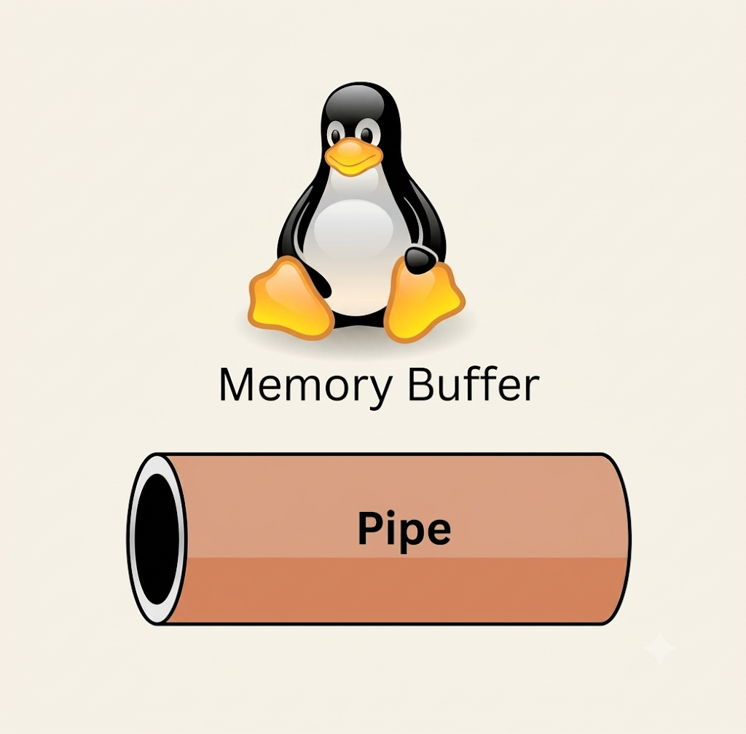
03
PIPE
Unidirectional byte-stream interface.
Concept
PIPE size, block, SIGPIPE
pipe and fork
shell and pipe
11/22

Slide 12
3. PIPE
What is Pipe?
A pipe is an IPC (Inter-Process Communication) mechanism that allows one process to transmit a byte stream to another process via the kernel.
Characteristics:
- byte stream
- unidirectional
- kernel-managed buffer
- highly suitable for communication between related processes, such as parent and child
Suitable for | Not suitable for
Data streaming | Complex message structures
Parent–child communication | Random access
Simple producer–consumer scenarios | Large shared datasets
Passing stdin / stdout | Multiple clients requiring flexible communication
12/22

Slide 13
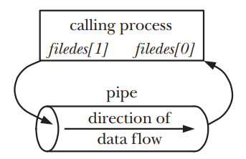

3. PIPE
Some API of Pipe:
API | Role in Pipe Communication | Return
pipe(int fd[2]) | Creates a pipe object: fd[0] → read end fd[1] → write end | 0 success -1 failure
write(fd, buf, size) | Sends bytes into the pipe buffer | Bytes written -1 on error
read(fd, buf, size) | Receives bytes from the pipe buffer | Bytes read 0 -1 on error
close(fd) | Releases unused pipe ends | 0 success -1 failure
fd[1]
fd[0]
write
read
kernel
13/22

Slide 14
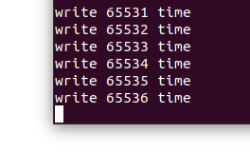
3. PIPE
Limit of pipe (defaut is 65536 byte (64kB))
Blocking in pipe
int main(int argc, char *argv[])
{
int n = 0;
int fd[2];
pipe(fd);
const char *msg = "H";
while (1)
{
write(fd[1], msg, strlen(msg));
n++;
printf("write %d time\n", n);
}
return 0;
}
Pipe empty
BLOCK
Pipe full
read
write
SIGPIPE
int fd[2];
pipe(fd);
close(fd[0]);
const char *msg = "HELLO";
int ret = write(fd[1], msg, strlen(msg));
14/22

Slide 15
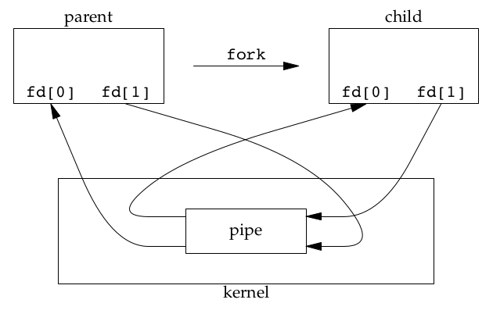

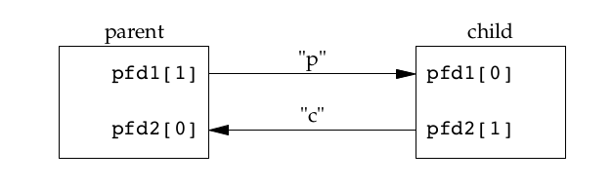
3. PIPE
pipe + fork
parent
child
parent
child
pipe(fd)
close fd[1]
close fd[0]
read
write
15/22

Slide 16
3. PIPE
shell and pipe
shell
input: ls | cat > doc.txt
" ls | cat > doc.txt "
pipe(fd)
fd[0] : read
fd[1] : write
fork()
shell parent
child 1: ls
dup2(fd[1], stdout)
close(fd[0])
close(fd[1])
waitpid(child 1, ...)
waitpid(child 2, ...)
shell parent
fork()
child 2: cat
dup2(fd[0], stdin)
close(fd[0])
close(fd[1])
dup2(file_fd, stdout)
close(fd[0])
close(fd[1])
close(file_fd)
exec("cat", ...)
file_fd = open("doc.txt", ...)
exec("ls", ...)
15/22

Slide 17
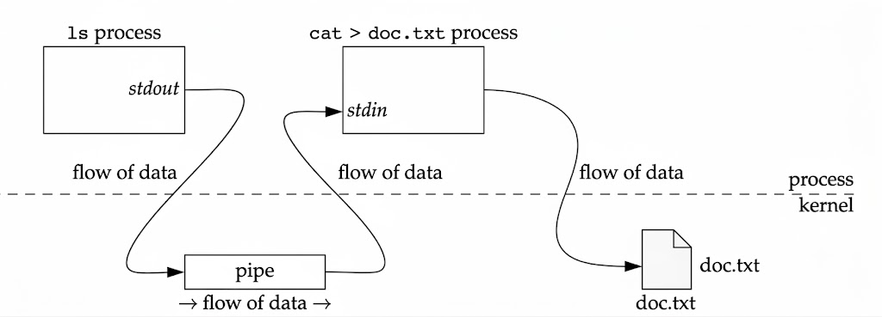


3. PIPE
shell and pipe
" ls | cat > doc.txt "
17/22

Slide 18
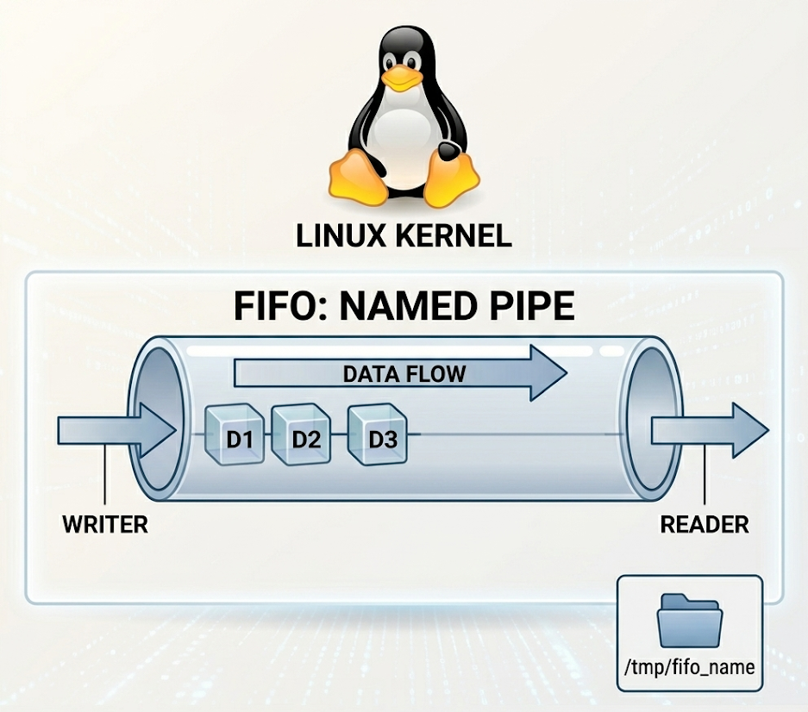
04
FIFOs
Persistent communication paths.
Concept
Create fifo
Multiple readers/writers
18/22

Slide 19
4. FIFOs
What is FIFOs?
A FIFO (named pipe) is a pipe with a name in the filesystem, which lets unrelated processes communicate. A FIFO is created with mkfifo() and accessed with open() like an ordinary file.
mkfifo("/tmp/fifo_A_to_B", 0666);
mkfifo("/tmp/fifo_B_to_A", 0666);
/* open fifo */
int fd = open("/tmp/fifo_A_to_B", O_WRONLY);
int fd1 = open("/tmp/fifo_B_to_A", O_RDONLY);
Function | Role
mkfifo() | Create an IPC endpoint
open() | Connect the process to the FIFO
read() | Receive data
write() | Send data
close() | Close connect to the FIFO
unlink() | Mark to delete the FIFO name
fcntl() | On/Off O_NONBLOCK
19/22

Slide 20
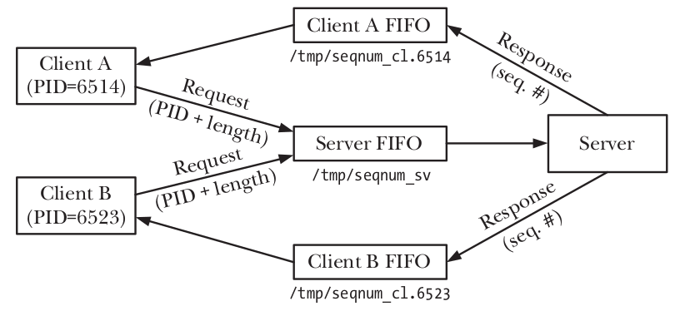



4. FIFOs
A server - multiple client
struct new_client
{
int id;
char fifo_name[32];
char data[128];
};
/tmp/fifo_1
read 164 bytes
write 164 bytes
sizeof(struct new_client) = 164 bytes
/tmp/fifo_server
/tmp/fifo_2
20/22

Slide 21
Synthetic
Pipe | FIFO
Anonymous | Named
pipe() | mkfifo()
File descriptors created directly | Pathname
Usually related processes | Can also be used by unrelated processes
21/22

Slide 22
Thank you for listening...
Embedded Trainees
22/22

Slide 23
2. IPC Overview
Compare:
What do you need to do? | Suitable IPC
The parent sends a byte stream to the child | Pipe
Two processes with no byte stream transfer relationship | FIFO
Send messages with clear boundaries | Message Queue
Send commands / events as messages | Message Queue
Share large amounts of data | Shared Memory
Producer/consumer synchronization | Semaphore
Protecting the critical section | Mutex
Wait a condition occur | Condition Variable
Simple notification | Signal

Slide 24
1. Daemon
Modern steps to create a daemon:
Create service unit
sudo vim /etc/systemd/system/myserver.service
Reload systemd
sudo systemctl daemon-reload
Enable & start
sudo systemctl enable --now myserver
Run service loop
Notify READY
sd_notify("READY=1")
Daemon Initialization
Lifecycle management
systemctl stop myserver
systemctl restart myserver
systemctl enable myserver
systemctl disable myserver
Monitor / Debug
systemctl status myserver
journalctl -u myserver -f
5/22

Slide 25
4. FIFOs
int flags = fcntl(pipefd[0], F_GETFL);
fcntl(pipefd[0], F_SETFL, flags | O_NONBLOCK);
char buf[100];
while (1)
{
int n = read(pipefd[0], buf, sizeof(buf) - 1);
if (n == -1)
{
if (errno == EAGAIN)
{
printf("Pipe is empty\n");
}
}
else if (n > 0)
{
buf[n] = '\0';
printf("Received: %s\n", buf);
}
/* do somthing */
/* check again */
}
Function | Role
mkfifo() | Create an IPC endpoint
open() | Connect the process to the FIFO
read() | Receive data
write() | Send data
close() | Close connect to the FIFO
unlink() | Mark to delete the FIFO name
fcntl() | On/Off O_NONBLOCK
19/22

