Slide 1
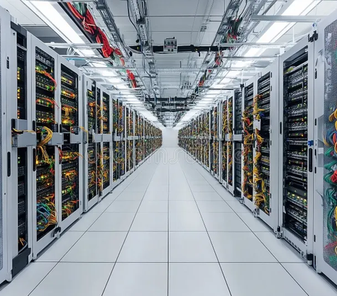

SYSTEM PROGRAMMING
Tạo PPT ngôn ngữ Tiếng Anh về chủ đề: Daemon, IPC overview: Pipe
Daemon Processes and Inter-Process Communication (IPC)
An overview of background processes and data exchange mechanisms in Unix systems.
TOPIC
DATE
FOCUS
IPC & Daemons
October 2026
Technical Deep-dive
System Programming | Daemon & IPC
01 / 13

Slide 2
02
AGENDA
IPC Mechanisms: Overview
Presentation flow and coverage topics.
1
2
3
4
Daemon Fundamentals
Pipes & Streams
Advanced IPC
Best Practices
Lifecycle and role of background processes.
Using pipes, popen, and pclose.
Coprocesses and named pipes (FIFOs).
Risk management and design patterns.
Learning Objective
Understand the core concepts of background processes and standard data exchange techniques.
System Programming | Daemon & IPC
02 / 13

Slide 3

01
DAEMONS
Introduction to Daemons
Long-lived processes running independently of terminal sessions.
NEXT SECTION
Core IPC methods starting with Pipes.
System Programming | Daemon & IPC
03 / 13

Slide 4
04
IPC CONCEPTS
Why Inter-Process Communication?
Facilitating safe data sharing and synchronization.
CORE CHALLENGE
Processes exist in isolated address spaces, necessitating robust communication channels for shared tasks.
Data Sharing
Synchronization
Modularity
Communication
Exchange of status or result sets.
Controlling order of execution.
Decomposing tasks into smaller processes.
Unidirectional vs Bidirectional.
ALIGNMENT GOAL
Select the appropriate IPC mechanism based on the relationship between processes.
System Programming | Daemon & IPC
04 / 13

Slide 5
5
Tạo PPT ngôn ngữ Tiếng Anh về chủ đề: Daemon, IPC overview: Pipe
Data Flow in IPC
Visualization of component interactions.
Process A
Channel
Process B
Feedback
Data Source
Pipes/FIFOs
Data Sink
Status signals
Control
Observability
Ownership
Signals and locks.
Logging and monitors.
Responsible process.
System Programming | Daemon & IPC
05 / 13

Slide 6
06
PIPES
Standard Pipes
Unidirectional byte-stream interface.
Pipes (pipe)
Coprocesses
Simplest IPC mechanism.
• Unidirectional
• Requires related processes
• Byte stream based
Extended pipe usage.
• Bidirectional support
• Requires two pipe pairs
• Complex setup
LIMITATION
Pipes are limited to communication between related processes (e.g., parent/child).
System Programming | Daemon & IPC
06 / 13

Slide 7


7
FUNCTIONS
Using popen and pclose
Stream-based pipe convenience functions.
1
popen
2
Stream
3
pclose
Creates pipe, forks, executes shell.
Return file pointer for reading/writing.
Closes stream and waits for process exit.
System Programming | Daemon & IPC
07 / 13

Slide 8
08
ADVANCED IPC
Coprocesses
Expanding pipe capabilities.
01
02
03
04
05
Parent initiates
Pipe pair
Process Forking
and exec
Data I/O
Loop
Synchronization
Logic
Termination
Sequence
CONCEPT
REQUIRMENTS
A coprocess allows a program to send input to another process and receive the output synchronously.
Managed by two unidirectional pipes to achieve bidirectional flow.
System Programming | Daemon & IPC
08 / 13

Slide 9
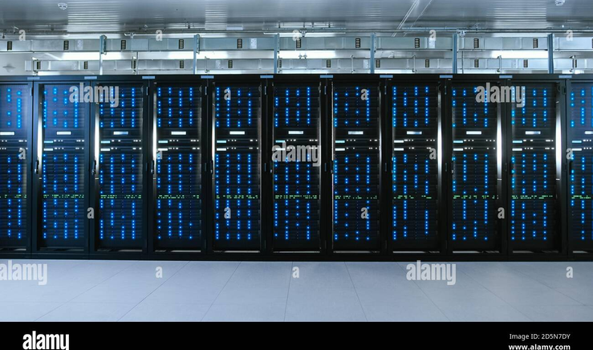

9
FIFOS
FIFOs: Named Pipes
Persistent communication paths.
Filesystem Path
Exposes pipe as a file for unrelated access.
Persistence
Exists even when no processes are connected.
Access Control
Uses standard file permissions.
System Programming | Daemon & IPC
09 / 13

Slide 10
10
TABLE
IPC Characteristics
Comparison of communication mechanisms.
Method | Relationship | Persistence | Complexity
Pipe | Related | No | Low
FIFO | Unrelated | Yes | Medium
Coprocess | Related | No | High
popen | Related | No | Low
MAIN INSIGHT
Choose based on process relationship (Pipes) or global accessibility (FIFOs).
COMPLEXITY
Coprocesses add significant overhead.
STANDARD
POSIX compliant APIs.
System Programming | Daemon & IPC
10 / 13

Slide 11
11
RISKS
Risks and Best Practices
Safe management of IPC communication.
Risk | Likelihood | Impact | Owner | Mitigation
Deadlock | Medium | High | Developer | Order I/O
Leaked Pipes | High | Medium | Developer | Close on exit
Blocking | Medium | Medium | System | Non-blocking I/O
Buffer Overflow | Low | High | Developer | Size checks
ESCALATION TRIGGER
Deadlocks or hanging processes indicate incorrect pipe management.
System Programming | Daemon & IPC
11 / 13

Slide 12
12
Tạo PPT ngôn ngữ Tiếng Anh về chủ đề: Daemon, IPC overview: Pipe
Summary Takeaways
Key concepts to remember.
1
2
3
Process Decoupling
Pipe Efficiency
FIFO Utility
Daemons thrive in decoupled systems.
Use pipe/popen for simple streams.
Named pipes for unrelated processes.
CORE LESSON
Select IPC by relationship scope. Maintain lifecycle hygiene.
System Programming | Daemon & IPC
12 / 13

Slide 13
13
Tạo PPT ngôn ngữ Tiếng Anh về chủ đề: Daemon, IPC overview: Pipe
Next Steps
Putting theory into practice.
RECOMMENDATION
Review manual pages for specific API parameters and implement non-blocking I/O.
Read Manuals
Error Handling
Testing
API documentation.
Robust cleanup logic.
Verify pipe closure.
RESOURCES
APUE (Advanced Programming in the UNIX Environment), man pages.
System Programming | Daemon & IPC
13 / 13

