Slide 1
Embedded Linux Overview, Cross-compilation,
Boot Process
Presenter: Nguyen Manh Hung
Date: 29/10/2026
Embedded Trainees
1/20

Slide 2
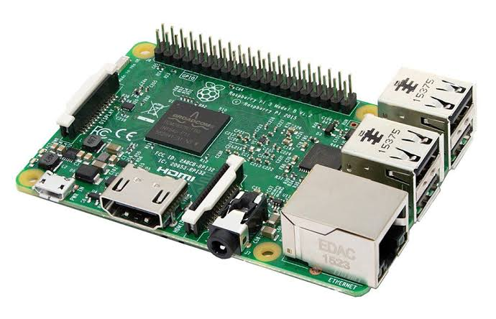
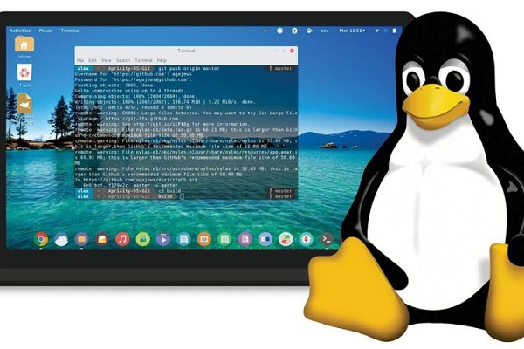

PROBLEM STATEMENT
Linux Computer
Raspberry pi 3 Model B
2/22
Notes:
I would like to propose a project: building an embedded system for the Raspberry pi 3. This involves using my own computer to develop the toolchain, kernel, and root filesystem, and subsequently booting the system on the actual hardware.

Slide 3
OVERVIEW
1
2
3
Embedded Linux Overview
Cross-compilation
Boot Process
What is Embedded Linux?
Components of an embedded Linux system.
What is cross-compilation?
Why we need it?
Detail build the cross-compilation.
What does a toolchain consist of?
Choosing a C library: glibc, uClibc-ng, or musl?
The entire startup process.
Linux kernel, Device Tree and root filesystem.
What does U-Boot do?
2/22

Slide 4
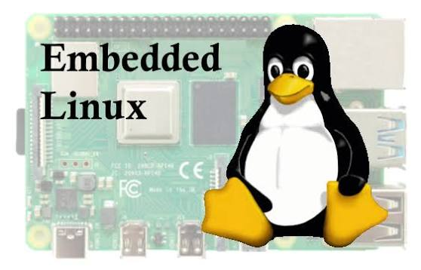
01
Embedded Linux Overview
What is Embedded Linux?
Components of an embedded Linux system.
3/22

Slide 5
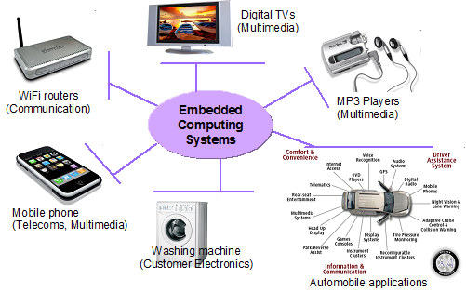
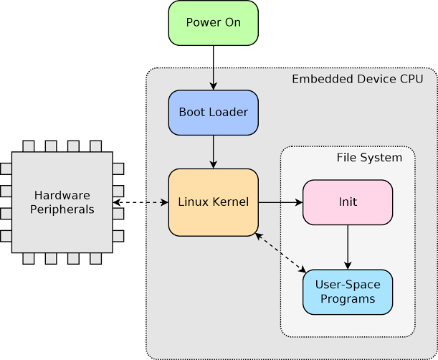
1. Embedded Linux Overview
What is Embedded Linux?
Embedded Linux is a version of the Linux operating system that has been customized and streamlined to run on embedded systems.
Common Practical Applications:
Components of an embedded Linux system.
4/22

Slide 6


1. Embedded Linux Overview
How can I use an Ubuntu machine to create software that will run on a Raspberry pi?
Characteristic | Ubuntu PC (Host) | Raspberry pi 3 B (Target)
Device | Ubuntu computer | Raspberry Pi 3 Model B
CPU | x86-64 | ARM Cortex-A53
Software architecture | x86-64 | AArch64
Role | Compiling software | Running software
Operating system | Ubuntu 22.04 | Linux for ARM64
4/22

Slide 7
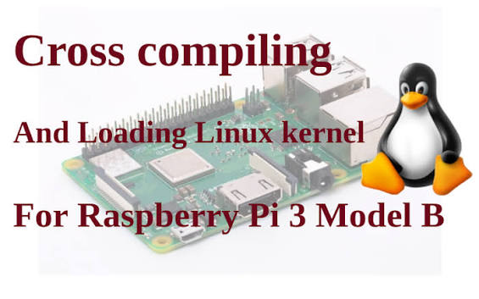
02
Cross-compilation
Cross-compilation: How can an x86-64 Ubuntu machine build programs that run on an ARM64 Raspberry Pi?
What is cross-compilation?
Why we need it?
Detail build the cross-compilation.
What does a toolchain consist of?
Choosing a C library: glibc, uClibc-ng, or musl?
7/22

Slide 8
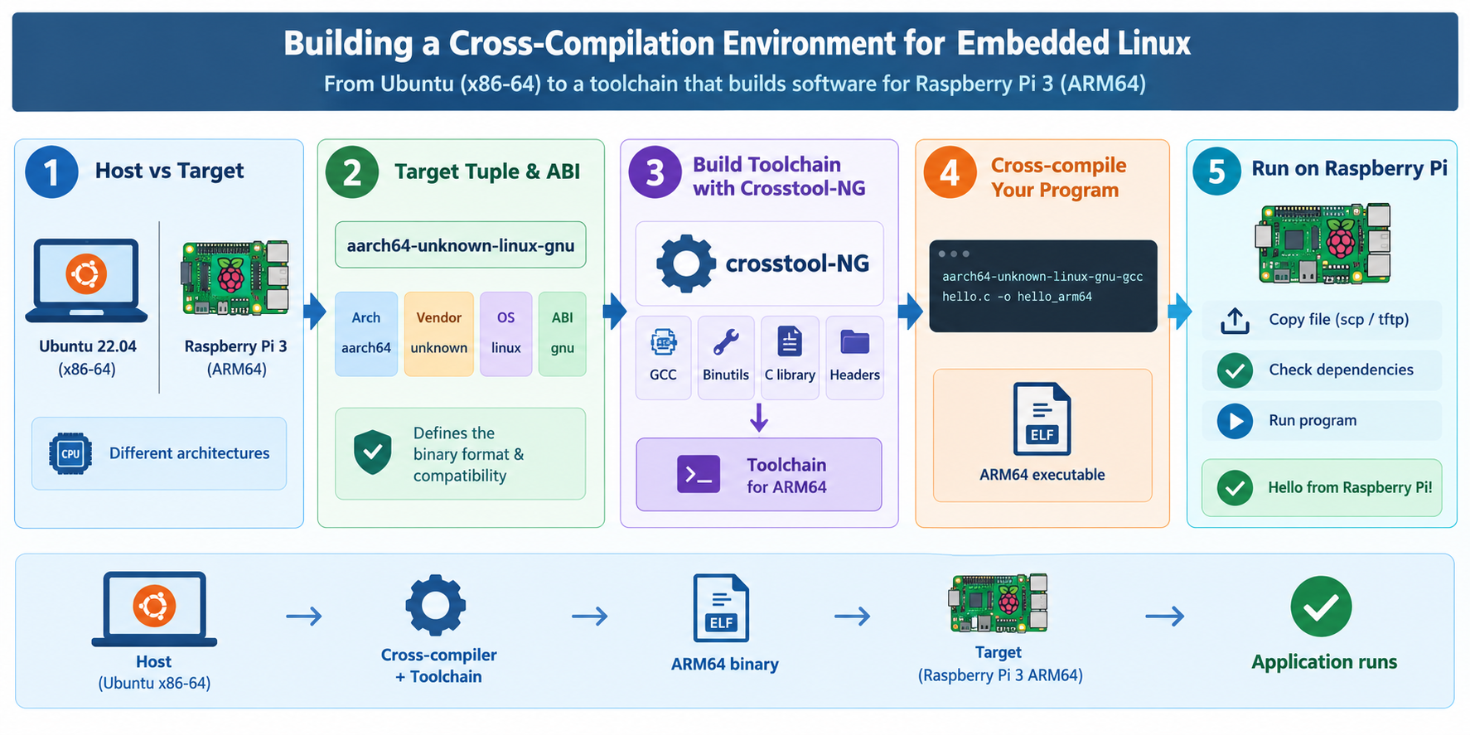
2. Cross-compilation
2.1 What is cross-compilation?
Cross-compilation is the process of compiling software on one system to produce executable code for a different target system.
8/22

Slide 9
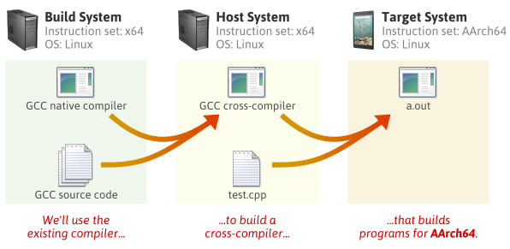
2. Cross-compilation
2.2 build - host - target
Dumping internal crosstool-NG configuration
Building a toolchain for:
build = x86_64-pc-linux-gnu
host = x86_64-pc-linux-gnu
target = aarch64-unknown-linux-gnu
8/22

Slide 10
2. Cross-compilation
2.3 target tuple: ( <arch>-<vendor>-<os>-<abi> )
Component | Meaning | Common Value
Architecture | 64-bit ARM CPU | arm, aarch64, riscv64, mips, x86_64
Vendor | No specific vendor specified | none, unknown, pc, poky, buildroot
OS | Linux operating system | linux, none (bare-metal), w64
ABI/environment | GNU/Linux environment, typically associated with glibc | gnu, gnueabihf (hard-float), eabi, musl,
Example: aarch64-unknown-linux-gnu
8/22

Slide 11
2. Cross-compilation
2.4 Choosing a cross-compilation setup approach:
a. Use a ready-to-use cross-compiling toolchains
Toolchain | Target architecture | Example use case
aarch64-linux-gnu-gcc | ARM64 / AArch64 | Raspberry Pi running 64-bit Linux
arm-linux-gnueabihf-gcc | ARM 32-bit, hard-float | Raspberry Pi running 32-bit Linux
arm-linux-gnueabi-gcc | ARM 32-bit, soft-float ABI | Older ARM Linux systems
arm-none-eabi-gcc | ARM bare-metal | STM32, firmware not running Linux
Advantages:
Quick to set up.
No need to manually build GCC, binutils, or the C library.
Well-suited for learning how to cross-compile C applications.
Disadvantages:
Difficult to maintain full control over the versions and configurations of individual components.
The toolchain may be incompatible with the runtime environment of a specific target if not carefully verified.
Not an optimal choice if the project requires a custom, precisely reproducible build environment.
8/22

Slide 12
2. Cross-compilation
b. Building a custom toolchain using Crosstool-NG
What is Crosstool-NG?
Crosstool-NG is a toolchain generator that automates the process of building cross-compilation toolchains.
Components of a toolchain:
GCC — Compiler
Binutils — Tools for processing machine code
C library — API environment for applications
Sysroot — Target development environment
Common options:
glibc: suitable when the GNU/Linux ecosystem and broad compatibility are required.
musl: a lightweight C library, typically used in systems designed for minimalism.
uClibc-ng: an option geared toward embedded environments with specific requirements.
sysroot/
usr/
include/
lib/
8/22
lib/

Slide 13
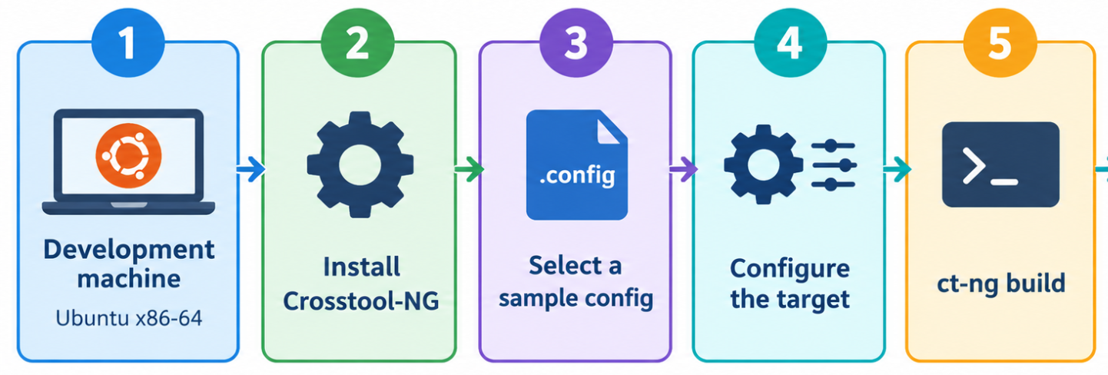

2. Cross-compilation
b. Building a custom toolchain using Crosstool-NG
Result cross-compilation toolchain: aarch64-unknown-linux-gnu
8/22

Slide 14
2. Cross-compilation
2.5 Run on Raspberry pi 3 B
Run example code:
Compile program to ARM: aarch64-unknown-linux-gnu-gcc hello.c -o hello_arm64
#include <stdio.h>
int main(void)
{
printf("Hello, Raspberry Pi!\n");
return 0;
}
Run on computer ubuntu:
Run on Raspberry pi 3 B:
After we have the cross-compilation toolchain, how do we build the Linux Operating System for Raspberry pi 3?
8/22

Slide 15
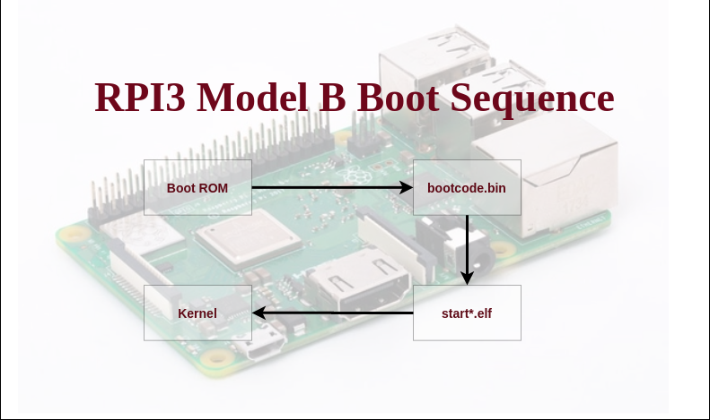
03
Boot Process
The boot process: How does the CPU go from power-on to the appearance of a Linux shell?
The entire startup process.
Linux kernel, Device Tree and root filesystem.
What does U-Boot do?
7/22

Slide 16
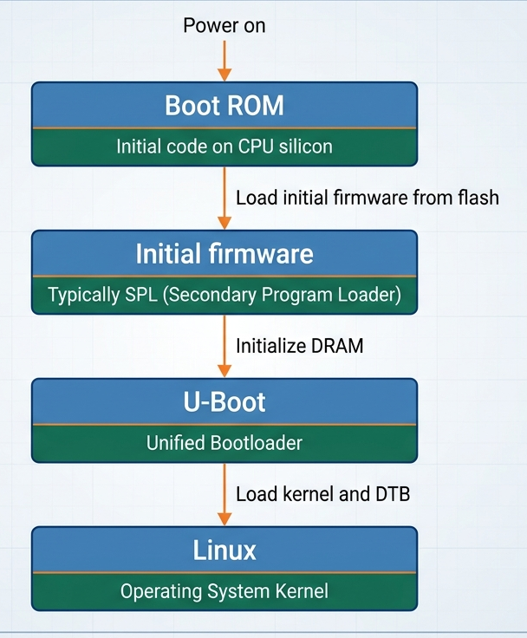
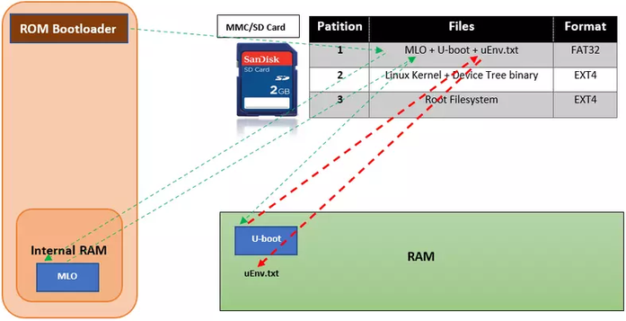
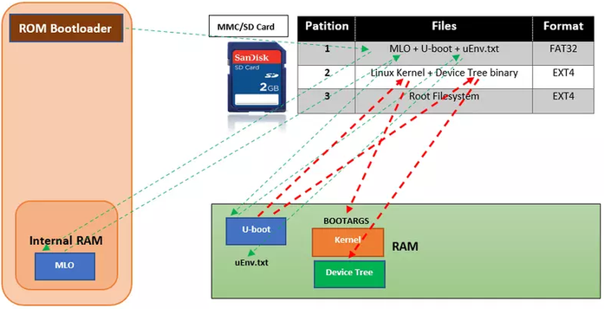
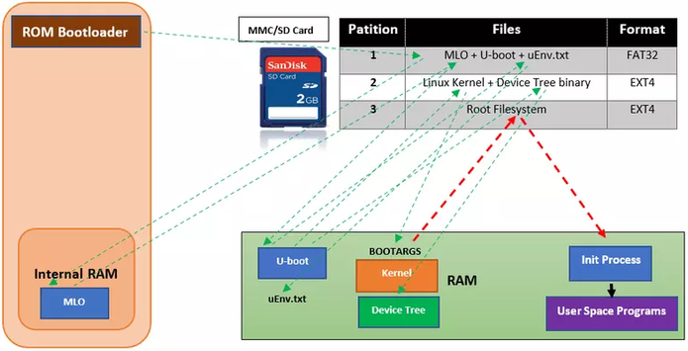
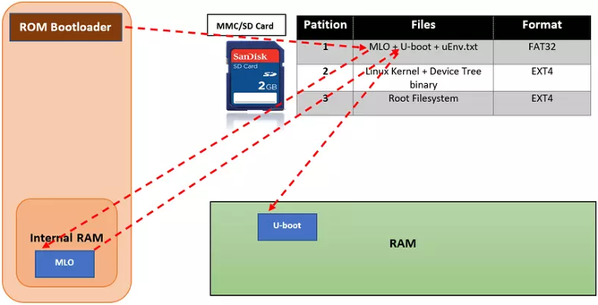
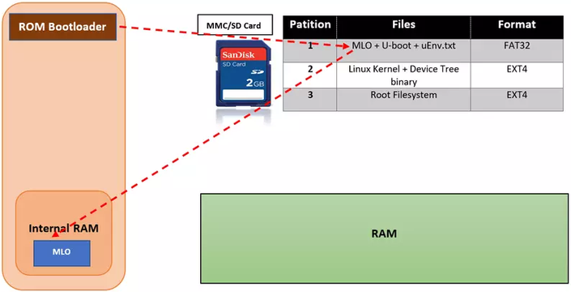
3. Boot Process
13/22

Slide 17

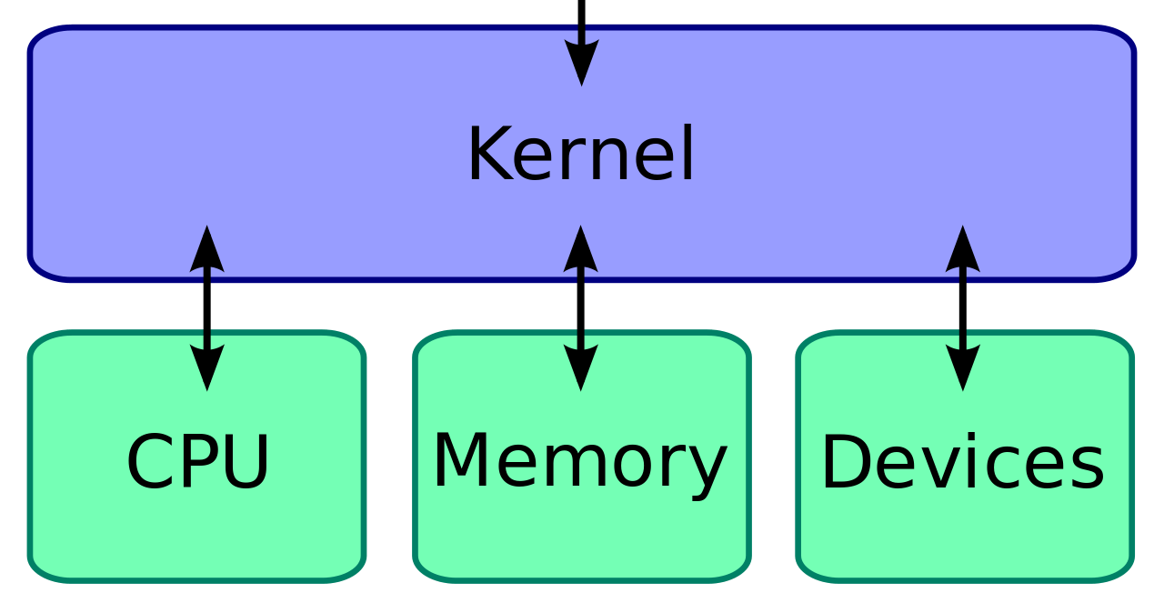

3. Boot Process
Linux Kernel
What is the role of the kernel?
The Linux kernel is the core component of the operating system.
13/22

Slide 18
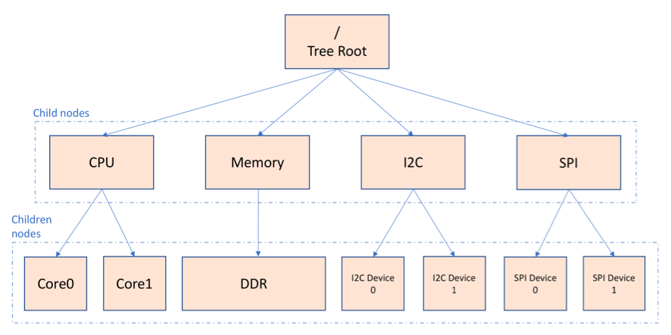
3. Boot Process
Device Tree
The kernel needs to know which hardware devices exist and how to access them.
A Device Tree describes information such as:
Address ranges and hardware resources.
UART, GPIO, Ethernet, and various buses.
Declared peripheral devices.
Information used by the kernel to select and initialize the appropriate drivers.
13/22

Slide 19
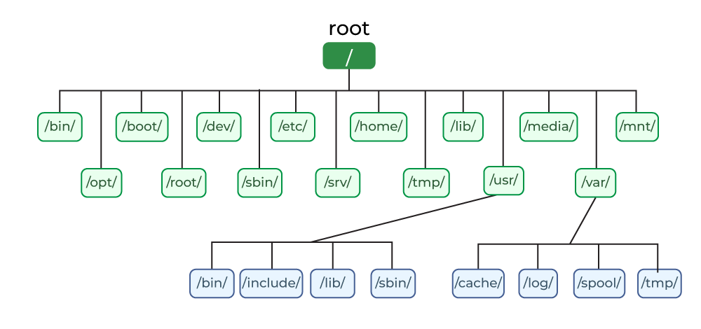
3. Boot Process
Root Filesystem (rootfs)
What is a rootfs?
A root filesystem is the directory tree that the kernel uses as the root directory (/) after it has been successfully mounted. It contains the programs, libraries, configuration files, and components necessary to transform the kernel into a functional, usable system.
13/22

Slide 20
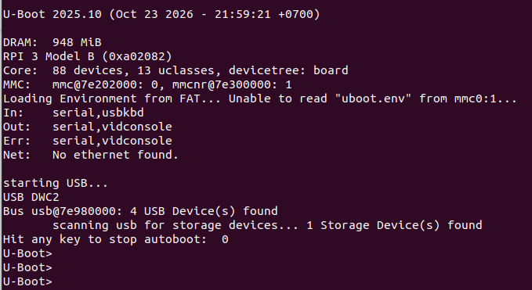
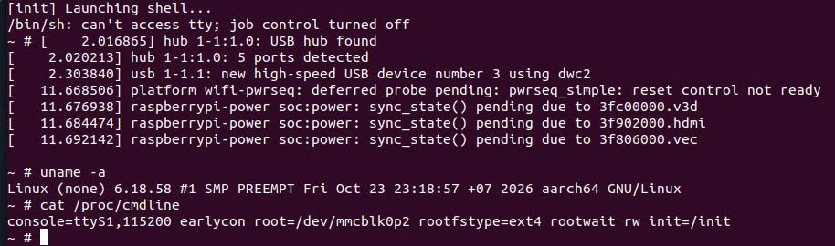
Result the Simple Linux running on Raspberry pi 3 B
After building the U-Boot, kernel, device tree, and root filesystem using a cross-compilation toolchain, we can load these components onto an SD card and proceed with the boot process.
13/22

Slide 21
Thank you for listening...
Embedded Trainees
22/22

