Slide 1
AI Projects
Delivering an ML/AI Strategy, AI for Business Leaders, Udacity
Ngo Minh Hung, 09 - 2022

Slide 2
Executive Summary
Purpose of Projects
Projects for a better future for people.
I study these projects to learn how to be a future business leader.
Methodology
Analysis conducted over _____5____ weeks
Over _3__ potential use cases underwent thorough assessment for feasibility and impact
Incorporated both technical knowledge and user feedback
Path Forward
__2_ use cases identified for implementation
Needs and requirements to be successful
Next steps

Slide 3
I began with five use case ideas
Quality Control Tool
Model of Modern Quality Control System
------------------------------------------
Car Charger Model
Models of electric car charging stations
------------------------------------------
Facial Recognition Technology
Model of Facial Recognition Technology
------------------------------------------
Machine Maintenance Model
Model of Machine Maintenance System
------------------------------------------
Engine Check Light System
Model of Engine Check Light System
------------------------------------------

Slide 4
I assessed feasibility vs. impact for all cases
Key criteria assessed
UC1:<Quality Control Tool>
UC2:<Facial Recognition Technology>
UC3:<Engine Check Light System>
UC4:<Car Charger Model>
UC5:<Machine Maintenance Model>
UC 4
UC 1
UC 2
Impact
UC 5
UC 3
Feasibility

Slide 5
Transforming our business using ML/AI with these top two use cases
Car Charger Model
Models of electric car charging stations
Quality Control Tool
Model of Modern Quality Control System
By executing on these two projects I believe we can drive ___growth values________ for our business by _smart models______ and become a(n) ____successful___ business.

Slide 6
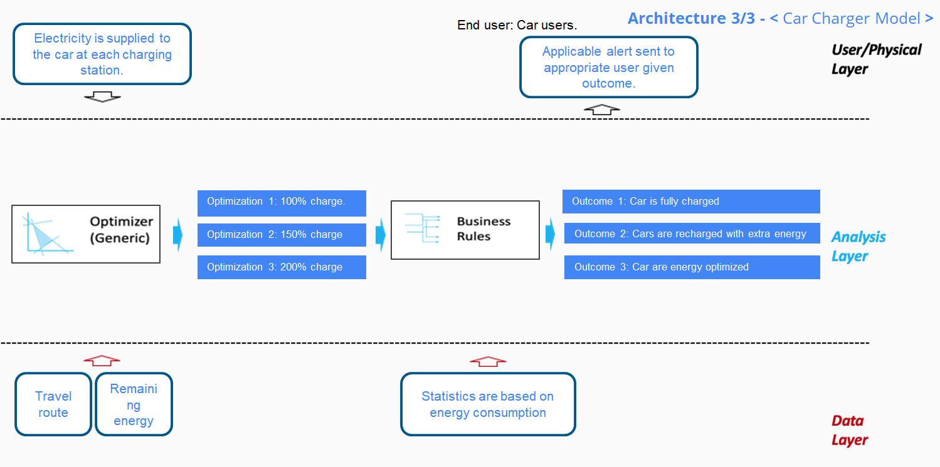
_____Car Charger Model_____(Use case) Deep Dive
Process Today
Specify input values.
- Analyze the inputs, then identify the right model.
Set up a simple initial architecture.
Process Tomorrow
- Analyze Business Rules.
- Analyze the outcomes and outputs.
- Architectural finishing.
The impact of this model will be significant thanks to the network of modern electric charging stations!

Slide 7
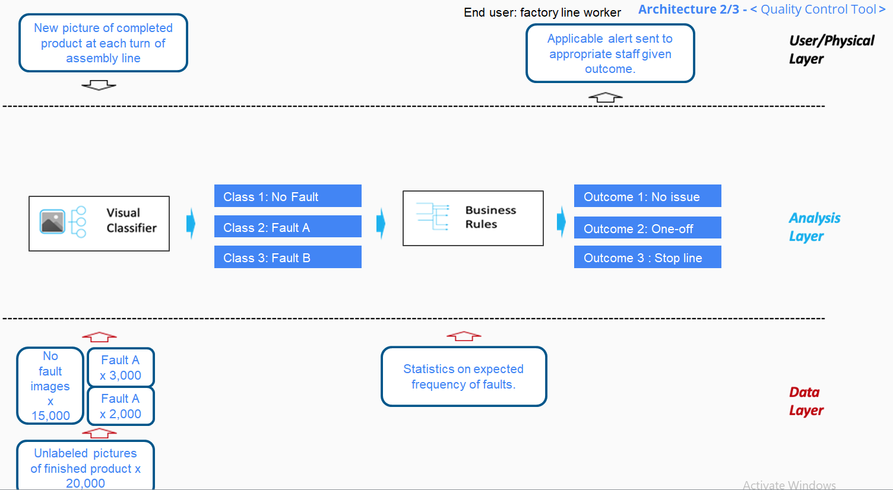
____Quality Control Tool______(Use case) Deep Dive
Process Today
Specify input values.
- Analyze the inputs, then identify the right model.
Set up a simple initial architecture.
Process Tomorrow
- Analyze Business Rules.
- Analyze the outcomes and outputs.
- Architectural finishing.
The impact of this model will be very significant thanks to modern camera systems and data from satellites!

Slide 8
Risks/Mitigations
 | Car Charger Model | Quality Control Tool
Accuracy Definition | Concerns: The accuracy of the Car Charger Model is quite high, so there is not much to worry about in this case. Plan: Maintain the stability of the accuracy of this model. | Concerns: The accuracy of the Car Charger Model is quite high, so there is not much to worry about in this case. Plan: Maintain the stability of the accuracy of this model.
Underfitting/Overfitting Definition | Concerns: Underfitting Plan: It is not simply a matter of whether cars are charged with electricity (sustainable energy) or gasoline (unsustainable energy). In the future, sustainable energy should be added more water or wind power for vehicles. | Concerns: Overfitting Plan: Image data collected from cameras and satellites can become too complex to detailed. This problem will add time to quality management leading to costly expenses. Satellites may not be needed to reduce costs.
Ethical Concerns Definition | Concerns: The most affected party are the traditional petrol refueling agents. Plan: It takes time and a clear plan to transition the sustainable energy model, from petrol to electric power. | Concerns: Stakeholders are companies or small and medium enterprises. These companies lack the necessary resources and resources to provide a sufficient number of quality cameras for the product quality assurance process. Plan: The win-win cooperation between small businesses and larger ones, will boost the country's technological development.

Slide 9
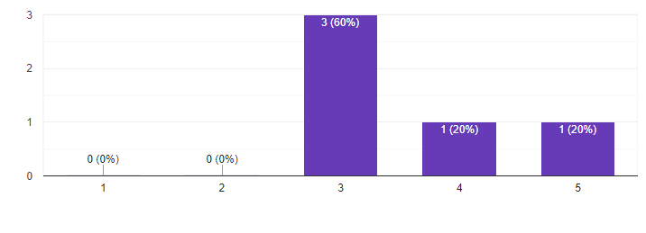
Feedback Thus Far
Illustrative Verbatim Quotes
Proposed Next Steps
Proposed next step 1: Analyze responses.
Proposed next step 2: Finalize the model based on the feedback.
“Powering electric vehicles will become easier.”
“Use Case 1 will open a new era of development in the electric car industry.”
“The network of electric charging stations is designed in a smart and modern way.”
Proposed Timeline
Illustrative Visualization
Month 1
Deliverable 1
Deliverable 2
Month 2
Deliverable 1
Deliverable 2
Month 3
Final Deliverable

