Slide 1
AI For Business Leaders Course
Project Steps: Delivering an ML/AI Strategy

Slide 2
AI for Business Leaders
Project Step 2C
First Prioritization Grid

Slide 3
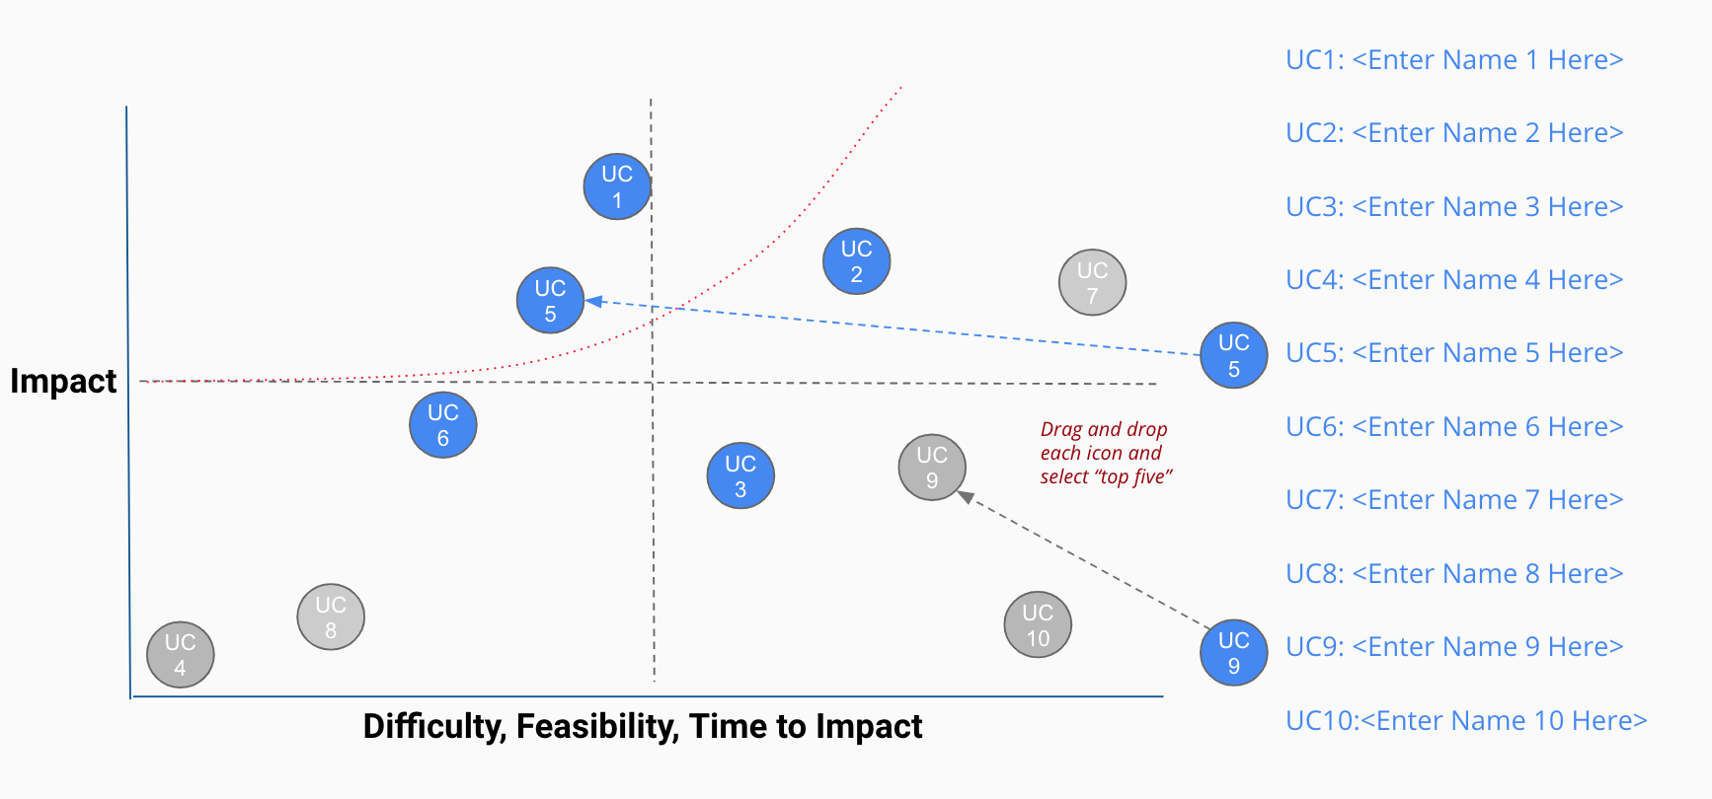
Your First Prioritization Grid
DIRECTIONS: For each of your use cases, review your answers to the 5V questions in Step 2A, and the operations you chose in Step 2B.
Then on the grid on the next slide, not this slide, move each blue use case icon to a place indicating how you see this use case’s impact and feasibility.
(Recall that the upper right quadrant is usually the most desirable, as it indicates we expect higher feasibility and greater impact.)
UC 2
Drag and drop icons for each use case
Remember to think about both axes!

Slide 4
First Prioritization Grid
(Follow directions on previous slide)
high
UC1: <Quality Control Tool>
UC 1
UC2: <Facial Recognition Technology>
UC 4
UC 2
UC3: <Engine Check Light System>
Impact
UC 5
UC4: <Car Charger Model>
UC5: <Machine Maintenance Model>
UC 3
low
low
Feasibility
high

Slide 5
Now Prioritize and Eliminate Three Use Cases
1) Review the locations of your use cases on the grid on the previous slide. Remember we want to prioritize use cases for AI and ML that offer the greatest impact for the least difficulty.
2) Now in the grid on the previous slide change the color from blue to grey for two use case circles you want to de-prioritize.
3) This leaves your top three use cases in blue that you want to move forward with in the rest of the project.

Slide 6
Nice work, you’ve completed Step 2C of the project!

Slide 7
AI for Business Leaders
Project Step 3
Architectures for Top 3 Use Cases

Slide 8
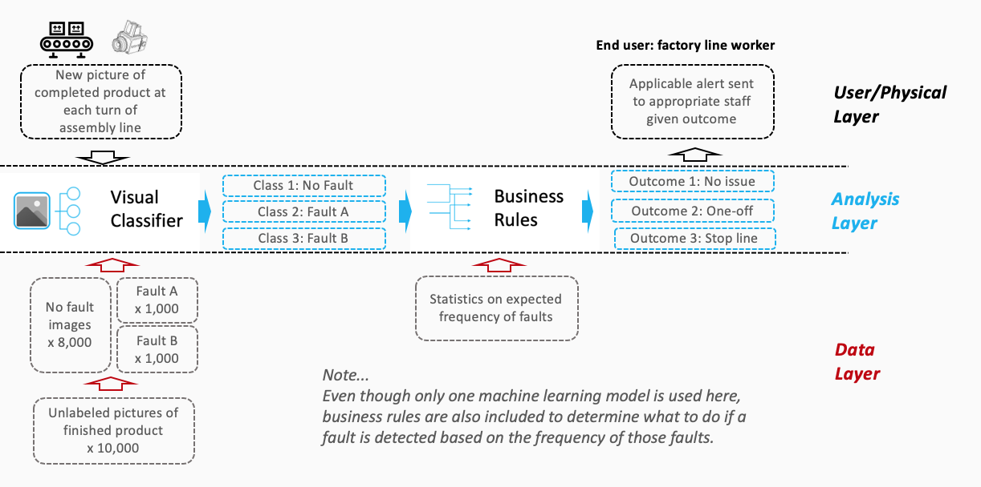

Creating High Level Architectures
Sample Completed Architecture
For the top three use cases you prioritized in Project Step 2C, you’ll now create a high level architecture for each, on slides 10-12.
For this step, be sure to review Lesson 3 but also recognize that this process allows significant creative freedom.
Keep a focus on… - Data flow/direction - Clear view on inputs/outputs - Simplicity
Write the use case name at the top of each slide.
Do all work on slides 10-12:
Copy and paste capabilities from slide 9 into Analysis Layer
Identify relevant User/Physical and Data Layer attributes
Copy and paste arrows from slide 9 to show data flow, input/output
Use annotations to help explain difficult concepts

Slide 9
















Your AI/ML Toolkit - List of Capabilities
Generic ML Capabilities
Natural Language Processing
Voice/Speech Processing
Computer Vision
Other Capabilities
Drawing Tools
User/Physical Layer
Analysis Layer
Data Layer

Slide 10
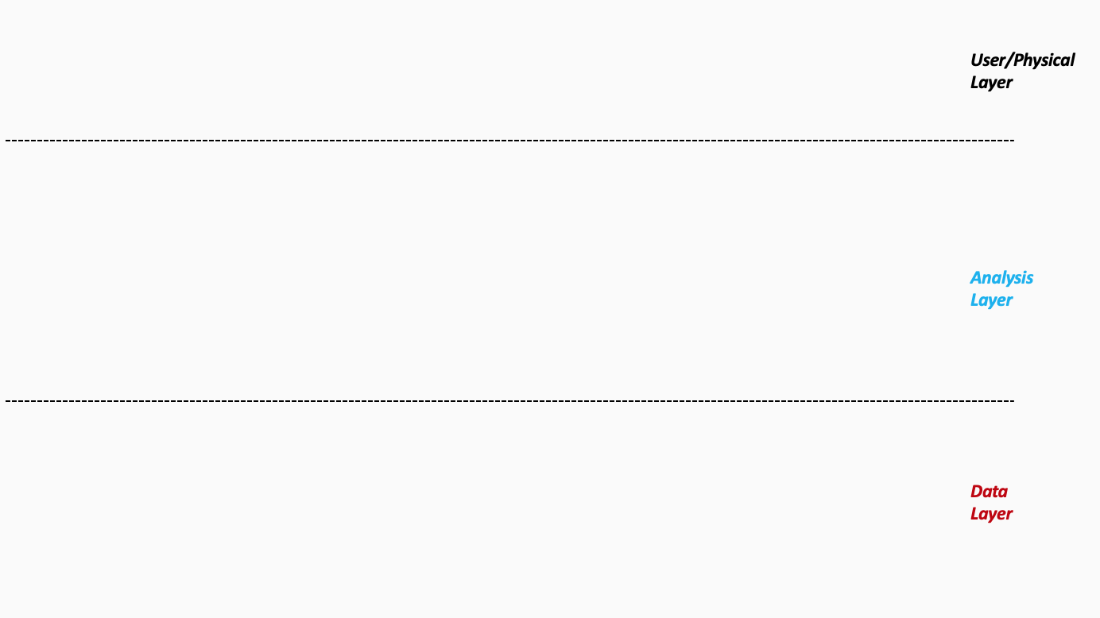

Recognition 1: No Fault
Architecture 1/3 - < Facial Recognition Technology >
A new image of each face is determined at each recognition.
End user: Car users.
Applicable alert sent to appropriate user given outcome.
Outcome 1: No issue
Recognition 2: Fault A
Outcome 2: One-off
Recognition 3: Fault B
Outcome 3: Stop line
No fault images x 10,000
Fault A x 1,000
Statistics on expected frequency of faults.
Fault B x 1,000
Unlabeled images of each face x 12,000
Notes:
Please follow the directions on slide 8. Copy and paste the desired icons provided you on slide 9 onto this page.

Slide 11
End user: factory line worker
Architecture 2/3 - < Quality Control Tool >
New picture of completed product at each turn of assembly line
Applicable alert sent to appropriate staff given outcome.
Class 1: No Fault
Outcome 1: No issue
Class 2: Fault A
Outcome 2: One-off
Class 3: Fault B
Outcome 3 : Stop line
No fault images x 15,000
Fault A x 3,000
Statistics on expected frequency of faults.
Fault A x 2,000
Unlabeled pictures of finished product x 20,000
Notes:
Please follow the directions on slide 8. Copy and paste the desired icons provided you on slide 9 onto this page.

Slide 12
Architecture 3/3 - < Car Charger Model >
End user: Car users.
Electricity is supplied to the car at each charging station.
Applicable alert sent to appropriate user given outcome.
Optimization 1: 100% charge.
Outcome 1: Car is fully charged
Optimization 2: 150% charge
Outcome 2: Cars are recharged with extra energy
Optimization 3: 200% charge
Outcome 3: Car are energy optimized
Travel route
Remaining energy
Statistics are based on energy consumption
Notes:
Please follow the directions on slide 8. Copy and paste the desired icons provided you on slide 9 onto this page.

Slide 13
Excellent, you’ve completed Step 3 of the project!

Slide 14
AI for Business Leaders
Project Step 4C
Second Prioritization Grid

Slide 15
Your Second Prioritization Grid
Based on new information from your further analyses of your use cases in step 4A and 4B, you’ll engage in the same exercise as you did before in Step 2C to update your prioritization.
Move onto the grid the three use cases that you have been working with in steps 4A and 4B.
You MAY choose different use cases and shift your focus, if you feel these exercises have caused you to significantly revise your prior evaluations.
UC 2
Drag and drop icons for each use case
Remember to think about both axes!

Slide 16
Second Prioritization Grid
high
UC 4
UC1: <Quality Control Tool>
UC 1
UC2: <Facial Recognition Technology>
UC 2
UC3: <Engine Check Light System>
Impact
UC 5
UC4: <Car Charger Model>
UC5: <Machine Maintenance Model>
UC 3
low
low
Feasibility
high

Slide 17
Now Prioritize and Eliminate One More Use Case
1) Review the locations of your use cases on the grid on the previous slide. Remember we want to prioritize use cases for AI and ML that offer the greatest impact for the least difficulty.
2) Now in the grid on the previous slide change the color from blue to grey for one use case circle you want to de-prioritize.
3) This leaves your top two use cases in blue that you want to move forward with in the rest of the project. But you may still change these later.

Slide 18
Terrific, you’ve completed Step 4C of the project!

Slide 19
AI for Business Leaders
Project Step 5
Operational Considerations:
Accuracy, Bias, and Ethics

Slide 20
Accuracy, Bias, and Ethics Concerns
For each of your two remaining use cases, on the next two slides please write 2-3 paragraphs discussing how success will be measured and monitored.
Start by focusing on how model effectiveness would be measured, and speak to what success would look like.
Comment on any other operational concerns, including bias in the data, or ethical limitations, that could influence success.
For each concern you raise, comment on how you would measure or monitor this concern on an ongoing basis.

Slide 21
First Use Case
Car Charger Model
Models of electric car charging stations have been successful in the world, typically Tesla's smart charging station model.
By focusing on a network of convenient and smart charging stations that are present in almost any of your familiar destinations on the map: coffee shops, grocery stores, fast food stores,... Now , the worries about powering your car on your journey are gone.
The actual numbers can be easily seen when you go to Tesla's website, there are over 35000 Global Superchargers and the same number for Wall Connectors at Destination Charging Sites : https://www.tesla.com/charging. And this number will continue to grow over time. It is a clear demonstration of the future development of the electric car industry.
There is no ethical limitations to this model for success. The data collected from past electric charges can help optimize the car's power supply for future recharges.

Slide 22
Second Use Case
Quality Control Tool
The quality control of the production stage of products is no longer a strange thing in today's modern industry.In particular, in the production process of self-driving cars, we need a more modern and complex model.
More specifically, it is a quality management monitoring system using multiple cameras and data from satellites. This model uses "Computer Vision", a part of AI, through which it is easy to identify the smallest possible errors when a quality product is born.
The state-of-the-art camera system is equipped to show thousands of photos of the finished product, both defective and not: can reach a "good deal".
There is no ethical limitations to this model for success. Data is collected by cameras and satellites, thereby minimizing micro-errors from random sampling of traditional materials.

Slide 23
Well done! You’ve completed Step 5 of the project!

Slide 24
AI for Business Leaders
Project Step 6B
Feedback and Final Prioritization Grid

Slide 25
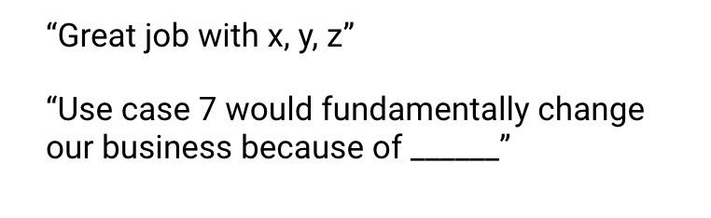
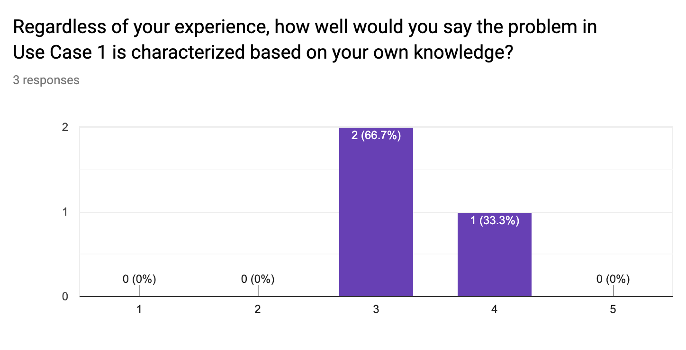
Feedback Visualization
Verbatim Quote Example
Depending on how you chose to gather feedback -- survey, phone call, etc. -- you will have a mix of quantitative and qualitative results.
Use the following pages to document your key takeaways in the form of verbatim quotes and visualizations.
For verbatim quotes, you should use direct quotes that indicate the support and critiques you encountered.
For visualizations, feel free to use the graph provided in your Google Form.
Visualization Example

Slide 26
Verbatim Quotes - <Car Charger Model>
“Powering electric vehicles will become easier.”
“Use Case 1 will open a new era of development in the electric car industry.”
“The network of electric charging stations is designed in a smart and modern way.”

Slide 27
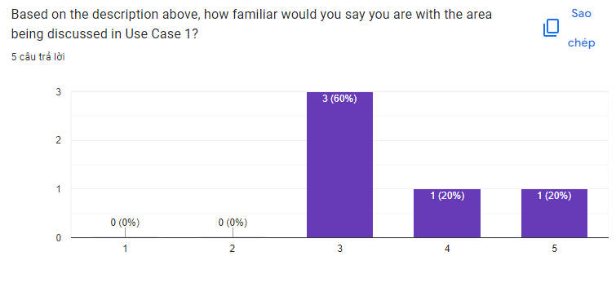
Visualization - <Car Charger Model>
Copy/paste or create any relevant graphics here

Slide 28
Verbatim Quotes - <Quality Control Tool>
“More precise and efficient quality control process.”
“Use Case 2 will help the quality control process to be more optimized.”
“Intelligent quality control system will help to produce more quality products.”

Slide 29
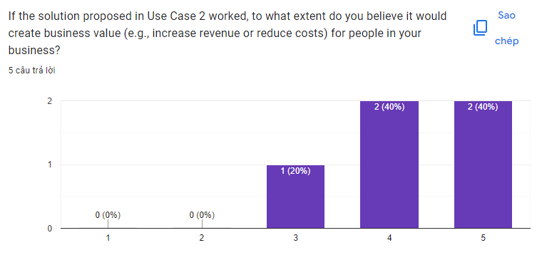
Visualization - <Quality Control Tool>
Copy/paste or create any relevant graphics here

Slide 30
Your Final Prioritization Grid
Based on the feedback you’ve gathered, and all of the previous information for each use case, you’ll now engage in the same prioritizing exercise as you have twice before.
You MAY choose to re-prioritize use cases and shift your focus if you feel these exercises have caused you to significantly revise your prior evaluations.
At the end of this exercise, you should have a final point of view on the use cases you’ll advocate in your ML/AI strategy!
UC 2
Drag and drop icons for each use case
Remember to think about both axes!

Slide 31
Final Prioritization Grid
high
UC 4
UC1: <Quality Control Tool>
UC 1
UC2: <Facial Recognition Technology>
UC 2
UC3: <Engine Check Light System>
Impact
UC 5
UC4: <Car Charger Model>
UC5: <Machine Maintenance Model>
UC 3
low
low
Feasibility
high

Slide 32
Nice work, you’ve completed Step 6B of the project!

