Slide 1




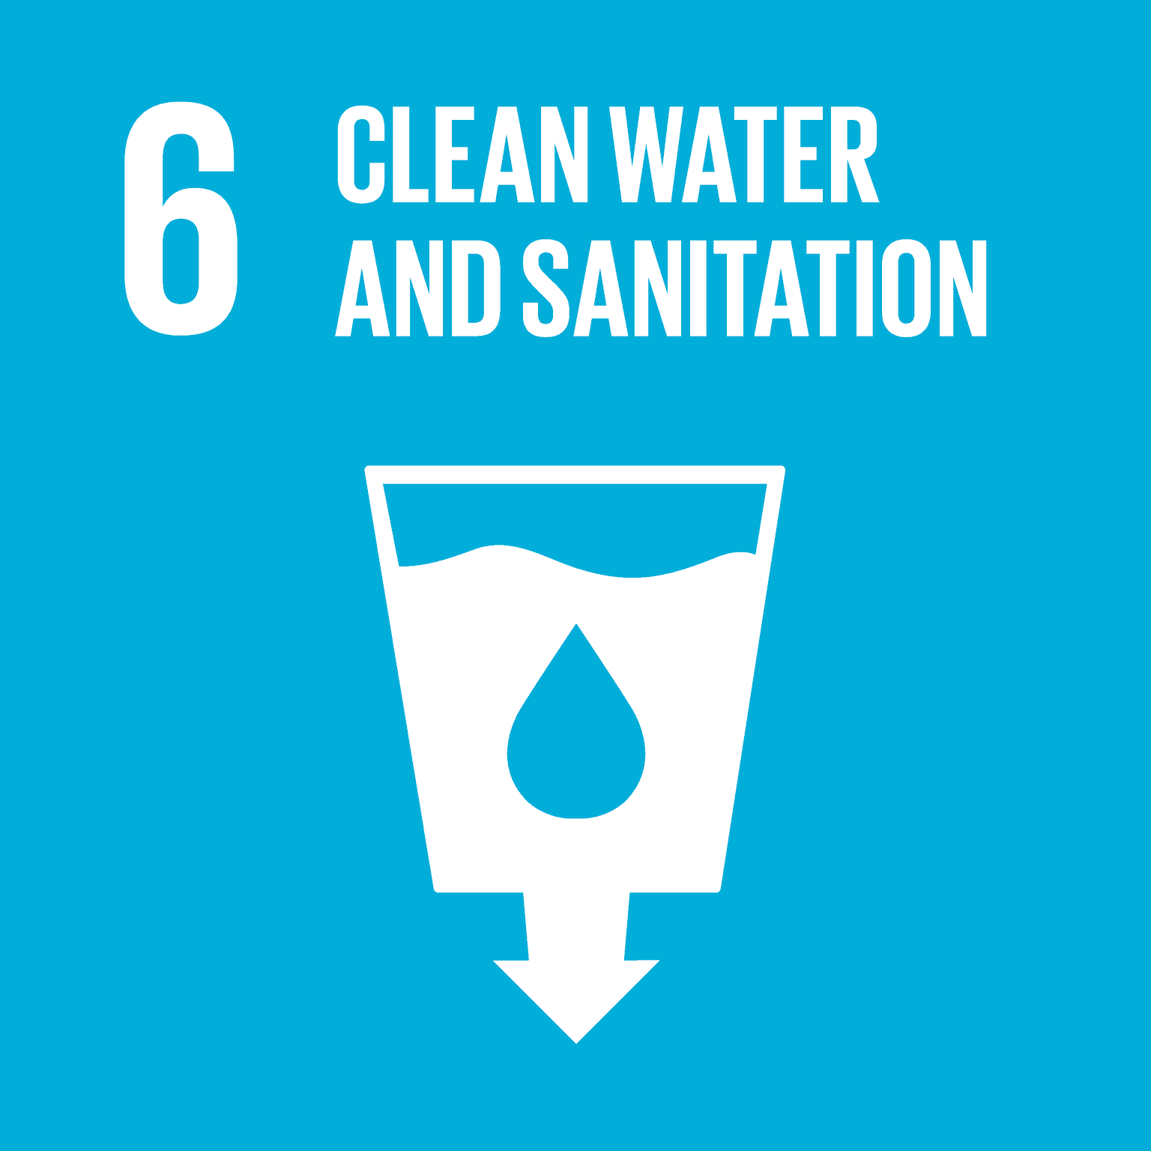
URBAN SLUMS INCLUSION: A DIGITALIZED APPROACH FOR BETTER SANITATION ACCESS Halting slums’ continuum through low-cost digitalized footprints to improve sanitation access
Team Name: Sparrows
Team Members: Nguyen Thanh Hung – Nguyen Gia Khanh
Institution: RMIT University Vietnam
Country: Vietnam
Targeted UN SDGs
Notes:
Honorable judges and distinguished guests,
Fifteen years ago, when attending a kindergarten school, there was one thing that I was always afraid of thinking about - sharing the toilet with other kids. I was so embarrassed and uncomfortable when sharing my toilet time with a group of students.
Growing up a little bit, we realized that it was a practice of kind-of under-basic sanitation and asked ourselves a question: How others feel about sharing their toilet even when living in a big city like us? That’s why we come up with a digitalized approach for urban slums to enhance their sanitation access.

Slide 2


THE PICTURE
Sanitation is deliberated as a key factor in enhancing the sustainable development of ASEAN
HOW ASEAN LEADERS THINK ABOUT SANITATION ACCESS?
65%
ASEAN Leaders consider resource access & efficiency as a current concern
#4
Water, waste & sanitation scores as one of the most important priorities in ASEAN
Source: The ASEAN Secretariat (2018)
Notes:
So, how ASEAN Leaders think about sanitation?
Actually, sanitation access is considered as a key factor for sustainable development of our region.

Slide 3
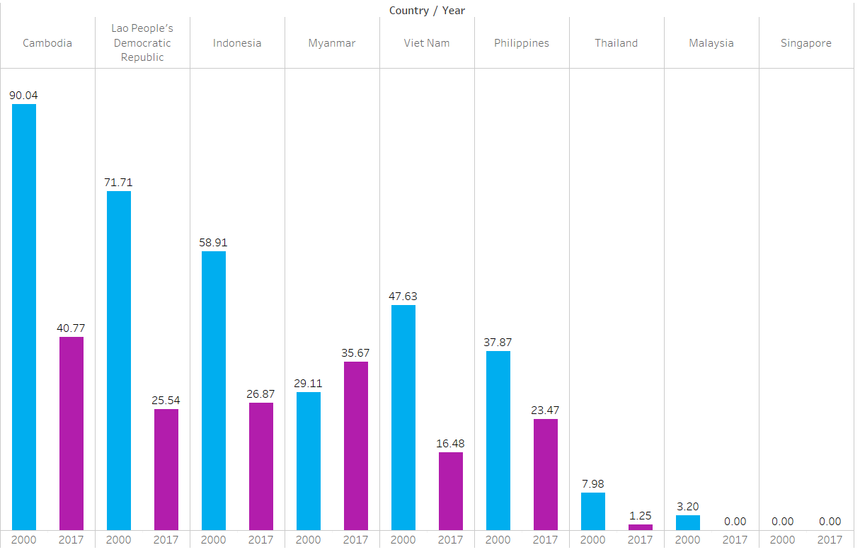
THE PICTURE
Significant effort has been made by ASEAN members to eradicate under-basic sanitation experiences
EFFORT TO IMPROVE SANITATION SYSTEMS HAS BEEN WITNESSED...
Percentage of ASEAN population living without basic sanitation (2010-2017)
Source: JPM (2019)
Notes:
And effort to improve sanitation access has been witnessed since ASEAN members have tried to eradicate under-basic sanitation experiences

Slide 4
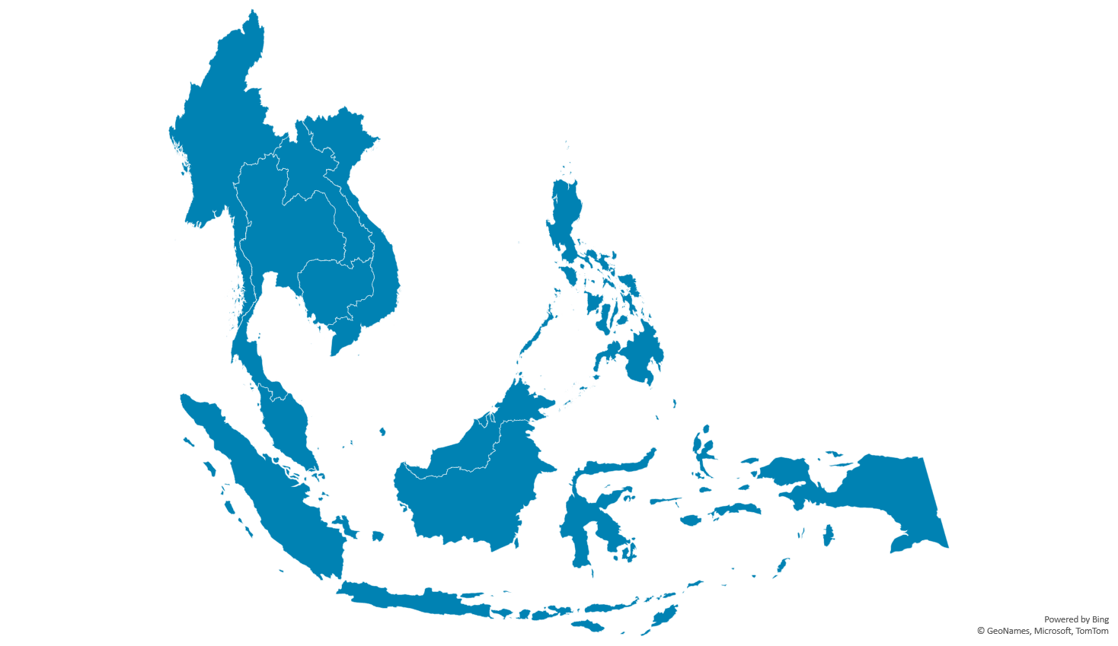
THE PICTURE
Currently, more than half a billion people are living in ASEAN
661 million inhabitants
… BUT IT HAS NOT BEEN STRONG ENOUGH
Source: Statista (2021)
Notes:
However, our effort has not been strong enough. Why is that?
‘Cause currently, more than 600 million people are living in ASEAN...
Có transition ở đây

Slide 5

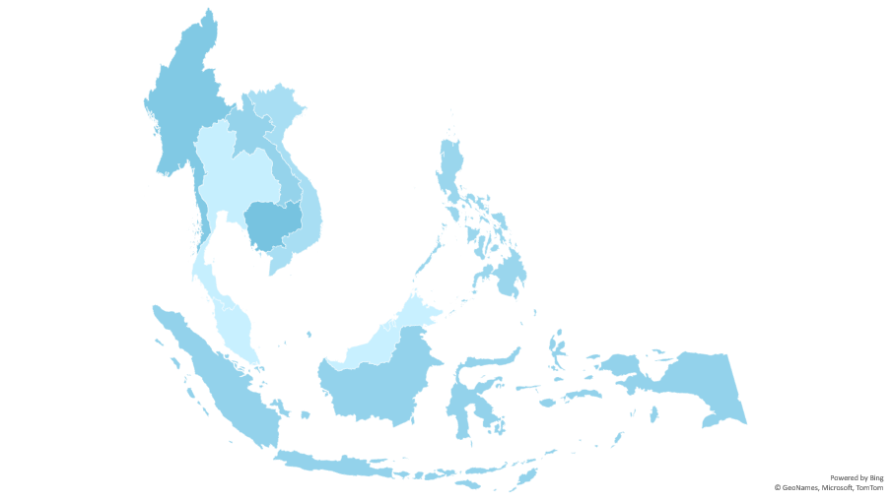
THE PICTURE
However, nearly one-fourth of ASEAN citizens are still living without basic sanitation systems
million
148 million living without improved sanitation system
0
75
… BUT IT HAS NOT BEEN STRONG ENOUGH
661 million inhabitants
Distribution of ASEAN population living without improved sanitation (2017)
Source: The World Bank Group (2020), Statista (2021)
Notes:
But nearly one-fourth of them are still living with under-basic sanitation systems.
And how about our urban areas?
Có transition ở đây

Slide 6
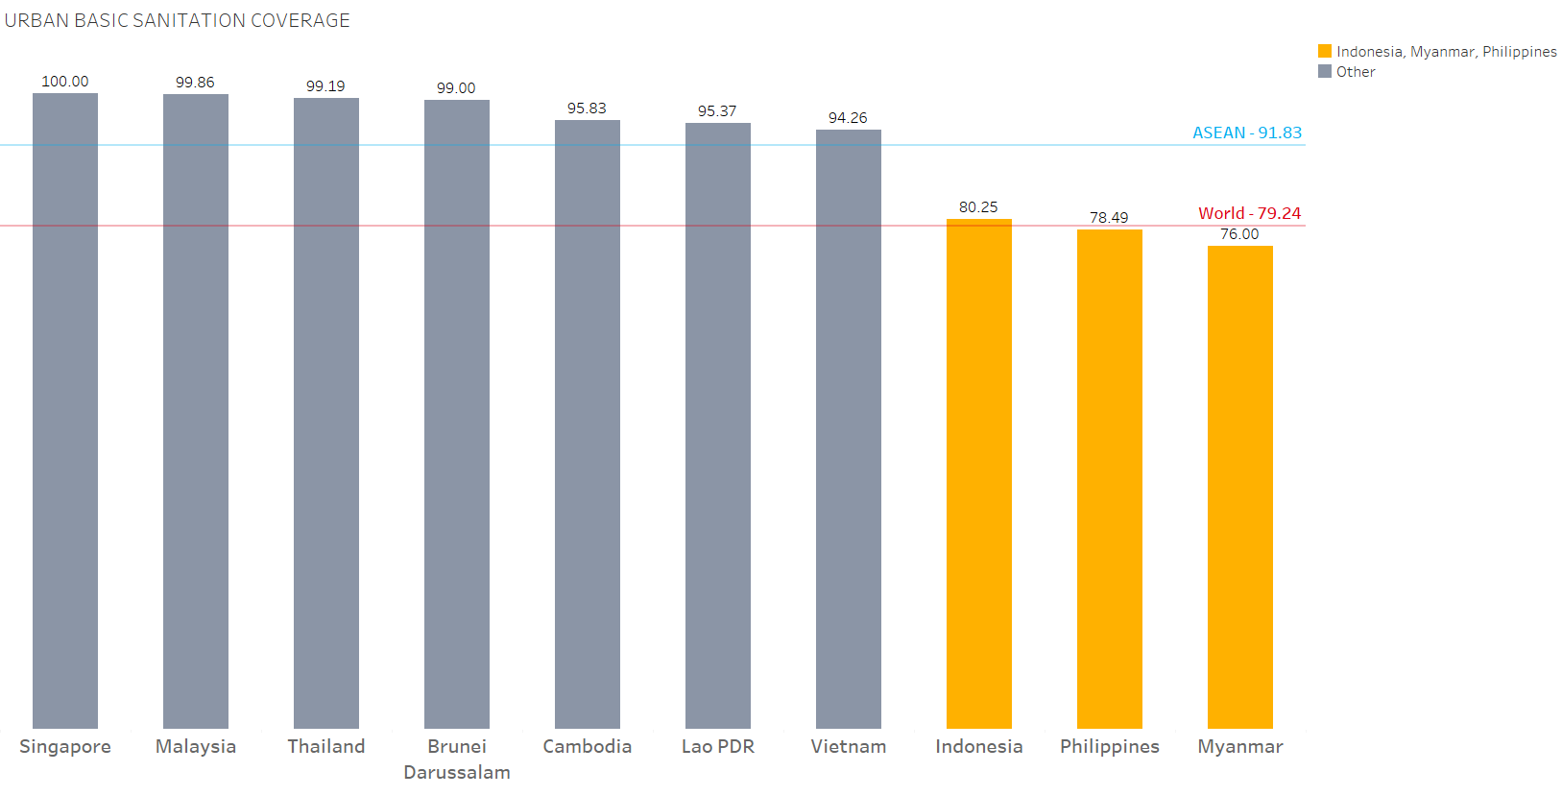
THE FALLOUT
Parts of ASEAN’s urban are suffering from
under-basic sanitation coverage
SURPRISINGLY,
OUR URBAN AREAS ARE NOT DOING WELL
Urban Basic Sanitation Coverage among ASEAN Countries (%)
Source: The World Bank Group (2020)
Notes:
Surprisingly, urban areas are not doing well since parts of them are still experiencing under-basic sanitation systems, notably Indonesia, Philippines and Myanmar.

Slide 7
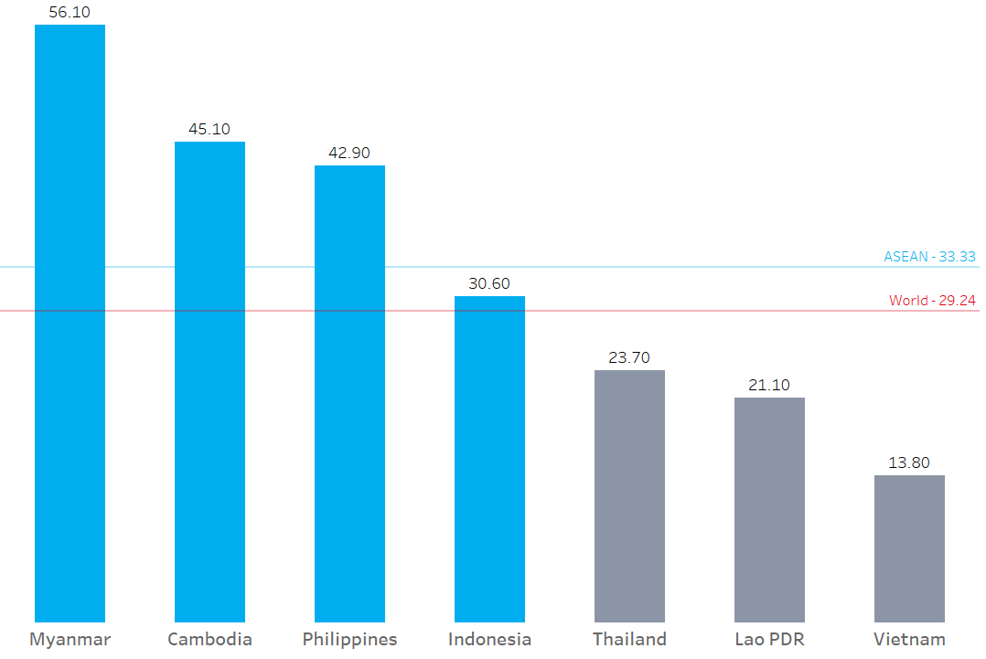
THE FALLOUT
4/10 member states have larger number of slum dwellers than the rest of the world
URBAN SLUM STILL ACCOUNTS FOR A SUBSTANTIAL PART OF ASEAN POPULATION
ASEAN – 33.33
30.60
World – 29.24
Percentage of Slum Dwellers in Urban Population among ASEAN Countries
Source: The World Bank Group (2020)
Notes:
And in fact, urban slums still account for a substantial part of ASEAN population.
And relating to the former data, Myanmar, Philippines and Indonesia also have high numbers of slums dwellers as well.
Có transition ở đây

Slide 8







THE FALLOUT
The larger the slum population is, the more likely they lack access to basic sanitation systems
Higher
sanitation level
URBAN SLUMS CORRELATES WITH
LOW ACCESS TO
BASIC SANITATION
Lower slum population
ASEAN Average
Higher
slum population
Lower
sanitation level
Correlation between Urban Areas’ Sanitation Level and Urban Poverty among ASEAN Members
Source: The World Bank (2020), JPM (2019)
Notes:
Hence, we can draw a conclusion that the larger the slum population is, the more likely they lack access to basic sanitation systems.
So what are the main causes that restrict them from attaining their rights?

Slide 9


THE FALLOUT
Low-income slum dwellers face high constraints while living in urban cities across ASEAN members
35%
1st Root Cause
of urban poverty population in developing countries live in Southeast Asia
$3.20 - $5.50
ACCESS HINDRANCE DUE TO
LOW INCOMES
The daily living poverty lines in low & middle-income countries
1/3
of them are among the poorest population in urban cities
Source: ADB (2017), The World Bank Group (2018)
Notes:
Firstly, a low income amount of less than $6.00 per day causes slum dwellers to face high constraints to access such sanitation systems.

Slide 10

THE FALLOUT
High operating costs of water and sanitation prevent slum dwellers from attaining their rights
=
1 month
2nd Root Cause
$168
Slum dwellers’ income
ACCESS HINDRANCE DUE TO
HIGH SERVICE FEES
Cost per capita for every connection of sanitation infrastructures
=
x2
The average price of a smartphone in ASEAN region
Source: ADB (2017), The Alliance For Affordable Internet (2020)
Notes:
Secondly, high operating costs of water and sanitation also prevent slum dwellers from having basic sanitation systems, equalling up to 2 average smartphones in ASEAN region.

Slide 11

THE FALLOUT
Lagging investment delays slum dwellers’ access into basic sanitation systems
Total Sanitation Investment
2017 Actual
2017 Target
2025 Target
3rd Root Cause
$1.9 billion
$5.2 billion
$6.4 billion
ACCESS HINDRANCE DUE TO
INADEQUATE
INVESTMENT
Public-Private Investment
100%
0%
Public
Private
Source: ADB (2017)
Notes:
Lastly, inadequate investment for sanitation has dragged down the access rate of slum dwellers.
And surprisingly, it is only public stakeholders who play the dominant role for solving this challenge while private stakeholders’ role remains questionable.

Slide 12
THE FALLOUT
Slum dwellers are more likely to face severe health issues than the rest of the population
CONSEQUENCES
THE SNOWBALL EFFECT
Slum dwellers
Infant Mortality Rate is
2-3x higher than other areas
Risk of major health diseases increases up to 20%
Source: Mberu et. al (2016), Mannan (2018)
Notes:
And the consequences are escalating day by day.
Obviously, slum dwellers are more likely to face severe health issues than the rest of the population.

Slide 13
THE FALLOUT
Poor working conditions are putting sanitation workers’ lives at risk
CONSEQUENCES
THE SNOWBALL EFFECT
Engaged in “4Ds” – Drudgery, Dangerous, Dirty, and Dehumanizing
Sanitation workers
Slum dwellers
High death rates
9 deaths per 1000
Source: Salve & Jungari (2020)
Notes:
Moverover, poor working conditions caused by under-basic sanitation systems put sanitation workers’ lives at risk as well.

Slide 14
THE FALLOUT
Urban areas are suffering from environmental pollution caused by slum areas
CONSEQUENCES
THE SNOWBALL EFFECT
Urban community
25% of all deaths are caused by water pollution issues from slum areas
Sanitation workers
Raising level of air pollution in surrounding area
Slum dwellers
Source: Senn & Spuhler (2013)
Notes:
Furthermore, urban areas can also suffer from environmental problems like water and air pollution caused by the low access rate to sanitation systems.

Slide 15

THE FALLOUT
Poor sanitation and subsequent health issues are dragging ASEAN’s economic growth
Economic loss
ASEAN
CONSEQUENCES
THE SNOWBALL EFFECT
$500 million
related to waste cleaning and water quality issues
Urban community
$175 million for healthcare and disease treatments
Sanitation workers
Slum dwellers
Up to 2% drop in ASEAN members’
GDP growth rate
Source: The World Bank (2008)
Notes:
And the overall ASEAN region can witness a wide range of issues, pulling down the GDP growth of each member by 2 percent.
Có transitions ở đây

Slide 16
A summary of our analysis & objective
SOCIAL ISSUE
Low access to basic sanitation services of ASEAN urban slum dwellers
WHAT ARE WE TRYING TO SOLVE TODAY?
Slum dwellers’ low income
High
up-front costs
ROOT CAUSES
Inadequate investment
GOAL
Accelerate the access rate to basic sanitation systems of urban slums
Notes:
So we have seen a low access rate to basic sanitation of slum dwellers, which is due to three different causes.
Hence, our goal is to accelerate the access rate of urban slums.

Slide 17
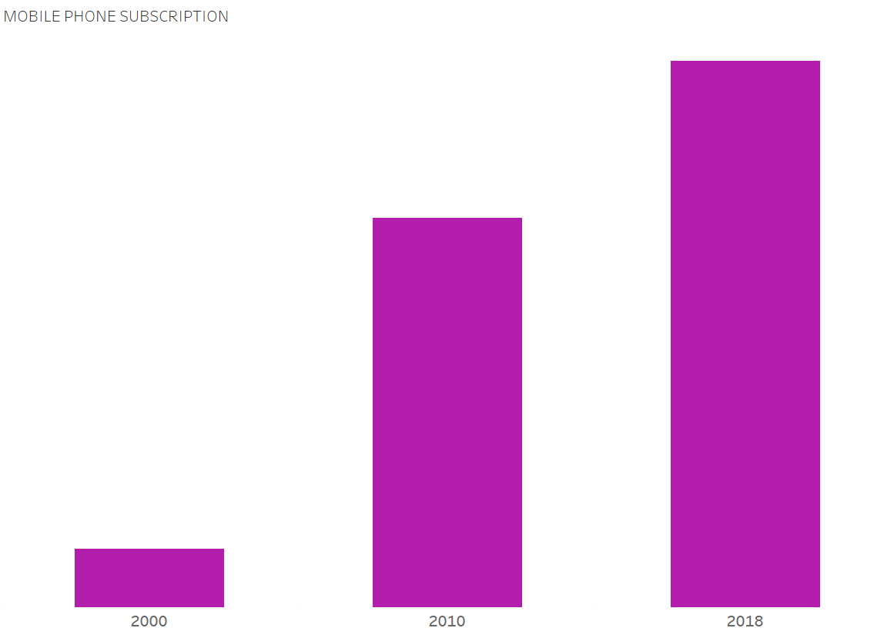
THE APPROACH
High mobile penetration stimulates digital transformation in ASEAN
A typical person in ASEAN owns 1.3 mobile phone
127.3
40% growth
POTENTIALS FROM DIGITAL TREND
IN ASEAN COMMUNITY
90.8
567% growth
13.6
Number of mobile phone per 100 people among ASEAN population (2000-2018)
Source: The World Bank (2020)
Notes:
In fact, we do see potentials emerging from the digital transformation brought about by high mobile penetration.

Slide 18
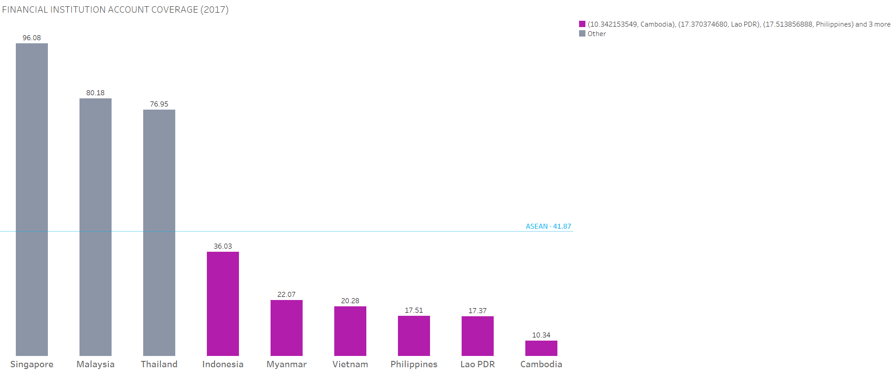
THE APPROACH
Low bank account ownership is creating opportunity for other cashless payment methods
POTENTIALS FROM FINANCIAL INCLUSION STATUS OF ASEAN
Financial institution account ownership (% population with low income)
Source: The World Bank (2018)
Notes:
And we also see the potentials from the financial inclusion status of ASEAN as low bank account ownership can create grounds for cashless payment methods.

Slide 19
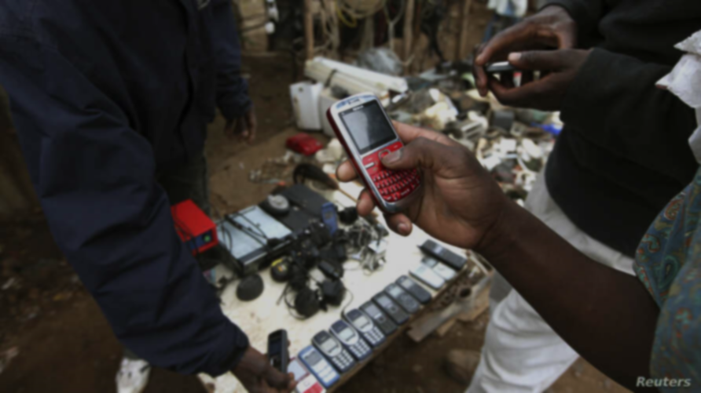
THE MMS PROGRAM
MOBILE MONEY FOR SANITATION ACCESS
Notes:
That’s why we come up with the MMS Program ⇒ Using Mobile Money for Sanitation Systems Access

Slide 20



THE APPROACH
A digitalized approach to increase access into basic sanitation systems for slum dwellers
Provide an interface that is available on mobile phone for initiating financial inclusion
WHAT IS
MOBILE MONEY?
Money is transferred, made and received through payments via mobile phone
Available to the unbanked
Source: GSMA (2014)
Notes:
Mobile money will provide an interface that is available on mobile phones and allows money to move between payments via mobile phones.

Slide 21
THE MMS PROGRAM
MOBILE MONEY FOR SANITATION ACCESS
THE APPROACH
What MMS Program can achieve with Mobile Money?
Slum Dwellers
Sanitation access & Financial inclusion
Service Providers
Costs reduction & Business expansion
Public-Private Stakeholders
Partnership & Development
Notes:
With the MMS Program, we focus on engaging three different stakeholders.

Slide 22




THE APPROACH
Improve basic sanitation access and
financial inclusion for slum dwellers
Provide affordable sanitation offerings and new money collection period
HOW MOBILE MONEY SERVES OUR GOAL?
Slum Dwellers
Sanitation access & Financial inclusion
Provide an up-to-date and convenient payment method
Provide a transparent, and affordable way to secure/withdraw/deposit money
Notes:
Specifically, we try to improve basic sanitation access and financial inclusion for slum dwellers through affordable sanitation solutions and convenient payment methods.

Slide 23



THE APPROACH
Allow mobile money & sanitation providers to reach business efficiency in providing relevant services
Reduce cash collection costs, staff time, and vendor commission
HOW MOBILE MONEY SERVES OUR GOAL?
Service Providers
Costs reduction & Business expansion
Extend their low-cost services to low-income segments
Improve business plan and pricing strategy through collected data on usage
Notes:
We will also assist service providers to reach their business efficiency through reaching a new customer group for their products.

Slide 24



THE APPROACH
Establish a mutual platform for public & private stakeholders to develop and partner up
Provide effective funding/partnership mechanisms among stakeholders
HOW MOBILE MONEY SERVES OUR GOAL?
Public-Private Stakeholders
Partnership & Development
Support stakeholders’ role as “capacity builders”
Support all stages of characteristics NGOs/ NPOs/ Government cycle of innovate-demonstrate-advocate to replicate
Notes:
We also try to establish a mutual platform for public and private sectors to develop and partner up to solve this challenge.

Slide 25

THE MMS PROGRAM
MOBILE MONEY FOR A BETTER ASEAN
THE APPROACH
What MMS Program can achieve with Mobile Money?
Slum Dwellers
Sanitation access & Financial inclusion
Service Providers
Costs reduction & Business expansion
Public-Private Stakeholders
Partnership & Development
THE FOLLOWING KEY ELEMENTS WILL BE ATTAINED BY 2025
ASEAN SOCIO-CULTURAL COMMUNITY BLUEPRINT 2025
ASEAN ECONOMIC COMMUNITY BLUEPRINT 2025
ELEMENT B.1
ELEMENT C.2
ELEMENT D.5
ELEMENT D.1
ELEMENT D.3
ELEMENT D.5
Reduce inequality and promote equitable access to social protection
Promote coordination to provide access clean and safe sanitation
Implement a more inclusive and consultative process involving the private sector
Promote the contribution of stakeholders to the regional integration efforts
Enhance cross-sectoral and cross-pillar coordination to ensure availability sanitation facilities in times of crisis
Promote Private-Public Partnership (PPP) for economic and social development
Notes:
And by involving the three mentioned pillars of stakeholders, we can achieve six key elements from both ASEAN Socio-Cultural and Economic Community Blueprint.

Slide 26

LET’S EXPLORE THE MOBILE MONEY JOURNEY
TO ACCESS BETTER SANITATION SYSTEM
Sanitation fee is issued and sent by SMS to owner’s account
Customers choose option “Pay Bill”
Customers enter their IDs (e.g. phone numbers )
The bill is paid
Your Sanitation Bill
1. Pay Bills
2. Service A
3. Service B
4. More
ID 00000, with the amount 00.00 has been paid agains
Sanitation Service
Enter Customer Number
Option
Clear
Option
Clear
Option
Clear
Option
Clear
START
1
2
3
4
5
6
7
FINISH
Mobile is topped up with a certain balance
*101#
1. Sanitation
2. Water
3. Service 1
4. Service 2
After bill amount has been fetched, kindly enter OTP to complete the transaction
Mobile’s balance will be directly deducted
Option
Clear
Option
Clear
Option
Clear
Customers access mobile money menu (through SIM menu, USSD, or mobile app)
Customers select the service (or enter the pay bill number)
The bill amount is queried automatically
Notes:
So the journey with mobile money to access better sanitation systems is very simple, just like you register for a 4G package with your mobile service providers.
And in fact, we can use it on both cellphones and smartphones!

Slide 27
THE MMS PROGRAM
IMPLEMENTATION PLAN
IMPLEMENTATION
2021
2023
2025
2030+
Timeline
Phase
Launch & Grow
Sustain
Evolve
Goals
Provide affordable sanitation services with simplified mobile money process
Critical mass of active users and stable service offerings
Expansion of program functionality, services, and partnerships
Evaluate customer engagement & continue to expand the usage network
Digital credits adoption
Update MM functions to include other extended services
Develop and transfer to an ecosystem-based platform
Strategies
Partner with government/ private stakeholders to fund sanitation facilities and educate people using MMS
Establish financial assistant framework and promotional programs
Gradually improve slum dweller’s sanitation habit
Actively engage relevant stakeholders
Provide access to sanitation on extensive scale
Establish an active role of slum dwellers in acquiring the access to sanitation
Enhance living standards in slum areas on ASEAN scale
Strengthen collaboration between ASEAN state members
Impacts
Notes:
With MMS Program, we aim to execute the project through 3 phases:
Launch and Growth, in which we try to provide affordable sanitation services with a simplified mobile money process through partnership with relevant stakeholders to fund and educate for our project .
Sustain Phase is when a critical mass of active users and stable service offerings are recorded
3.Evolve Phase starts to expand our program functionality, services and partnerships, allowing us to make country-adapted projects for other ASEAN members.
Có transition ở đây

Slide 28

ACTION PLAN
The Plan is based on the ASEAN Economic Community Blueprint 2025, ASEAN Socio-Cultural Community Blueprint 2025 &
The 2030 Agenda for Sustainable Development
2023 - 2025
2025 - 2030
2021 - 2023
Sustain
Evolve
Launch & Grow
Critical mass of active users and
stable service offering
Expansion of program functionality, services, and partnerships
Affordable sanitation services with simplified mobile money process launched
Call for cooperation of the Department of Economics & Social Affairs
First round of expansion of services functionality
New value-added services layered into the program (from other providers such as financial services)
Call for funding from private sectors/ government in providing access to improved sanitation systems
Critical mass of active users in slums begin to use the service, creating program momentum
Implement accessible sanitation to all slum dwellers
Partner with NGOs/ NPOs/ government to provide education for the usage of sanitation system with mobile money
Collaborate with SAP to construct built-in data & research projects for consumers’ engagement & credit score evaluation
Advise the Government and relevant private-sector stakeholders to evolve regulation to accommodate new services and consumer protection requirements
Provide discount and necessities strategies to encourage participation of dwellers
Create consumer loyalty strategies based on the credit score reports to maintain the number of users
Implement all country-designed infrastructure to improve regional sanitation access
Launch basic sets of sanitation services with simplified mobile money process for certain slums
Advise the Government and relevant private-sectors stakeholders of necessary adjustments to regulations to accommodate growth of services
PROGRAM EVALUATION KEY CRITERIAS
Sustainability
Coverage
Scalability
Access
Sanitation system usage
Services & Functionality expansion
Service transferability
Functioning of facilities
Communication capabilities & Decision-making
Training provision
Cost sharing/willingness to pay
Notes:
Please refer to this Action Plan for detail activities in our program
And furthermore, we intend to create a system of evaluation, involving three key criterias: Sustainability, Coverage and Scalability.

Slide 29

IMPLEMENTATION
Overall health & living conditions of urban dwellers will be improved
Social Gains
THE MMS PROGRAM
SOCIO-ECONOMIC IMPACT ASSESSMENT
83 million
+
40 million
Urban slum dwellers living without improved sanitation
Projected people living near slum areas being affected
=
123 million
People with better living standard
36%
25/1000
Risk of diarrhea in infants
Children’ lives saved per year
Source: Statista (2021), Banerjee et. al (2020), The World Bank Group (2011)
Notes:
Through the MMS Program, the overall health & living conditions of urban dwellers can be improved since 120 million people can improve their living standards

Slide 30

IMPLEMENTATION
Substantial economic impacts will be inherited from higher access to basic sanitation
Economic Gains
THE MMS PROGRAM
SOCIO-ECONOMIC IMPACT ASSESSMENT
$US 1
=
$US 9
Spent on Sanitation
Savings on treatment, health-care costs, and gains from productivity
=
100,000
$US 1 billion
Investment in Water & Sanitation
Jobs created in the regional economy
1.5%
ASEAN members’ National GDPs
Source: Singh (2014), The World Bank Group (2008), UNESCO (2016)
Notes:
And the overall economic development of ASEAN member states can be substantial, with an average of 1.5% increase in their national GDPs.

Slide 31
THE MMS PROGRAM
MOBILE MONEY FOR A BETTER ASEAN
Notes:
So, let’s join the MMS Program for a better ASEAN :)

Slide 32
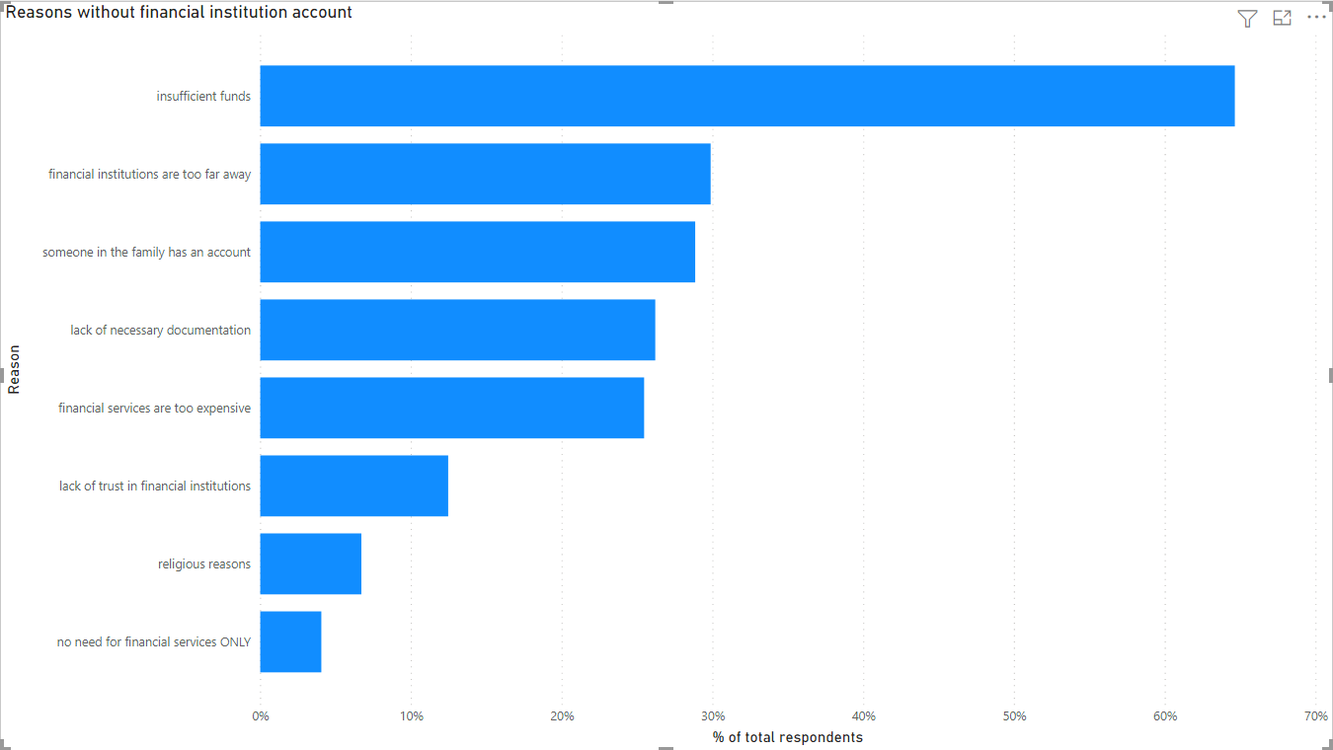
APPENDICES
Appendix 1: REASONS WHY LOW-INCOME INDIVIDUALS HESITATE TO OPEN AN ACCOUNT (BANKS & FINANCIAL INSTITUTIONS)
Notes:
https://datacatalog.worldbank.org/dataset/global-financial-inclusion-global-findex-database

Slide 33
APPENDICES
Appendix 2: MOBILE MONEY OPERATIONAL RISK MANAGEMENT
TYPE OF RISK | RISK | RISK DESCRIPTION | MEASUREMENTS
Operational Risks | Identity theft | Customers data compromise allows other parties to replicate customers’ identity and conduct fraudulent transactions | One customer – one account in the system; Effective PIN protection; Protective process of PIN reset;
 | Imposture of provider status | Unauthorized agents impersonate as authorized ones, performing fraudulent transactions for money and confidence trickery to exploit customers data | Publish clear fee structure; Publish programs for unauthorized agents clearance on markets; Provide constant agent branding;
 | Unable to transaction | Broken interconnection between various infrastructure and systemts results in the inability to carry out transations; Insufficienct customer literacy of mobile money also leads to this inability; | Conduct sufficient evaluation on mobile money operation on a cyclical basis; Enhance interface consistency to maintain the usage of under-average literate people; Secure sufficient data for required rollback in the event of uncertainties;
 | Networks’ repeated transaction notification | Mobile money operators have a tendency to repeatedly deliver SMSs to end-users, leading to inconsistent instructions on payment | Technical intervention should be conducted to disable retry pattern for transactions; Transaction requests should be numbered on user interface;

Slide 34
APPENDICES
Appendix 3: MOBILE MONEY OPERATIONAL RISK MANAGEMENT (CONT’D)
TYPE OF RISK | RISK | RISK DESCRIPTION | MEASUREMENTS
Operational Risks | Transaction delay | Delayed interconnection between various infrastructure and systemts results in the untimely transations, causing confusion for customers in making transactions | Establish the comprehensive product rollout management among relevant providers
 | Service’s balance updates delay | Delayed balance updates can be caused due to the lengthy chain of infrastructures and system of mobile money, causing possible failure of future transactions | Provide adequate pathways for message delivery chain; Provide clear transaction commitment points to support further tracking activities;
 | Spoofed cash withdrawls | Fraudulent customers impersonating mobile money customers to conduct cash withdrawals | Establish appropriate security strategies to protect the systems from technical attacks; Adopt suitable framework and staff education to differentiate valid and invalid transactions;
 | Mobile money program fails to reach sustainability | There are chances that the associated programs cannot reach the commercial sustainability point, causing relevant stakeholders to withdraw | Provide clear research and guidance on country-based implementation plan; Create assessment plans for every stages of the projects (weekly/monthly/quarterly and by divisions);

Slide 35
APPENDICES
Appendix 4: MOBILE MONEY CREDIT AND LIQUIDITY RISK MANAGEMENT
TYPE OF RISK | RISK | RISK DESCRIPTION | MEASUREMENTS
Credit and Liquidity Risks | Insolvency of the mobile money’s provider | The mobile money provider could be facing some financial difficulties and putting the customer’s deposits at risk | Regulators must occasionally watch the capital adequacy of the mobile money’s provider to minimize the risk of liquidity and take actions accordingly to protect the customer’s deposits
 | Customer do not repay a loan granted | Customer may not have a strong relationship with the lender, lack of credit worthy and not feeling obliged to repay the loans | Credit rating and payback ability should be evaluated to determine the proper lending amount Mobile money providers and lenders should monitor repayment patterns of the customer closely and detect any abnormal behaviour of the customer
 | Lender credibility | Customer may not be aware of the credibility of the lender and may face some stricter policies or higher lending rates among other partners | Mobile money providers should give customer with deep and full information of the lenders and warn customer about potential risk for accepting the funds

Slide 36
APPENDICES
THE MMS PROGRAM
Appendix 5: HOW MMS PROGRAM USES MOBILE MONEY
PAYMENT
RESEARCH & DEVELOPMENT
FUNCTION
DIGITAL CREDITS
Reduce provider’s operating cost by collecting payment via mobile money
Provide financial assistance for sanitation infrastructures & operating fees
Provide real-time traditional and non-traditional data of customers
METHOD
Provide discount & necessities campaigns for sanitation facilities acquisition
Evaluate participant’s credit score to apply discount or promotional program
Play a critical in program assessment and evaluation

Slide 37
REFERENCES
Alliance for Affordable Internet 2020, From luxury time to lifeline: Reducing the cost of mobile devices to reach universal internet access, Alliance for Affordable Internet, Web Foundation, . <https://a4ai.org/wp-content/uploads/2020/08/Alliance-for-Affordable-Internet_Device-Pricing_PUBLIC.pdf>.
Asian Development Bank (ADB) 2017, Meeting Asia’s Infrastructure Needs, Asian Development Bank, Metro Manila, <https://www.adb.org/sites/default/files/publication/227496/special-report-infrastructure.pdf>.
Banerjee, S, Sar, A & Pandey, S 2020, ‘Improved yet Unsafe: An Aquatic Perspective of Indian Infant Mortality’, Journal of Health Management, vol. 22, no. 1, 57-66, . <https://journals.sagepub.com/doi/full/10.1177/0972063420908379>.
GSMA 2014, Mobile Money for the Unbanked Mobile money profitability: A digital ecosystem to drive healthy margins, GSMA, London, <https://www.gsma.com/mobilefordevelopment/wp-content/uploads/2015/11/2014_Mobile-money-profitability-A-digital-ecosystem-to-drive-healthy-margins.pdf>.
Günther, I & Fink, G 2011, Water and Sanitation to Reduce Child Mortality – The Impact of Cost of Water and Sanitation Infrastructure, The World Bank Group, viewed 5 August 2021, . <https://data.worldbank.org/indicator/FX.OWN.TOTL.ZS>.
JPM 2019, Estimates on the use of water, sanitation and hygiene by country (2000-2017), datafile, WHO & UNICEF, viewed 30 June 2021, <https://washdata.org/data/downloads#WLD>.
Mannan, M 2018, Burden of Disease on the Urban Poor: A Study of Morbidity and Utilisation of Healthcare among Slum Dwellers in Dhaka City, Bangladesh Institute of Development Studies, Dhaka, . <https://think-asia.org/bitstream/handle/11540/9487/REF_17_1_Full.pdf?sequence=1>.
Mberu, B, Haregu, T, Kyobutungi, C & Ezeh, A 2016, ‘Health and health-related indicators in slum, rural, and urban communities: a comparative analysis’, Global Health Action, vol. 9, no. 1, . <https://www.tandfonline.com/doi/full/10.3402/gha.v9.33163>.
Salve, P & Jungari, S 2020, ‘Sanitation workers at the frontline: work and vulnerability in response to COVID-19’, Local Environment – The International Journal of Justice and Sustainability, vol. 25, no. 8, 627-630, . <https://www.tandfonline.com/doi/full/10.1080/13549839.2020.1792430>.
Senn, D & Spuhler, D 2013, Water, Sanitation and Urbanization, SSWM, viewed 5 August 2021, . <https://sswm.info/node/7722>.
Singh, P 2014, ‘The health and economic cost of poor sanitation’, World Health Organization, 19 November, viewed 5 August 2021, <https://www.who.int/southeastasia/news/speeches/detail/the-health-and-economic-cost-of-poor-sanitation>.

Slide 38
REFERENCES
Statista 2021, Share of population in urban areas in Southeast Asian countries in 2020, Statista, viewed 5 August 2021, <https://www.statista.com/statistics/616014/urban-population-in-southeast-asia-by-country/>.
Statista 2021, Total Population of the ASEAN countries from 2011 to 2021, Statista, viewed 30 July 2021, <https://www.statista.com/statistics/796222/total-population-of-the-asean-countries/>.
The ASEAN Secretariat 2018, ASEAN Sustainable Urbanization Strategy, The ASEAN Secretariat, Jakarta, <https://asean.org/storage/2018/11/ASEAN-Sustainable-Urbanisation-Strategy-ASUS.pdf>.
The World Bank Group 2008, Economic Impacts of Sanitation in Southeast Asia – A four-country study conducted in Cambodia, Indonesia, the Philippines and Vietnam under the Economic Sanitation Initiatives (ESI), The World Bank, Jakarta, <https://www.wsp.org/sites/wsp/files/publications/Sanitation_Impact_Synthesis_2.pdf>.
The World Bank Group 2018, Account ownership at a financial institution or with a mobile-money-service provider (% of population ages 15+), The World Bank Group, viewed 5 August 2021, <https://data.worldbank.org/indicator/FX.OWN.TOTL.ZS>.
The World Bank Group 2018, Global Financial Inclusion (Global Findex) Database, The World Bank Group, viewed 5 August 2021, <https://datacatalog.worldbank.org/dataset/global-financial-inclusion-global-findex-database>.
The World Bank Group 2018, Nearly Half the World Lives on Less than $5.50 a Day, The World Bank Group, viewed 3 August 2021, <https://www.worldbank.org/en/news/press-release/2018/10/17/nearly-half-the-world-lives-on-less-than-550-a-day>.
The World Bank Group 2020, Mobile cellular subscriptions (per 100 people), The World Bank Group, viewed 30 June 2021, <https://data.worldbank.org/indicator/IT.CEL.SETS.P2>.
The World Bank Group 2020, People living in slums (% of urban population), The World Bank Group, viewed 30 June 2021, <https://data.worldbank.org/indicator/EN.POP.SLUM.UR.ZS>.
The World Bank Group 2020, People using at least basic sanitation services (% of population), The World Bank Group, viewed 30 June 2021, <https://data.worldbank.org/indicator/SH.STA.BASS.ZS>.
The World Bank Group 2020, People using at least basic sanitation services, urban (% of urban population), The World Bank Group, viewed 30 June 2021, <https://data.worldbank.org/indicator/SH.STA.BASS.UR.ZS>.
The World Bank Group 2020, Population living in slums (% of urban population), The World Bank Group, viewed 30 June 2021, <https://data.worldbank.org/indicator/EN.POP.SLUM.UR.ZS>.
UNESCO 2016, The United Nations World Water Development Report 2016 – Water and Jobs, UNESCO, Paris, <https://www.unescap.org/sites/default/files/2016%20UN%20World%20Water%20Development%20Report-%20Water%20and%20Jobs.pdf>.

