Slide 1

Regional Sales Analysis Report
Trends, top-performing regions, customer behavior, and growth opportunities

Slide 2
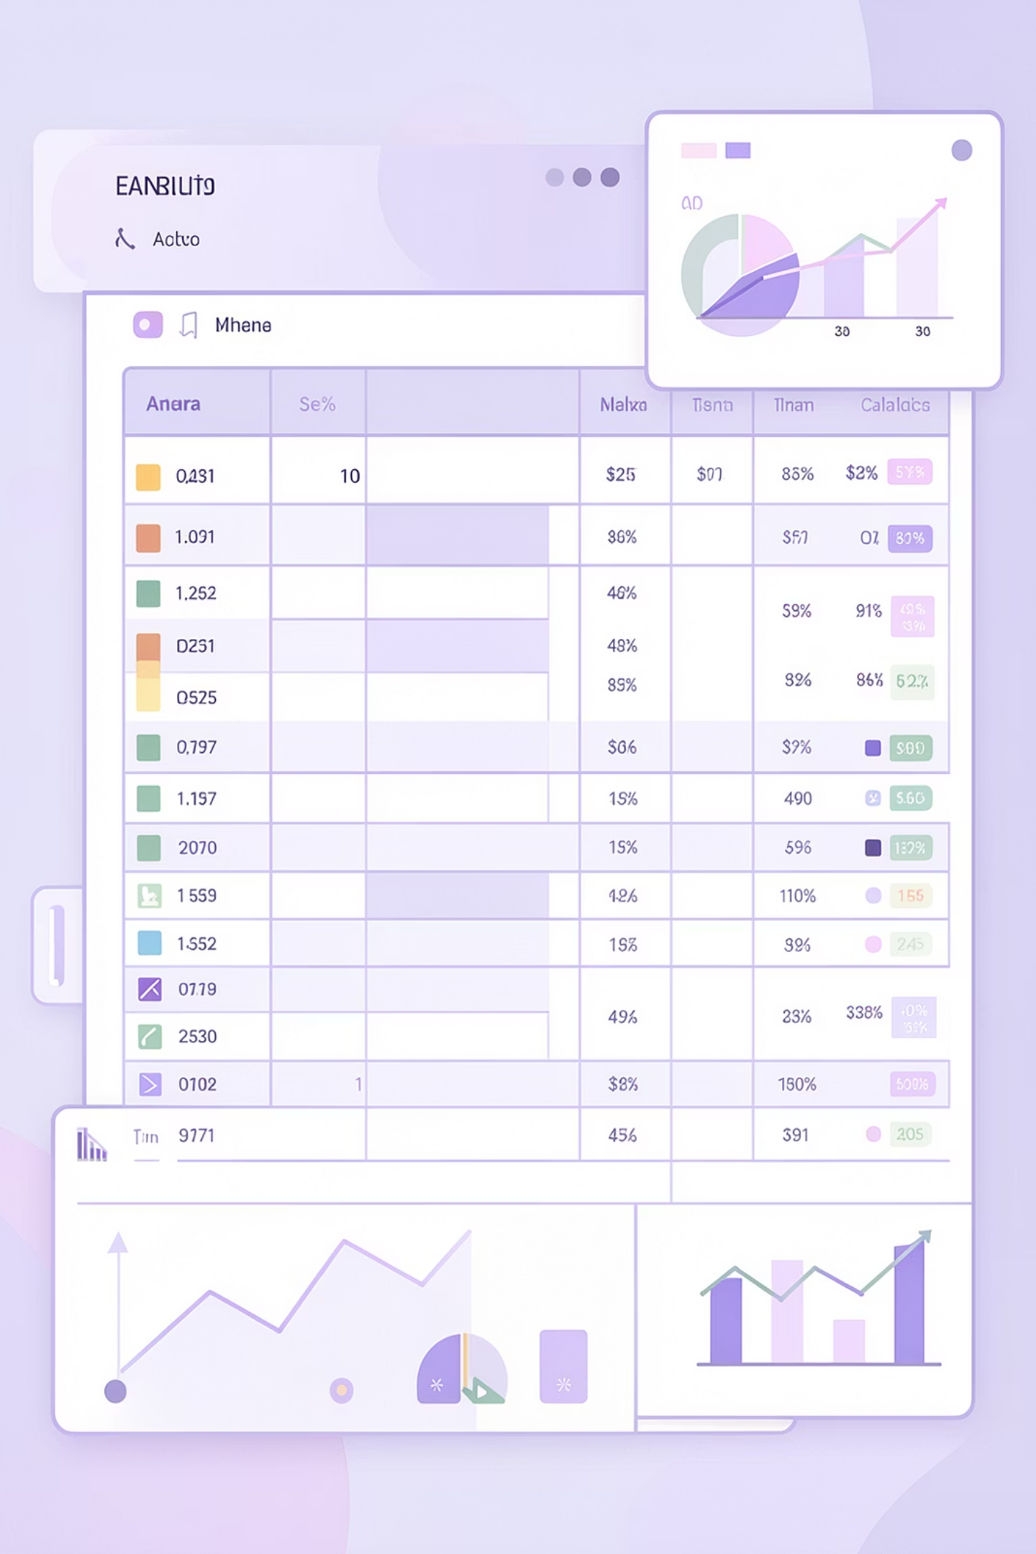
The Dataset
64,104
12
Rows
Columns
Key Fields
Region, category, sales, order date, customer segments

Slide 3

Exploratory Data Analysis
Data Preparation
Imported via pandas, cleaned nulls
Merged sheets, renamed to snake_case
Created total_cost, profit, profit_margin

Slide 4
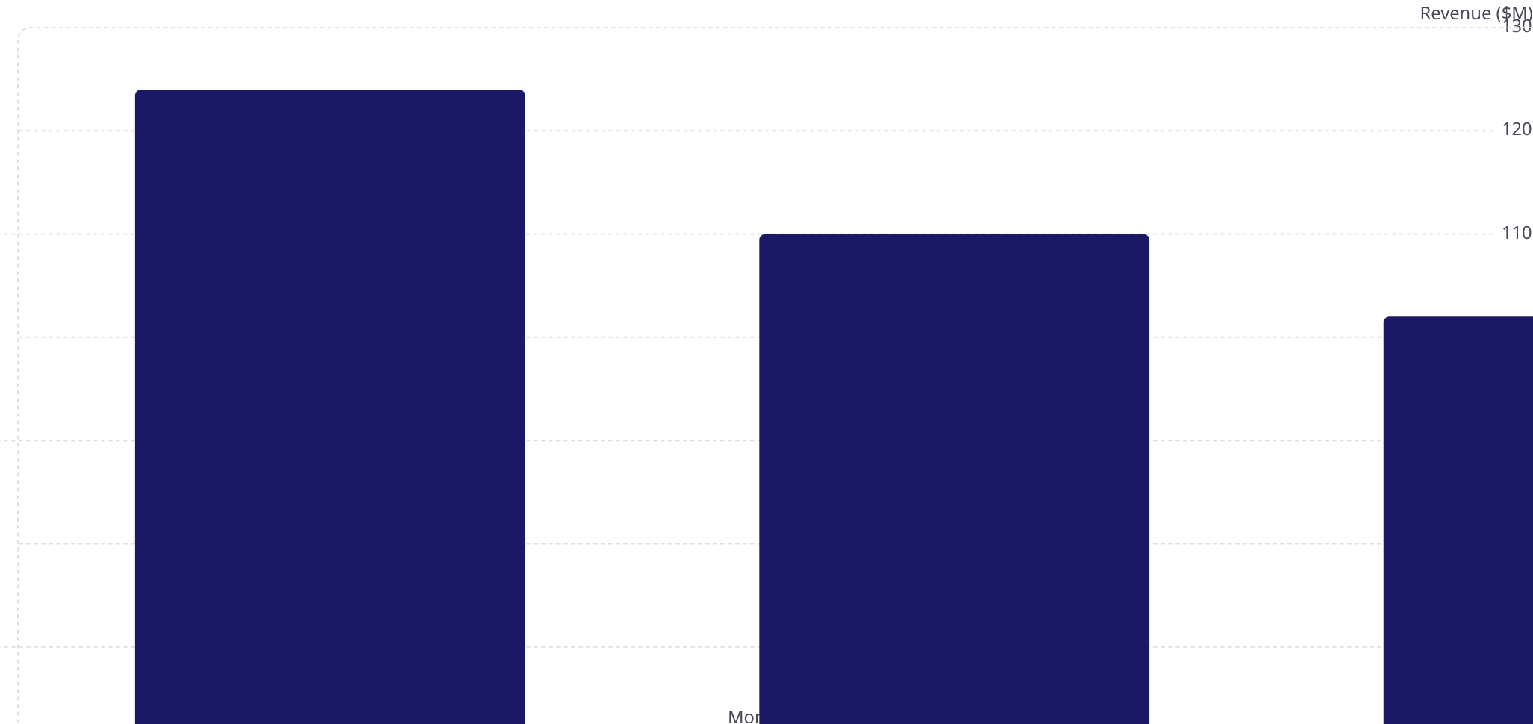
Monthly Sales Trend
January peaks at $124M, dipping to $95M in April — pronounced seasonality.

Slide 5
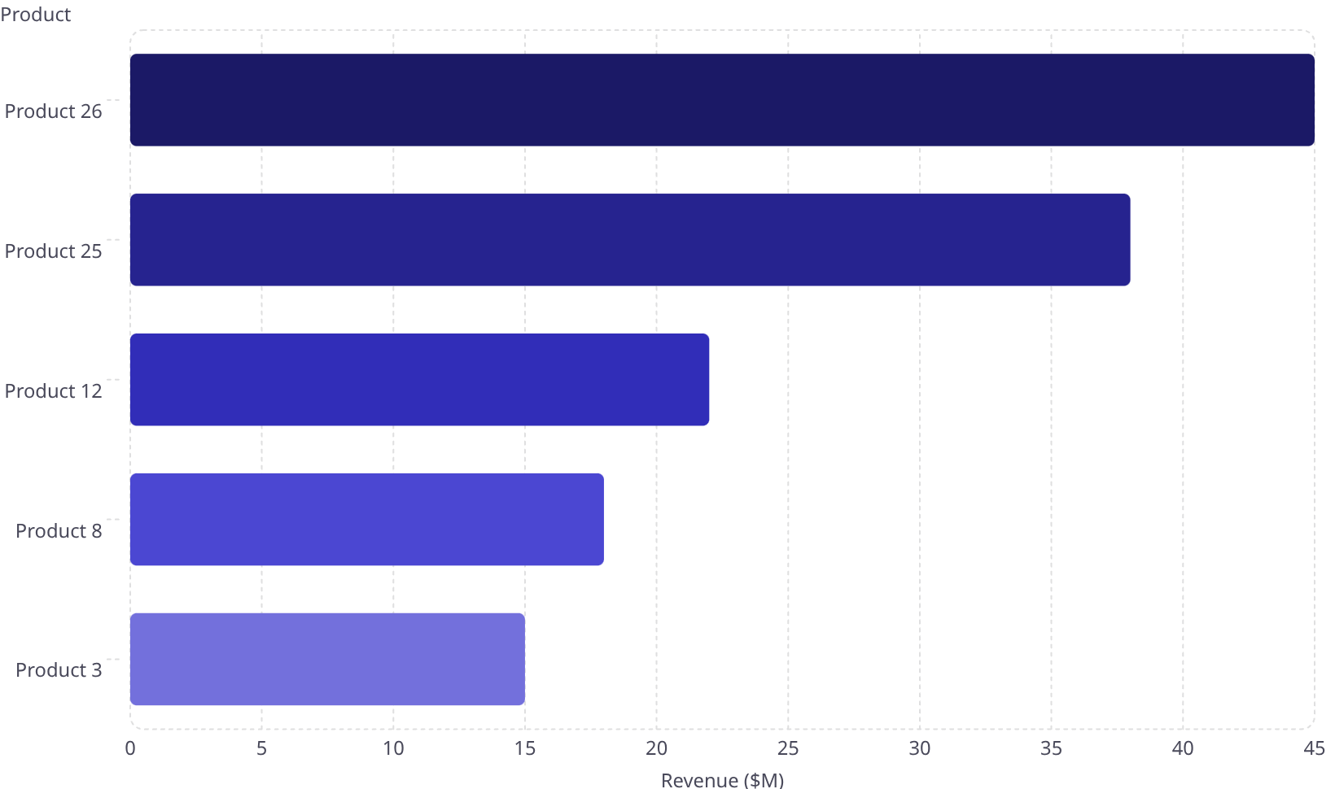
Top Products by Revenue
SKU Concentration
Products 26 & 25 drive ~25% of total sales.

Slide 6
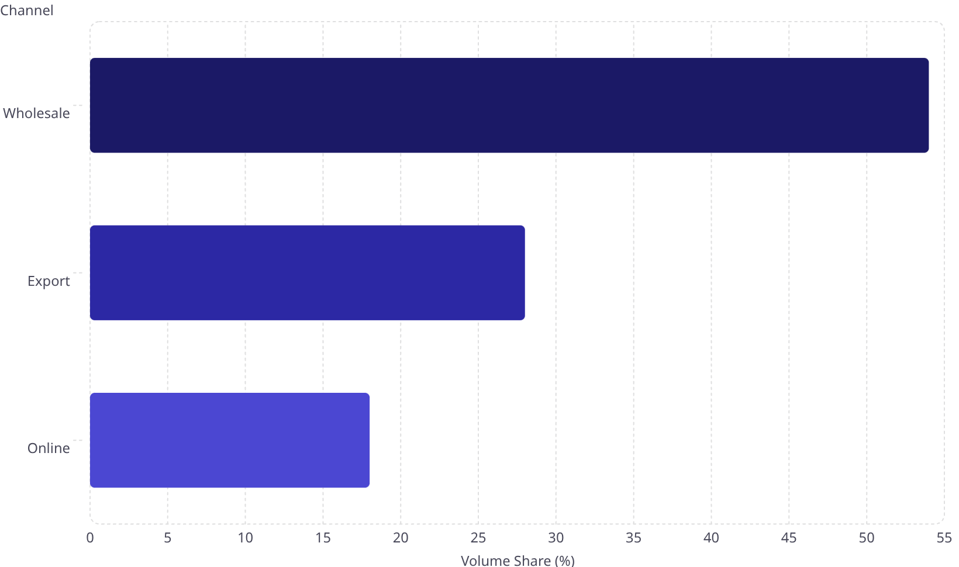
Sales by Channel
Channel Trade-Off
Wholesale: 54% of volume
Export: ~38% avg margin — highest

Slide 7
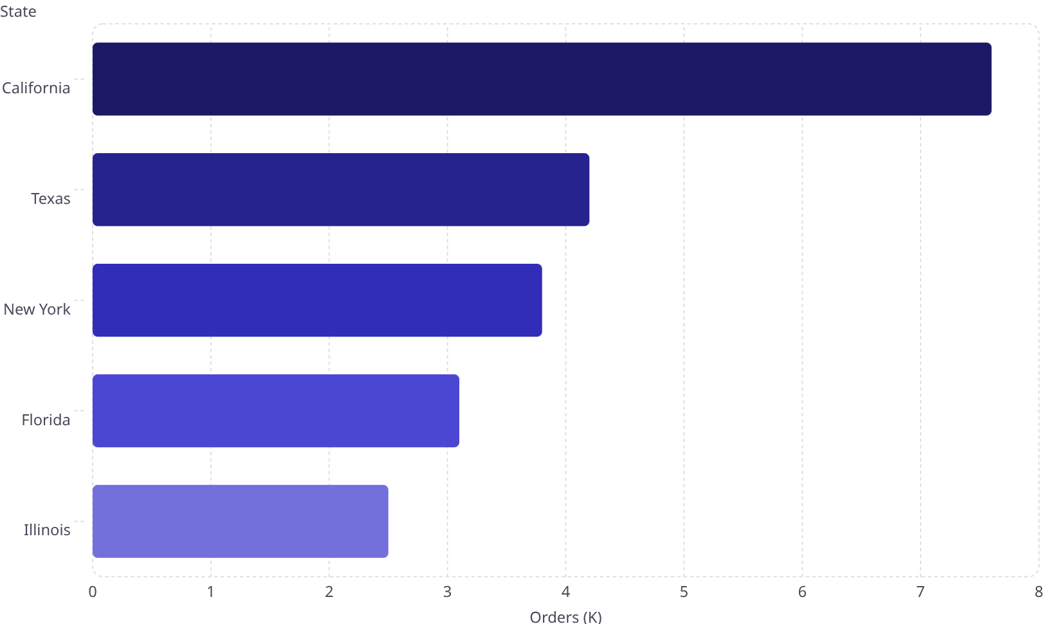
Geographic Insights
California Dominance
7.6K orders · $230M
West region shows the largest swings

Slide 8
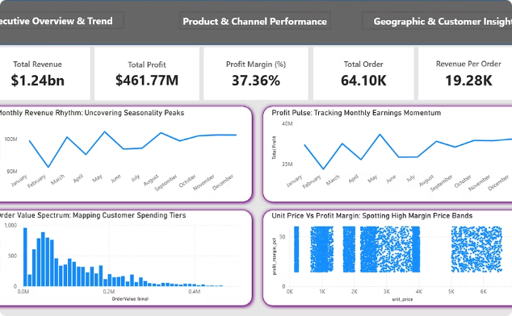
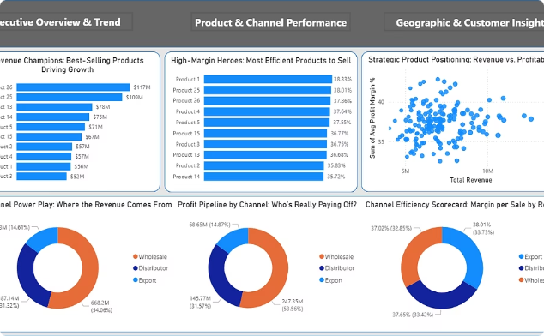
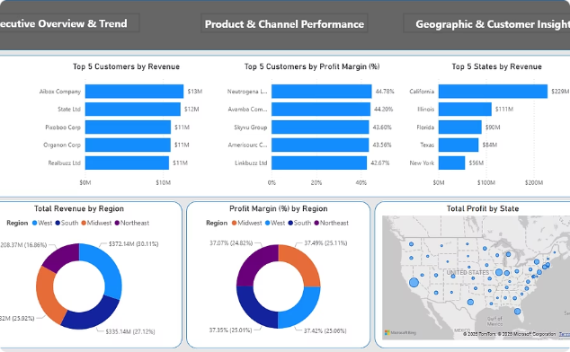
Power BI Dashboard
Page 1
Page 2
Page 3
Executive Overview & Trend
Product & Channel Performance
Geographic & Customer Insights

Slide 9
Key Findings
Seasonality
SKU Concentration
Channel Trade-Off
Jan $124M → Apr $95M
Products 26 & 25 = ~25% of sales
Wholesale 54% vol; Export ~38% margin
Geography
Top Customers
California 7.6K orders, $230M; West most volatile
Aibox Company & State Ltd lead revenue

Slide 10







Recommendations & Conclusion
Seasonal Promotions
SKU Optimization
Channel Expansion
April recovery, January amplification
Focus on Products 26 & 25; phase out low-margin SKUs
Incentivize Export; volume deals in Wholesale
Regional Investment
Margin Monitoring
Replicate California; boost Northeast & Midwest
Flag orders below 80% margin; analyze cost drivers
Actionable insights to optimize strategy and drive revenue growth.

