Slide 1
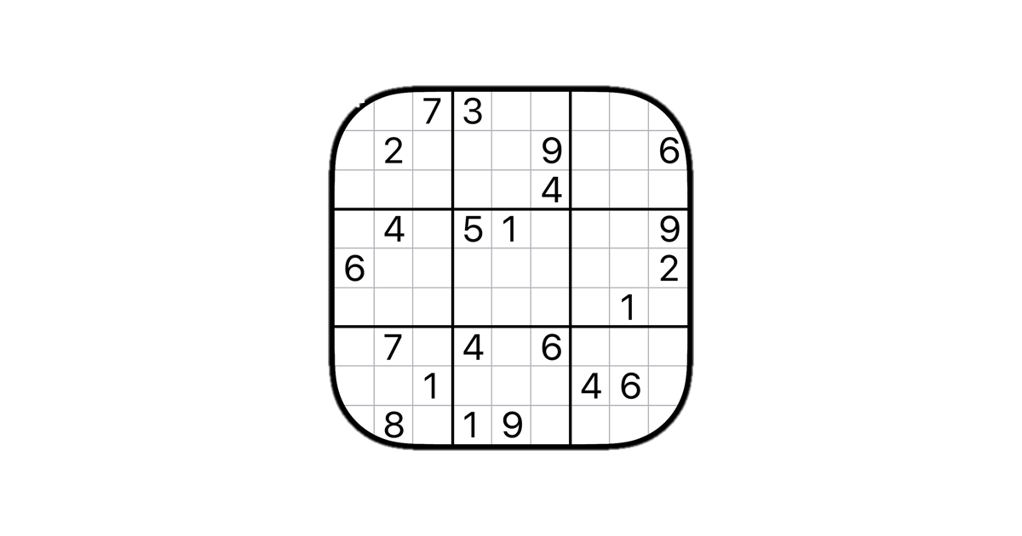
SKIP
SUDOKU
HH

Slide 3
SKIP
SUDOKU
HH

