Slide 1
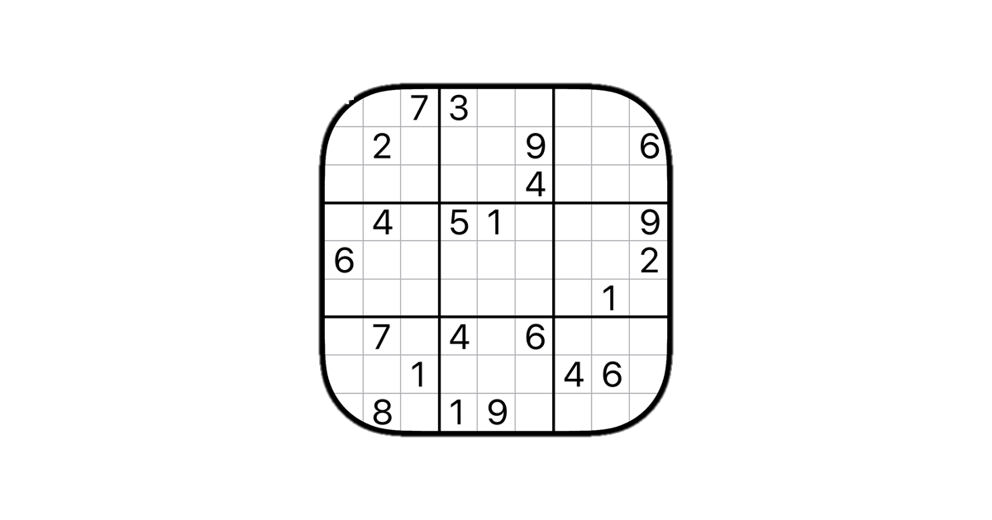
SKIP
SUDOKU
HH

Slide 3
SKIP
SUDOKU
HH

Slide 5
4
1
5
SUDOKU
HH
2
9
3
CONTINUE
8
NEW
7
About

Slide 6
4
1
5
2
9
3
8
7

Slide 7
123:12

Slide 8
4
1
5
2
9
3
8
7

