Slide 1
SDN basics and OpenFlow

Slide 2
SDN basics and OpenFlow
Review some related concepts
SDN overview
OpenFlow

Slide 3
Review of related concepts
What are Control plane and data plane?
Are they always together in a device historically?
Why separate control?
Rapid innovation: control independent of hardware
Network wide view: possible to infer and reason about network behavior
More flexibility: introducing new services rapidly

Slide 4
Review of related concepts
Is OpenFlow SDN?
No. OpenFlow is an API that is standardized between control plane and data plane. OpenFlow is one enabling technology for SDN. SDN may build over other enabling technology.
Another approach for SDN is Network Function Virtualization (NFV).

Slide 5
What is software defined networking?
Software-defined networking (SDN) is an approach to computer networking that allows network administrators to manage network services through abstraction of lower-level functionality.
Abstractions for three problems: constrained forwarding model, distributed state, detailed configuration
SDN is
Directly programmable: network control is programmable because it is decoupled from forwarding functions
Agile: administrator can dynamically adjust network-wide traffic flow to meet changing needs.
Centrally managed: network intelligence is logically centralized.
Programmatically configured
Open standards-based and vendor-neutral

Slide 6
Forwarding abstraction
Control plane needs flexible forwarding model
With behavior specified by control program applications
Use a generic “flow” concept that is inclusive and forward based on flows.
Historically the hardware’s capability for forwarding is vendor dependent
e.g. forwarding based on L2 address, L3 address
This abstracts away forwarding hardware
Flexibility and vendor-neutrality are both valuable

Slide 7
State Distribution Abstraction
Shield control mechanisms from state distribution while allowing access to the state
Split global consensus-based distributed algorithms into two independent components: a distributed (database) system and a centralized algorithm.
We know how to deal with both.
Natural abstraction: global network view
Implemented with a network operating system.
Control (configuration) mechanism is now abstracted as a function of the global view using API
Control is now based on a centralized graph algorithm instead of a distributed protocol.

Slide 8
Network Operating System(NOS)
NOS: a distributed system that creates and maintains a network view
Communicates with forwarding elements
Get state information from forwarding elements
Communicates control directives to forwarding elements
Using forwarding abstraction
NOS plus forwarding abstraction = SDN (v1)

Slide 9
Configuration abstraction
Application should not configure each individual network device.
The NOS provides consistent global view of the network
Configuration is a function of the global view
NOS eases the implementation of functionality
Does not help specification of functionality
Need a specification abstraction

Slide 10
Specification abstraction
Give control programs an abstract view of network
Abstract view is a function of global view. The abstract view could be just a giant switch connecting all ports, or individual logical topology for each application.
Control program is abstract mapping
Abstract configuration = Function (abstract view)
Abstraction models should have just enough detail to specify goals
Don’t provide information needed to implement goals.

Slide 11
Simple Example: Access Control
Source: Scott Shenker, UC Berkeley
What
Abstract Network
Model
Global
Network View
How
Notes:
What is access control?

Slide 12
Software Defined Networks
Source: Scott Shenker, UC Berkeley
Specifies behavior
Control Program
Abstract Network Model
Compiles to topology
Network Virtualization
Global Network View
Transmits to switches
Network OS

Slide 13
What Does This Picture Mean?
Source: Scott Shenker, UC Berkeley
Write a simple program to configure a simple model
Configuration is merely a way to specify what you want
Examples
ACLs: who can talk to who
Isolation: who can hear my broadcasts
Routing: only specify routing to the degree you care
Some flows over satellite, others over landline
TE: specify in terms of quality of service, not routes
Virtualization layer “compiles” these requirements
Produces suitable configuration of actual network devices
NOS then transmits these settings to physical boxes

Slide 14
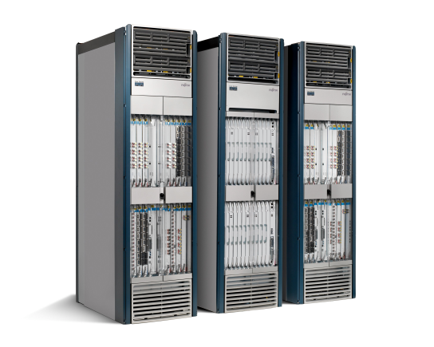

Openflow: Simplifying the control
Routing, management, mobility management, access control, VPNs, …
Feature
Feature
Million of lines of source code
5400 RFCs
Barrier to entry
Operating
System
Specialized Packet Forwarding Hardware
Billions of gates
Bloated
Power Hungry
Many complex functions baked into the infrastructure
OSPF, BGP, multicast, differentiated services, Traffic Engineering, NAT, firewalls, MPLS, redundant layers, …
Ossified networks today
Notes:
14

Slide 15
OpenFlow: a pragmatic compromise
+ Speed, scale, fidelity of vendor hardware
+ Flexibility and control of software and simulation
Vendors don’t need to expose implementation
Leverages hardware inside most switches today (ACL tables)

Slide 16
How does OpenFlow work?
16

Slide 17
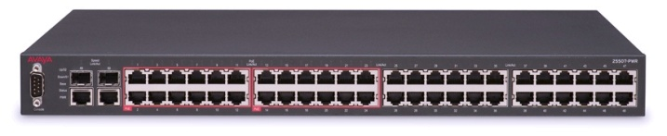
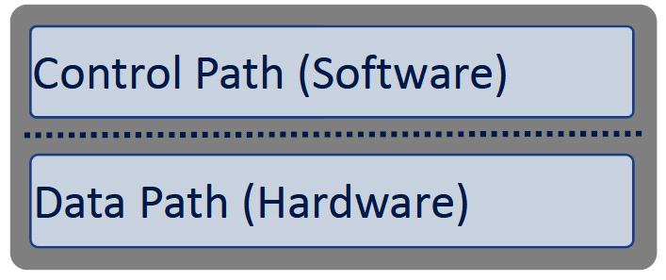
Ethernet switch
What sets the forwarding
Table in Ethernet?
Forwarding table:
12:12:12:12:12:12 port 1
3f:13:33:ef:ff:ff port 2

Slide 18
OpenFlow Controller
OpenFlow Protocol (SSL/TCP)
Control Path
OpenFlow
Data Path (Hardware)

Slide 19
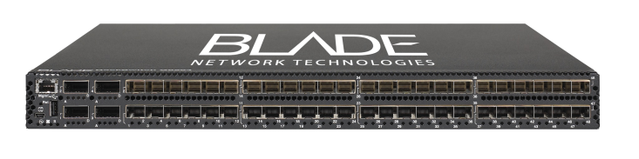

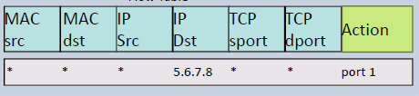

OpenFlow switch
SSL
OpenFlow controller
software
OpenFlow Client
hardware
Flow table
Port 1
Port 2
Port 3
Port 4

Slide 20
Openflow switch
An Openflow switch (Ethernet switch) has an internal flow table.
If a packet matches an entry in the flow table, perform the actions (e.g. forward to port 10) according to the flow table.
If a packet does not match any entry in the flow table. Send it to the Openflow controller
The controller will figure out what to do with such packet
The controller will then respond to the switch, informing how to handle such a packet so that the switch would know how to deal with such packets next time.
For each flow, ideally the controller will be queried once.
Openflow defines the standard interface to add and remove flow entries in the table.

Slide 21


OpenFlow Example
Controller
OpenFlow Client
PC
Software
Layer
Flow Table
MAC
src
MAC
dst
IP
Src
IP
Dst
TCP
sport
TCP
dport
Action
Hardware
Layer
*
*
*
5.6.7.8
*
*
port 1
port 1
port 2
port 3
port 4
5.6.7.8
1.2.3.4

Slide 22
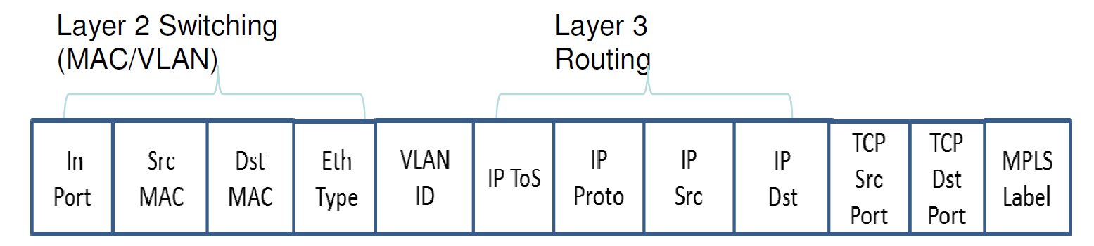
Flow switching and routing
Layer 4
Each individual field + meta data
Wild Card aggregation
E.g. IP-subnet: 192.168.*/24

Slide 23
OpenFlow Basics Flow Table Entries
Rule
Action
Stats
Packet + byte counters
Forward packet to zero or more ports
Encapsulate and forward to controller
Send to normal processing pipeline
Modify Fields
Any extensions you add!
Switch
Port
VLAN
ID
VLAN
pcp
MAC
src
MAC
dst
Eth
type
IP
Src
IP
Dst
IP
ToS
IP
Prot
L4
sport
L4
dport
+ mask what fields to match
Notes:
Now I’ll describe the API that tries to meet these goals.

Slide 24
Examples
Switching
Switch
Port
MAC
src
MAC
dst
Eth
type
VLAN
ID
IP
Src
IP
Dst
IP
Prot
TCP
sport
TCP
dport
Action
*
*
00:1f:..
*
*
*
*
*
*
*
port6
Flow Switching
Switch
Port
MAC
src
MAC
dst
Eth
type
VLAN
ID
IP
Src
IP
Dst
IP
Prot
TCP
sport
TCP
dport
Action
port3
00:20..
00:1f..
0800
vlan1
1.2.3.4
5.6.7.8
4
17264
80
port6
Firewall
Switch
Port
MAC
src
MAC
dst
Eth
type
VLAN
ID
IP
Src
IP
Dst
IP
Prot
TCP
sport
TCP
dport
Action
*
*
*
*
*
*
*
*
*
22
drop

Slide 25
Examples
Routing
Switch
Port
MAC
src
MAC
dst
Eth
type
VLAN
ID
IP
Src
IP
Dst
IP
Prot
TCP
sport
TCP
dport
Action
*
*
*
*
*
*
5.6.7.8
*
*
*
port6
VLAN Switching
Switch
Port
MAC
src
MAC
dst
Eth
type
VLAN
ID
IP
Src
IP
Dst
IP
Prot
TCP
sport
TCP
dport
Action
port6,
port7,
port9
*
*
00:1f..
*
vlan1
*
*
*
*
*

Slide 26

Centralized vs Distributed Control Both models are possible with OpenFlow
Centralized Control
Distributed Control
Controller
Controller
OpenFlow
Switch
OpenFlow
Switch
Controller
OpenFlow
Switch
OpenFlow
Switch
Controller
OpenFlow
Switch
OpenFlow
Switch

Slide 27
Flow Routing vs. Aggregation Both models are possible with OpenFlow
Flow-Based
Every flow is individually set up by controller
Exact-match flow entries
Flow table contains one entry per flow
Good for fine grain control, e.g. campus networks
Aggregated
One flow entry covers large groups of flows
Wildcard flow entries
Flow table contains one entry per category of flows
Good for large number of flows, e.g. backbone

Slide 28
Reactive vs. Proactive (pre-populated) Both models are possible with OpenFlow
Reactive
First packet of flow triggers controller to insert flow entries
Efficient use of flow table
Every flow incurs small additional flow setup time
If control connection lost, switch has limited utility
Proactive
Controller pre-populates flow table in switch
Zero additional flow setup time
Loss of control connection does not disrupt traffic
Essentially requires aggregated (wildcard) rules

Slide 29
Openflow specifications
From 1.0.0 to 1.5.0 (1.6 not public yet)
Briefly introduce concepts in versions 1.0.0 to 1.2.0

Slide 30
Openflow 1.0 concepts
Ports and Port queues
Flow table
Packet matching
Actions and packet forwarding
Messaging between controller and switch

Slide 31
Open Flow Protocol Messages
Controller-to-switch: from the controller to manage or inspect the switch state
Features, config, modify state, read state, packet-out, etc
Asynchronous: send from switch without controller soliciting
Packet-in, flow removed/expired, port status, error, etc
Symmetric: symmetric messages without solicitation in either direction
Hello, Echo, etc.

Slide 32
Openflow 1.1 concepts
Multiple flow tables
Groups
MPLS and VLAN tag support
Virtual ports
Controller connection failure

Slide 33
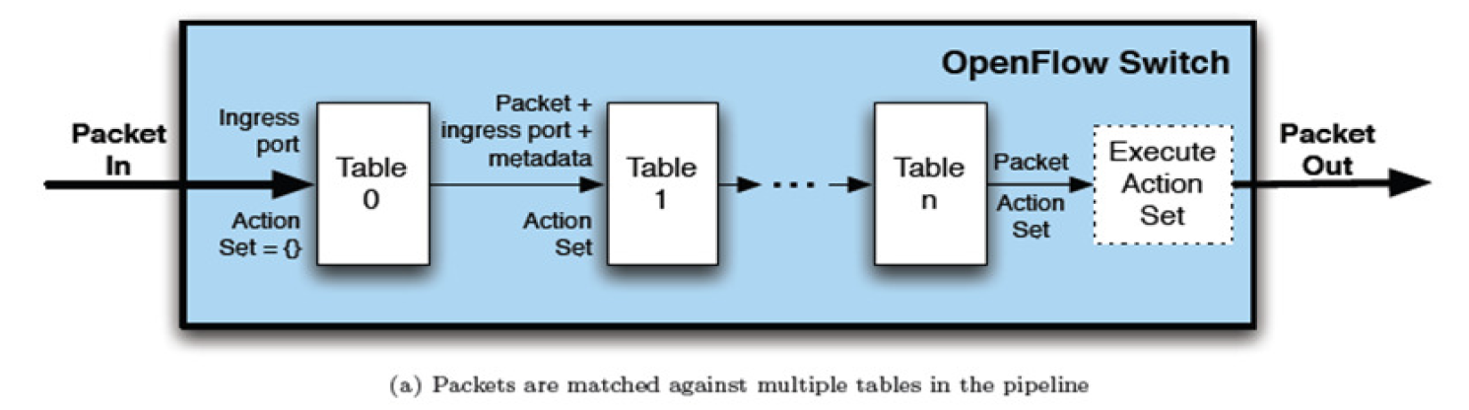
Pipeline processing (in 1.1)
A switch can have multiple flow tables that are matched in a pipeline fashion.

Slide 34
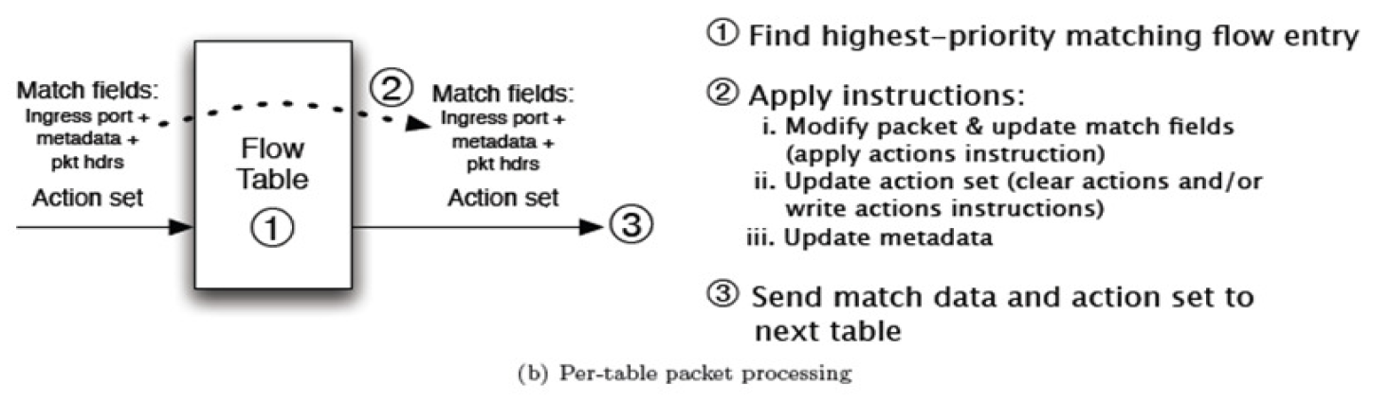
Per table packet processing

Slide 35
Groups
Group table: entries and actions
To refine flooding
Support multicast
As a base for rules that apply to multiple flows

Slide 36
1.2.0 concepts
Extensible match support
Extensible set_field packet-rewrite support
IPv6
Multiple controller enhancements
Later versions of Openflow specification supports more necessary functions.

Slide 37
Going further
Openflow is implemented in MiniNet (mininet.org), a simulation infrastructure.
Related resources
Open Networking Foundation: https://www.opennetworking.org/
This lecture materials are based on various resources in the net, in particular this file
https://www.clear.rice.edu/comp529/www/papers/tutorial_4.pdf
And book “Software Defined Networks A Comprehensive Approach” by Paul Goransson and Chuck Black

Slide 38
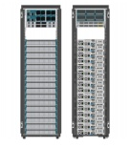
Openflow controllers
App
App
App
App
App
App
App
App
App
App
App
Network elements has two components: OpenFlow client, forwarding hardware with flow tables.
The SDN controller must implement the network OS functionality
Provide abstraction to the upper layer
Provide control to the underlying hardware
Managing the resources
Northbound Interface
SDN controller
OpenFlow

Slide 39
SDN controllers (NOS) .vs. OS
OS
Network OS
Resources managed
CPU, memory, disk, IO devices, etc
Applications:
User programs that use the resources
OS functionality (abstraction):
CPU virtualization
Memory virtualization
IO virtualization
File systems
Resources managed
Connected switches/routers/NICs
Applications
Firewall, migration, network virtualization, NAT, TE, etc
NOS functionality?
Network abstraction – this is a new thing that is not well understood.

Slide 40
NOS functionality
From: “NOX: towards an Operating System to Networks”
NOS should present application programs with a centralized programming model
Programs should be written in terms of high level abstractions, not low-level parameters

Slide 41
Existing SDN controllers
NOX/POX
Ryu
Floodlight
Pyretic
Frenetic
Open Daylight
And many more
Some artificial differences: language
More important differences:
API
Functionality

Slide 42
Openflow controller: NOX/POX
Originally developed by Nirica
NOX: C++ version; POX: python version
Nox for performance; Pox for rapid prototyping.
POX comes with Mininet – the simulation infrastructure
OpenFlow v.1.0
Programming model:
Controller registers for events (PacketIn, ConnectionUP, etc).
Programmer write event handler

Slide 43
NOX/POX Events
FlowRemoved
ConnectionUP
PacketIn
etc
User write event handlers
E.g. ConnectionUp: record in the database, PacketIn: compute the route, setup flow table along the path, etc
Abstraction? Global view build from control program, fairly low level.

Slide 44
See lab3_controller.py for an example Pox controller
10.0.0.2
3
1
2
1
2
1
10.0.0.1
1
2
4
3
2
10.0.0.3

Slide 45
Openflow SDN current state
App
App
App
App
App
App
App
App
App
App
App
4. Firewall, virtual network, TE, IDS, etc
Open Interface
Northbound API, not standardized yet
Net Windows
Net Linux
Net Mac
OS
or
or
3. SDN controllers (floodlight, nox, etc)
Open Interface
OpenFlow: standardized for
Ethernet/IP/TCP
2. OpenFlow enabled switches/routers
simple hardware doing forwarding only
forwarding table can be set by other
entity through OpenFlow

