Slide 1


Applying AI in Software Architecture and Design
Notes:
NOTE:
To change the image on this slide, select the picture and delete it. Then click the Pictures icon in the placeholder to insert your own image.

Slide 2
INTRODUCTION
Objective: Guide students in using AI tools to support software system design and select appropriate architecture.
Key Tools: ChatGPT, GitHub Copilot, PlantUML
Related CLOs: CLO3, CLO4, CLO6

Slide 3
Tools: ChatGPT, PlantUML, GitHub Copilot
ChatGPT : https://chatgpt.com/
PlantUML: https://www.plantuml.com/
GitHub Copilot: https://github.com/copilot

Slide 4
Use Case Analysis and Modeling with AI (Support Session 10)
ChatGPT:
Ask for suggestions on Actors and main Use Cases from a system description
Generate Use Case descriptions (brief, main flow, alternate flow) from input requirements
Suggest functionality based on business-related keywords
PlantUML:
Generate Use Case diagrams from text descriptions or ChatGPT outputs
Demo (illustrative slide):
Input: “Library management system with functions: borrow/return books, log in, search for books...”
Output: Use Case Diagram generated using PlantUML

Slide 5
Use Case Analysis and Modeling with AI
Sample Prompt for ChatGPT:
Prompt 1: “As a software system designer, I need to design a library management system with the following functionalities:
Users can log in, search for books, borrow, and return them
Librarians can manage books and user accounts
Please help identify the Actors and major Use Cases.”
=> Let students explain the rationale behind the identified actors and use cases.
Prompt 2: Write PlantUML code for all the proposed Use Cases.
Copy the result and paste it into PlantUML to generate the diagram.

Slide 6
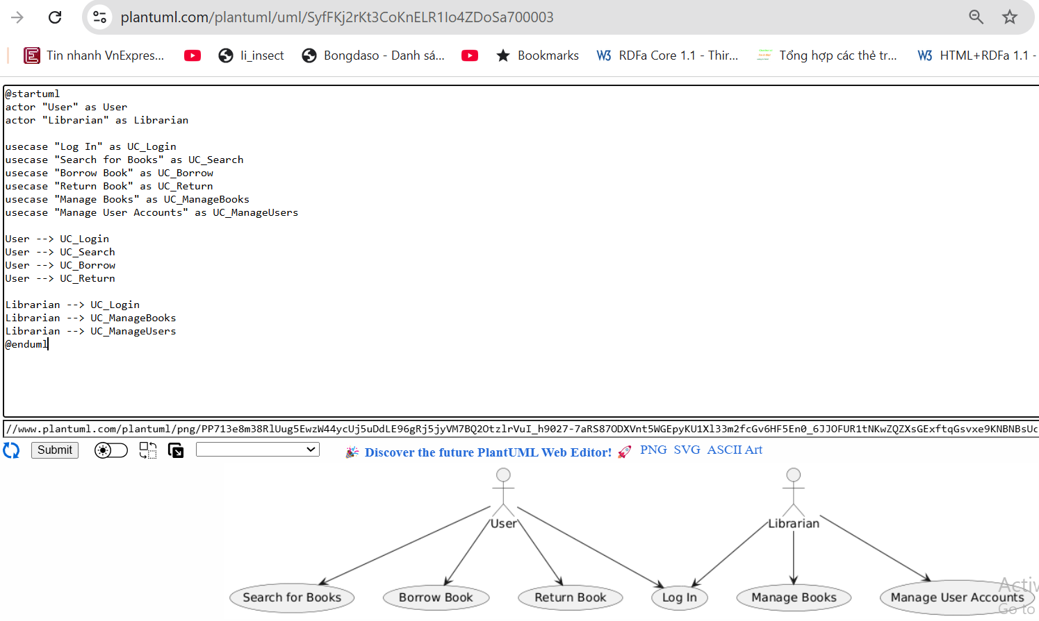
Use Case Analysis and Modeling with AI

Slide 7
AI-Supported System Design.
ChatGPT:
Suggest architectural structure based on style (Layered, MVC, Microservice, etc.)
Generate block-based system descriptions (Component Diagram, Deployment Diagram)
Assist in analyzing trade-offs between different architectural styles
PlantUML:
Quickly draw architecture diagrams (Component, Deployment)
Copilot:
Generate code templates for architectural components
Demo:
Input: “Design a Layered architecture for an online shopping system”
Output: Component Diagram + description of architecture layers

Slide 8
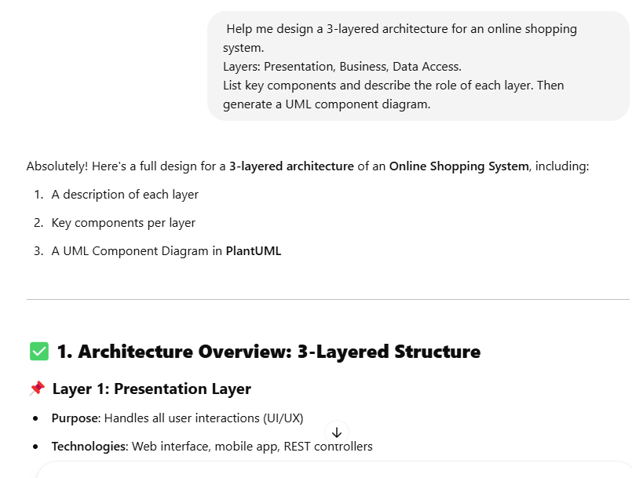
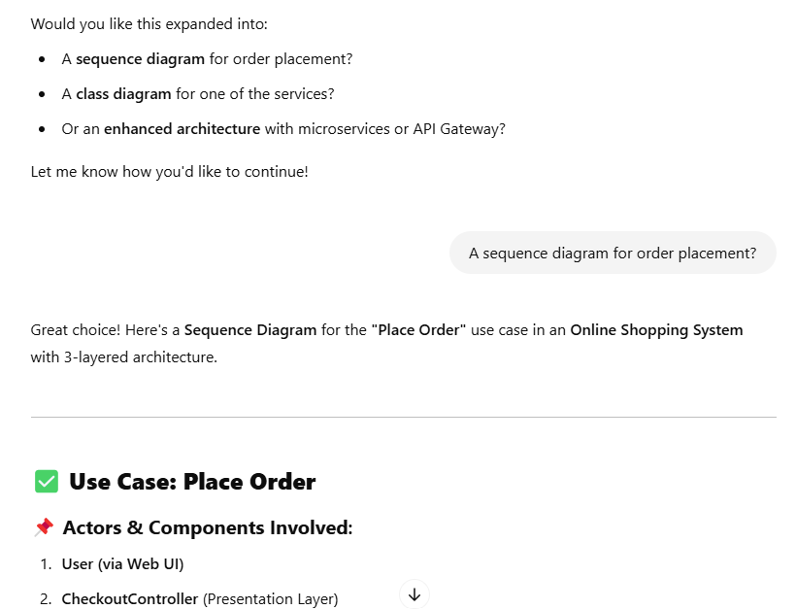
AI-Supported System Design.
Sample Prompt for ChatGPT:
Help me design a 3-layered architecture for an online shopping system.
Layers: Presentation, Business, Data Access.
List key components and describe the role of each layer. Then generate a UML component diagram.

Slide 9
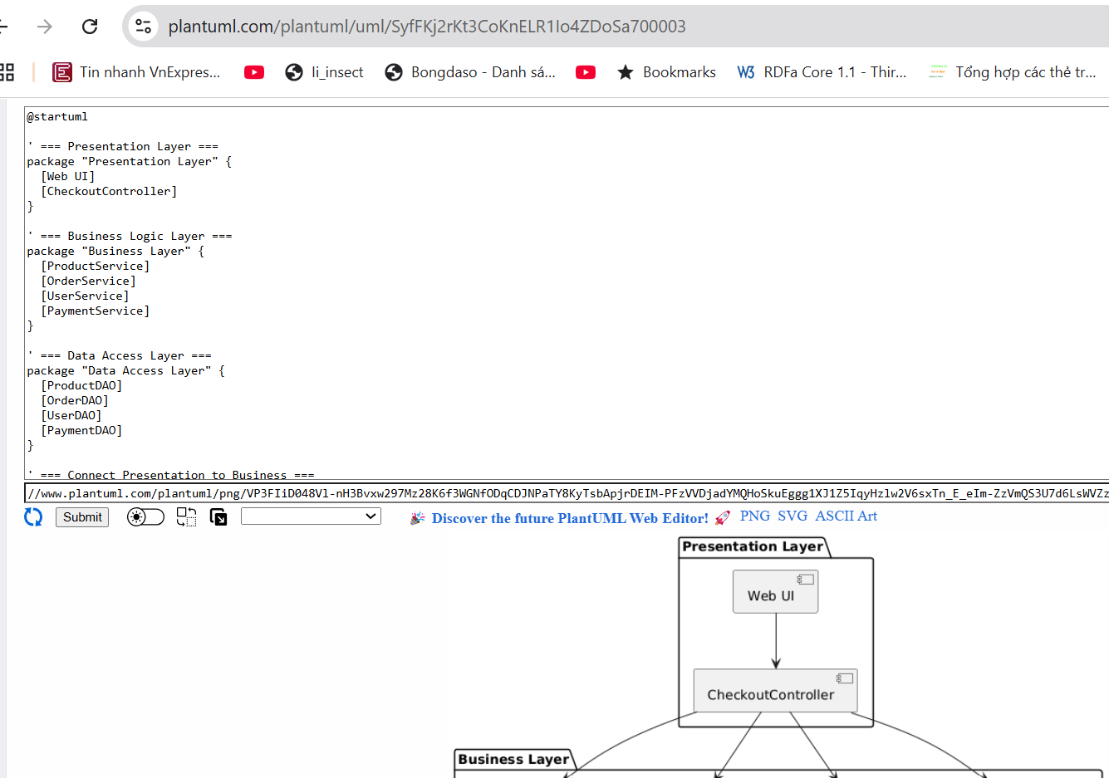
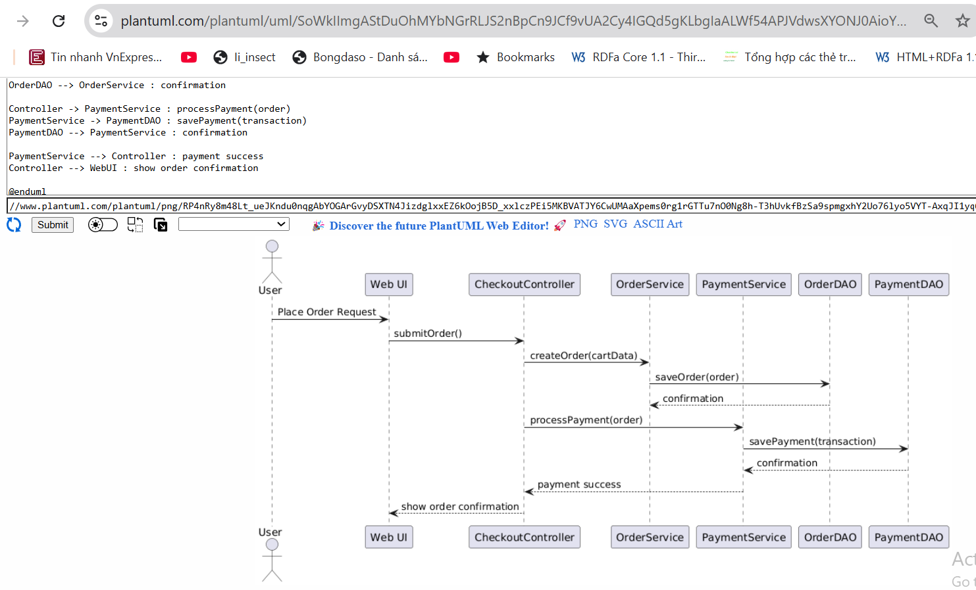
AI-Supported System Design.
Copy the PlantUML code to generate the diagram.

Slide 10
AI-Supported System Design.
Use GitHub Copilot to:
Quickly generate Service and DAO classes
Auto-complete common methods (CRUD)
Support code generation following popular design patterns (Service, Repository, Dependency Injection...)

Slide 11
AI Suggestions for Design Patterns
ChatGPT:
Ask: “Which pattern fits Use Case A?”
Suggest patterns that fit specific functionalities (e.g., Singleton for Logging, Strategy for Payment, etc.)
Generate sample code for specific patterns
Copilot:
Automatically generate pattern code when comments are written (e.g., “// Singleton pattern for configuration”)
Demo:
Input: “Design a flexible payment processing module that supports multiple methods”
Output: Strategy Pattern + Java code snippet

Slide 12
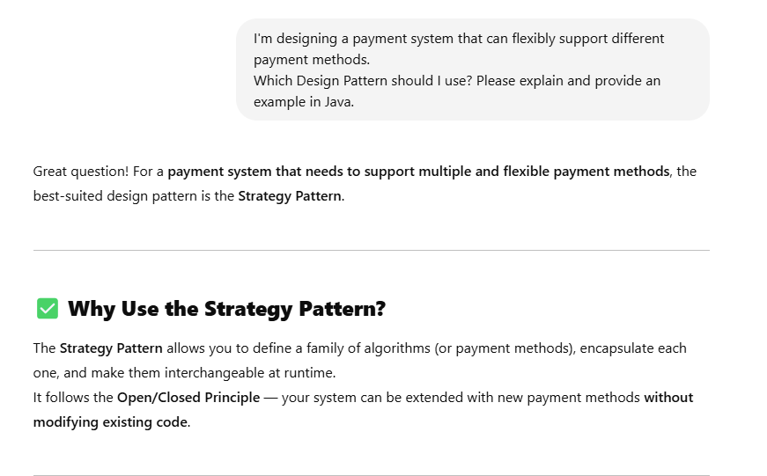
AI Suggestions for Design Patterns
"The system supports multiple payment methods (Momo, ZaloPay, Credit Card). It must be easily extensible.“
Sample Prompt for ChatGPT:
I'm designing a payment system that can flexibly support different payment methods. Which Design Pattern should I use? Please explain and provide an example in Java.

Slide 13
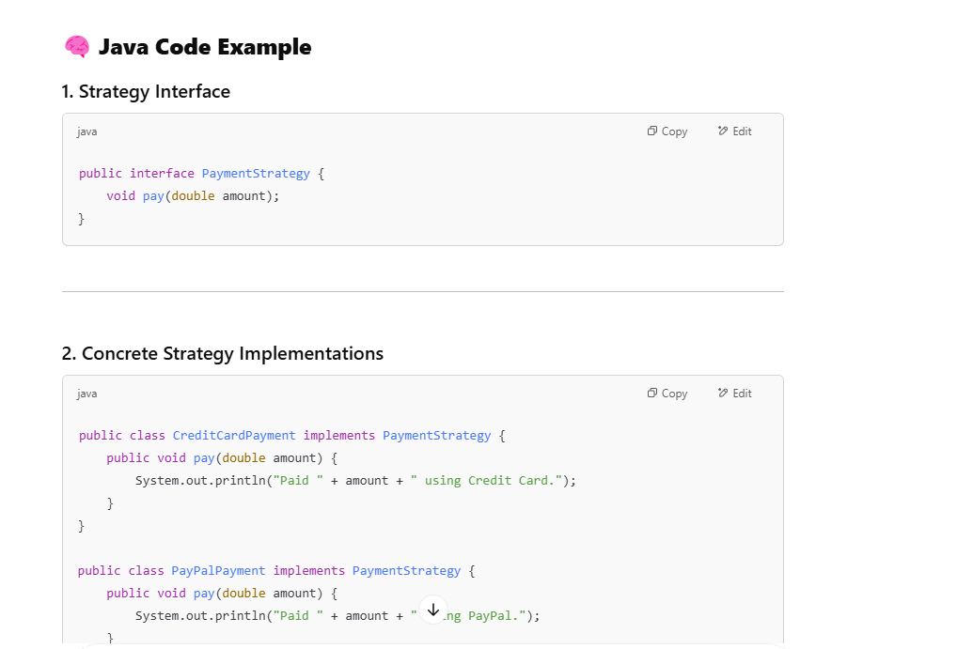
AI Suggestions for Design Patterns

Slide 14
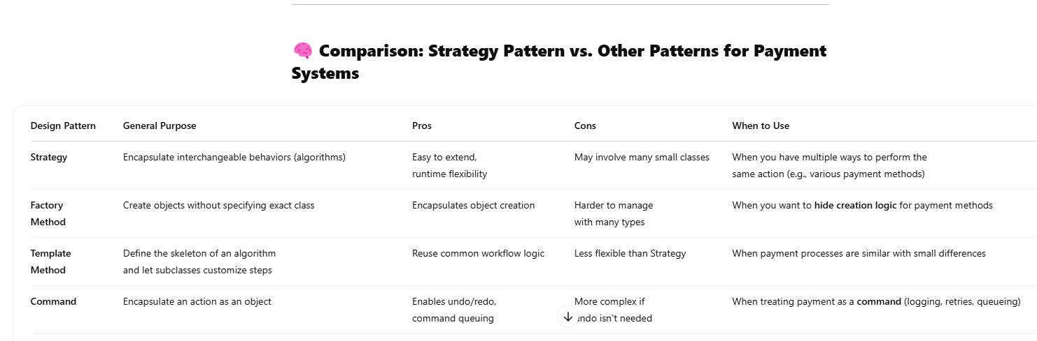
AI Suggestions for Design Patterns

Slide 15
Using AI to Select an Appropriate Architecture
Describe the System Requirements
Sample Prompt for ChatGPT:
I am designing a real-time chat application with high concurrency, scalability, and fast message delivery. What architectural style do you recommend and why?
Use AI to Compare Architecture Styles
Sample Prompt for ChatGPT:
Compare Microservices, Layered Architecture, and Event-Driven Architecture for an online shopping system. List pros and cons of each.
Ask ChatGPT to Generate a Diagram
Sample Prompt for ChatGPT:
Generate a PlantUML component diagram for a microservices architecture of an e-commerce platform.
Review and Customize

Slide 16
Using AI to Select an Appropriate Architecture
Case study:
You are assigned to design an Online Food Delivery System with the following requirements:
Functional Requirements:
Users can browse menus, place orders, and track orders in real time
Restaurants receive and prepare orders
Delivery drivers accept delivery tasks and update status
The system sends live order status updates to users
Non-Functional Requirements:
The system must handle thousands of concurrent orders
Real-time response is required (order tracking)
The system must be scalable to support multiple restaurants and regions
High reliability between loosely coupled components (delivery, payment, etc.)

Slide 17
Using AI to Select an Appropriate Architecture
Use AI (e.g., ChatGPT) to recommend a suitable software architecture for the system
Explain why that architecture is appropriate
Ask the AI to compare at least two architectures (e.g., Microservices vs Layered)
Request a PlantUML Component Diagram for the recommended architecture
Identify and suggest appropriate Design Patterns for key components (e.g., payment, notification, delivery assignment)

Slide 18
Conclusion
Conclusion
AI is a supportive assistant, not a replacement for the designer
AI outputs need validation and refinement
Integrating AI helps students think more systematically and work more efficiently

