Slide 1
Login SQLite
Notes:
https://thangcoder.com/lap-trinh-android/hoc-lap-trinh-android-nang-cao/sqlite-trong-lap-trinh-android

Slide 2
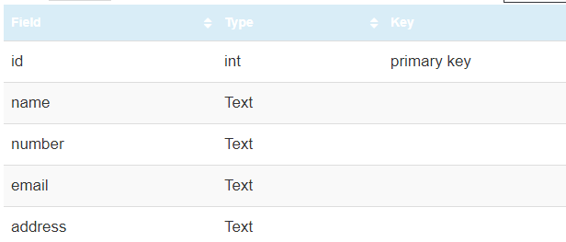
CRUD Database

Slide 3
Login voi CSDL SQLite

Slide 4
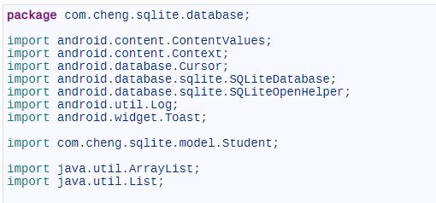

Slide 5
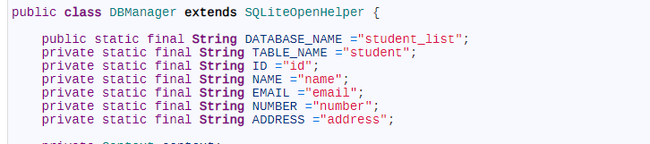

Slide 6
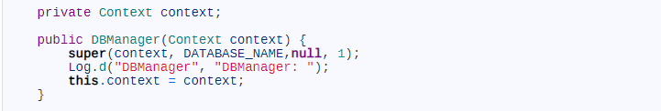

Slide 7
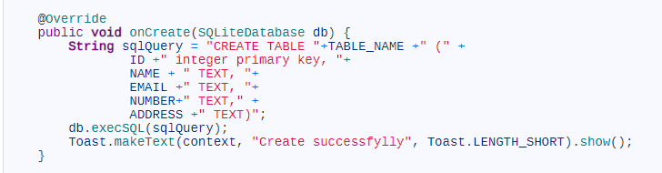

Slide 8
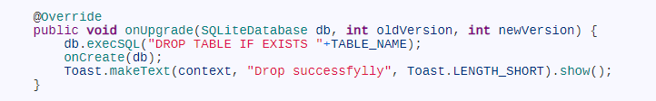

Slide 9
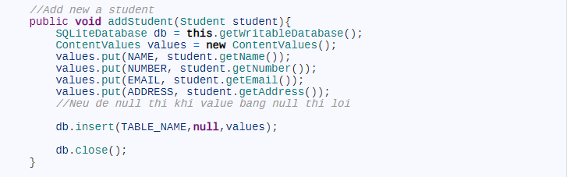

Slide 10
Login example
https://www.jackrutorial.com/2018/03/android-login-with-sqlite-database-tutorial.html

