Slide 1

Python Primer 1: Types and Operators
© 2013 Goodrich, Tamassia, Goldwasser
Python Primer

Slide 2
The Python Interpreter
Python is an interpreted language.
Commands are executed through the Python interpreter.
  The interpreter receives a command, evaluates that command, and reports the result of the command.
A programmer defines a series of commands in advance and saves those commands in a text file known as source code or a script.
For Python, source code is conventionally stored in a file named with the .py suffix (e.g., demo.py).
© 2013 Goodrich, Tamassia, Goldwasser
Python Primer

Slide 3
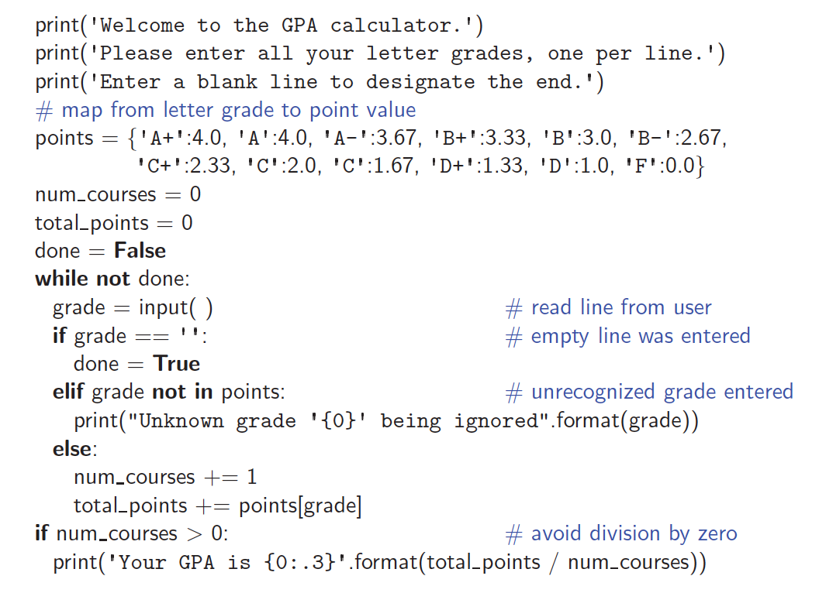
An Example Program
© 2013 Goodrich, Tamassia, Goldwasser
Python Primer

Slide 4
Objects in Python
Python is an object-oriented language and classes form the basis for all data types.
Python’s built-in classes:
  the int class for integers,
  the float class for floating-point values,
  the str class for character strings.
© 2013 Goodrich, Tamassia, Goldwasser
Python Primer

Slide 5

Identifiers, Objects, and the Assignment Statement
The most important of all Python commands is an assignment statement: temperature = 98.6
  This command establishes temperature as an identifier (also known as a name), and then associates it with the object expressed on the right-hand side of the equal sign, in this case a floating-point object with value 98.6.
© 2013 Goodrich, Tamassia, Goldwasser
Python Primer

Slide 6
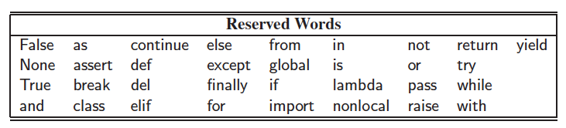
Identifiers
Identifiers in Python are case-sensitive, so temperature and Temperature are distinct names.
Identifiers can be composed of almost any combination of letters, numerals, and underscore characters.
An identifier cannot begin with a numeral and that there are 33 specially reserved words that cannot be used as identifiers:
© 2013 Goodrich, Tamassia, Goldwasser
Python Primer

Slide 7
Types
Python is a dynamically typed language, as there is no advance declaration associating an identifier with a particular data type.
An identifier can be associated with any type of object, and it can later be reassigned to another object of the same (or different) type.
Although an identifier has no declared type, the object to which it refers has a definite type. In our first example, the characters 98.6 are recognized as a floating-point literal, and thus the identifier temperature is associated with an instance of the float class having that value.
© 2013 Goodrich, Tamassia, Goldwasser
Python Primer

Slide 8
Objects
The process of creating a new instance of a class is known as instantiation.
To instantiate an object we usually invoke the constructor of a class:
w = Widget()
  This is assuming that the constructor does not require any parameters.
If the constructor does require parameters, we might use a syntax such as
w = Widget(a, b, c)
Many of Python’s built-in classes a literal form for designating new instances. For example, the command
temperature = 98.6
results in the creation of a new instance of the float class.
© 2013 Goodrich, Tamassia, Goldwasser
Python Primer

Slide 9
Calling Methods
Python supports functions a syntax such as sorted(data), in which case data is a parameter sent to the function.
Python’s classes may also define one or more methods (also known as member functions), which are invoked on a specific instance of a class using the dot (“.”) operator.
For example, Python’s list class has a method named sort that can be invoked with a syntax such as data.sort( ).
  This particular method rearranges the contents of the list so that they are sorted.
© 2013 Goodrich, Tamassia, Goldwasser
Python Primer

Slide 10
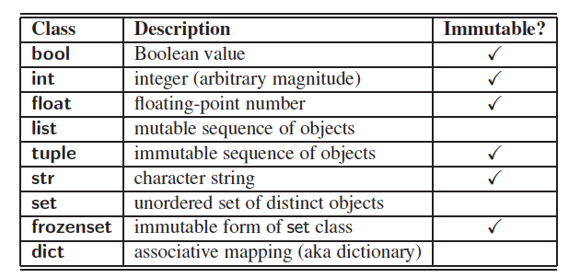
Built-In Classes
A class is immutable if each object of that class has a fixed value upon instantiation that cannot subsequently be changed. For example, the float class is immutable.
© 2013 Goodrich, Tamassia, Goldwasser
Python Primer

Slide 11
The bool Class
The bool class is used for logical (Boolean) values, and the only two instances of that class are expressed as the literals:
True and False
The default constructor, bool( ), returns False.
Python allows the creation of a Boolean value from a nonboolean type using the syntax bool(foo) for value foo. The interpretation depends upon the type of the parameter.
  Numbers evaluate to False if zero, and True if nonzero.
  Sequences and other container types, such as strings and lists, evaluate to False if empty and True if nonempty.
© 2013 Goodrich, Tamassia, Goldwasser
Python Primer

Slide 12
The int Class
The int class is designed to represent integer values with arbitrary magnitude.
  Python automatically chooses the internal representation for an integer based upon the magnitude of its value.
The integer constructor, int( ), returns 0 by default.
This constructor can also construct an integer value based upon an existing value of another type.
  For example, if f represents a floating-point value, the syntax int(f) produces the truncated value of f. For example, int(3.14) produces the value 3, while int(−3.9) produces the value −3.
  The constructor can also be used to parse a string that represents an integer. For example, the expression int( 137 ) produces the integer value 137.
© 2013 Goodrich, Tamassia, Goldwasser
Python Primer

Slide 13
The float Class
The float class is the floating-point type in Python.
  The floating-point equivalent of an integral number, 2, can be expressed directly as 2.0.
  One other form of literal for floating-point values uses scientific notation. For example, the literal 6.022e23 represents the mathematical value 6.022×10²³.
The constructor float( ) returns 0.0.
When given a parameter, the constructor, float, returns the equivalent floating-point value.
  float(2) returns the floating-point value 2.0
  float(‘3.14’) returns 3.14
© 2013 Goodrich, Tamassia, Goldwasser
Python Primer

Slide 14
The list Class
A list instance stores a sequence of objects, that is, a sequence of references (or pointers) to objects in the list.
Elements of a list may be arbitrary objects (including the None object).
Lists are array-based sequences and a list of length n has elements indexed from 0 to n−1 inclusive.
Lists have the ability to dynamically expand and contract their capacities as needed.
Python uses the characters [ ] as delimiters for a list literal.
  [ ] is an empty list.
  [‘red’, ‘green’, ‘blue’] is a list containing three string instances.
The list( ) constructor produces an empty list by default.
The list constructor will accept any iterable parameter.
  list(‘hello’) produces a list of individual characters, [‘h’, ‘e’, ‘l’, ‘l’, ‘o’].
© 2013 Goodrich, Tamassia, Goldwasser
Python Primer

Slide 15
The tuple Class
The tuple class provides an immutable (unchangeable) version of a sequence, which allows instances to have an internal representation that may be more streamlined than that of a list. Parentheses delimit a tuple.
  The empty tuple is ()
To express a tuple of length one as a literal, a comma must be placed after the element, but within the parentheses.
  For example, (17,) is a one-element tuple.
© 2013 Goodrich, Tamassia, Goldwasser
Python Primer

Slide 16
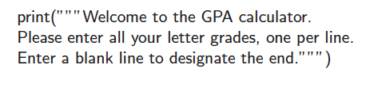
The str Class
String literals can be enclosed in single quotes, as in ‘hello’, or double quotes, as in "hello".
A string can also begin and end with three single or double quotes, if it contains newlines in it.
© 2013 Goodrich, Tamassia, Goldwasser
Python Primer

Slide 17
The set Class
Python’s set class represents a set, namely a collection of elements, without duplicates, and without an inherent order to those elements.
Only instances of immutable types can be added to a Python set. Therefore, objects such as integers, floating-point numbers, and character strings are eligible to be elements of a set.
  The frozenset class is an immutable form of the set type, itself.
Python uses curly braces { and } as delimiters for a set
  For example, as {17} or {‘red’, ‘green’, ‘blue’}
  The exception to this rule is that { } does not represent an empty set. Instead, the constructor set( ) returns an empty set.
© 2013 Goodrich, Tamassia, Goldwasser
Python Primer

Slide 18
The dict Class
Python’s dict class represents a dictionary, or mapping, from a set of distinct keys to associated values.
Python implements a dict using an almost identical approach to that of a set, but with storage of the associated values.
  The literal form { } produces an empty dictionary.
A nonempty dictionary is expressed using a comma-separated series of key:value pairs. For example, the dictionary {‘ga’ : ‘Irish’, ‘de’ : ‘German’} maps ‘ga’ to ‘Irish’ and ‘de’ to ‘German’.
Alternatively, the constructor accepts a sequence of key-value pairs as a parameter, as in dict(pairs) with pairs = [(‘ga’, ‘Irish’), (‘de’, ‘German’)].
© 2013 Goodrich, Tamassia, Goldwasser
Python Primer

Slide 19
Expressions and Operators
Existing values can be combined into expressions using special symbols and keywords known as operators.
The semantics of an operator depends upon the type of its operands.
For example, when a and b are numbers, the syntax a + b indicates addition, while if a and b are strings, the operator + indicates concatenation.
© 2013 Goodrich, Tamassia, Goldwasser
Python Primer

Slide 20

Logical Operators
Python supports the following keyword operators for Boolean values:
The and and or operators short-circuit, in that they do not evaluate the second operand if the result can be determined based on the value of the first operand.
© 2013 Goodrich, Tamassia, Goldwasser
Python Primer

Slide 21
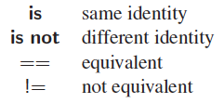
Equality Operators
Python supports the following operators to test two notions of equality:
The expression, a is b, evaluates to True, precisely when identifiers a and b are aliases for the same object.
The expression a == b tests a more general notion of equivalence.
© 2013 Goodrich, Tamassia, Goldwasser
Python Primer

Slide 22
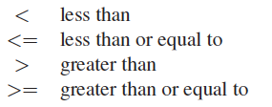
Comparison Operators
Data types may define a natural order via the following operators:
These operators have expected behavior for numeric types, and are defined lexicographically, and case-sensitively, for strings.
© 2013 Goodrich, Tamassia, Goldwasser
Python Primer

Slide 23
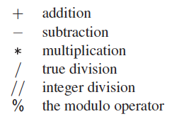
Arithmetic Operators
Python supports the following arithmetic operators:
For addition, subtraction, and multiplication, if both operands have type int, then the result is an int; if one or both operands have type float, the result is a float.
True division is always of type float, integer division is always int (with the result truncated)
© 2013 Goodrich, Tamassia, Goldwasser
Python Primer

Slide 24
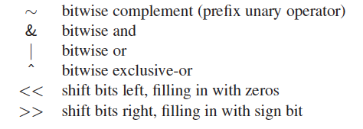
Bitwise Operators
Python provides the following bitwise operators for integers:
© 2013 Goodrich, Tamassia, Goldwasser
Python Primer

Slide 25
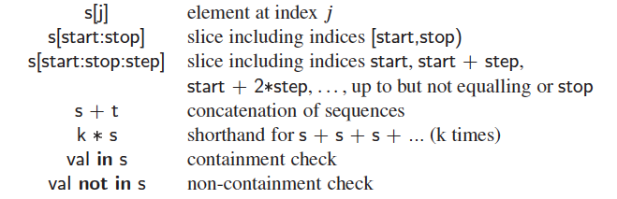
Sequence Operators
Each of Python’s built-in sequence types (str, tuple, and list) support the following operator syntaxes:
© 2013 Goodrich, Tamassia, Goldwasser
Python Primer

Slide 26
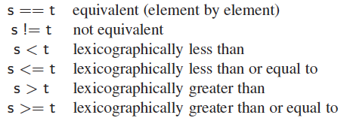
Sequence Comparisons
Sequences define comparison operations based on lexicographic order, performing an element by element comparison until the first difference is found.
  For example, [5, 6, 9] < [5, 7] because of the entries at index 1.
© 2013 Goodrich, Tamassia, Goldwasser
Python Primer

Slide 27
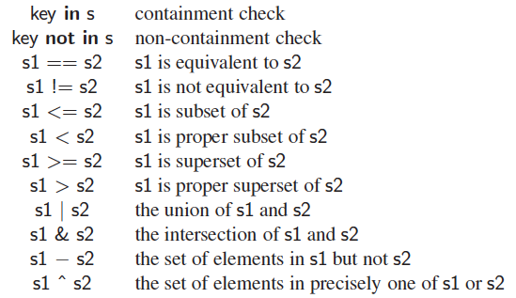
Operators for Sets
Sets and frozensets support the following operators:
© 2013 Goodrich, Tamassia, Goldwasser
Python Primer

Slide 28
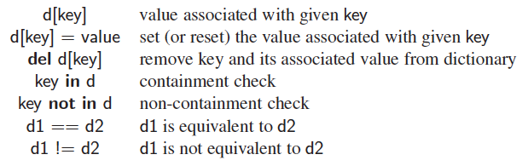
Operators for Dictionaries
The supported operators for objects of type dict are as follows:
© 2013 Goodrich, Tamassia, Goldwasser
Python Primer

Slide 29
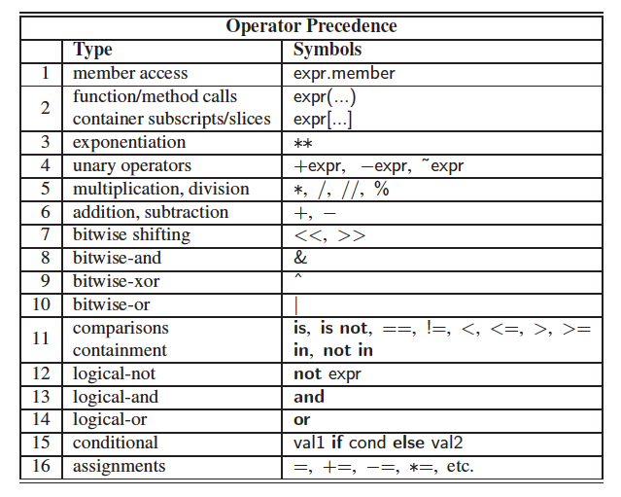
Operator Precedence
© 2013 Goodrich, Tamassia, Goldwasser
Python Primer

