Slide 1

Chapter 2:
SQL for Data Science with R

Slide 2
Getting Started with Databases using R 1
- Why use R with Relational Databases
- R Persistence Options
- Terminology Comparison
- Mapping Data between R and RDBMS

Slide 3
Objective
Explain the benefits of using R wit relational databases
R Persistence Options
Terminology Comparison
Mapping Data between R and RDBMS

Slide 4
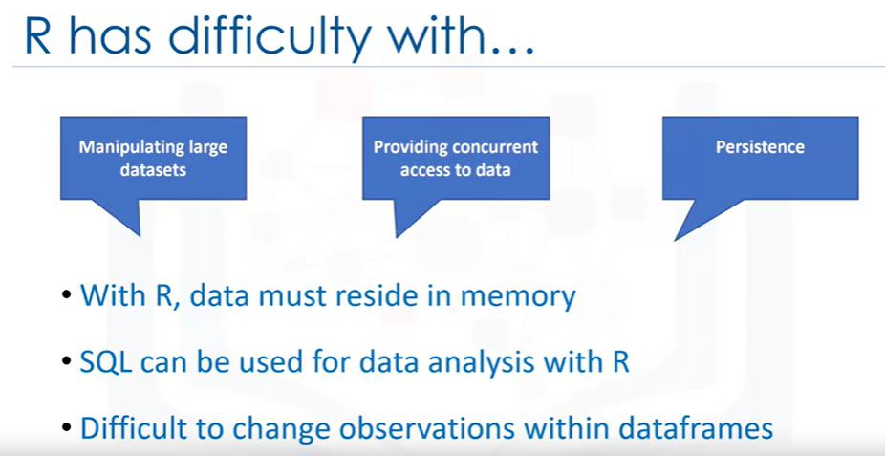
Why use R with Relational Databases

Slide 5
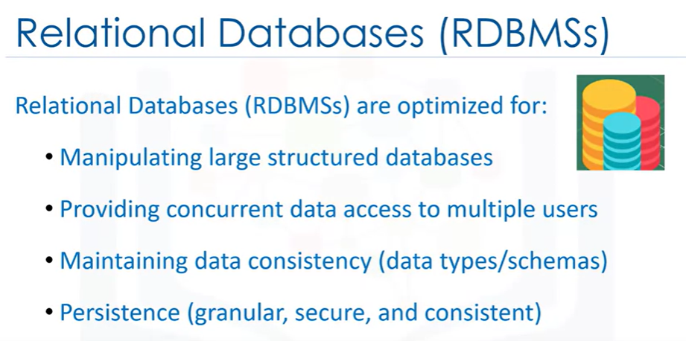
Why use R with Relational Databases

Slide 6
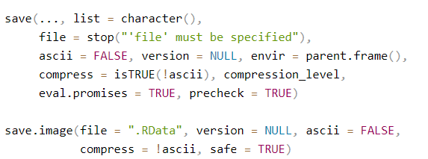
R Persistence Options
Syntax

Slide 7
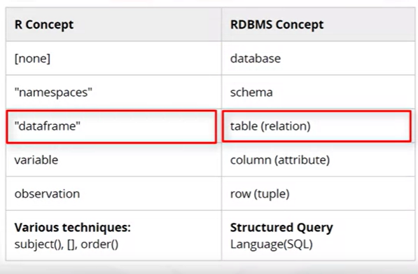
Terminology Comparison

Slide 8

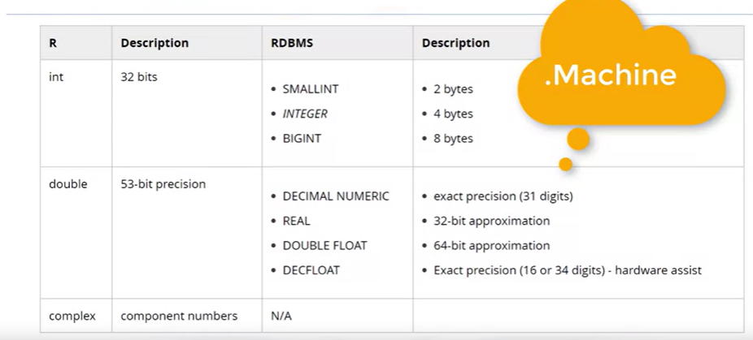
Mapping Data between R and RDBMS

Slide 9
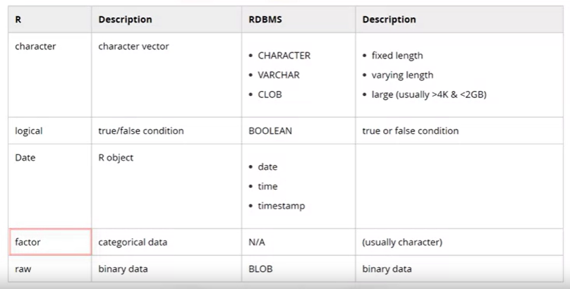
Mapping Data between R and RDBMS

Slide 10
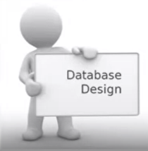
Database Design Considerations
Relational databases are usually designed to minimize data redundancy.
Data redundancy can lead to data anomalies and corruption and is generally avoided by design.
Applying database normalization techniques reduce redundancy and improve usage of storage.
Proper use of foreign keys also reduces data redundancy and the chance of destructive anomalies

Slide 11
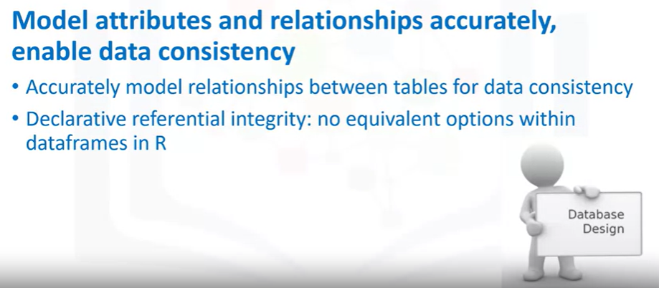
Database Design Considerations

Slide 12
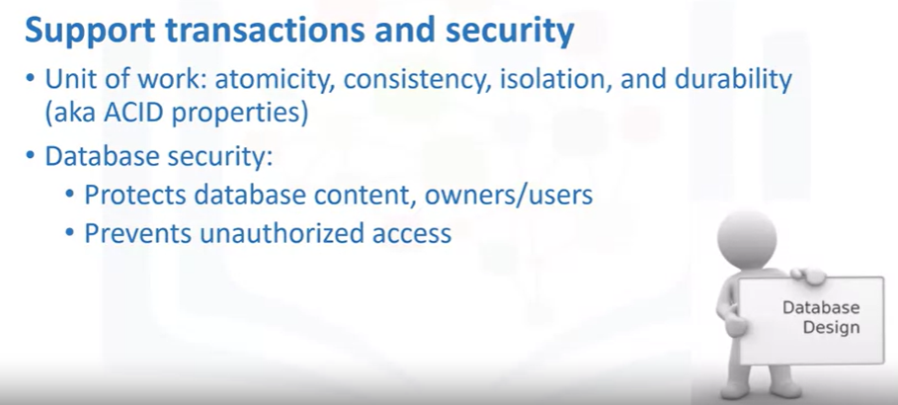
Database Design Considerations

Slide 13
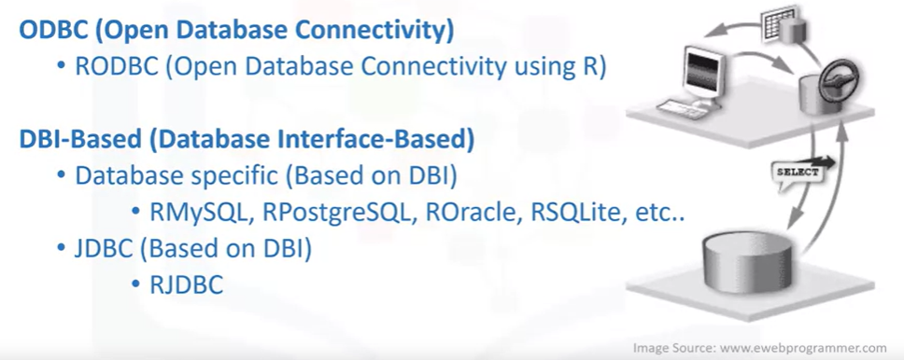
Connectivity Options
There are many different R packages available for database server data access.

Slide 14
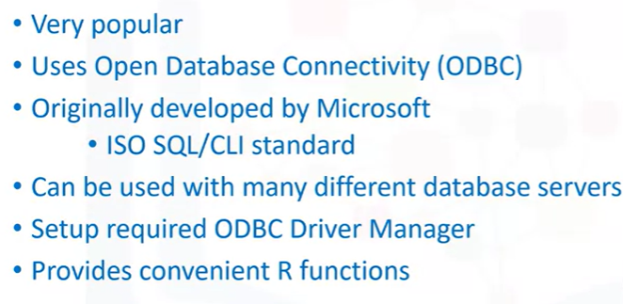
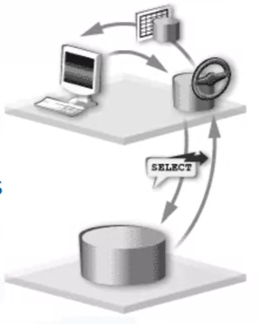
Connectivity Options

Slide 15
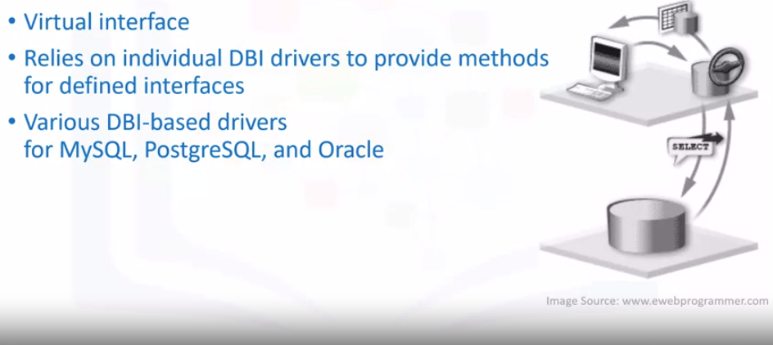
Connectivity Options

Slide 16

Connectivity Options

Slide 17
Summary
At this point in the course, you know:
Why use R with Relational Databases
R Persistence Options
Terminology Comparison
Mapping Data between R and RDBMS

Slide 18
Q & A

