Slide 1

Chapter 2:
SQL for Data Science with R

Slide 2
Working with Database Objects using R 1
- Working with Data
- Database Design and Data Preparation

Slide 3
Objective
Working with Data: Steps required to obtain data from an external data source and map them to a relational database design
Database design that supports data analysis tasks
Data preparation

Slide 4

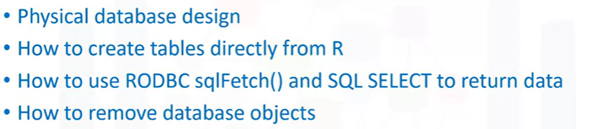
Working with Data
Examine the task of obtaining data from an external data source and mapping it to a relational database design:

Slide 5
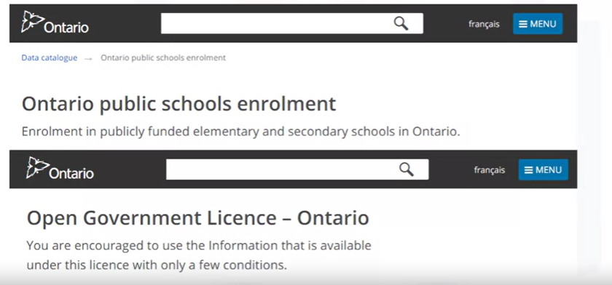
Working with Data
Examine the enrollment of students across the 5,000 or so different publicly-funded schools in the Province of Ontario in Canada

Slide 6
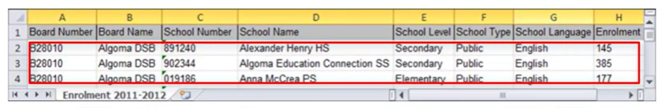
Working with Data
Problem: The redundancy of data.
Design a database system to support many concurrent R users
Split data into 2 different tables:
A table stores information about each school board
A table stores information about each individual school

Slide 7
Working with Data
Problem: Encounter similar datasets either pre-existing as database tables, database dump files or raw data.
- Consider the logical and physical database design for this data
- Create the tables and load the data for our analysis.

Slide 8
Working with Data
Problem: Encounter similar datasets either pre-existing as database tables, database dump files or raw data.
- Consider the logical and physical database design for this data
- Create the tables and load the data for our analysis.

Slide 9

Working with Data
Task 1: Create the logical and physical database designs. Tools are available that extremely helpful for this task; IBM InfoSphere Data Architect is
Task 2: Clean and split the data into load files. Python or other tools/languages are usually used for this task.
Task 3: Create the physical database objects using database commands or using R.
Task 4: Get the data into the database using database commands or using R.
Task 5: Analyze the data in the database using R.

Slide 10
Working with Data
What are the considerations?
When working with some data, steps are consistent even with large or small datasets. We only consider:
Database design process
Choice of database server
Concurrent access
Use R to perform data analysis

Slide 11

Working with Data
Task 1: Build a logical and physical model of the data using a tool like IBM InfoSphere Data Architect
Task 2: Clean and split the data into load files
Task 3: Create the physical DB objects using database tools or from R using RODBC.
Task 4: Get the data into Database
Task 5: Analyze data using R and/or SQL
Notes:
Task 1: Examine the data. We want to better understand the quality and nature of the data. Since we want the data to be analyzed from a database server we should build a logical and physical model of the data using a tool like IBM InfoSphere Data Architect. These tools provide many benefits, especially if you expect more attributes to be added to the data over time.
The data models can be easily maintained and shared with others.
Task 2: Could take a few minutes or a few hours depending on the quality of the data and often this phase involves the use of tools such as Python.
Task 3: Involves the creation of tables to hold the data to be analyzed. This can be accomplished outside of R using database tools or from R using RODBC.
Task 4: Involves loading the data into the newly defined tables.
Task 5: Involves the use of R and/or SQL to extract data from the database and perform data analysis tasks.

Slide 12

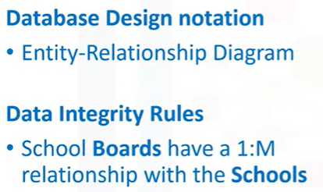
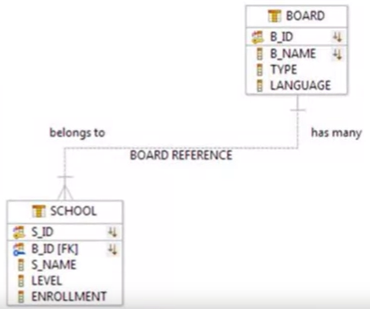
Database Design and Data Preparation

Slide 13
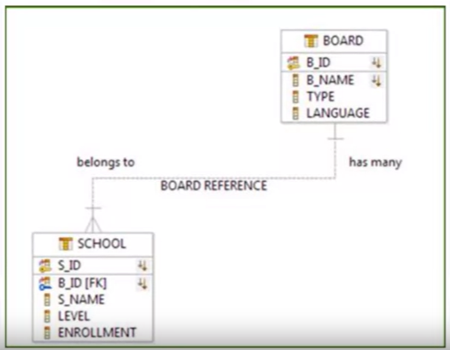
Database Design and Data Preparation
We say, school boards have a 1-to-many
relationship with the schools

Slide 14


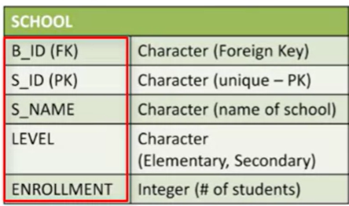
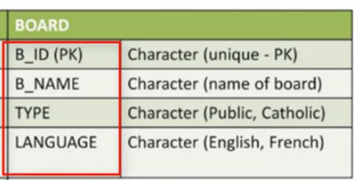
Database Design and Data Preparation
The S_ID attribute is a primary key and there is a foreign key of B_ID identified to maintain a referential constraint between the two tables.
This relationship is modeled to ensure that any new school MUST belong to a school board before the school can be created

Slide 15
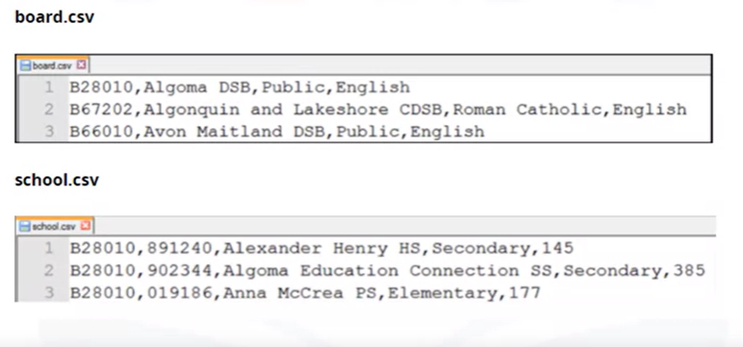
Database Design and Data Preparation
Examine the quality and format of the data: use Python or other tools to prepare the data before moving the data into the defined tables.

Slide 16
Summary
At this point in the course, you know:
Accessing and querying a database using R is a five-step process that includes creating logical and physical database designs, cleaning and splitting the data into load files, creating the physical database objects, getting the data into the database, and analyzing the data.
A logical design is defined by an entity-relationship diagram and data integrity rules, while a physical database design includes the preparation of data for the RDBMS into load files.

Slide 17
Q & A
Chapter1- Importing Datasets

