Slide 1

Chapter 2:
SQL for Data Science with R

Slide 2
Working with Database Objects using R 1

Slide 3
Objective
Create a physical database and required database objects from a database model
Differentiate between IMPORT and LOAD commands
Chapter1- Importing Datasets

Slide 4

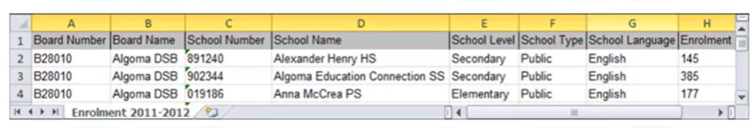
Creating Physical Database Objects
Task 3
Use DB2 as the database server.
The concept is similar for most relational database servers

Slide 5

Creating Physical Database Objects
Using the DB2 Command Line Processor to create two databases.
The CONNECT command is used to ensure connect to the newly created database.

Slide 6
Creating Physical Database Objects
Directly using native commands within the database server
Using RODBC functions within R itself

Slide 7
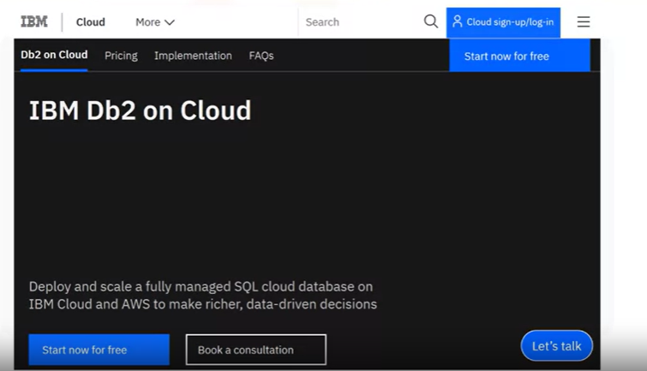
Creating Physical Database Objects

Slide 8
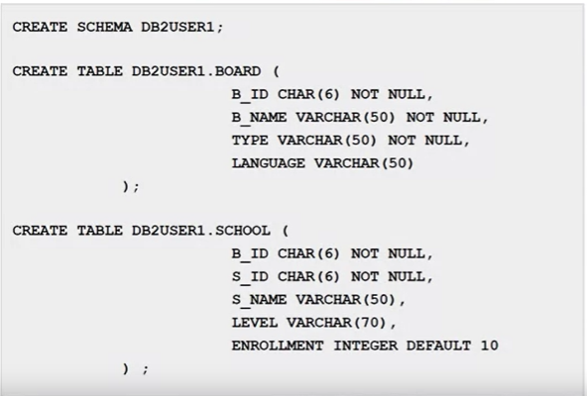
Creating Physical Database Objects

Slide 9
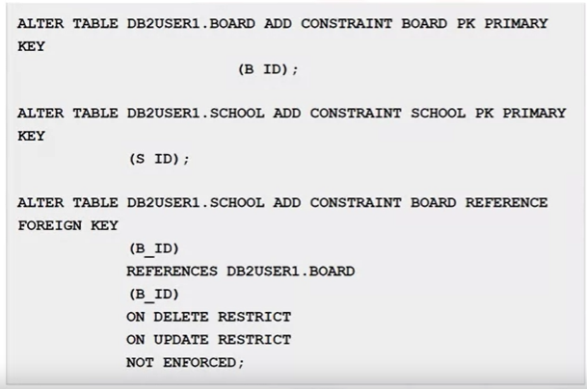
Creating Physical Database Objects
Some databases provide graphical tools and wizards for this purpose

Slide 10

Creating Physical Database Objects
- sqlQuery(): create a database from an R script
- sqlClear(): remove the data

Slide 11
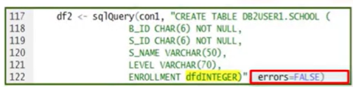


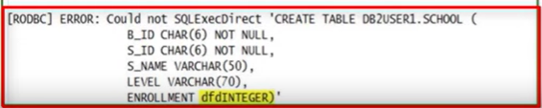
Creating Physical Database Objects

Slide 12

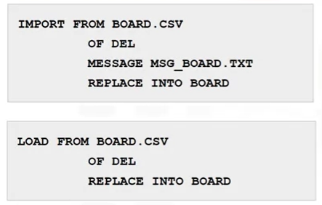
Loading the Data
The IMPORT command performs SQL INSERT statements
for a group of rows and then commits the transaction periodically.

Slide 13

Loading the Data
The IMPORT command performs SQL INSERT statements
for a group of rows and then commits the transaction periodically.

Slide 14

Loading the Data
The LOAD command will bypass the database transactional logging mechanism and store the data on disk very quickly.
his technique is fine for a few thousand rows of data, but if you have hundreds of
thousands or millions of rows of data, the LOAD command is the better option.

Slide 15
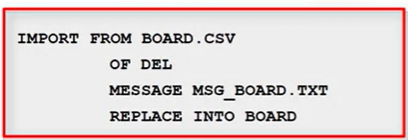
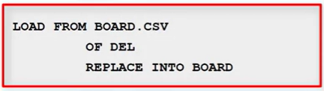
Loading the Data
Use the IMPORT command for small to medium datasets
Use the LOAD command is best for large datasets.
It bypasses the logging mechanism and is much faster.

Slide 16
Summary
At this point in the course, you know:
You use the logical database model to create the physical database objects by defining a storage area, which will include system tables and log files, connecting to the database, and creating the tables.
When adding small to medium amounts of data to a database server, use the IMPORT command, which performs SQL INSERT statements for a group of rows and commits the transaction periodically.
When adding larger amounts of data to a database server, use the LOAD command because it bypasses the transaction logging mechanism and speeds up the process.

Slide 17
Q & A
Chapter1- Importing Datasets

