Slide 1

Chapter 2:
SQL for Data Science with R

Slide 2
Working with Database Objects using R 3

Slide 3
Objective
Querying Data (SQL SELECT)
Analyzing the Data

Slide 4
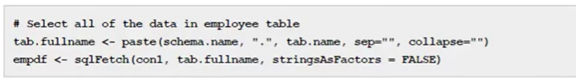
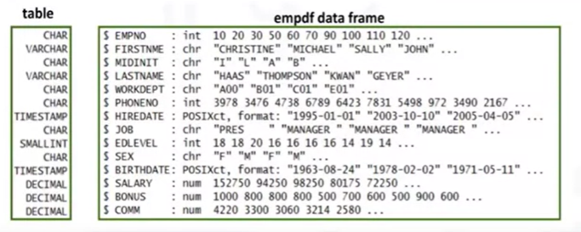
Querying Data (SQL SELECT)
- sqlFetch(): select a full-table

Slide 5


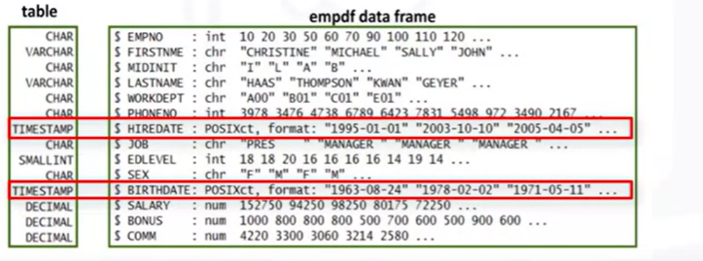
Querying Data (SQL SELECT)
Data Mapping is determined by RODBC to avoid using empty tables.
stringsAsFactors parameter is set to FALSE
HIREDATE & BIRTHDATE columns are mapped to the POSIXct data types

Slide 6
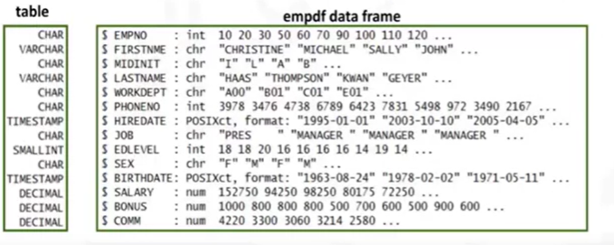
Querying Data (SQL SELECT)
Data Mapping is determined by RODBC to avoid using empty tables.
stringsAsFactors parameter is set to FALSE

Slide 7

Querying Data (SQL SELECT)
Scenario 1: Examine possible correlations between the age and the salaries
of a group of employees.
1
2
3

Slide 8


Querying Data (SQL SELECT)
Scenario 1: Examine possible correlations between the age and the salaries
of a group of employees.
4
5

Slide 9
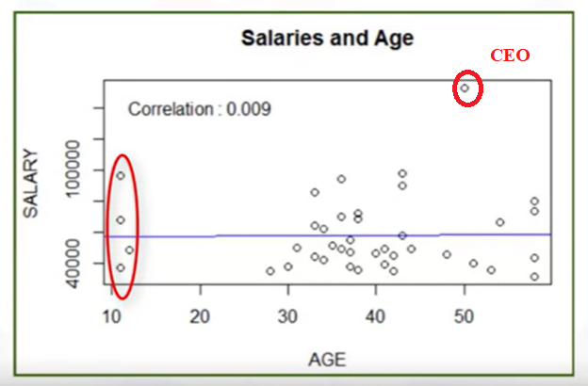
Querying Data (SQL SELECT)
1- There is very little correlation between ages and salaries.
2- Outlier, which would likely represent the president or CEO of the company.
3- The distribution of age values is also a bit strange, as there are four (4) employees who seem to be 10 or 11 years old

Slide 10

Querying Data (SQL SELECT)
Scenario 2: Analyze the distribution salaries by job type: Are the salaries by job type reasonable?
1 - consider job type as a factor (or category variable)
2 - create a boxplot to show distribution and mean by job.

Slide 11
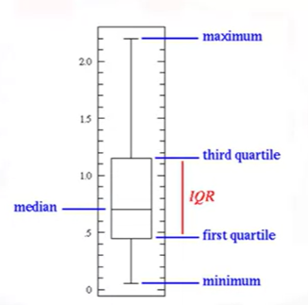
Querying Data (SQL SELECT)
Boxplots are used to visualize the median and distribution, both within a category and
across categories.

Slide 12
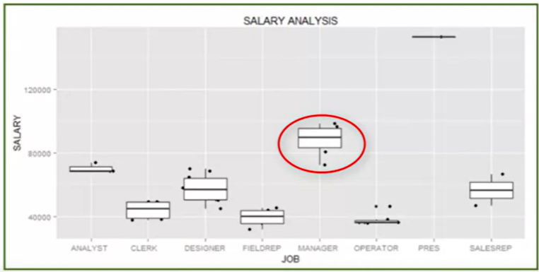
Querying Data (SQL SELECT)
generate a boxplot with jitter of salaries by job category.
=> the job type Manager earns higher salaries than most other job types.

Slide 13

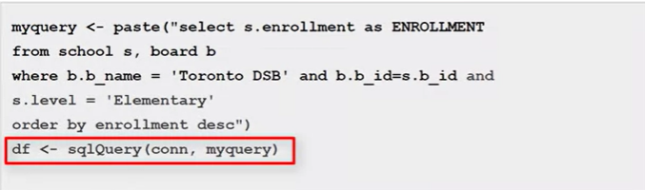
Analyzing the Data
When data is to be retrieved into R, simply call the RODBC sqlQuery() or sqlFetch() functions.
Example: using sqlQuery() to execute a SQL statement

Slide 14

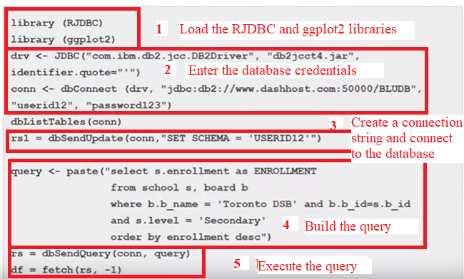
Analyzing the Data

Slide 15
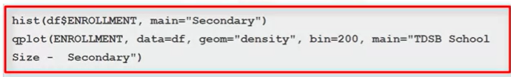
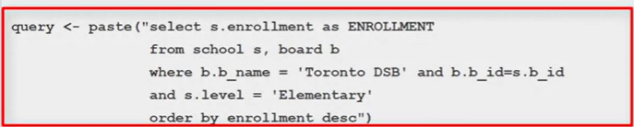

Analyzing the Data
Get the data for the Toronto District School Board.
Define the dataframes
Print the dataframes

Slide 16

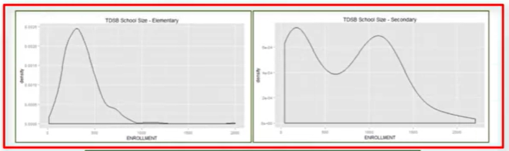
Analyzing the Data
Creates a density boxplot for the secondary, elementary, and Toronto District School Board.
Quite a different distribution of enrollment at elementary and secondary schools. There is a clear bi-modal distribution of sizes for secondary schools and a normal distribution of elementary

Slide 17
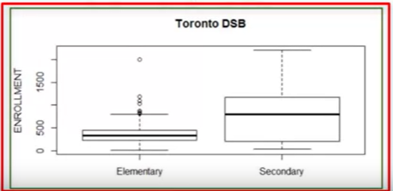
Analyzing the Data
Secondary schools are larger on average than elementary schools.

Slide 18
Summary
At this point in the course, you know:
After creating the database, you can use it to analyze the data by loading the data into a dataframe using the sqlQuery() or sqlFetch() function.

Slide 19
Q & A
Chapter1- Importing Datasets

