Slide 1

Chapter 3: Data Analysis with R

Slide 2
Model Evaluation 2

Slide 3
Objective
Improve the generalization of your models using regularization
Compare and contrast regularization types
Chapter1- Importing Datasets

Slide 4

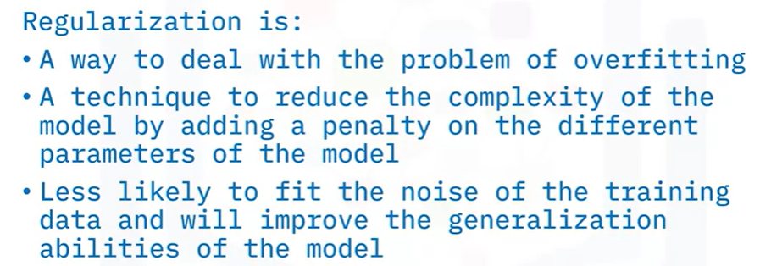
Regularization

Slide 5
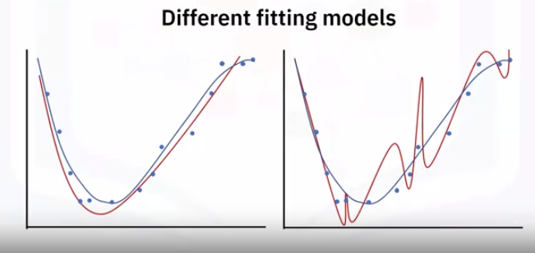
Regularization
Regularization is a technique used to avoid this overfitting problem
Models overfit the data that have, for example, too many parameters.
Notes:
When the model fits the training data but does not have good predicting performance and generalization power, you have an overfitting problem

Slide 6
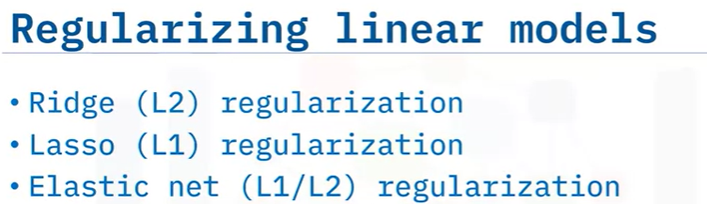
Regularization
Notes:
When the model fits the training data but does not have good predicting performance and generalization power, you have an overfitting problem

Slide 7

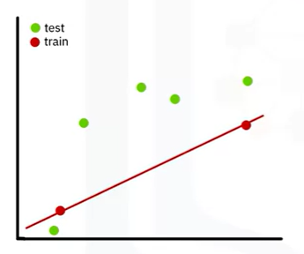
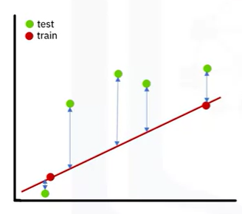

Regularization
Fit a red line between the two red dots using least squares.
Sum of square residuals =0
Notes:
When the model fits the training data but does not have good predicting performance and generalization power, you have an overfitting problem

Slide 8
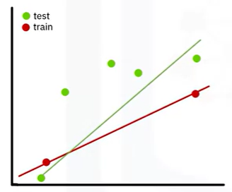
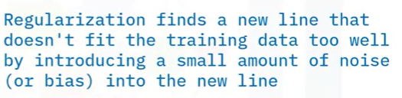
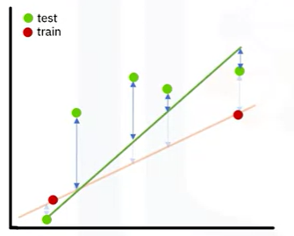

Regularization
Notes:
When the model fits the training data but does not have good predicting performance and generalization power, you have an overfitting problem

Slide 9
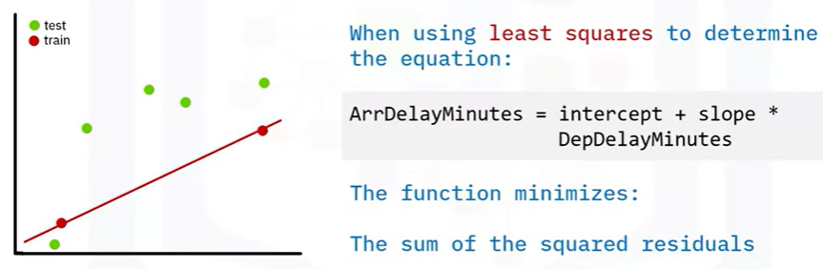
Regularization
Notes:
When the model fits the training data but does not have good predicting performance and generalization power, you have an overfitting problem

Slide 10

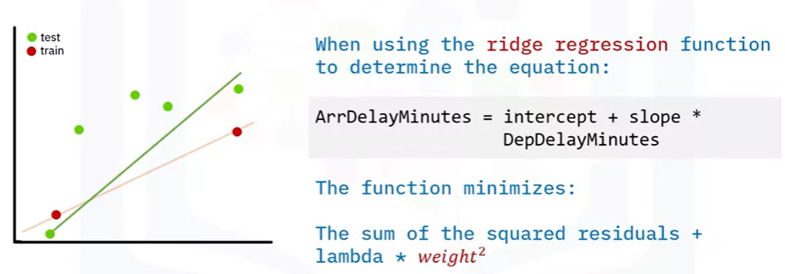
Regularization
Notes:
When the model fits the training data but does not have good predicting performance and generalization power, you have an overfitting problem

Slide 11

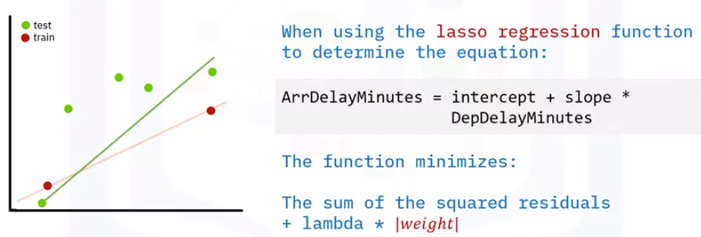
Regularization
Notes:
When the model fits the training data but does not have good predicting performance and generalization power, you have an overfitting problem

Slide 12
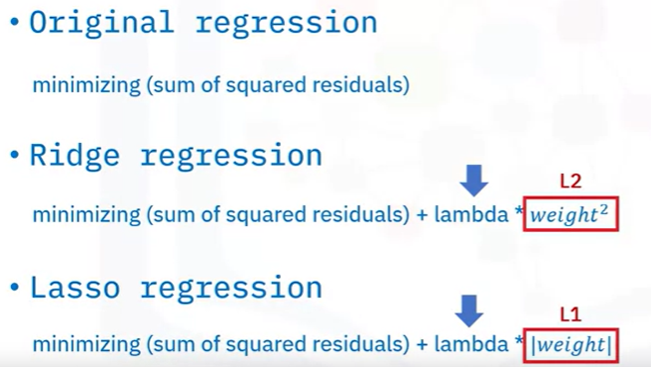
Regularization

Slide 13
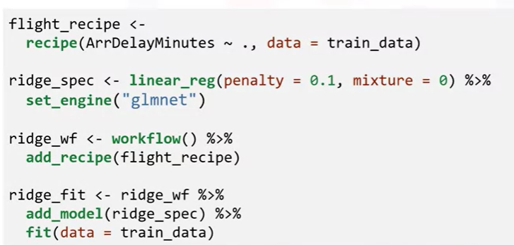
Regularization
Value of lambda
Proportion of L1 penalty
For ridge regression, specify Mixture = 0

Slide 14
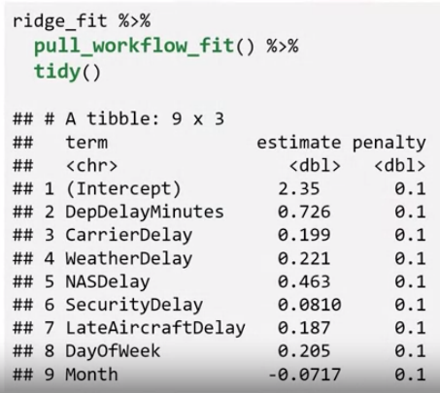
Regularization

Slide 15

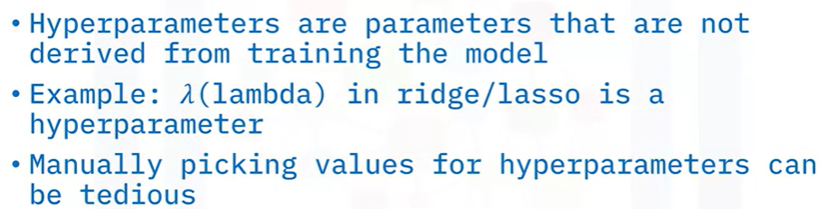
Grid Search

Slide 16
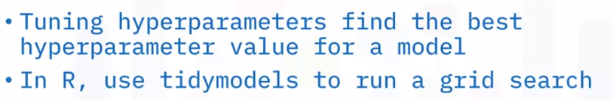
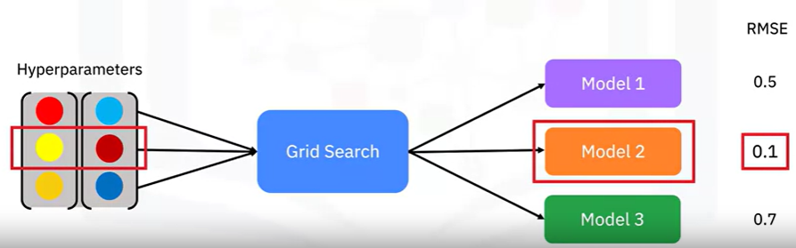
Grid Search

Slide 17
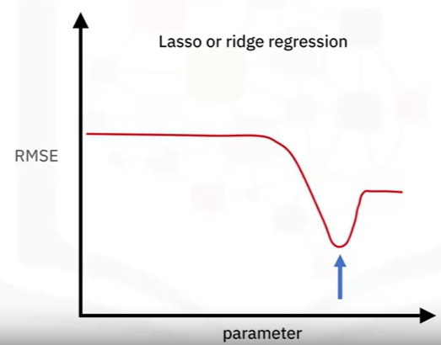
Grid Search
For every parameter that you use in grid search, a new model is trained.
Grid search tries to find the value of the parameter that has the smallest error.

Slide 18
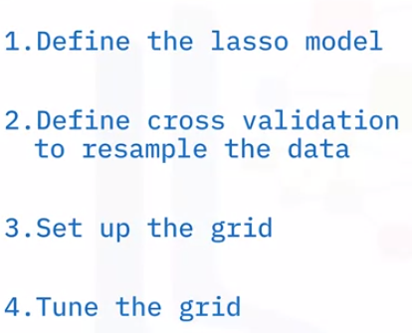
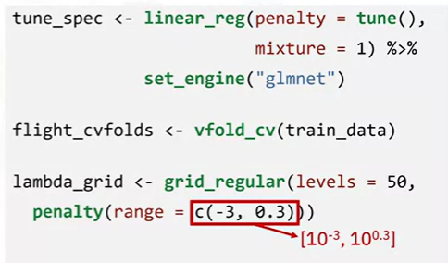
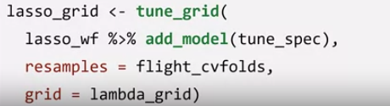
Grid Search

Slide 19
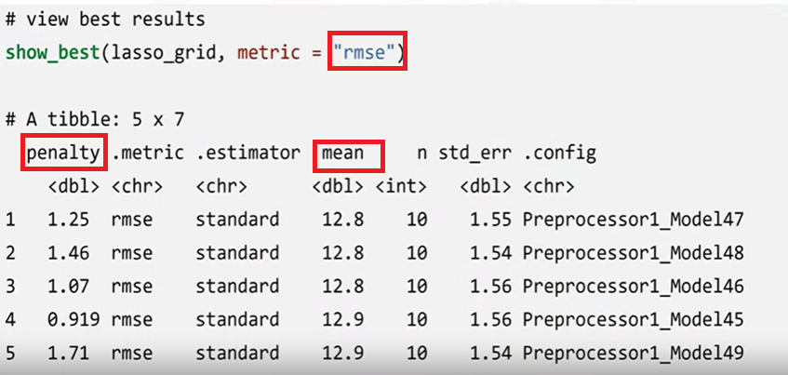
Grid Search

Slide 20
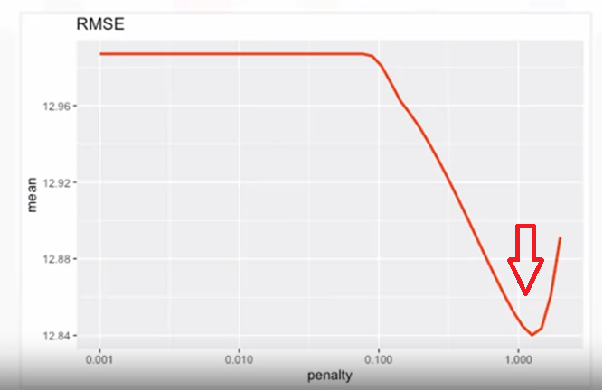
Grid Search

Slide 21
Summary
Improve the generalization of your models using regularization
Compare and contrast regularization types
Chapter1- Importing Datasets

Slide 22
Q & A
Chapter1- Importing Datasets

