Slide 1

Chapter 3: Data Analysis with R

Slide 2
Data Wrangling 1

Slide 3
Objective
Explain why data pre-processing is important
Analyze and decide how to handle missing values using functions from R
Use R functions for formatting data to improve data analysis
Chapter1- Importing Datasets

Slide 4

Pre-Processing Data in R
It is the process of converting or mapping data from one “raw” form into another format to prepare it for further analysis.
Data pre-processing is also often called “data cleaning” or “data wrangling”

Slide 5
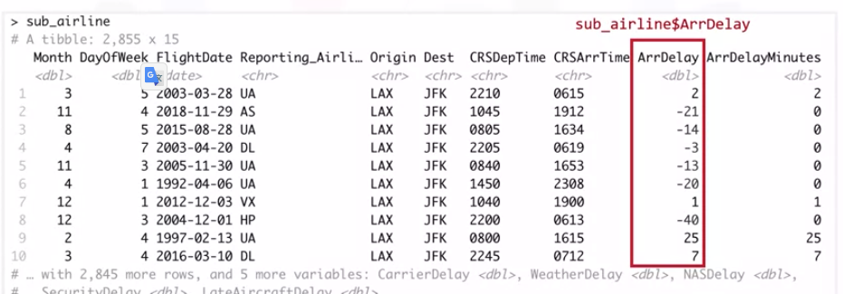
Pre-Processing Data in R
Perform data frame operations along columns, with each row of the column representing a sample
Access a column by specifying the name of the column
Example: access "ArrDelay” => this column is a vector.

Slide 6
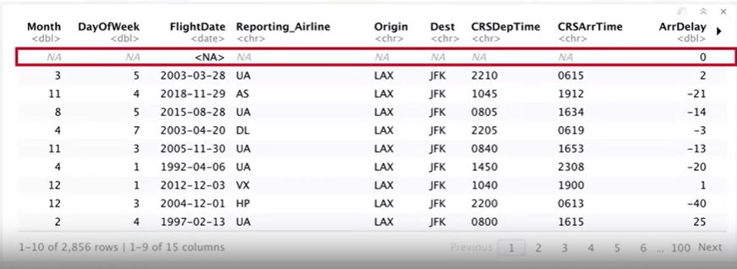
Pre-Processing Data in R

Slide 7

Dealing with Missing Values in R
What is the missing value?
Missing values occurs when no data value is stored for a variable for a particular observation => this variable has a “missing value”
Represented as “?”, “N/A”, zero, or just a blank cell

Slide 8
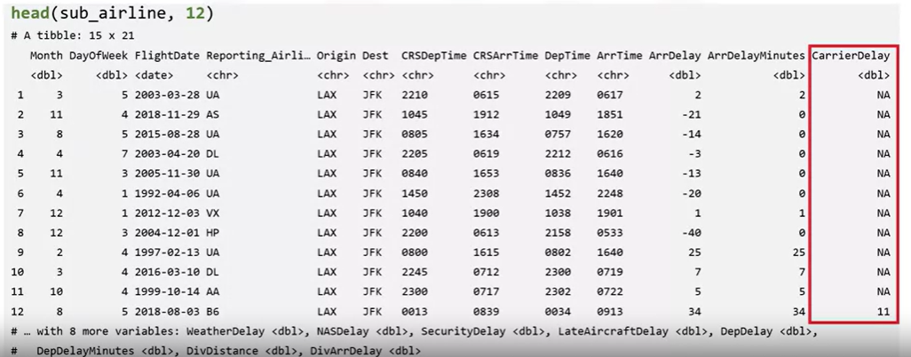
Dealing with Missing Values in R

Slide 9
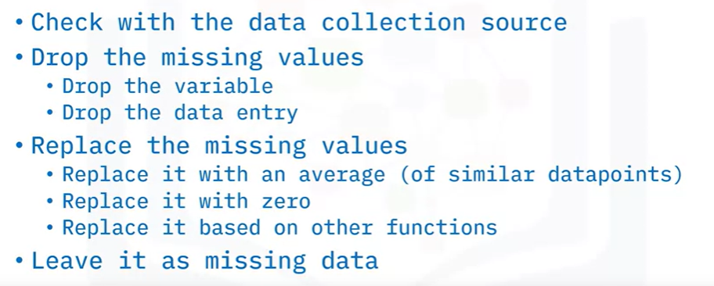
Dealing with Missing Values in R

Slide 10

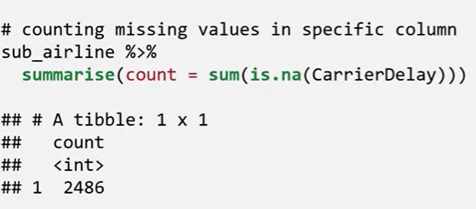
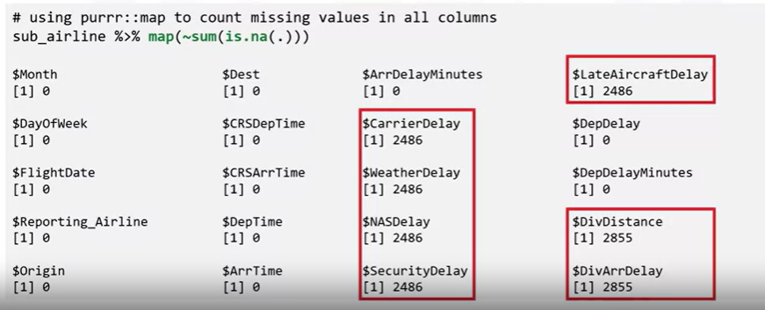
Dealing with Missing Values in R

Slide 11

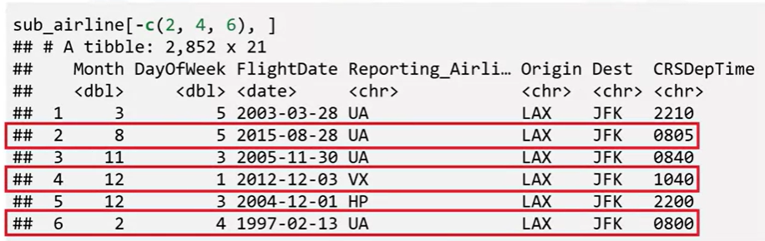
Dealing with Missing Values in R

Slide 12

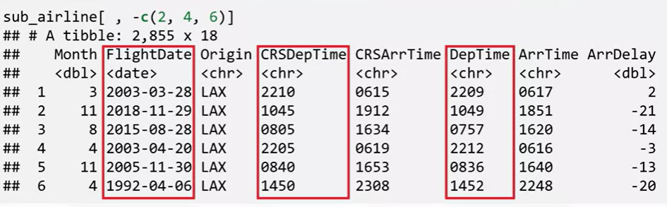
Dealing with Missing Values in R

Slide 13

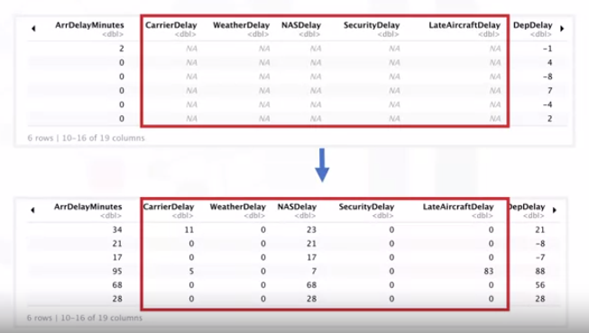
Dealing with Missing Values in R

Slide 14
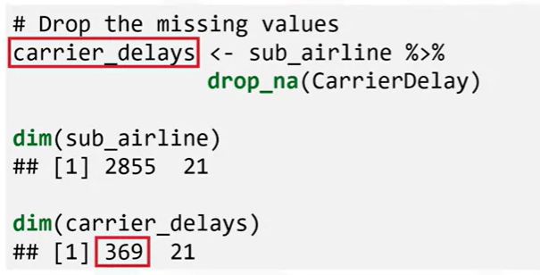
Dealing with Missing Values in R

Slide 15

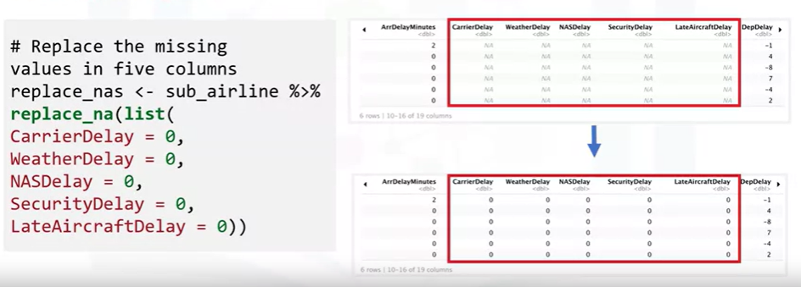
Dealing with Missing Values in R

Slide 16
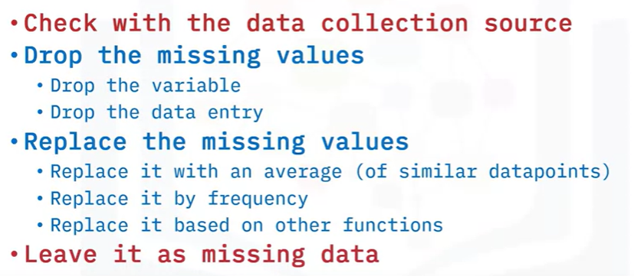
Dealing with Missing Values in R

Slide 17
Summary
At this point in the course, you know:
Data pre-processing (or data wrangling) is the process of converting or mapping data from the initial “raw” form into another format to prepare the data for further analysis.
Can handle missing data by dropping or replacing the missing values, working with the source of the data to either determine what the missing values should be or provide a better source of data, or leave the missing values in place.

Slide 18
Q & A

