Slide 1

Chapter 3: Data Analysis with R

Slide 2
Data Wrangling 2

Slide 3
Objective
Use R functions for formatting data to improve data analysis
Determine if and how data needs to be normalized
Write R functions to normalize data
Implement data binning
Convert categorical variables to quantitative values with indicator variables
Chapter1- Importing Datasets

Slide 4

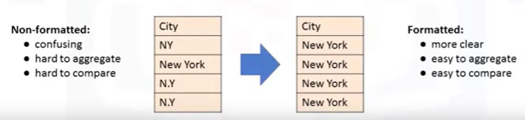
Data Formatting in R
Data is usually collected from different sources and by different people and it may be stored in different formats
Data formatting means bringing data into a common standard of expression that allows to make meaningful comparisons.
Example

Slide 5
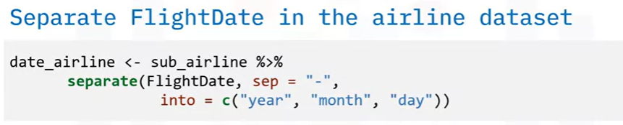
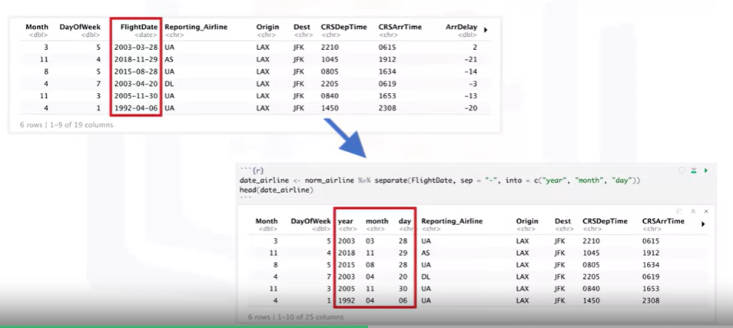
Data Formatting in R

Slide 6

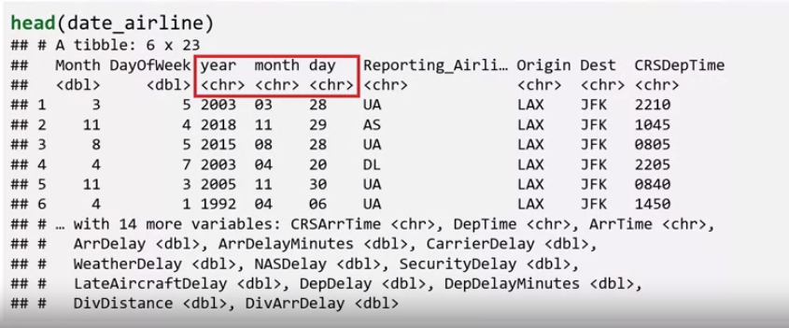
Data Formatting in R

Slide 7

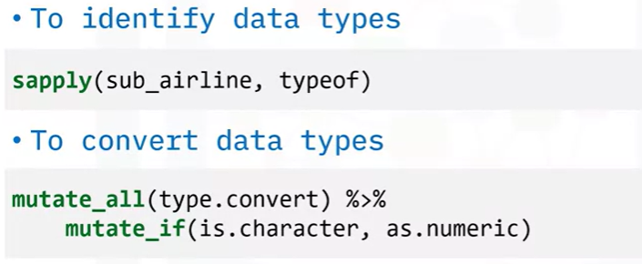
Data Formatting in R

Slide 8
Data Formatting in R

Slide 9
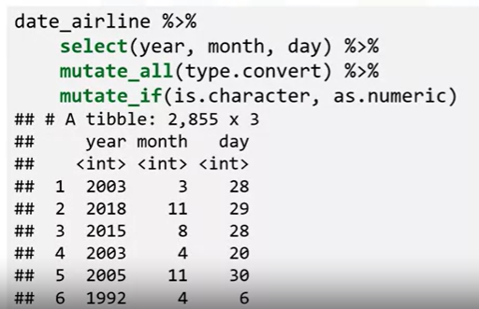
Data Formatting in R

Slide 10
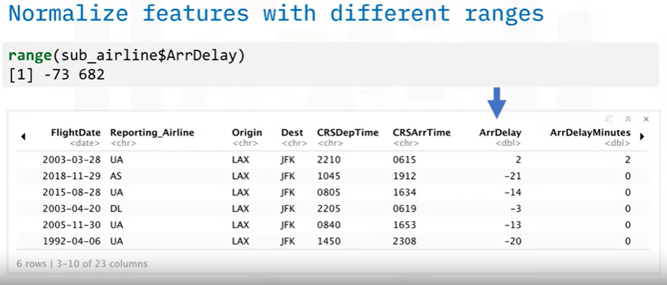
Data Normalization in R

Slide 11
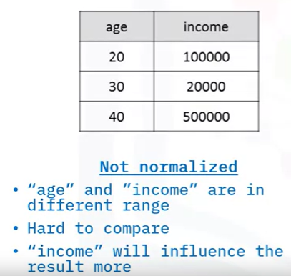
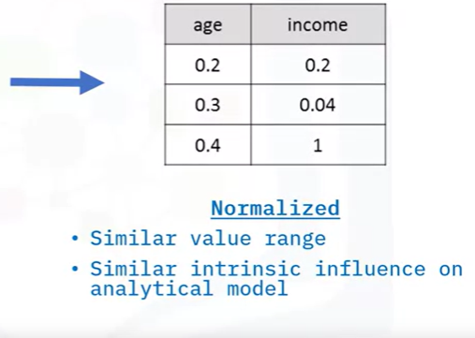
Data Normalization in R
Data Normalization

Slide 12
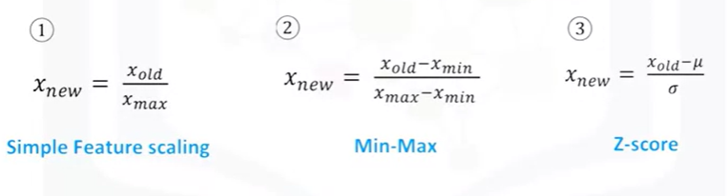
Data Normalization in R
Data Normalization

Slide 13
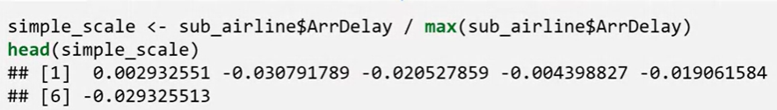

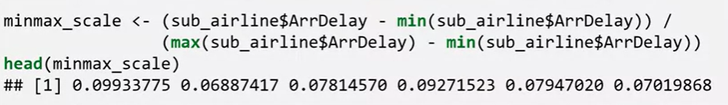
Data Normalization in R

Slide 14

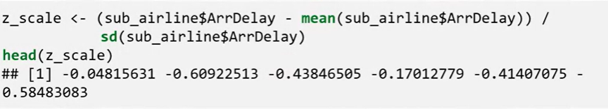
Data Normalization in R

Slide 15

Binning in R
Binning is a method of data pre-preprocessing using to group numerical values together into bins.
It is particularly useful for comparison between groups of data.
It improves the accuracy of the predictive models
It helps to better understand data distribution
It can divide values into four quartiles

Slide 16
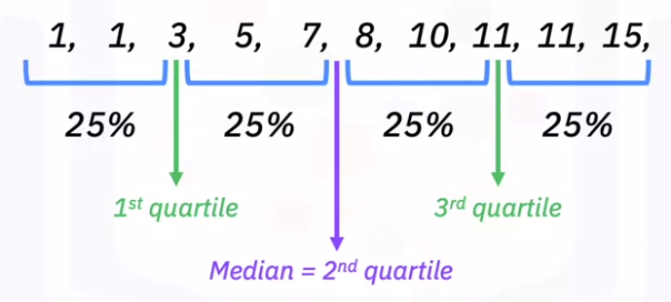
Binning in R
Example

Slide 17
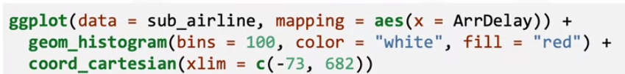
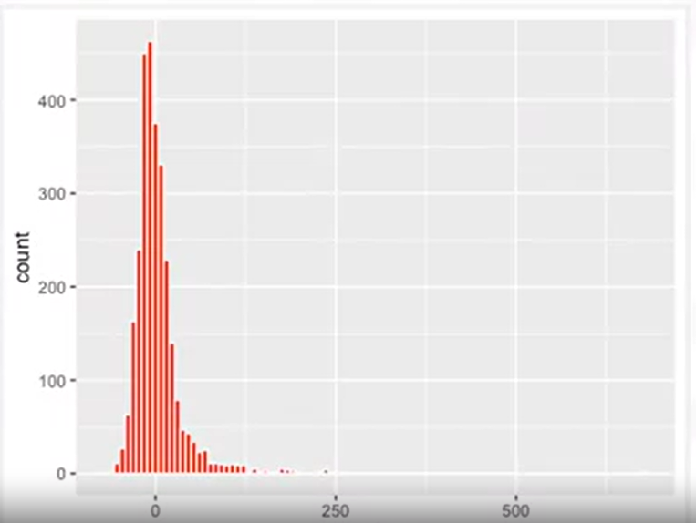
Binning in R
Example
ArrDelay

Slide 18

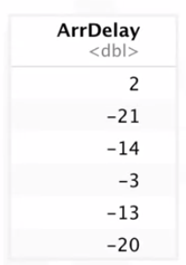
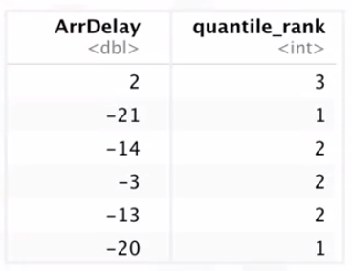
Binning in R
Example

Slide 19
Binning in R
Example

Slide 20

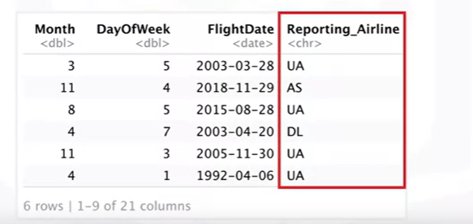
Turning Categorical Values to a
Numeric Variable in R
Problem: Most statistical models cannot take in objects or strings as input and, for model training

Slide 21
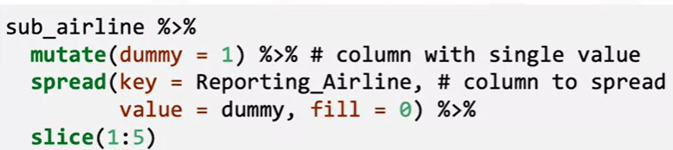
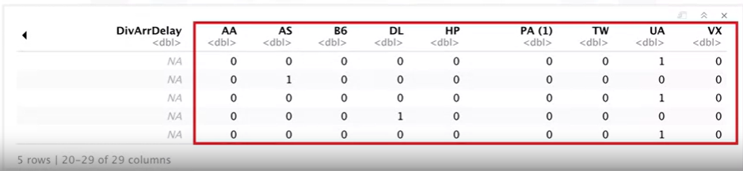
Turning Categorical Values to a
Numeric Variable in R
Solution:
Add dummy variables for each unique category
Assign 0 or 1 in each category

Slide 22

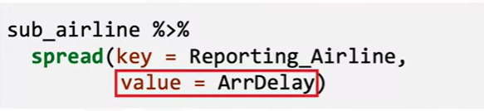
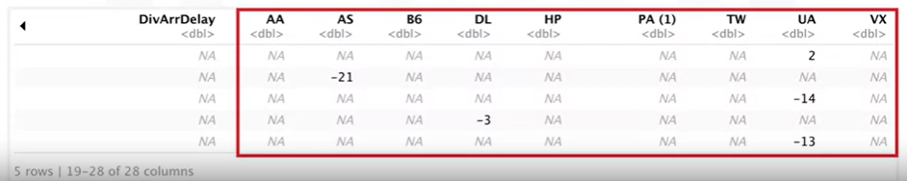
Turning Categorical Values to a
Numeric Variable in R
Solution:
Add dummy variables for each unique category
Assign flight delay, “ArrDelay” in each category

Slide 23
Summary
Can reformat data to bring it into a common standard of expression, which helps you make meaningful comparisons.
Can reformat an entire column by using the separate() function or correct data types by using the mutate_all() and mutate_if() functions.
Normalization is a way to bring all data into a similar range, for more meaningful comparison.
A few of the most common ways to normalize data include simple feature scaling, Min-Max, and Z-score.
Binning can improve the accuracy of predictive models and help you better understand the distribution of your data.
One binning approach divides numerical values into quartiles to improve data analysis.
Can turn categorical values to numeric values by using a technique called “one-hot encoding”.

Slide 24
Q & A

