Slide 1

Chapter 3: Data Analysis with R

Slide 2
Exploratory Data Analysis 1

Slide 3
Objective
Write R code to return descriptive statistics about a dataset
Calculate summary statistics for groups of data in a data set using the group_by() and summarize() methods
Create heatmaps and boxplots

Slide 4


Descriptive Statistics
Descriptive statistics allow to exploratory data analysis.
When you begin to analyze data, it’s important to explore your data before building complicated models.
What causes flight delays?
Some useful exploratory data analysis techniques starting with descriptive statistics.

Slide 5


Descriptive Statistics
Describe the basic features of a dataset
Generates a short summary about the sample and measures of the data.

Slide 6
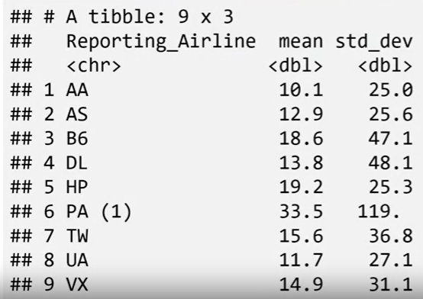
Descriptive Statistics

Slide 7
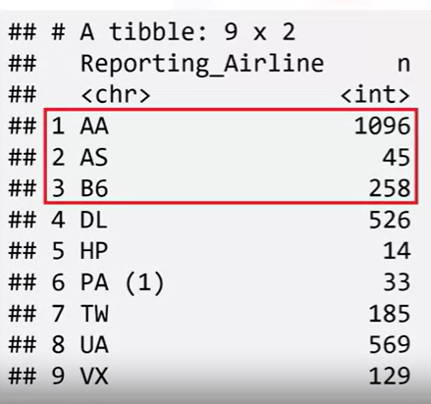

Descriptive Statistics

Slide 8

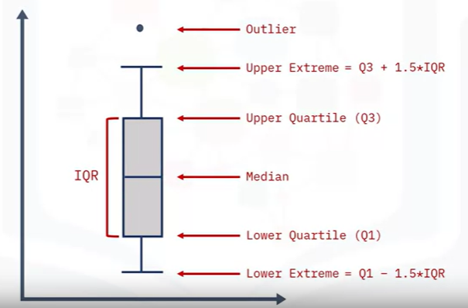
Descriptive Statistics

Slide 9
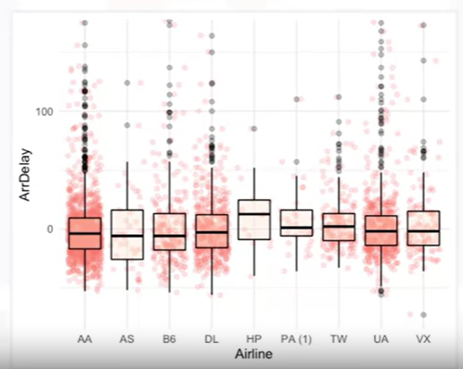
Descriptive Statistics

Slide 10

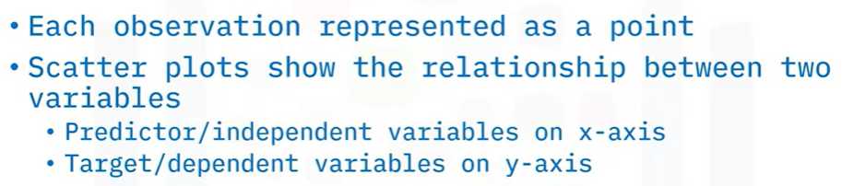
Descriptive Statistics

Slide 11
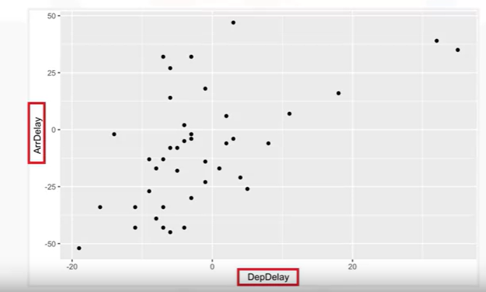
Descriptive Statistics
Target variable
Predictor variable
Notes:
This plot shows the relationship between two variables.
The predictor variable is the variable that you are using to predict an outcome. In this case, the predictor variable is the departure delay. The target variable is the variable that you are trying to predict. In this case, our target variable is the arrival delay since this would be the outcome.
In a scatterplot, you typically set the predictor variable on the x-axis (or horizontal axis) and the target variable on the y-axis (or vertical axis).
In this case, “DepDelay” is on the x-axis and “ArrDelay” is on the y-axis. To generate the scatter plot, use the ggplot() function, passing in the x and y variables.
It’s important to label your axes and provide a plot title so you know what you are looking at.
Now, how is the variable departure delay related to arrival delay?

Slide 12
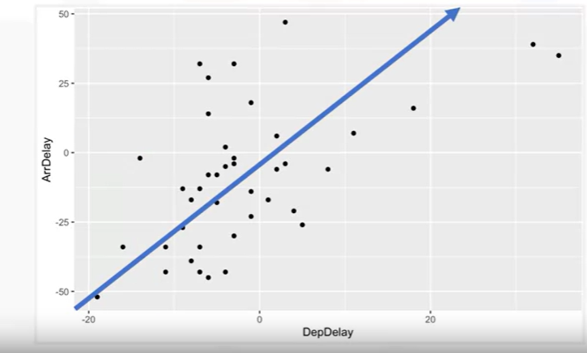
Descriptive Statistics
The departure delay time goes up, the time of the arrival delay also increases
There is a positive linear relationship between these two variables

Slide 13

Grouping Data in R
Questions?
Is there any relationship between the reporting airline and the flight delays?
Does the day of the week of the flight have a relatively longer delay time?
Answer:
Grouping the data by the different reporting airline, and compare the results for each day of the week against each other.
Notes:
For example, people take flights for business trips most frequently on Mondays and Fridays.
Does that impact the length of the flight delay?”

Slide 14
Grouping Data in R
In tidyverse, using the group_by() function can:
Apply the group_by() function to categorical variables
Group the data into subsets according to the different categories of that variable.
Group by a single variable or multiple variables by passing in multiple variable names.

Slide 15


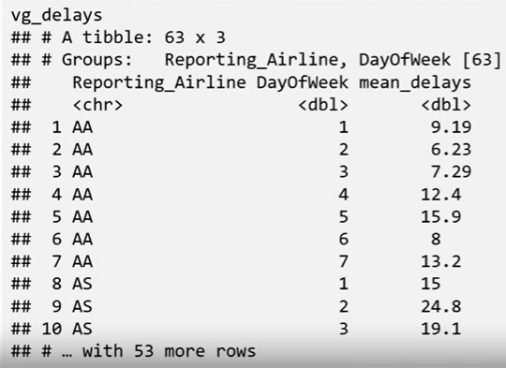
Grouping Data in R

Slide 16

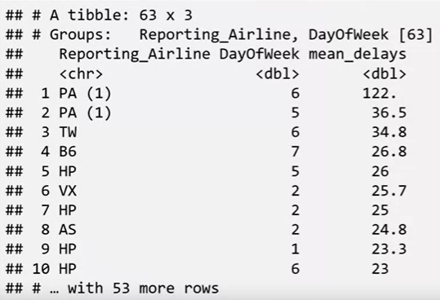
Grouping Data in R

Slide 17

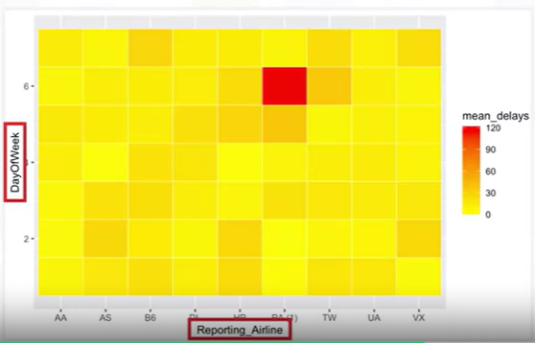
Grouping Data in R
Plot the target variable over multiple variables allows to get visual clues of the relationship between these variables and the target.
The top section of the heat map seems to have higher flight delays on
average than the bottom section.
A heatmap is a more direct way to visualize the average flight arrival delays depending on reporting airline and the day of week

Slide 18
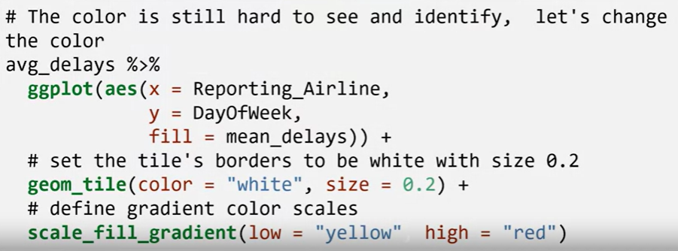
Grouping Data in R
Plot the target variable over multiple variables to get visual clues of the relationship between these variables and the target.

Slide 19
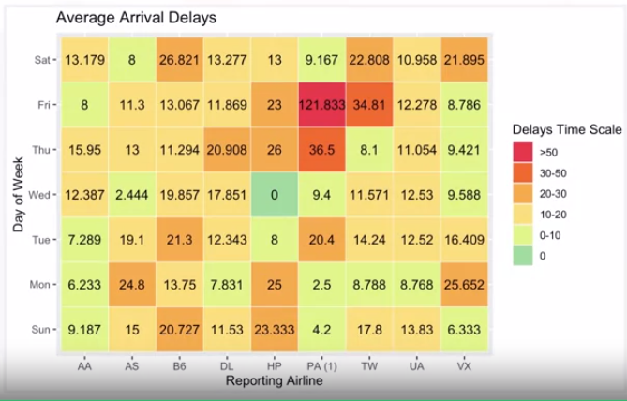
Grouping Data in R
Plot the target variable over multiple variables to get visual clues of the relationship between these variables and the target.

Slide 20
Summary
Write R code to return descriptive statistics about a dataset
Calculate summary statistics for groups of data in a data set using the group_by() and summarize() methods
Create heatmaps and boxplots

Slide 21
Q & A

