Slide 1

Chapter 3: Data Analysis with R

Slide 2
Model Development in R 2

Slide 3
Objective
Analyze data sets using polynomial regression models
Contrast regression models using visualization
Chapter1- Importing Datasets

Slide 4
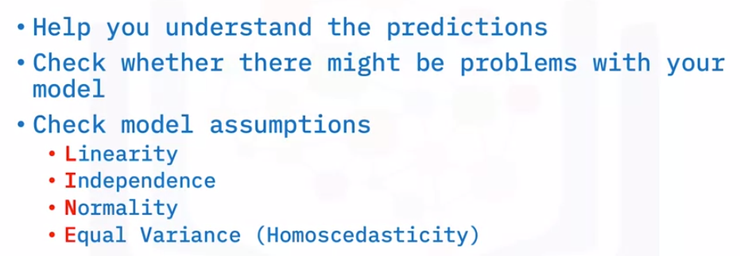
Assessing Models Visually
Focus on two ways: regression plots and residual plots

Slide 5
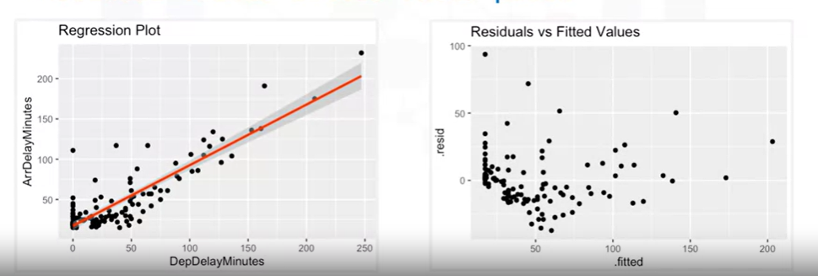
Assessing Models Visually
Focus on:
Regression plots
Residual plots

Slide 6
Assessing Models Visually
Why use a regression plot?
It a good estimate of
the relationship between two variables,
the strength of the correlation,
the direction of the relationship (positive or negative)

Slide 7
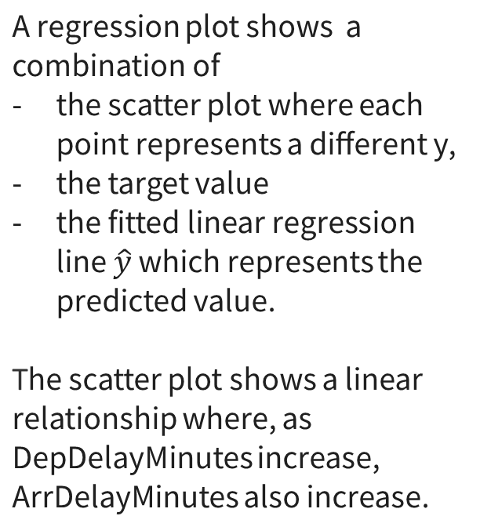
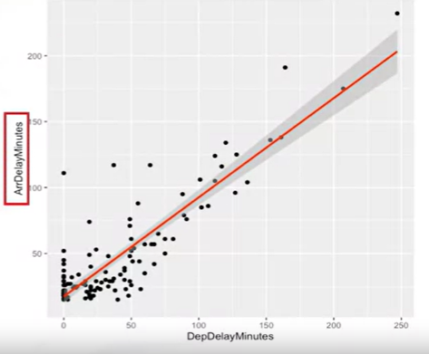
Assessing Models Visually

Slide 8
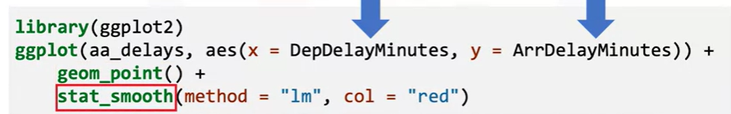
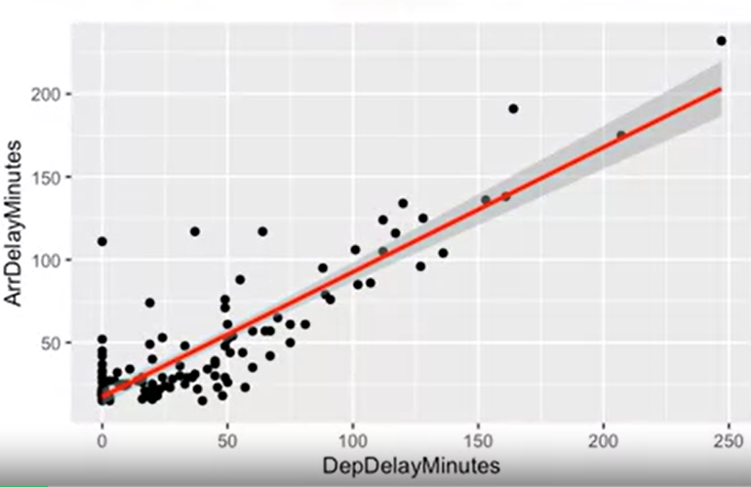
Assessing Models Visually
- geom_point() creates a scatter plot that represents the data points of departure
and arrival delays.
- stat_smooth() plots the red line and grey confidence interval bands of the fitted linear regression model.

Slide 9

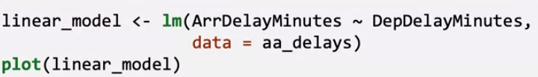
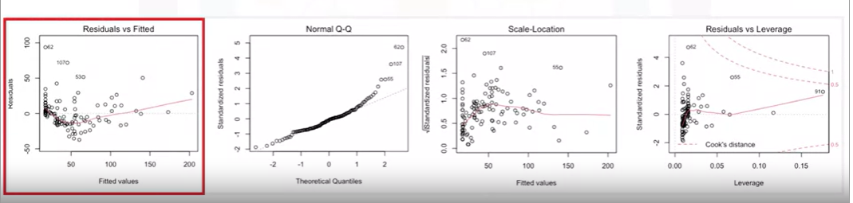
Assessing Models Visually
The output is four different diagnostic plots.
You can visually inspect these plots to get a sense of how you did on several of the assumptions outlined above.

Slide 10
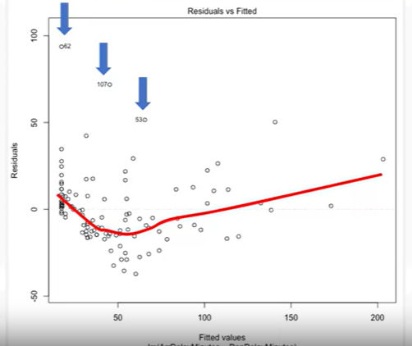
Assessing Models Visually
Residuals versus fitted, is useful for checking the assumption of linearity and homoscedasticity.
A few problems:
Three data points that have large residuals (observations 82, 107, and 53).
The red line plotted the residuals is not straight => Non linear
The data is not homoscedastic
Notes:
Residuals versus fitted, is useful for checking the assumption of linearity and homoscedasticity.
Looking at this plot, you can see a few problems. R automatically flagged three data points that have large residuals (observations 82, 107, and 53).
Besides that, the residuals do not appear to be linear because the red line plotted through the residuals is not straight.
It also looks like the data is not homoscedastic, given that they do not appear evenly spread around the y = 0 line.
Let's talk about several cases of a residual plot and what they indicate. First, this is a good residual plot. You expect to see that the results have zero mean
and are distributed evenly around the x-axis with similar variance and no curvature. This type of residual plot indicates that the assumption of linearity and homoscedasticity is
met

Slide 11
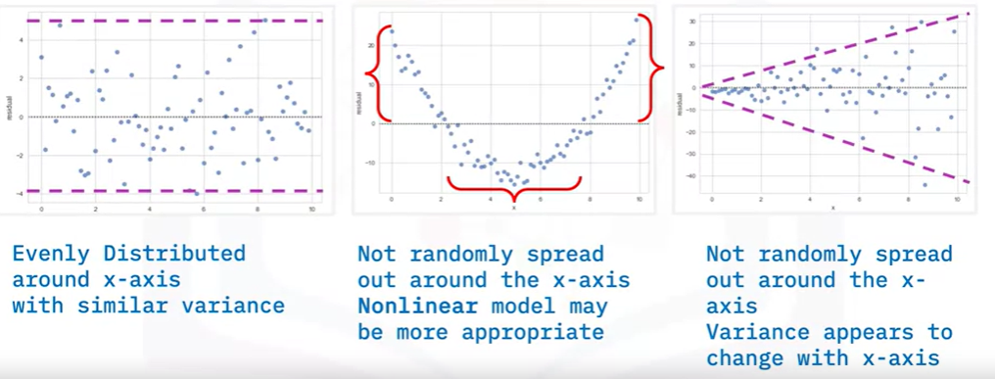
Assessing Models Visually
a good residual plot => assumption of linearity and homoscedasticity is
met
model violates an assumption
Notes:
Let's talk about several cases of a residual plot and what they indicate. First, this is a good residual plot. You expect to see that the results have zero mean
and are distributed evenly around the x-axis with similar variance and no curvature. This type of residual plot indicates that the assumption of linearity and homoscedasticity is
met
The residuals are not randomly separated; this suggests the linear assumption is incorrect. This plot suggests a non-linear function, which we will handle in the next section. In this plot, you can see that the variance of the residuals increases with x, therefore our model violates an assumption.
In this plot, you can see that the variance of the residuals increases with x, therefore our model violates an assumption. The normality assumption is evaluated based on the residuals and can be evaluated using a

Slide 12
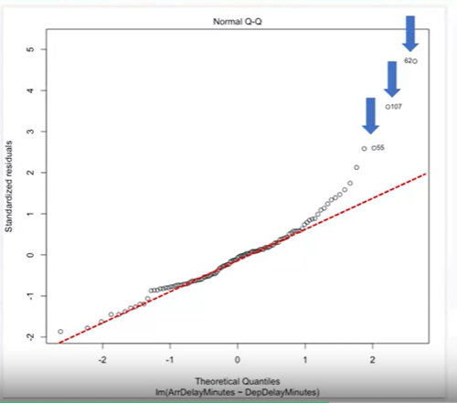
Assessing Models Visually
The normality assumption is evaluated using a quantile-quantile plot (or Q-Q plot) by comparing the residuals to “ideal” normal observations along the 45-degree line.
R automatically identifies three data points that have large residuals (observations 55, 107, and 62).
The plot shows some deviation from the straight-line pattern indicating a distribution with heavier tails than a normal distribution.
Notes:
So, what useful information can you read from a Q-Q plot?
Let’s look at three general situations and explain their implications.
Here is how an optimal normal Q-Q plot appears, and it suggests that the error terms are normally
distributed.
This is an example where the Q-Q plot is heavy-tailed.
There are too many extreme positive and negative residuals, so the error terms are not normally
distributed.
A

Slide 13
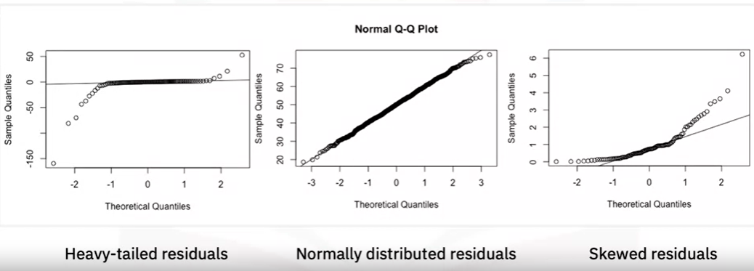
Assessing Models Visually

Slide 14
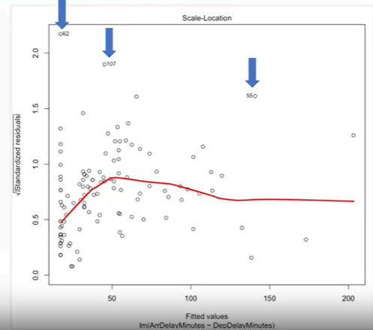
Assessing Models Visually
It shows the square rooted standardized residual vs. the predicted value, is useful for checking the assumption of homoscedasticity
Good: If the red line on the plot is flat and horizontal with equally and randomly spread data points
Violated this assumption: If the red line has a positive slope to it, or if the data points are not randomly spread
out.
Example:
- R again flagged observations 62, 107, and 55.
- There is not a horizontal line with randomly scattered data points around it, so the homoscedasticity assumption is not satisfied
Notes:
This example plot determines if there is a pattern in the residuals.
If the red line you see on your plot is flat and horizontal with equally and randomly spread
data points (like the night sky), you’re good.
If your red line has a positive slope to it, or if your data points are not randomly spread
out, you’ve violated this assumption.
In this case, R again flagged observations 62, 107, and 55.
Besides that, there is not a horizontal line with randomly scattered data points around
it, so the homoscedasticity assumption is not satisfied

Slide 15
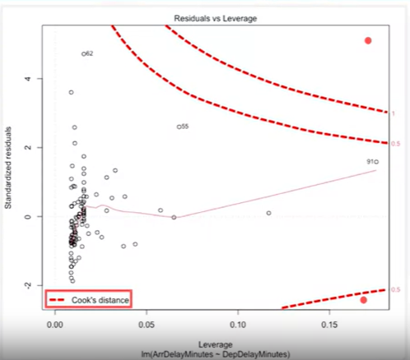
Assessing Models Visually
This plot helps to find influential cases if any are present in the data.
- Not all outliers are influential in linear regression analysis.
- Data have extreme values, they might not be influential to determine a regression line.
The results wouldn’t be much different if you either include or exclude them from analysis.
Points with high leverage and high absolute residual like the red dots would be considered influential such as 62, 55, and 91
Notes:
The red dashed curved lines on the plot represents Cook’s distance.
If you don’t have influential cases, the dashed red curve will be minor, with none of the data points crossing them, or the line will not present at all.
For example, points with high leverage and high absolute residual like the red dots would be considered influential.
However, looking at this plot, none of the points cross the dotted lines, but some points come close.
Observations 62, 55, and 91 come close to being “influential”.
You could still try to remove these observations, re-run this analysis, and determine how much the model improved.

Slide 16
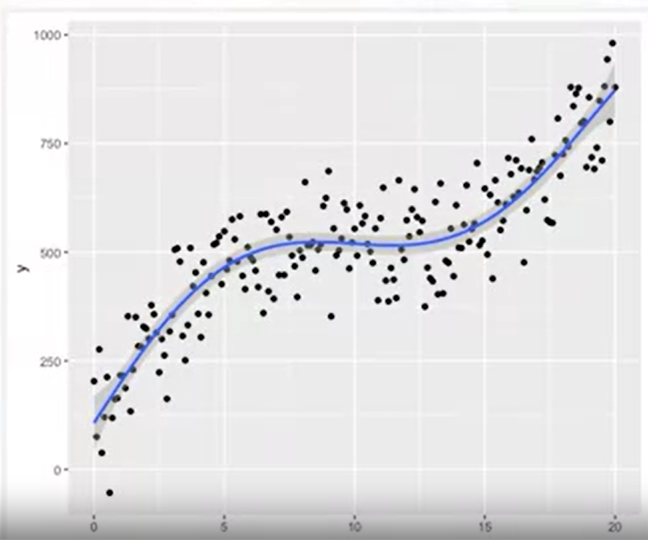
Polynomial Regression
Polynomial regression is a special case of general linear regression.
It is beneficial for describing curvilinear relationships by squaring higher-order terms of the predictor variables in the model

Slide 17
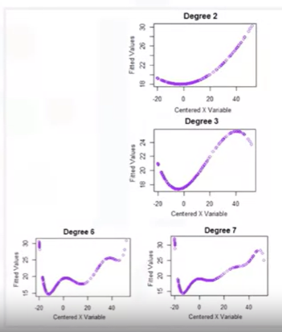
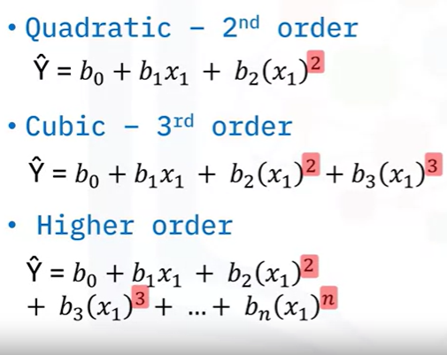
Polynomial Regression

Slide 18
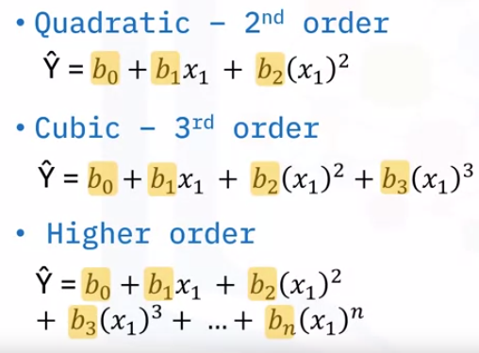
Polynomial Regression
These coefficients are learned by the model

Slide 19



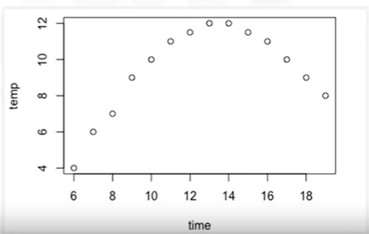
Polynomial Regression

Slide 20
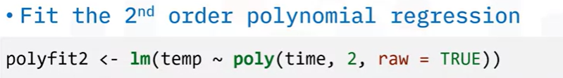
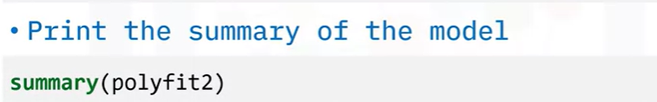

Polynomial Regression

Slide 21
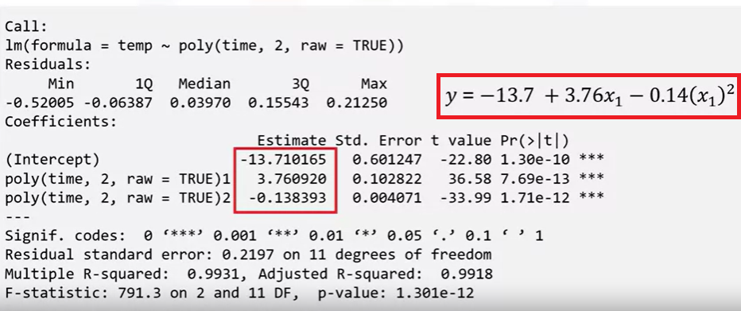
Polynomial Regression

Slide 22
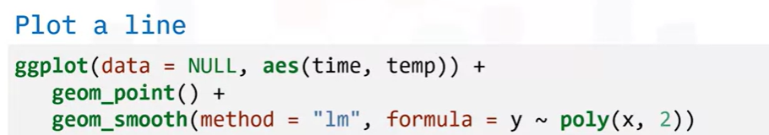
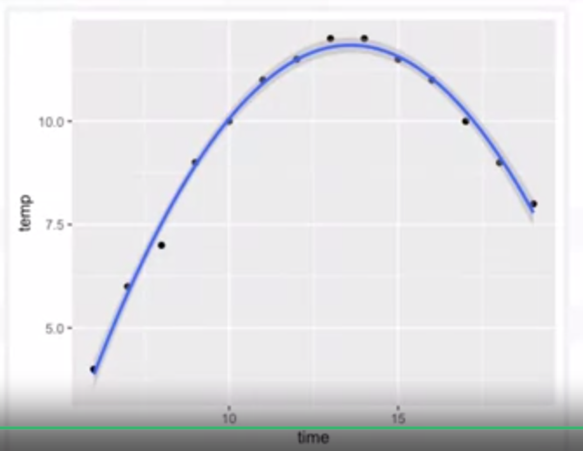
Polynomial Regression

Slide 23
Summary
Analyze data sets using polynomial regression models
Contrast regression models using visualization

Slide 24
Q & A

