Slide 1

Chapter 3: Data Analysis with R

Slide 2
Model Development in R 3

Slide 3
Objective
Interpret model fits using R-squared and MSE for in sample evaluation
Predict data values based on a model
Evaluate a model to determine if it is correct
Chapter1- Importing Datasets

Slide 4
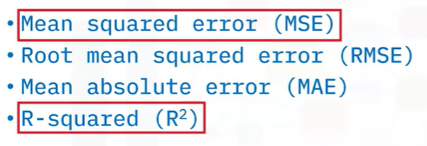
Assessing the Model

Slide 5

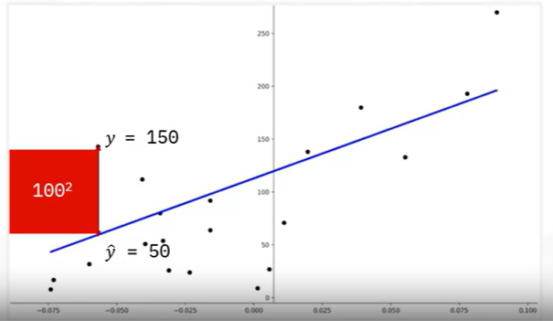
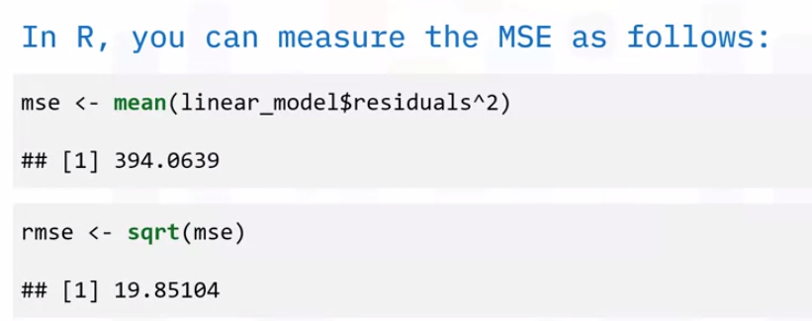
Assessing the Model
Y1=150,
ŷ1=50
MSE=(150-50)^2=100^2
Notes:
n: number of samples
Y: predicted values
Y: real values

Slide 6
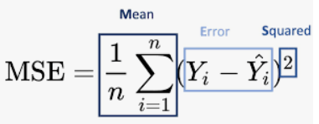
Assessing the Model
MSE assesses the average squared difference between the observed and predicted values.
When a model has no error, the MSE equals zero. As model error increases, its value increases
y_{i} is the i^{th} observed value.
ŷ_{i} is the corresponding predicted value.
n = the number of observations.
Notes:
n: number of samples
Y: predicted values
Y: real values

Slide 7

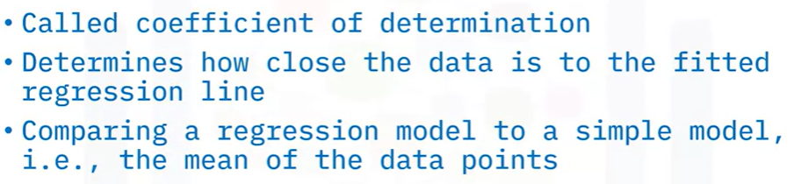
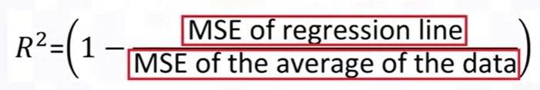
Assessing the Model
Notes:
n: number of samples
Y: predicted values
Y: real values

Slide 8
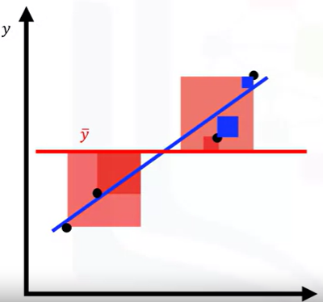
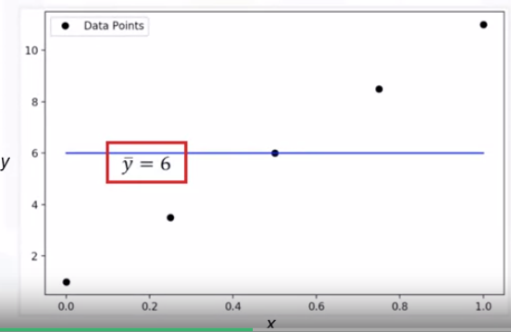
Assessing the Model
Example
The blue line represents the regression line.
The blue squares represent the MSE of the regression line.
The red line represents the average value of the data points.
The red squares represent the MSE of the red line.
The area of the blue squares is much smaller than the area of the red squares.
Notes:
Example

Slide 9
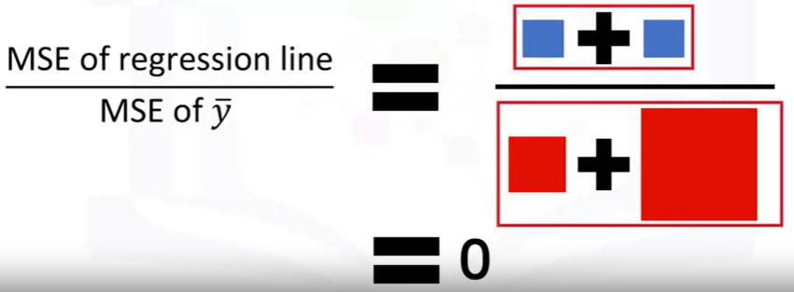
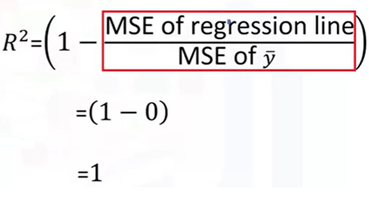
Assessing the Model
Notes:
Example

Slide 10

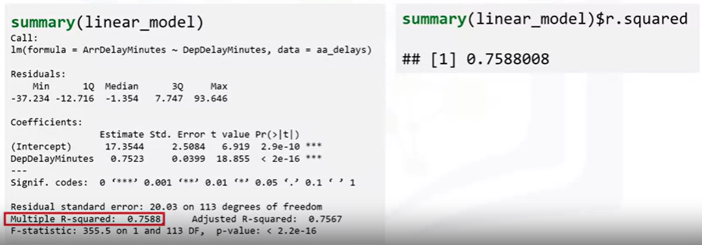
Assessing the Model
Notes:
Example

Slide 11

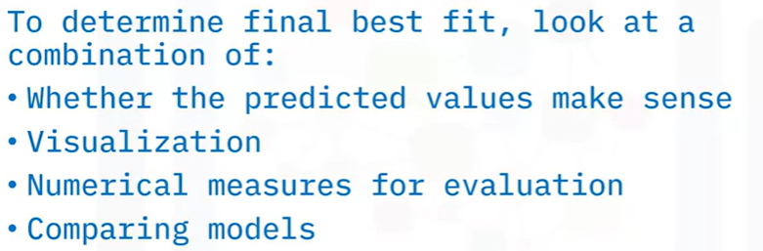
Prediction and Decision Making
Notes:
Example

Slide 12
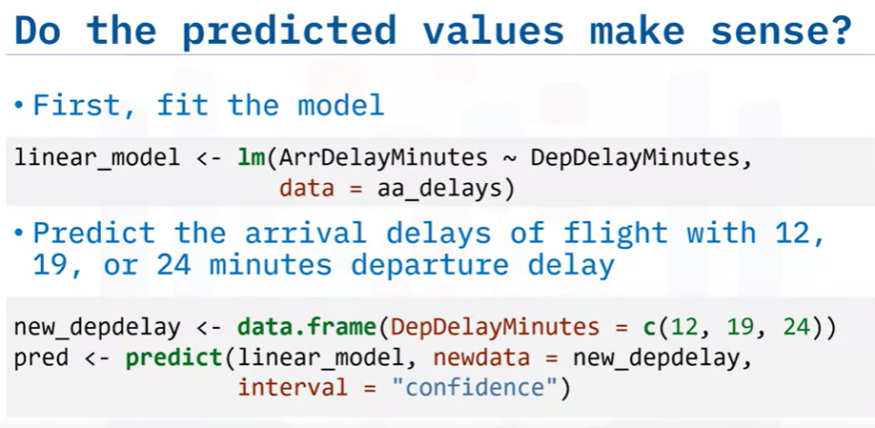
Prediction and Decision Making
Notes:
Example

Slide 13
Prediction and Decision Making
Notes:
Example

Slide 14
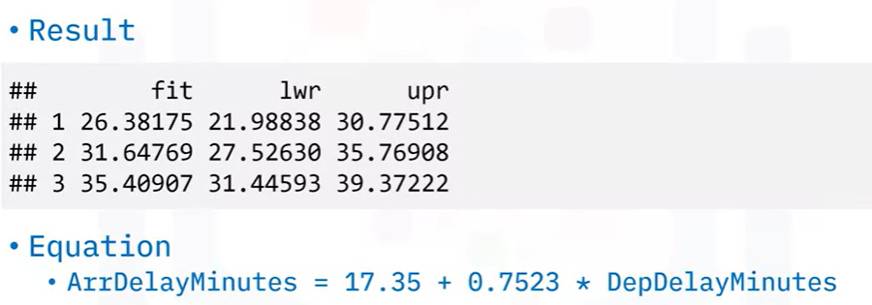
Prediction and Decision Making
Notes:
Example

Slide 15
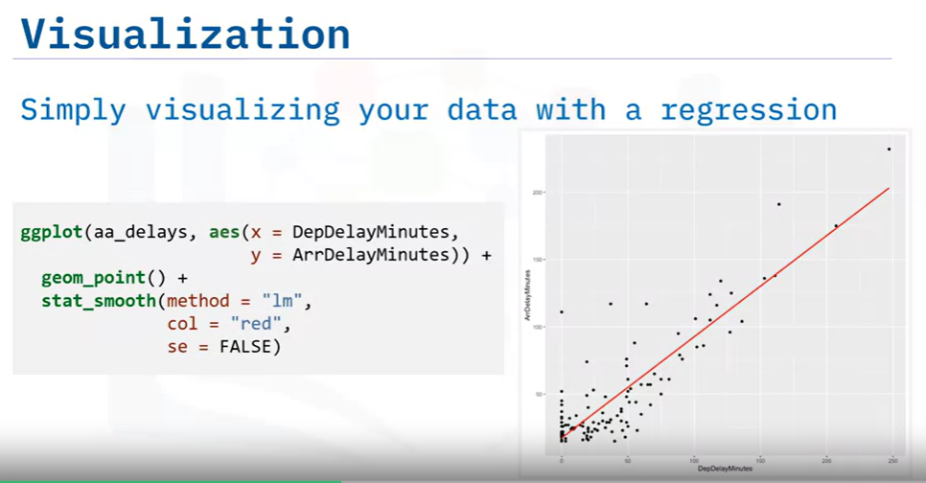
Prediction and Decision Making
The data trends up as the dependent variable increases.
=> Linear behavior
Notes:
Example

Slide 16
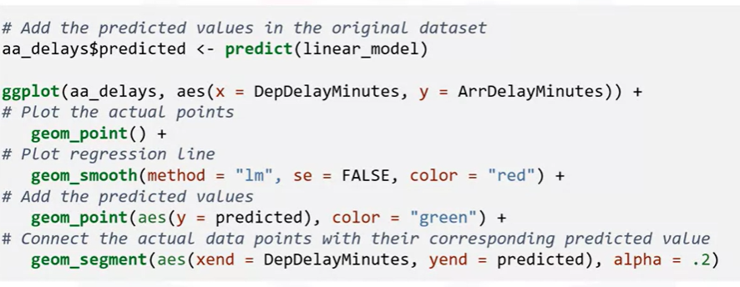
Prediction and Decision Making
Notes:
Example

Slide 17
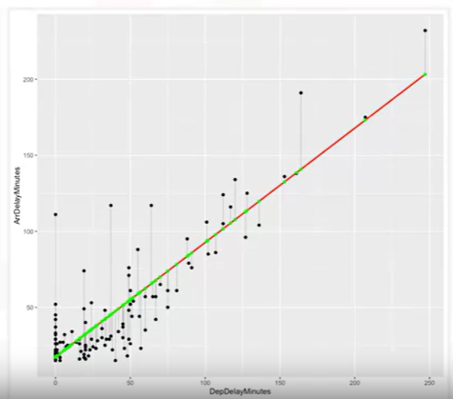
Prediction and Decision Making
Red line is the fitted line
Green points are the predicted values
Black points are the actual values.
Notes:
Example

Slide 18
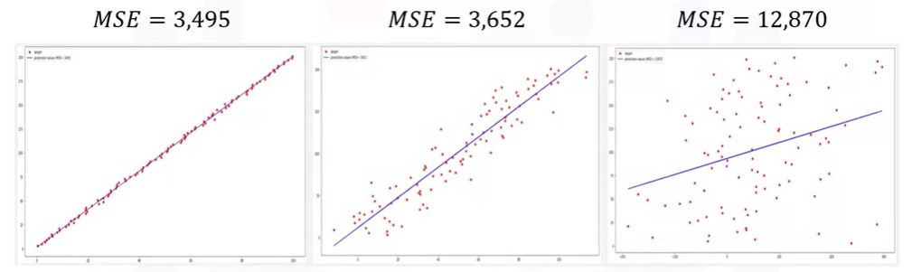
Prediction and Decision Making
Notes:
Example

Slide 19
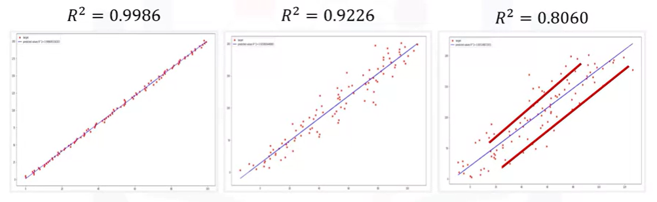
Prediction and Decision Making
Notes:
Example

Slide 20
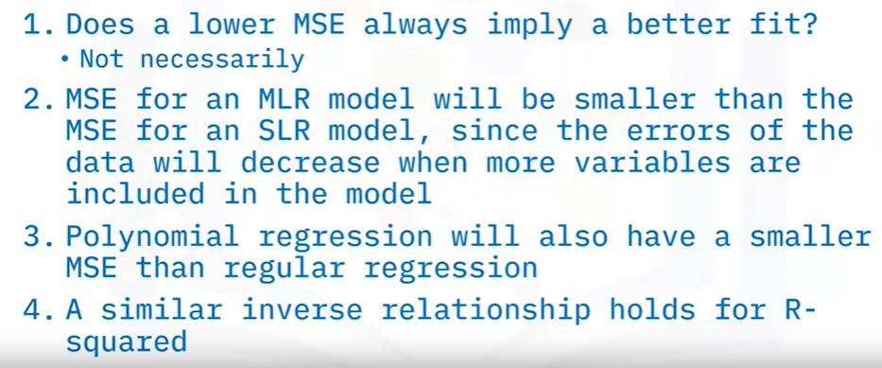
Prediction and Decision Making
Notes:
Example

Slide 21
Summary
Interpret model fits using R-squared and MSE for in sample evaluation
Predict data values based on a model
Evaluate a model to determine if it is correct

Slide 22
Q & A
Chapter1- Importing Datasets

