Slide 1

Chapter 4:
Data Visualization with R

Slide 2
Introduction to Data
Visualization 1

Slide 3
Objective
Classify charts into six main categories based on goals, aesthetics, and visual features
Create bar charts using the ggplot2 package
Create histogram charts using the ggplot2 package
Create pie charts using the ggplot2 package
Describe the components of a ggplot2 visualization
Choose an appropriate graph to visualize data in R
Chapter1- Importing Datasets

Slide 4
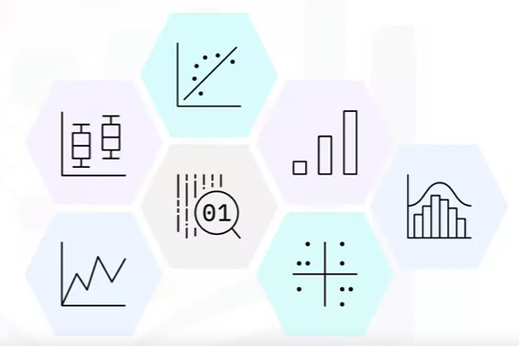
Introduction to Data Visualization
Data visualization represents data in the form of graphs, charts, plots, or any other formats.
Data visualization helps you interpret and understand the data
Identify patterns, trends, and anomalies in the data, making it easier for human brains to process and grasp the information.

Slide 5

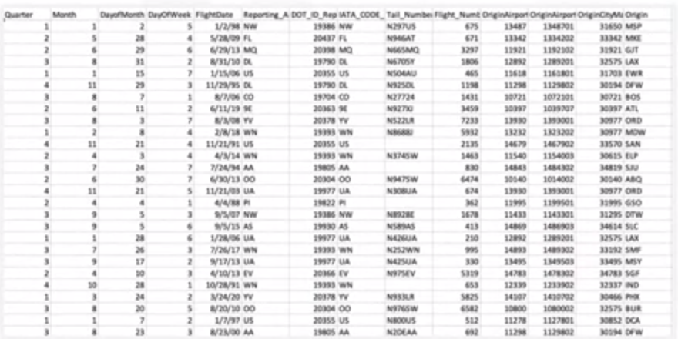
Introduction to Data Visualization
Example: Dataset of Domestic US airline performance
Determine the month and reporting airline with the highest number of flights
How effective and easy to extract this information from the spreadsheet?
Notes:
domestic US airline performance.

Slide 6
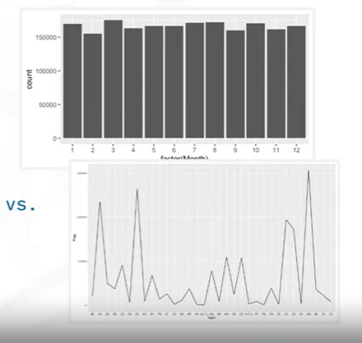
Introduction to Data Visualization
Determine the month and reporting airline with the highest number of flights
Data represented as charts
Charts make data more understandable
Notes:
domestic US airline performance.

Slide 7

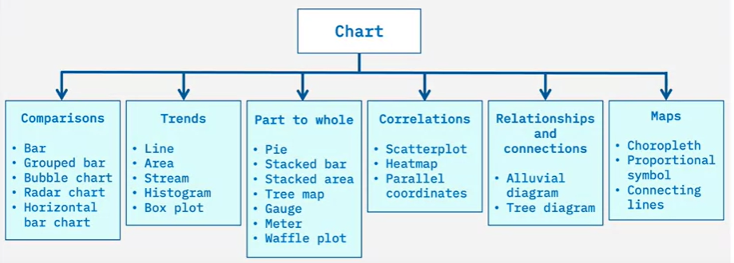
Introduction to Data Visualization
Charts can be classified into six categories based on the chart’s
goals, aesthetics, or visual features
Notes:
domestic US airline performance.

Slide 8
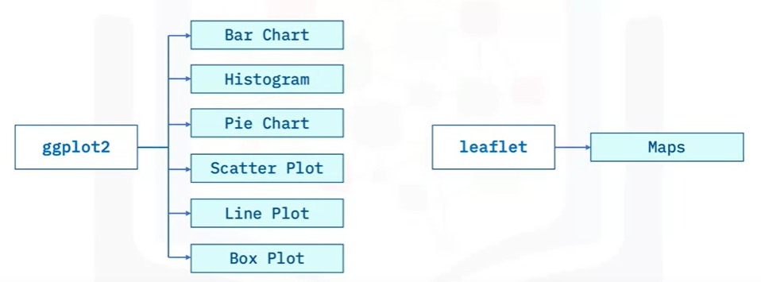
Introduction to Data Visualization
Two popular R packages for data visualization include the ggplot2 and Leaflet package
Can transform data into visuals and convey details as well as insights about the data to stakeholders.
Notes:
domestic US airline performance.

Slide 9


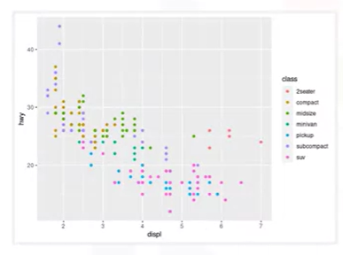
Using ggplot2
Languages have grammar to effectively communicate
Graphics also have grammar
Ggplot2 is based on the Grammar of Graphics
ggplot2 enables to compose simple to complex graphs by combining independent components more, faster, easy and powerful.
Notes:
domestic US airline performance.

Slide 10
Using ggplot2
Languages have grammar to effectively communicate
Graphics also have grammar
Ggplot2 is based on the Grammar of Graphics
ggplot2 enables to compose simple to complex graphs by combining independent components more, faster, easy and powerful.
Notes:
domestic US airline performance.

Slide 11
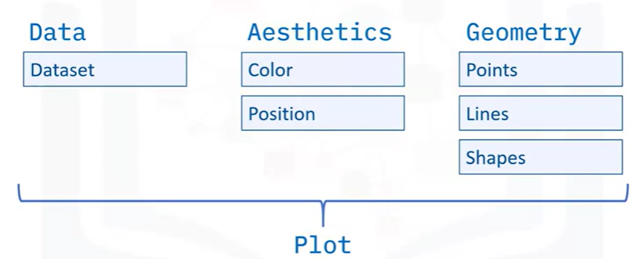
Using ggplot2
Three elements: Data, Aesthetics and Geometry
Notes:
domestic US airline performance.

Slide 12

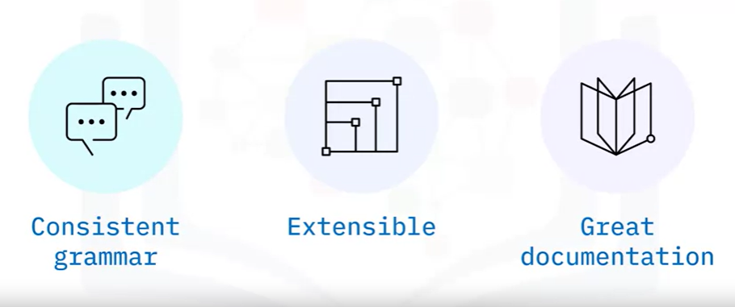
Using ggplot2
Notes:
domestic US airline performance.

Slide 13
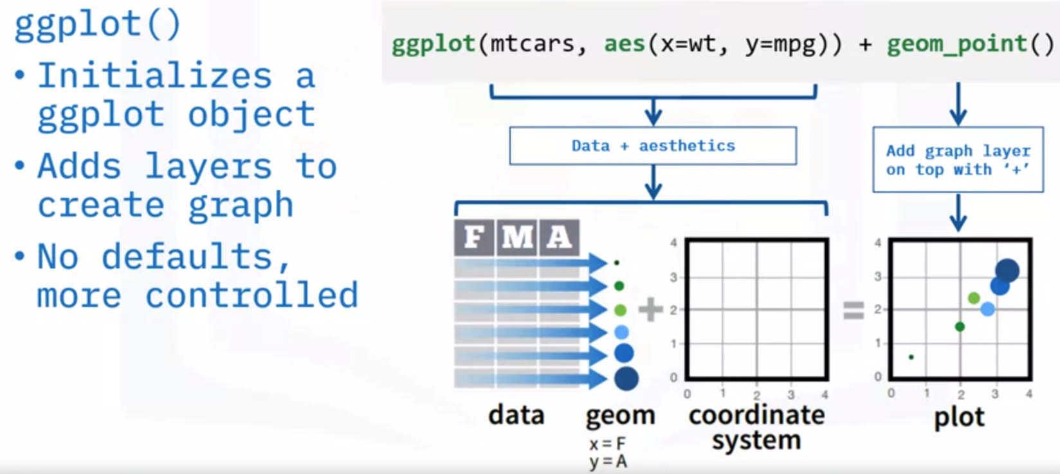
Using ggplot2
Notes:
domestic US airline performance.

Slide 14
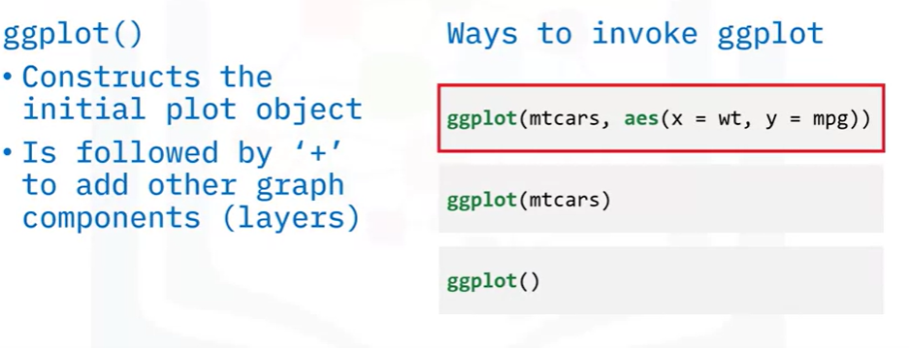
Using ggplot2
Notes:
domestic US airline performance.

Slide 15
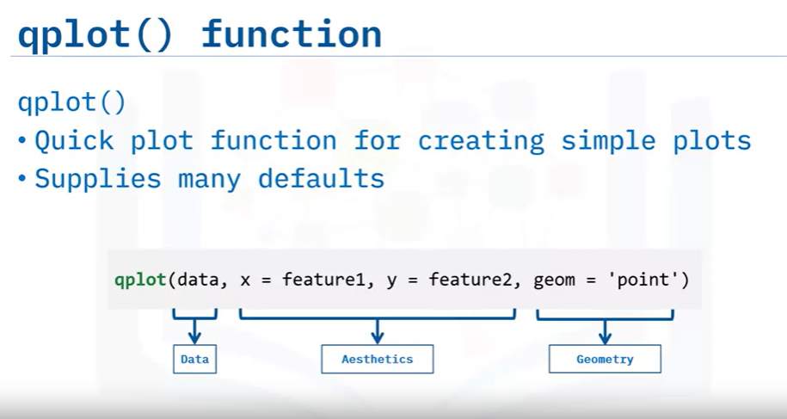
Using ggplot2

Slide 16
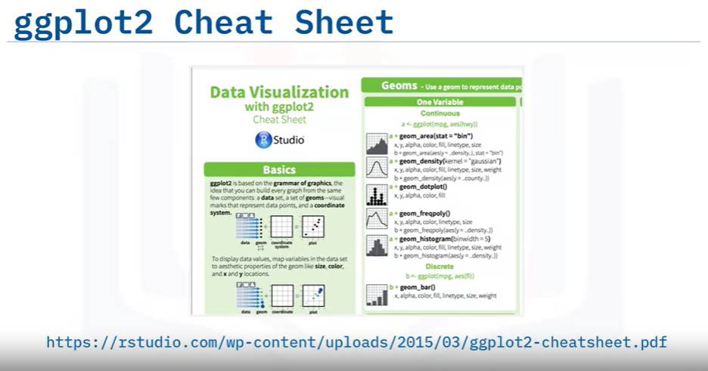
Using ggplot2

Slide 17
Summary
After this lesson, you know:
You can use data visualization to help you see trends, patterns, or anomalies that are not obvious when looking at raw data.
The six main categories of charts are comparison, trend, part to whole, correlation, relationship and connection, and map.
The R packages for visualization are ggplot2 for most categories of charts and Leaflet for maps.
The three components of a plot are data (the dataset), aesthetics (such as the color or position), and geometry (including points, lines, shapes, etc.)
While the qplot() function provides a quick and easy way to plot data, the ggplot() function provides the most flexibility.

Slide 18
Q & A
Chapter1- Importing Datasets

