Slide 1

Chapter 4:
Data Visualization with R

Slide 2
Basic Plots, Maps, and Customization 1

Slide 3
Objective
Create scatter plots using the ggplot2 library
Create line graphs using the ggplot2 library

Slide 4
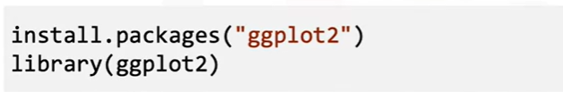
Scatter Plots
ggplot2” is a specialized library for creating aesthetically pleasing data visualizations
It’s an external library

Slide 5

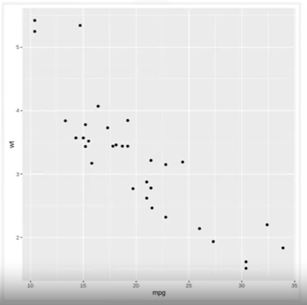
Scatter Plots
Dataset: mtcars
Input: including 11 variables.
Output: the miles per gallon, and weight of one individual automobile.
Qplot creates simple scatter plots
=> To customize using ggplot

Slide 6
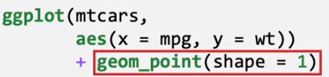
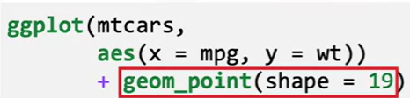
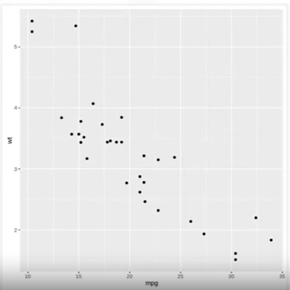
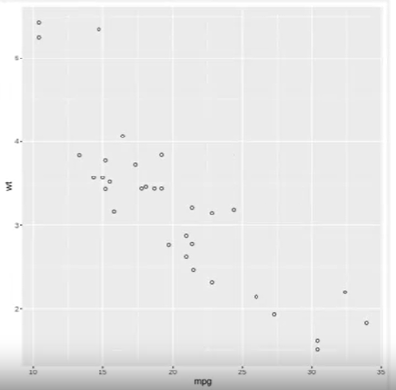
Scatter Plots

Slide 7
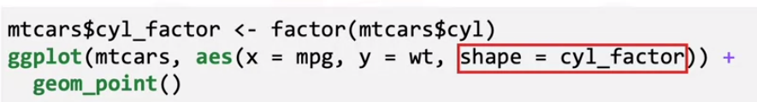
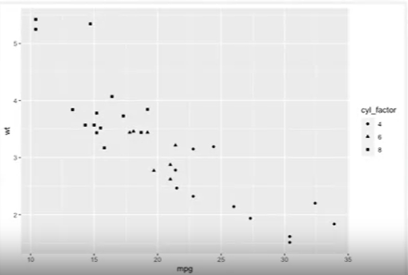
Scatter Plots
1- Create a factor from the cylinder variable
2- create the scatter plot usinh ggplot function:
Results:
Circles: 4-cylinder cars
Triangle: 6-cylinder cars Square: 8-cylinder cars.

Slide 8
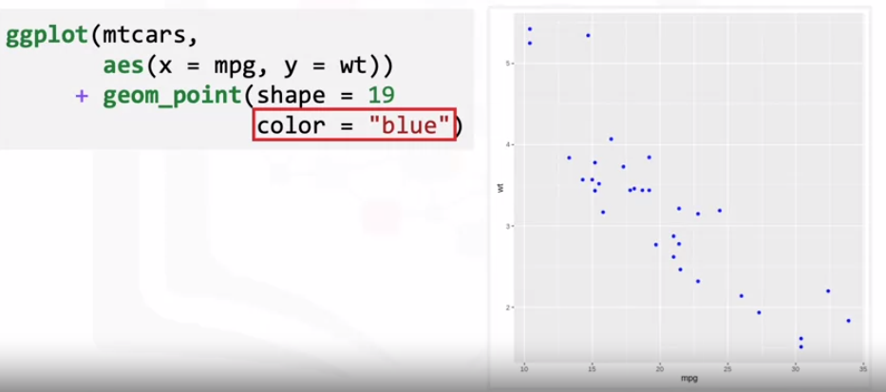
Scatter Plots

Slide 9
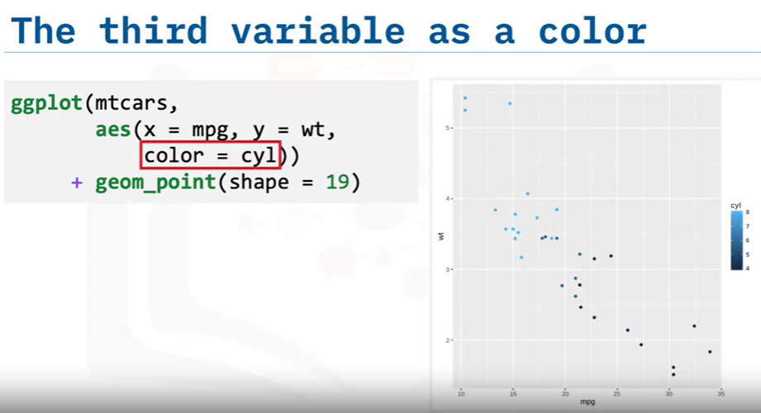
Scatter Plots

Slide 10
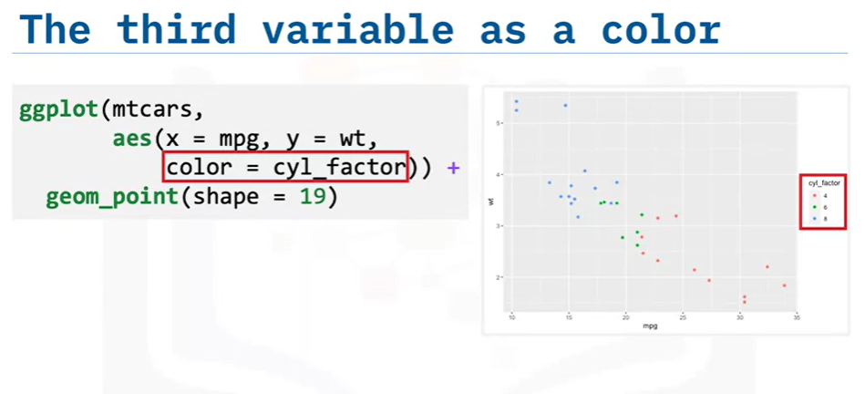
Scatter Plots

Slide 11
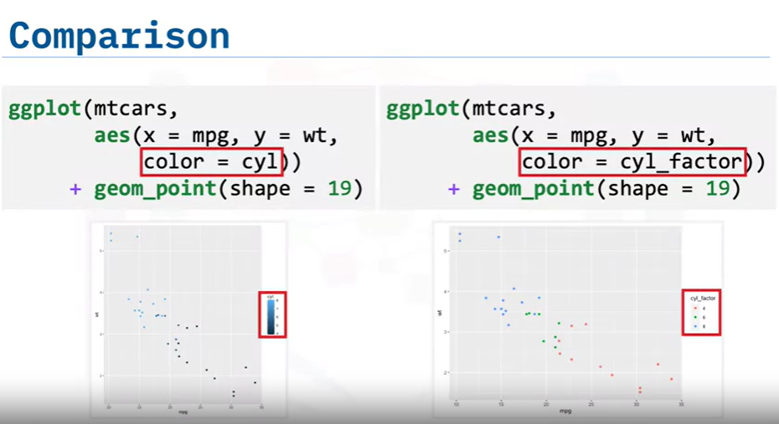
Scatter Plots
The left plot uses the cylinder data’s numeric range, and the right plot uses the cylinder
factor, and the right plot uses the cylinder factor, treating the values as separate categories.
Using the factor approach creates a much more aesthetically pleasing visual.

Slide 12
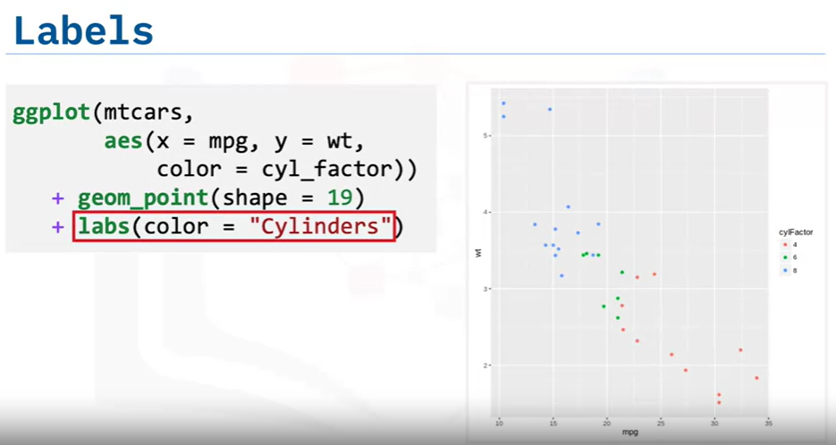
Scatter Plots

Slide 13
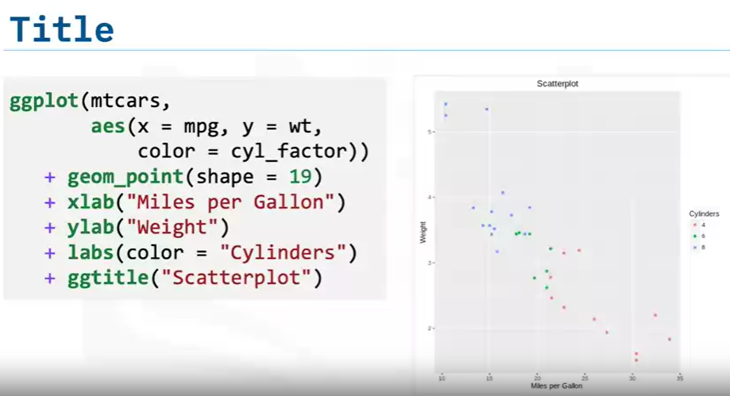
Scatter Plots

Slide 14
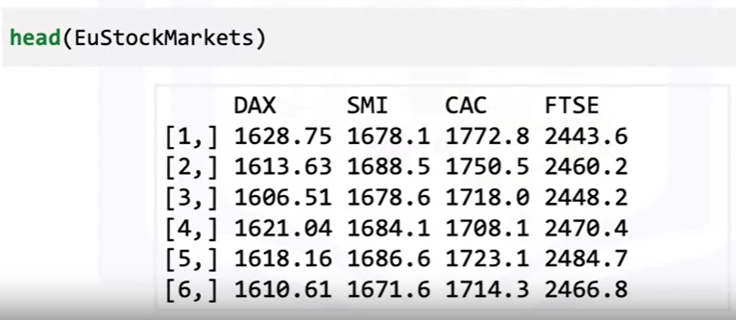
Line Plots
Data set: EUStockMarkets
1860 rows and 4 variables

Slide 15
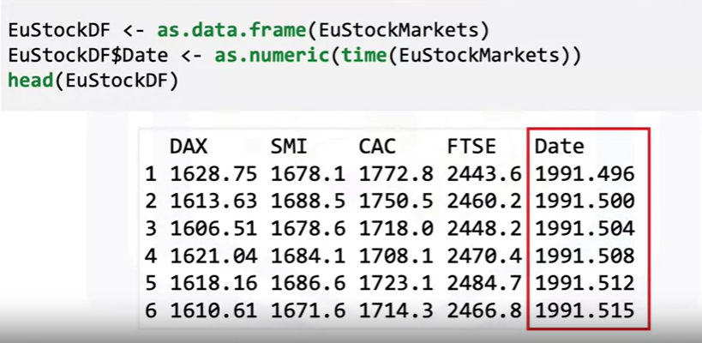
Line Plots
Data set: EUStockMarkets
ggplot cannot plot time series objects:
  Convert it to a data frame
  Extract the date information using the time() function

Slide 16

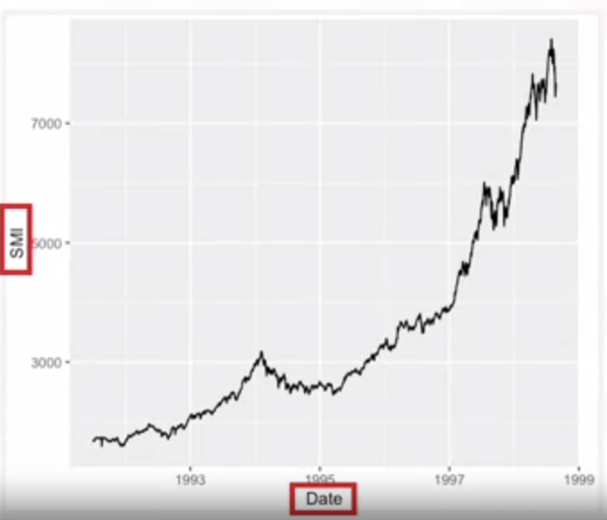
Line Plots
What does it mean SMI?

Slide 17
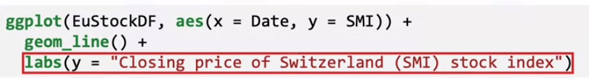
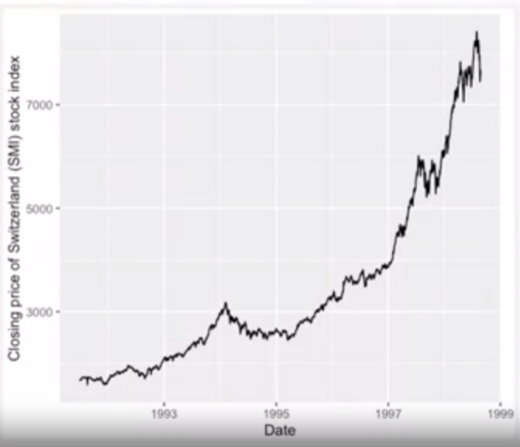
Line Plots

Slide 18

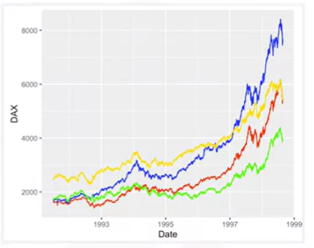
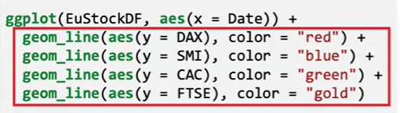
Line Plots
To add another line to the plot: using geom_line() function
Drawbacks
1- The y axis label and scales may not make sense for all the variables.
2- Must manually call geom_line() and set the color for every new line

Slide 19
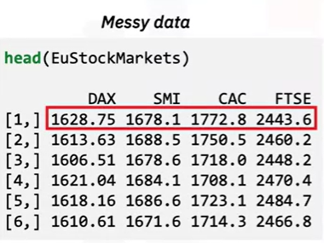
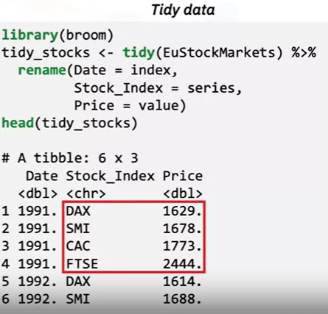
Line Plots
In original EUStockMarkets dataset, the market stock
indexes are arranged by columns instead of rows
=> Using Tidy to transform columns

Slide 20
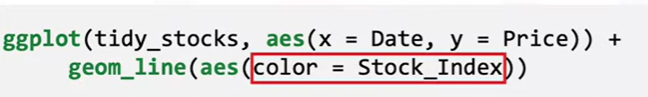
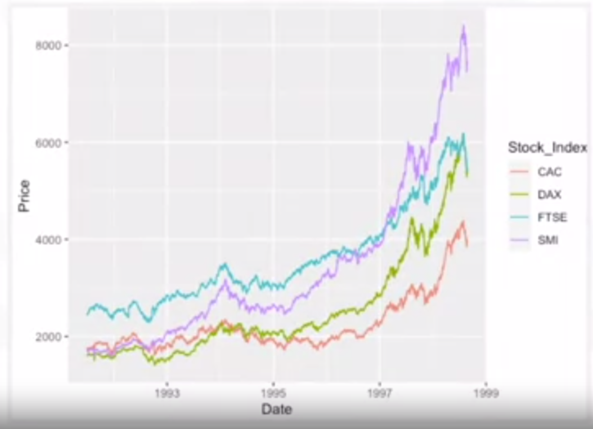
Line Plots
Results
Notes:
Results

Slide 21
Summary
After this lesson, you know:
A scatter plot shows how two variables relate to each other across the points of the dataset.
Create simple scatter plots using the qplot() function or more complex scatter plots using the ggplot() and geom_point() functions in the gggplot2 library.
Change the aesthetics of a scatter plot, including the shapes and colors of the individual points, by using the geom_point() and aes()
functions.
Line plots visualize time series data.
Create a line plot by specifying the x and y axis in aes(), and using the geom_line() function.
Modify the x and y axis labels using the labs() function.

Slide 22
Q & A

