Slide 1

Chapter 4:
Data Visualization with R

Slide 2
Basic Plots, Maps, and Customization 2

Slide 3
Objective
Create box plots using the ggplot2 library
Design customized plots using annotations, axis titles, and text labels
Chapter1- Importing Datasets

Slide 4
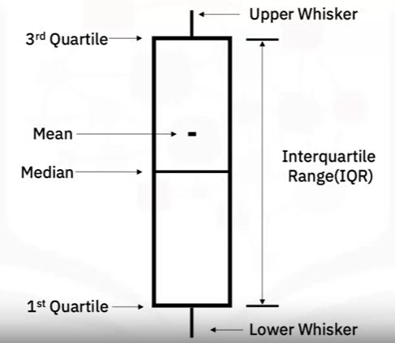
Box Plots
A box plot summarizes the distribution of sorted numerical data:
- 1st quartile: is the point 25% of the sorted data ( a quarter of the data points are less than this value).
- 3th quartile: 75% of the points are less than the value.
- Interquartile range is the difference between the 1st and 3th quartile.
- Median is the 2nd quartile (50% of the data falls below the median).
- Lower and upper whiskers indicate values outside the interquartile range.

Slide 5
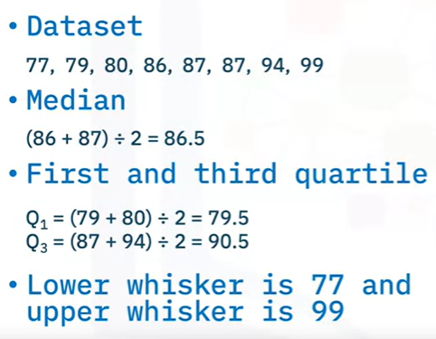
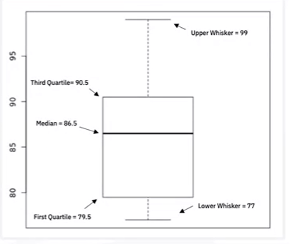
Box Plots

Slide 6

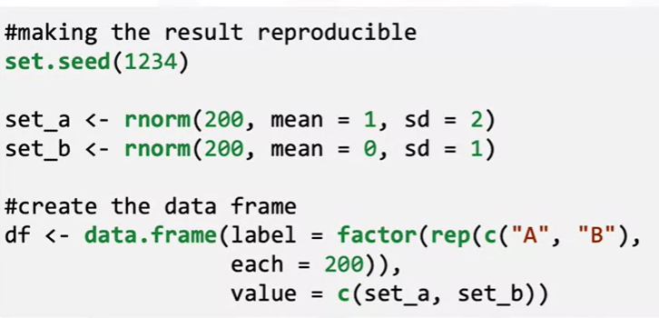
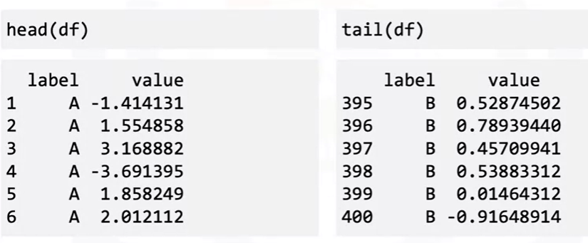
Box Plots

Slide 7
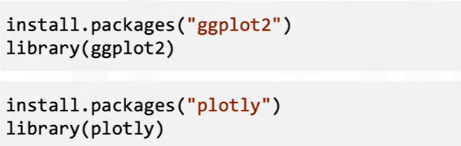
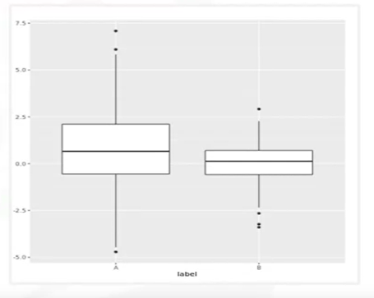
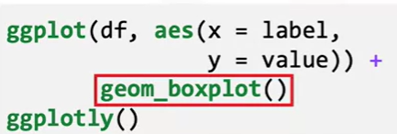
Box Plots

Slide 8

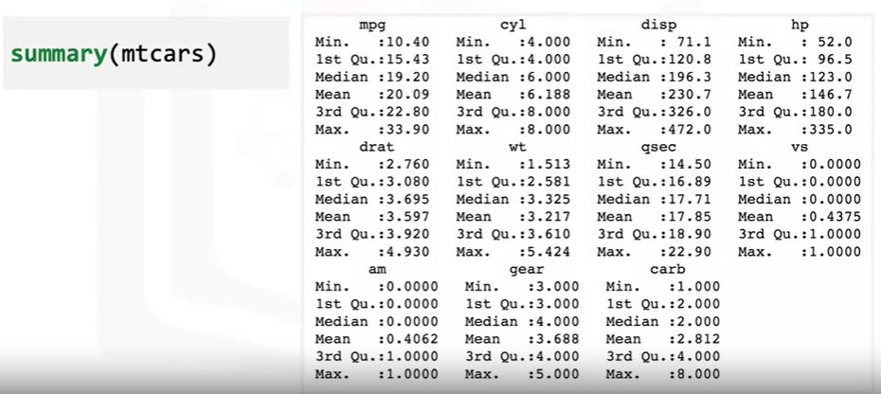
Box Plots

Slide 9
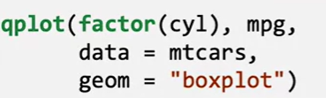
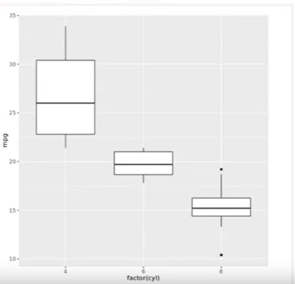
Box Plots
x axis: number of cylinders.
y axis: miles per gallon data.
Since the number of cylinders is more of a category than a numerical attribute, so the “factor” function is applied.
Get a box plot for each cylinder category.
See the relationship between cylinder count, and miles per gallon

Slide 10
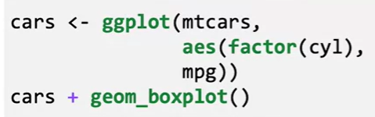
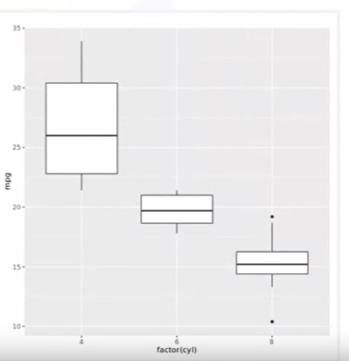
Box Plots
- See how “cylinder count” relates to the “miles per gallon” value.
- Adding “geom_boxplot”, we can see the box plot in the output.

Slide 11

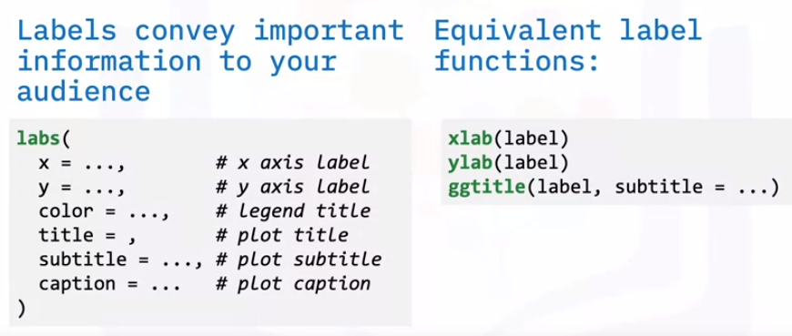
Customize Plots
It is important to add labels and titles to plots

Slide 12
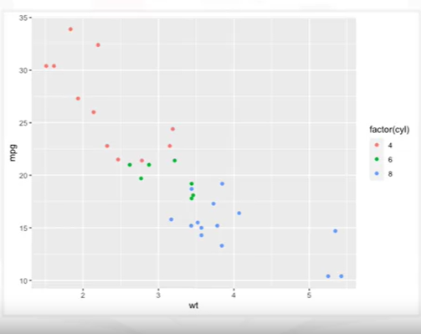
Customize Plots
This is a scatter plot using the default labels: no title, and the x-axis, y-axis labels, and legend labels

Slide 13
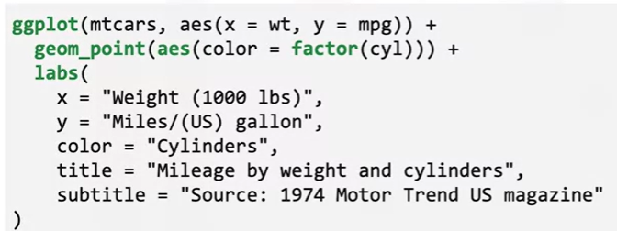
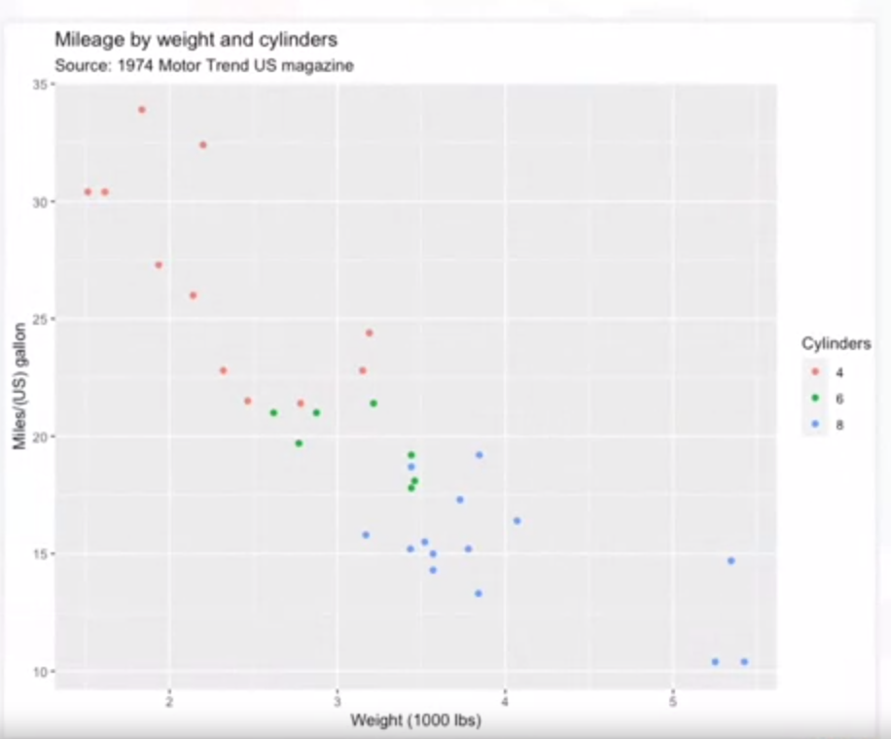
Customize Plots

Slide 14
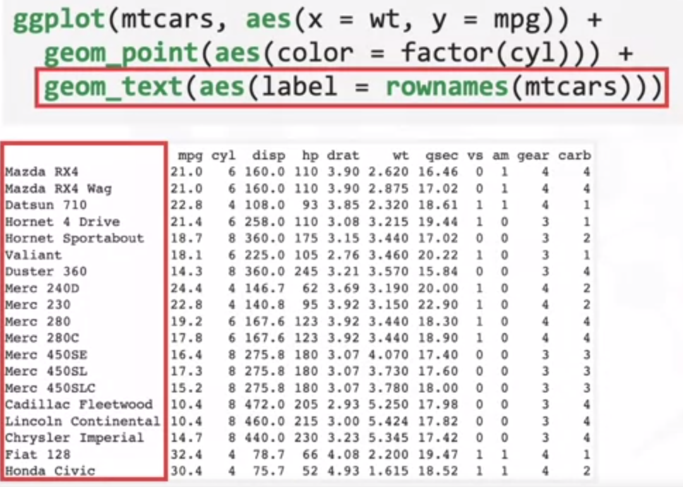
Customize Plots

Slide 15
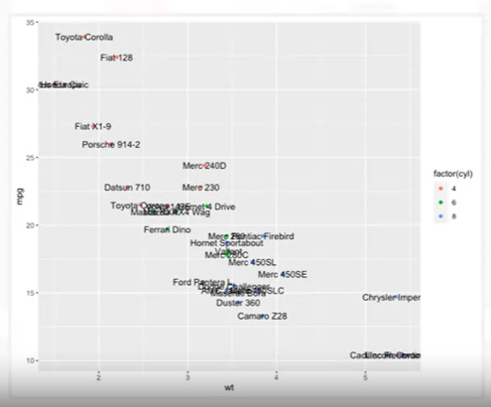
Customize Plots
Car names appear but a lot of the text is overlapping, some words are cut off, and it looks messy.

Slide 16
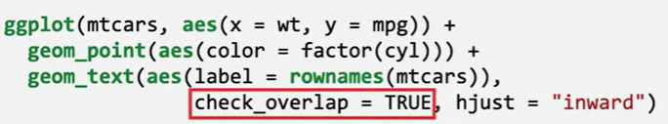
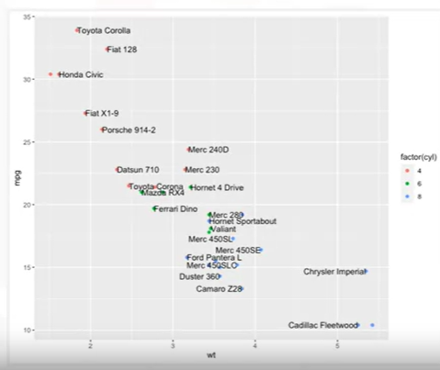
Customize Plots
Remove the overlapping text: check_overlap=TRUE

Slide 17
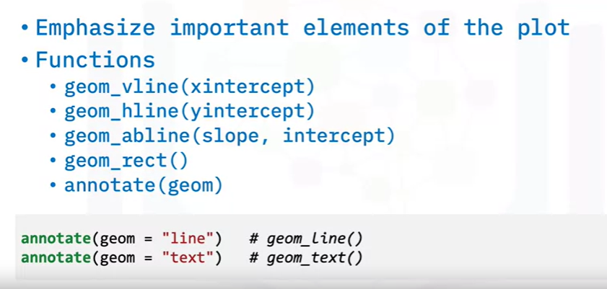
Customize Plots

Slide 18
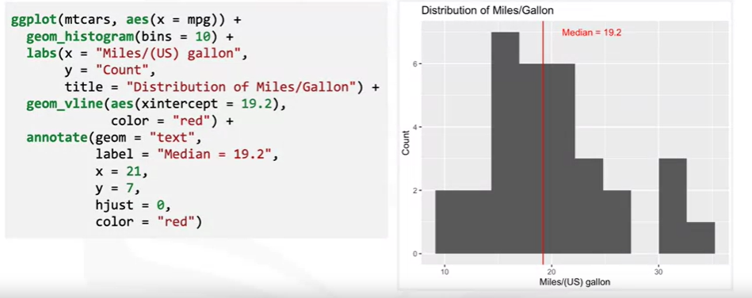
Customize Plots

Slide 19
Summary
After this lesson, you know:
Annotations provide metadata (or additional information about the data being displayed) for the plot.
Customize the titles associated with the plot, axes, and legends
using the labs() function.
Automatically remove overlapping labels from a plot by using
check_overlap = TRUE in the geom_text() function.

Slide 20
Q & A

