Slide 1

Chapter 4:
Data Visualization with R

Slide 2
Dashboards 1

Slide 3
Objective
Describe the role of the Shiny package in creating dashboards
Describe the server and user interface structure of a Shiny application
Explain the components that comprise a Shiny interactive dashboard
Create a simple Shiny app
Modify a Shiny ap with user interface components
Build an interactive Shiny dashboard
Deploy a Shiny app using Shinyapps.io
Generate downloadable reports using R Markdown
Design interactive dashboards to investigate key performance indicators (KPIs) with the Shiny package
Add user interface and server components to a Shiny app

Slide 4
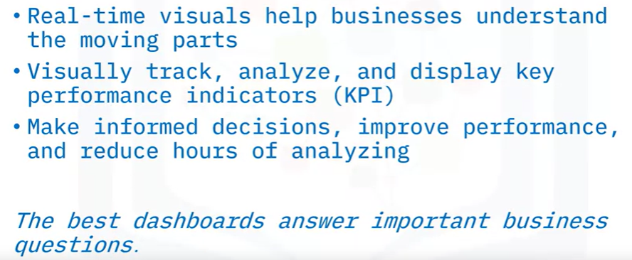
Introduction to Dashboards

Slide 5
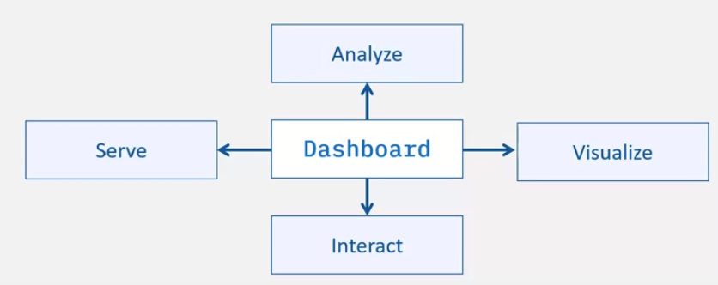
Introduction to Dashboards & Shiny
A dashboard consists of four components.
Listens to user requests and returns web pages using
a web server
Manipulate and summarize data using a backend library
Use frontend libraries to accept user inputs.
Create graphs using the graphing library.
Shiny is an R package for building interactive web applications that can help you with effective data storytelling.

Slide 6
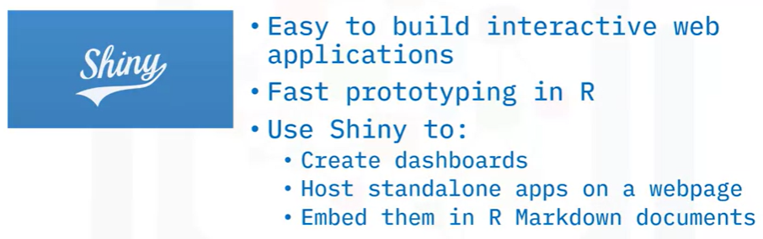
Introduction to Dashboards & Shiny

Slide 7

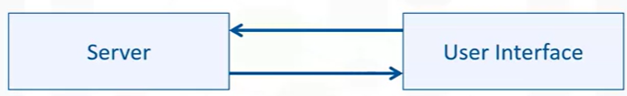
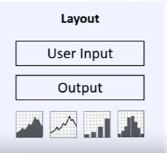
Introduction to Dashboards & Shiny
Shiny
Powers the app and holds the app logic
Tells the user interface which contents to show when the user interacts with the application.
Runs the application can be hosted on either your own computer or on a remote server.

Slide 8

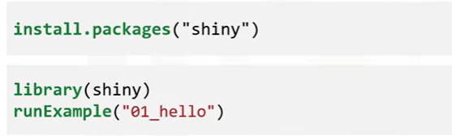
Introduction to Dashboards & Shiny

Slide 9

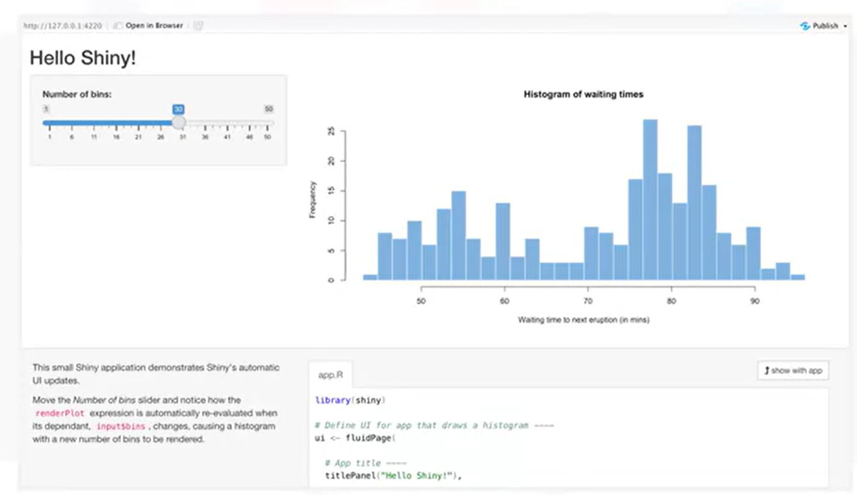
Introduction to Dashboards & Shiny

Slide 10
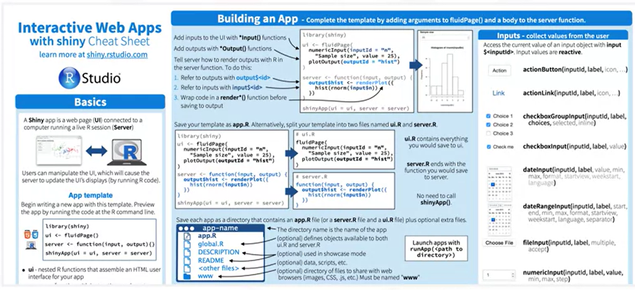
Introduction to Dashboards & Shiny

Slide 11
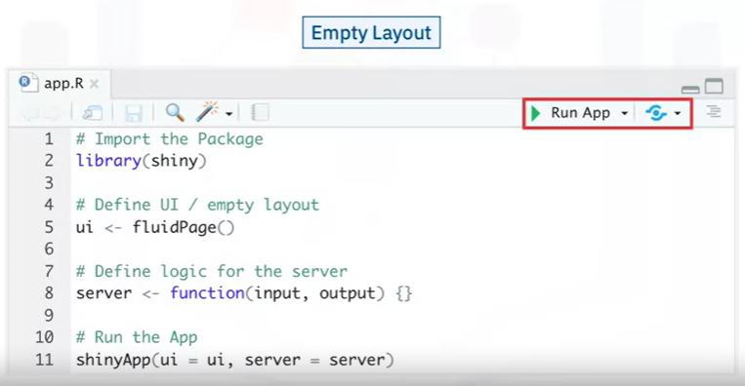
Shiny Basics
Basic template for creating any Shiny application: empty UI and an empty server

Slide 12
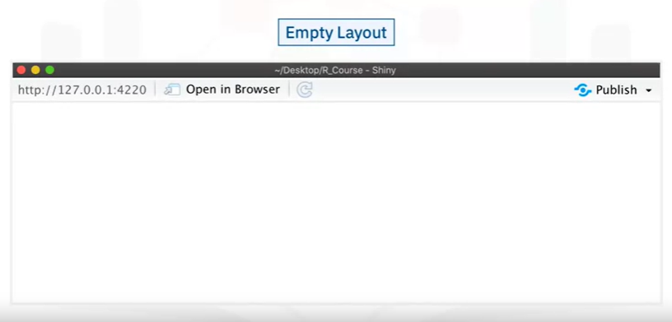
Shiny Basics

Slide 13
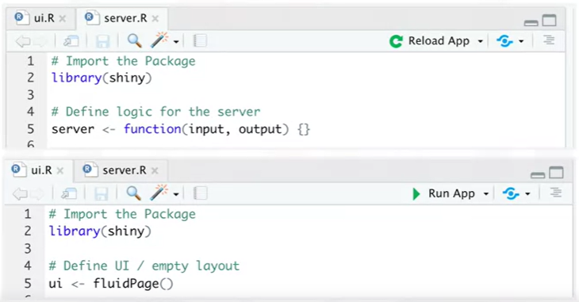
Shiny Basics

Slide 14
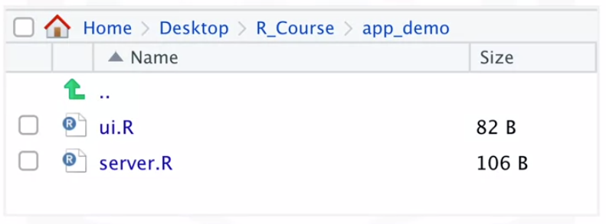
Shiny Basics
Do not have to call shinyApp() at the end of server.R or ui.R file.
Place the ui.R and server.R files into a single folder

Slide 15

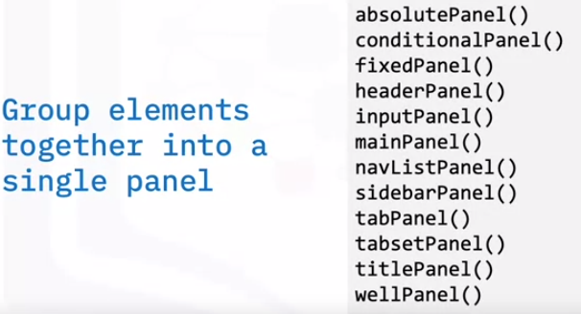
Shiny Basics
Panel groups UI elements together into a single panel.
Example: Text input and numeric input boxes can be grouped into a sidebar panel.

Slide 16
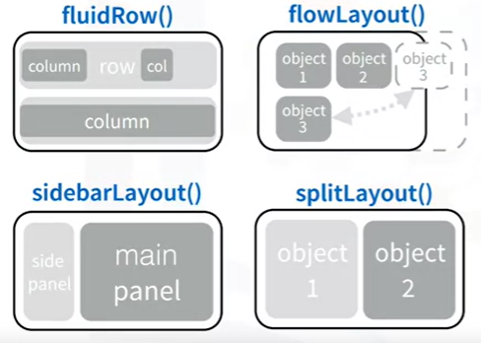
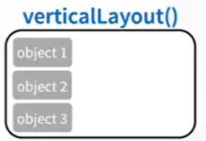
Shiny Basics
Use the Layout functions to organize panels containing UI elements in the application layout

Slide 17
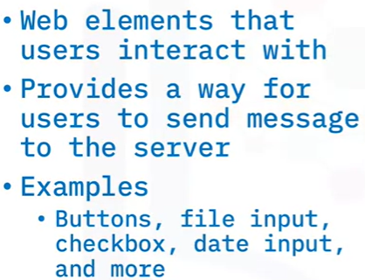
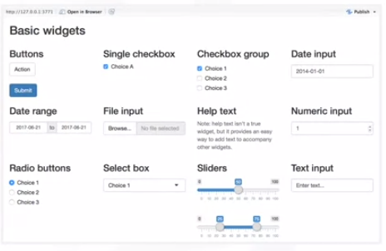
Shiny Basics

Slide 18
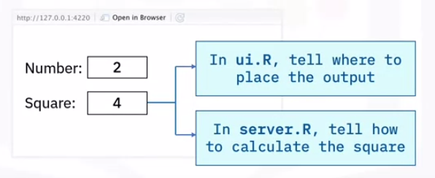
Shiny Basics

Slide 19
Summary
After this lesson, you know:
The best dashboards answer critical business questions.
An interactive dashboard is made up of four components: Analyze, visualize, interact, and Serve.
The Shiny package helps you build interactive dashboard apps using R.
A Shiny app works by defining a user interface (UI) and back-end server logic that work together to generate visualizations based on user input.
There are two standards for creating Shiny application files: a single file or two files named server.R and ui.R located in a single folder

Slide 20
Q & A

