Slide 1

Chapter 4:
Data Visualization with R

Slide 2
Dashboards 2

Slide 3
Objective
Build an interactive Shiny dashboard
Deploy a Shiny app using Shinyapps.io
Generate downloadable reports using R Markdown
Design interactive dashboards to investigate key performance indicators (KPIs) with the Shiny package
Add user interface and server components to a Shiny app

Slide 4
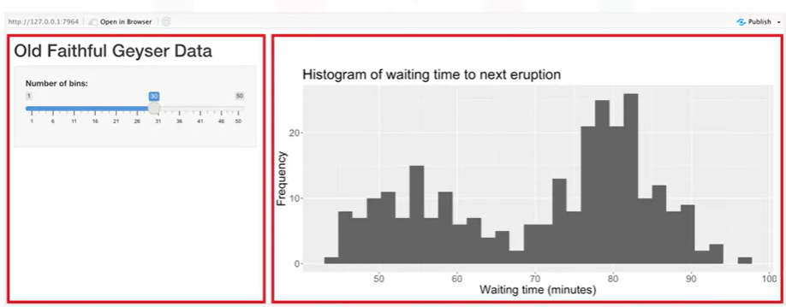
Create a Simple Shiny App
Dataset: faithful
This dashboard application has two sections.
Which layout with one of the application layouts?
Notes:
The dataset contains information about the waiting times between eruptions and the duration of the eruption for the Old Faithful geyser in Yellowstone National Park, which is in
the state of Wyoming in the USA.

Slide 5

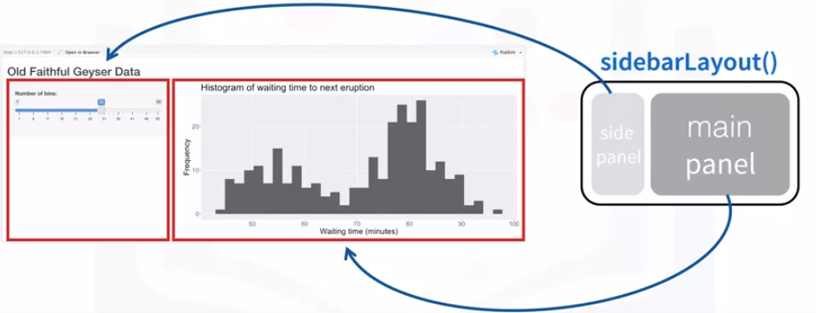
Create a Simple Shiny App
The sidebarLayout() function defines two sections: a side panel and a main panel
On the top, there is a title for the application. The slider input widget appears in the side panel.
The plot output appears in the main panel. Application logic will connect the elements behind the scenes in the server code

Slide 6
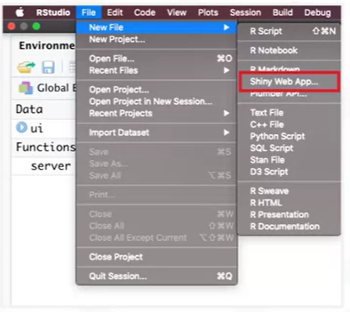
Create a Simple Shiny App
Get a basic layout of an application by selecting File, Shiny Web App, and then choosing Application File Structure.

Slide 7

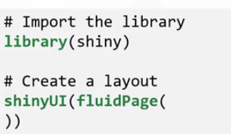
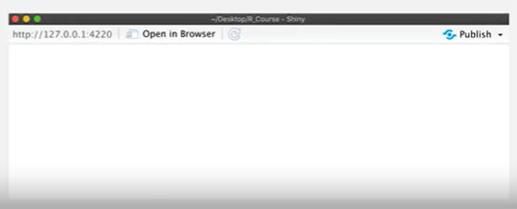
Create a Simple Shiny App

Slide 8
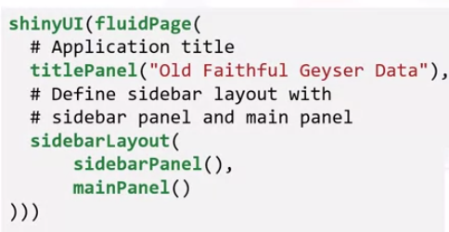
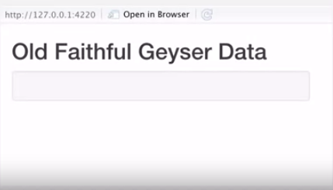
Create a Simple Shiny App

Slide 9
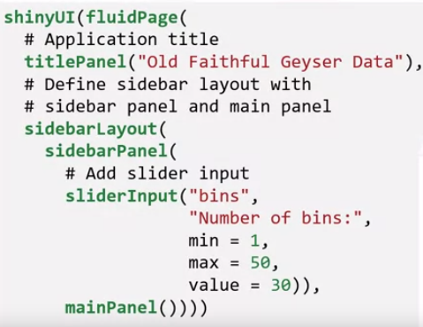
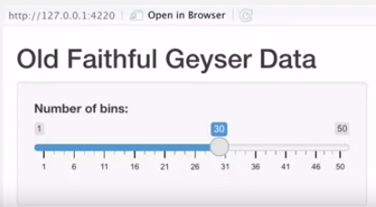
Create a Simple Shiny App

Slide 10
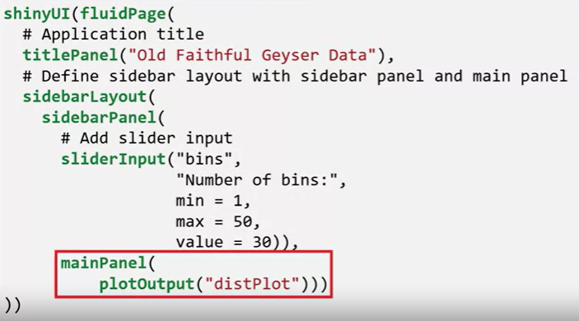
Create a Simple Shiny App

Slide 11

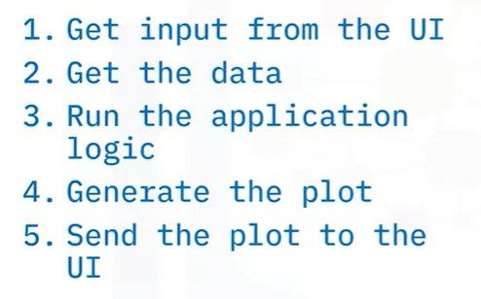
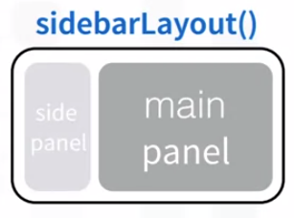
Create a Simple Shiny App

Slide 12
Create a Simple Shiny App

Slide 13
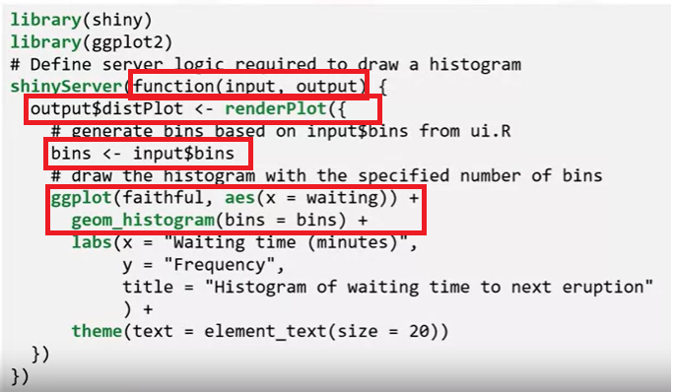
Create a Simple Shiny App

Slide 14
Create a Simple Shiny App
Results
Notes:
Results

Slide 15
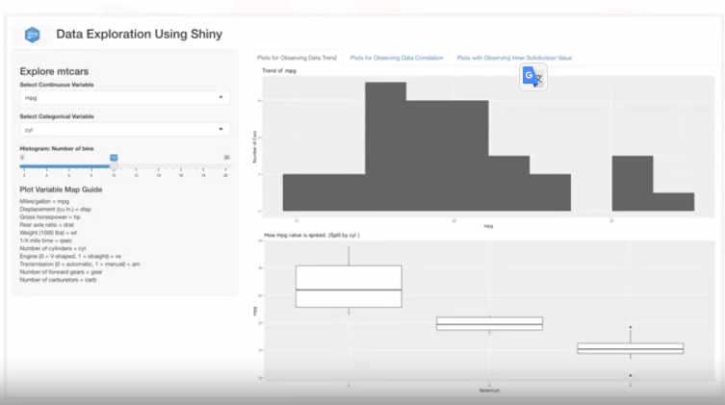
Explore Shiny Components
Goal: Build an interactive Shiny dashboard, which uses the empty cars dataset to generate plots for observing the data trend, correlation, and inner data subdivision
Notes:
Results

Slide 16
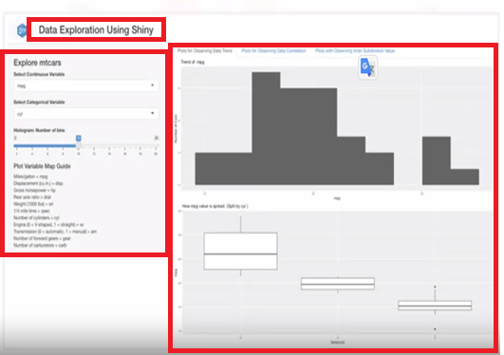
Explore Shiny Components
Add an application
title with an image
Goal: Build an interactive Shiny dashboard, which uses the empty dataset to generate plots for observing the data trend, correlation, and inner data subdivision
. Can interact with the input controls to change variables, toggle
between the tabs to see the data on different plots
Add a sidebar panel with drop down slider input, variables.
Display the output graphs on tabs
Notes:
Results

Slide 17
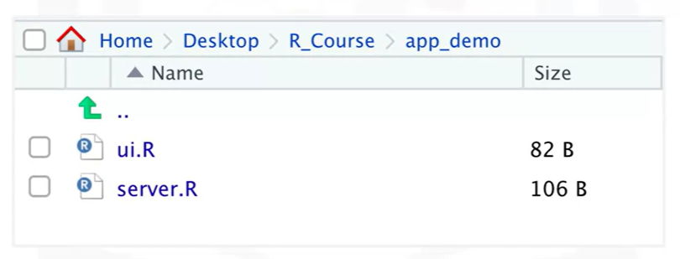
Explore Shiny Components
Create two files, ui.R and server.R.
Notes:
Results

Slide 18
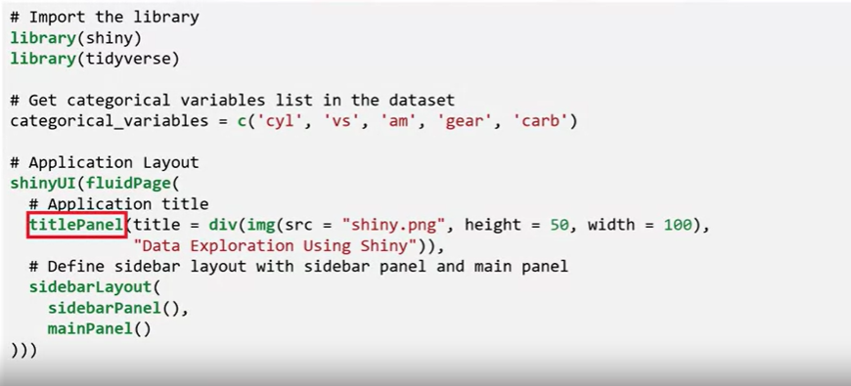
Explore Shiny Components
Design the user interface
Import required packages
Specify categorical variables in the dataset
Add a title panel
Define the sidebar layout
Define the main panel
Notes:
Results

Slide 19

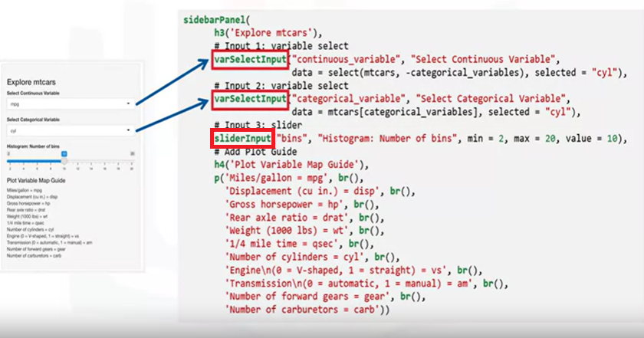
Explore Shiny Components
Structure of the sidebar
Notes:
Start by providing a title to the sidebar using the h3 heading tag.
Next, add two controls for choosing the input variables for the graphs. One for the continuous variable and the other for the categorical variable. The varSelectInput function creates a list of choices from the dataset column names. This function accepts the input ID that will be used to access the value, the display label for the control, the data frame from which the column names will be retrieved, and the initial default value, then add a slider input control for controlling number of histogram bins.
Finally, use HTML heading and paragraph tags to provide a guide for mapping the dataset variable names with the data glossary.

Slide 20

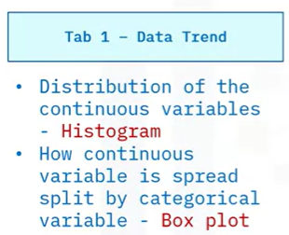
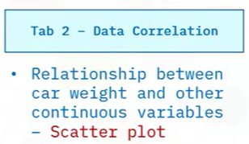
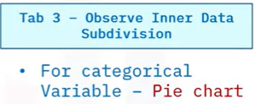
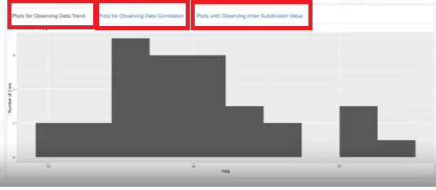
Explore Shiny Components

Slide 21
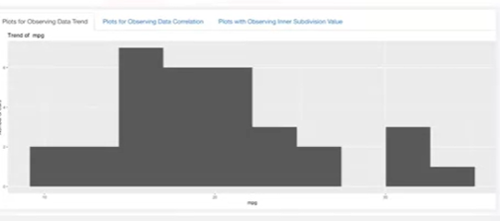
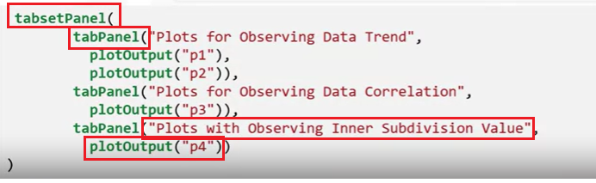
Explore Shiny Components

Slide 22
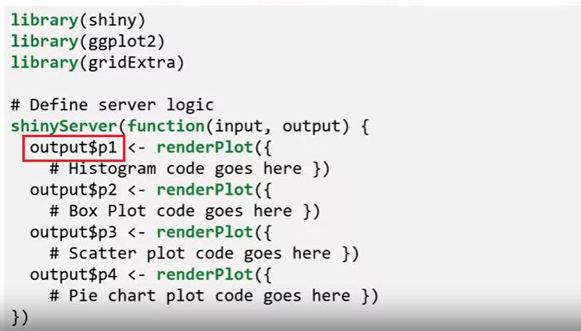
Explore Shiny Components

Slide 23

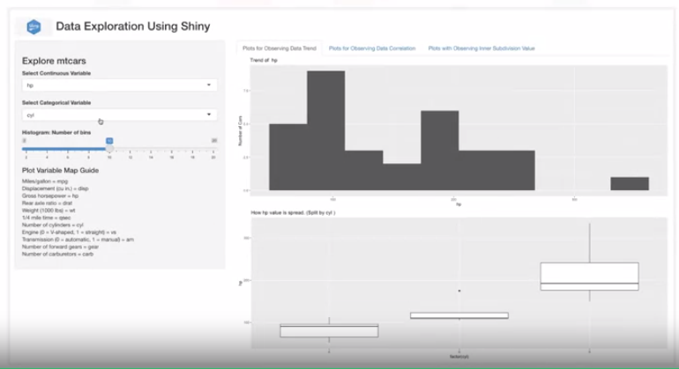
Explore Shiny Components

Slide 24
Summary
After this lesson, you know:
Add web components like images, list boxes, sliders, and HTML to a user interface.
Create a tabbed panel using tabPanel, organize multiple plots on a tabbed panel, and render plots using server-side logic.

Slide 25
Q & A

