Slide 1
All data
Training data
Test data
Fold 1
Fold 2
Fold 3
Fold 4
Fold 5
Iteration 1
Validation
Training
Training
Training
Training
Iteration 2
Training
Validation
Training
Training
Training
Iteration 3
Training
Training
Validation
Training
Training
Iteration 4
Training
Training
Training
Validation
Training
Iteration 5
Training
Training
Training
Training
Validation

Slide 2
ACTUAL CLASS
Apple
Orange
Mango
89
7
7
Apple
5
73
2
PREDICTED CLASS
Orange
1
0
85
Mango

Slide 3
ACTUAL CLASS
Positive
Negative
TP
FP
Positive
PREDICTED CLASS
FN
TN
Negative

Slide 4
support vectors
margin
margin

Slide 5



Slide 7



n
k
n
n
R
P
Q^{T}
B
k
q_{i}
i
m
$$=$$
$$×$$
$$+$$
r_{ui}
p_{u}
b_{u} + b_{i}
u
u
u
i
i

Slide 8
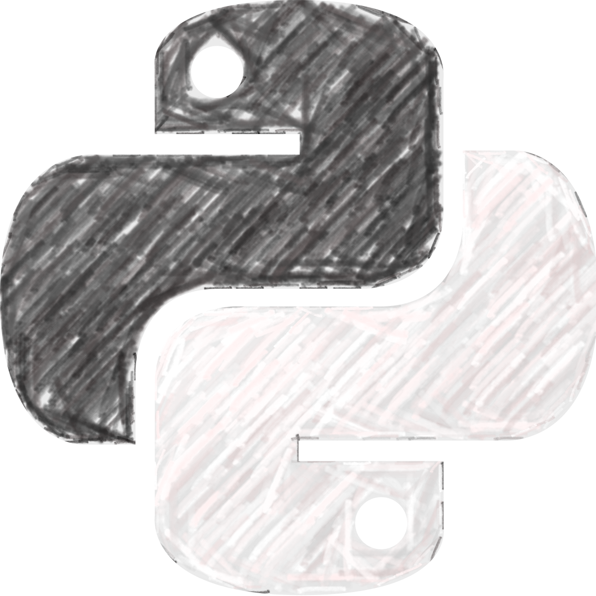
Data
Chilly
DataChilly
Chill with Data

Slide 9
Root
(50, 50, 50)
petal_width < 0.8
petal_width > 0.8
Leaf - Setosa
(50, 0, 0)
(0, 50, 50)
petal_width < 1.75
(0, 49, 5)
(0, 1, 45)

Slide 10
Petal length
(Root node)
<1 cm
>=1 cm
Sentosa
(Leaf node)
Petal width
(Non-leaf node)
<1.75 cm
>=1.75 cm
Branch
Versicolor
(Leaf node)
Virginica
(Leaf node)

Slide 11
Chest pain
(gini=0.45)
Good blood circulation
(gini=0.34)
Blocked ateries
(gini=0.36)
no
yes
no
yes
no
yes
Heart disease
Yes = 3
No = 3
Heart disease
Yes = 5
No = 2
Heart disease
Yes = 6
No = 1
Heart disease
Yes = 2
No = 4
Heart disease
Yes = 1
No = 3
Heart disease
Yes = 7
No = 2

Slide 12
Good blood circulation
(gini=0.34)
Good blood circulation
(gini=0.34)
no
yes
no
yes
Chest pain
(gini=0.19)
6/13
Blocked ateries (gini=0.14)
6/13
no
yes
no
yes
Heart disease
Yes = 2
No = 1
Heart disease
Yes = 4
No = 0
Heart disease
Yes = 1
No = 1
Heart disease
Yes = 5
No = 0

Slide 13
Good blood circulation
(gini=0.34)
no
yes
Blocked ateries (gini=0.14)
Blocked ateries (gini=0.22)
no
yes
no
yes
Heart disease
Yes = 1
No = 1
Heart disease
Yes = 5
No = 0
Heart disease
Yes = 0
No = 2
Heart disease
Yes = 2
No = 2

