Slide 1




Kiến tạo tương lai
THEO CÁCH CỦA BẠN
www.viettel.com.vn

Slide 2


Content
Model Interpretation
Machine Learning
What is Model Interpretation? Importance of Interpretability
Black-box vs White-box models and Interpretability techniques
Scope of Interpretability
Model Interpretation
Deploy with Python
www.viettel.com.vn

Slide 3
What is Model Interpretation?
www.viettel.com.vn

Slide 4

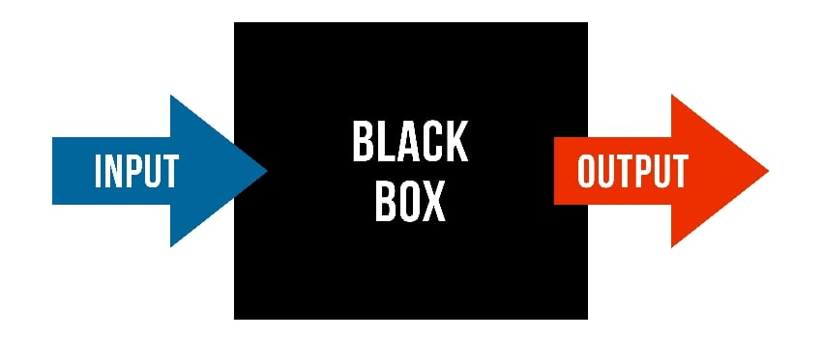
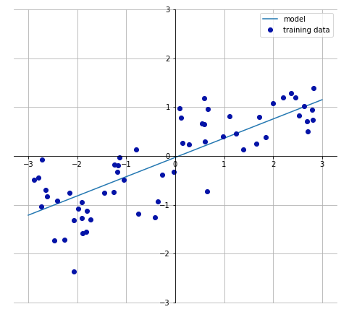
What is Model Interpretation?
System that performs behaviour but we don’t know how it works
Why should I trust the model?
How does the model make predictions?
www.viettel.com.vn

Slide 5
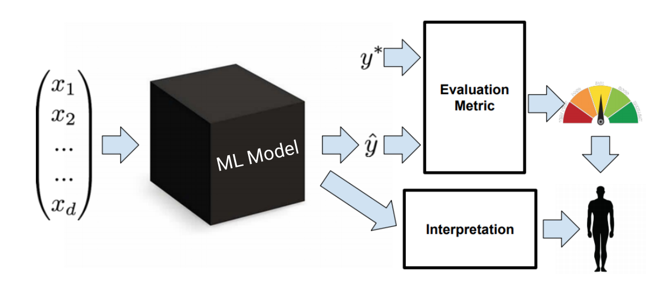
What is Model Interpretation?
www.viettel.com.vn

Slide 6
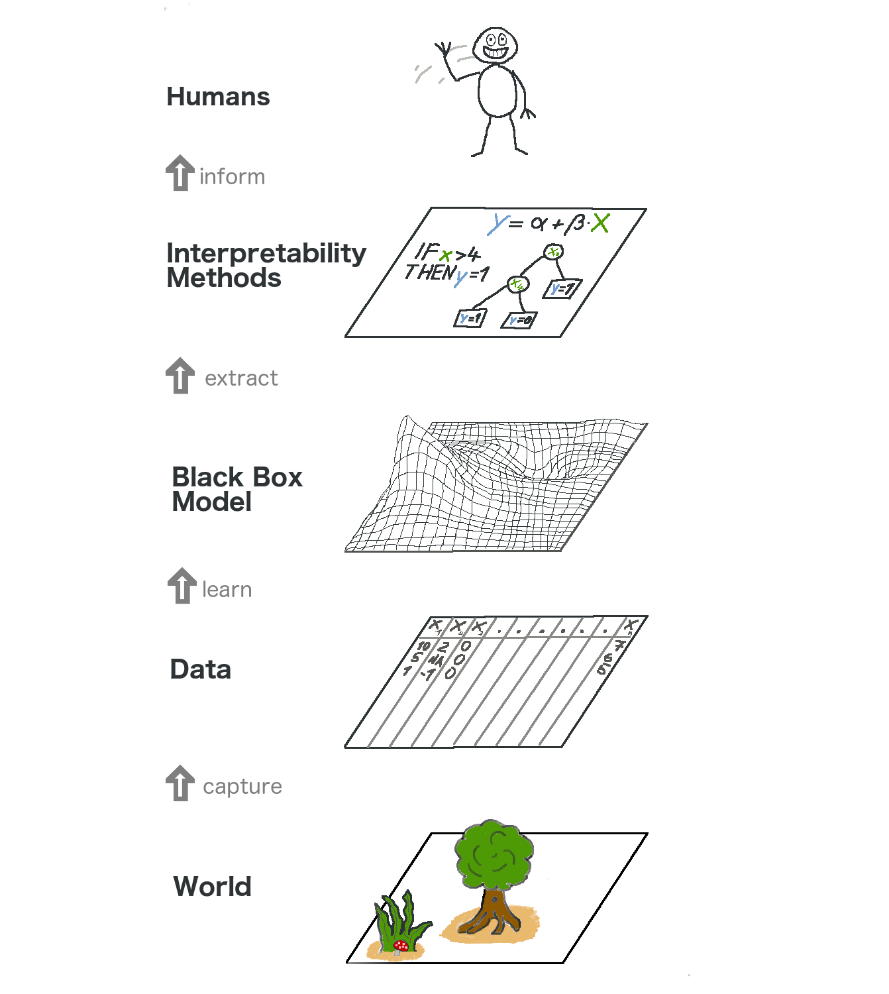
Importance of Interpretability
Ensures fairness of the model.
Ensures accountability and reliability of the model.
Ensures transparency of the model.
TRUST
www.viettel.com.vn

Slide 7
Black-box vs. white-box models
www.viettel.com.vn

Slide 8
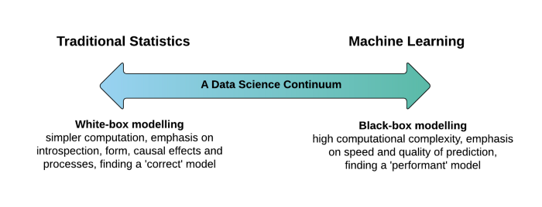
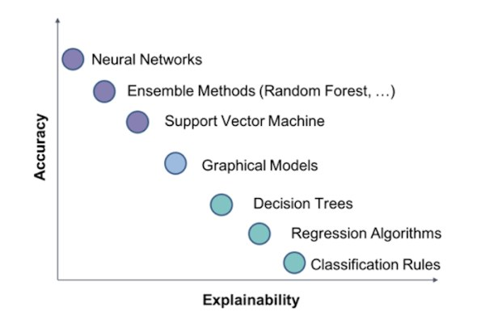
Black-box vs. white-box models
www.viettel.com.vn

Slide 9
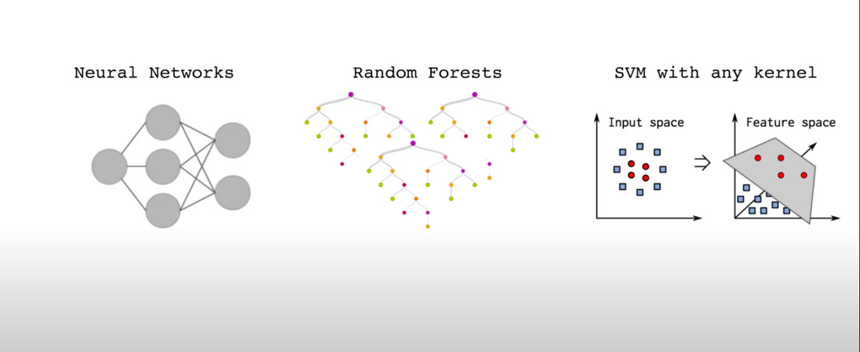
Motivated
What if you could understand why any classifier is making a decision?
www.viettel.com.vn

Slide 10
Scope of Interpretability
www.viettel.com.vn

Slide 11
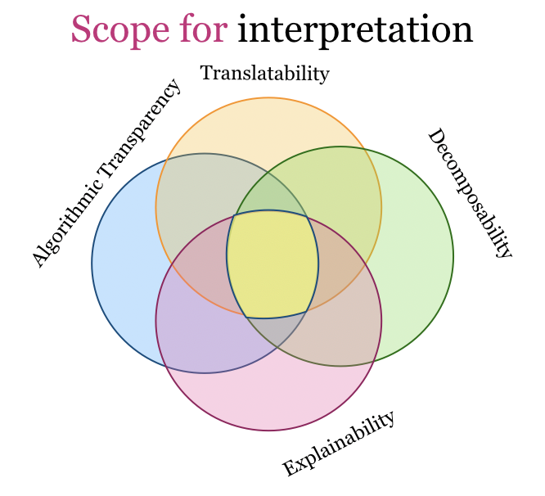
Scope of Interpretability
Global Model Interpretability
How does the trained model make predictions?
Local Model Interpretability
Why did the model make a certain prediction for an instance?
www.viettel.com.vn

Slide 12
Global Model Interpretability
www.viettel.com.vn

Slide 13
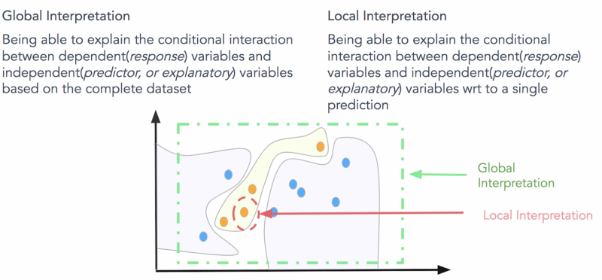
Global Model Interpretability
www.viettel.com.vn

Slide 14
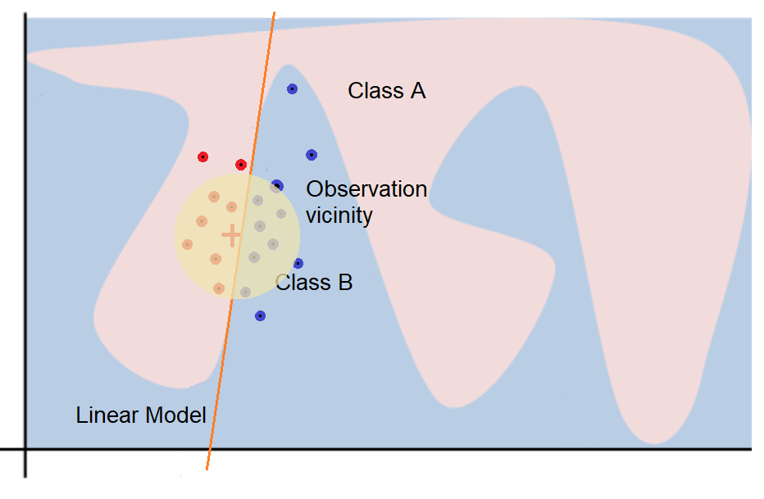
Global Model Interpretability
How does the model make predictions?
Global interpretability is all about being able to explain and understand model decisions based on conditional interactions between the dependent (response) variable(s) and the independent (predictor) features on the complete dataset
www.viettel.com.vn

Slide 15
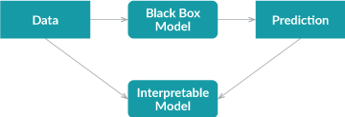
Importance of Interpretability
To train a surrogate for a black-box model M, trained on and a dataset X with target y, we have to:
Run the model M to get the predictions for the training dataset X to generate ŷ
Generate a new dataset using X and replacing the label column y with the predictions column ŷ
Select an interpretable model to be the surrogate model. This can be Linear Models, Logistic Regression, Decision Trees, Naïve Bayes, or K-nearest neighbors.
Train the interpretable model on the new dataset (the target is ŷ)
www.viettel.com.vn

Slide 16

Importance of Interpretability
One way to measure how well the surrogate replicates the black box model is the R-squared measure:
Advantages
Flexible: Any model from the interpretable models can be used.
Intuitive and straightforward: This means it is easy to implement, but also easy to explain to people not familiar with data science or machine learning.
Easily measure: easily measure how good our surrogate models are in approximating the black box predictions.
Disadvantages
Subset of the dataset
Conclusions about the model and not about the data.
Not clear what the best cut-off for R-squared
www.viettel.com.vn

Slide 17
Local Model Interpretability
www.viettel.com.vn

Slide 18
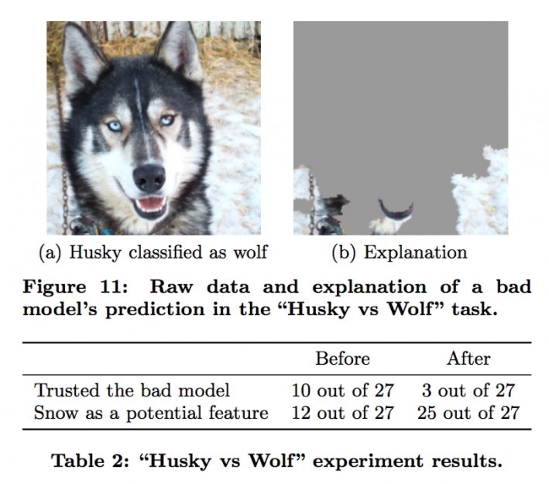

Local interpretable model-agnostic explanations (LIME)
Local surrogate models are interpretable models that are used to explain individual predictions of black box machine learning models — Christoph Molnar
Mathematically, local surrogate models with interpretability constraint can be expressed as follows:
LIME will seek to interpret model results for human decision-makers.
www.viettel.com.vn

Slide 19
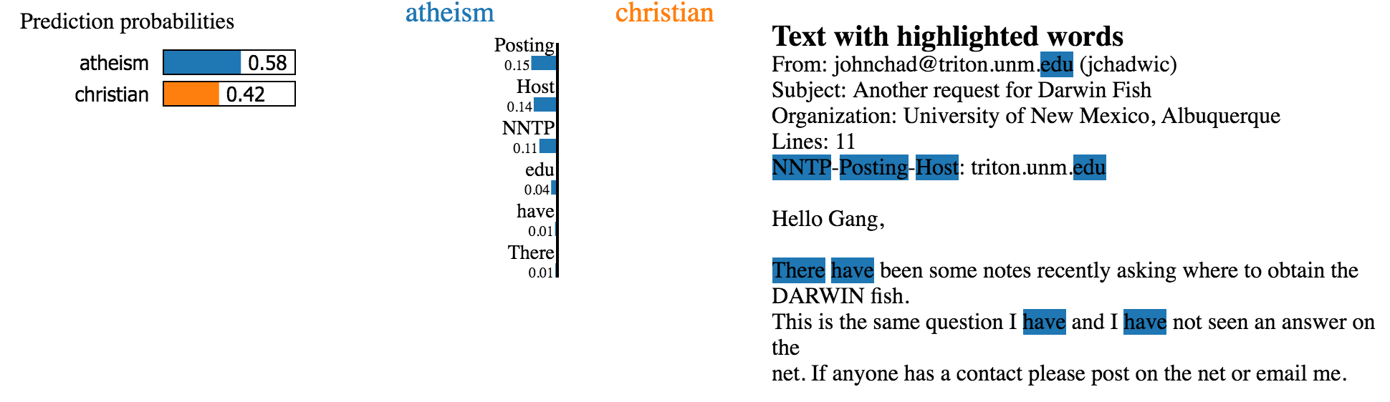
Local interpretable model-agnostic explanations (LIME)
www.viettel.com.vn

Slide 20
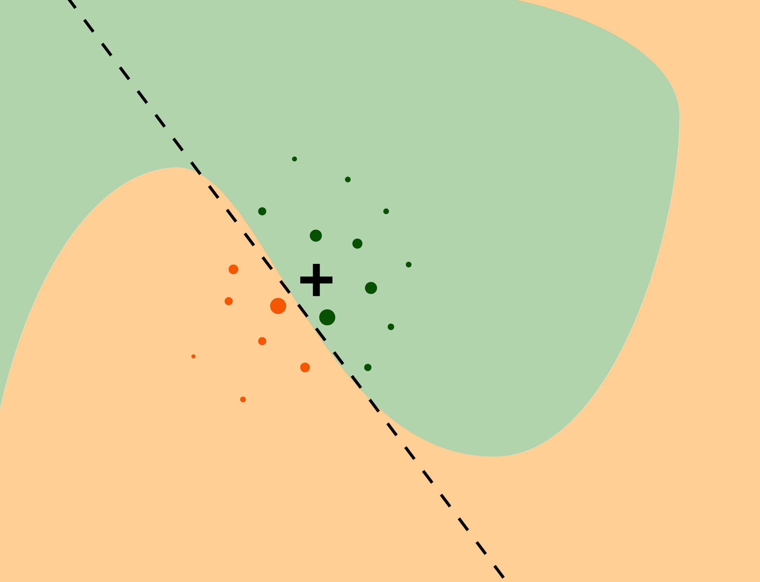
Local interpretable model-agnostic explanations (LIME)
Advantages
Replace the underlying machine learning model
Human-friendly explanations
The fidelity measure (how well the interpretable model approximates the black box predictions)
Disadvantages
Instability of the explanations.
Inclusion of unrealistic data instances
www.viettel.com.vn

Slide 21
Neural Network Interpretation
www.viettel.com.vn

Slide 22
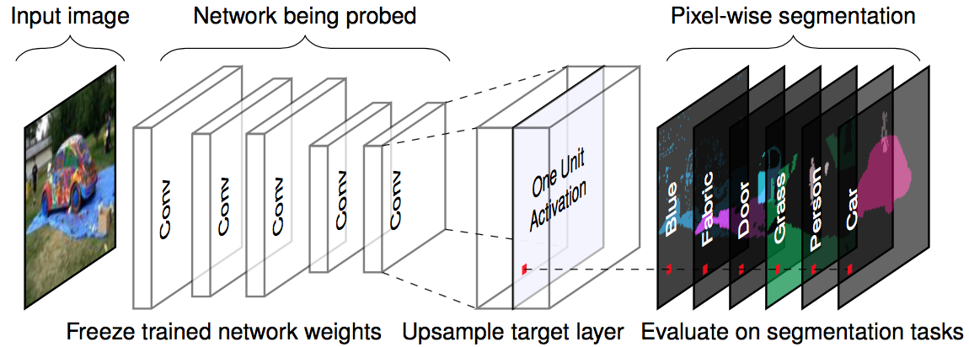
Neural Network Interpretation
www.viettel.com.vn

Slide 23
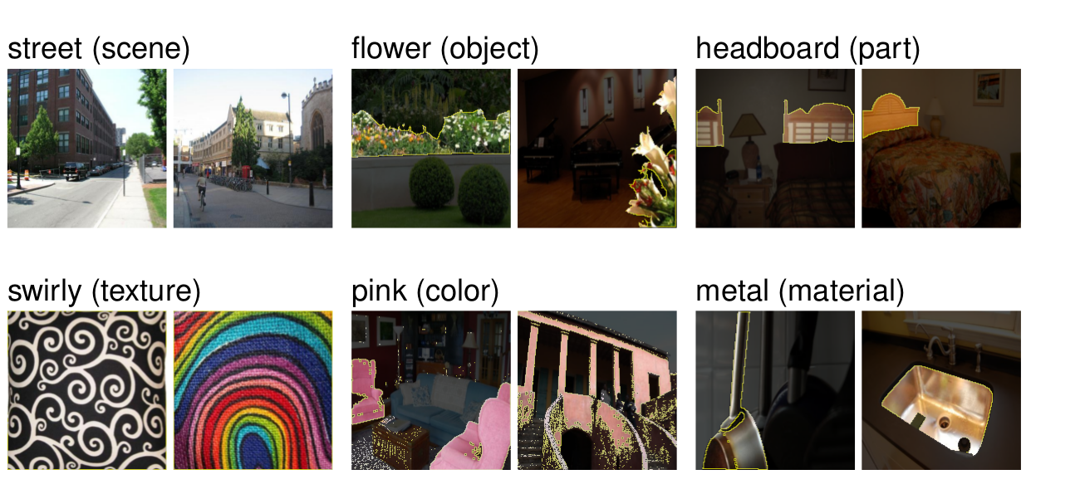
Neural Network Interpretation
Step 1: Broden dataset
www.viettel.com.vn

Slide 24
Learned Features
www.viettel.com.vn

Slide 25



Learned Features
Visualization/Local Explanations: Can the model identify what is/was important to its decision-making?
www.viettel.com.vn

Slide 26
Random Forrest Interpretation
www.viettel.com.vn

Slide 27
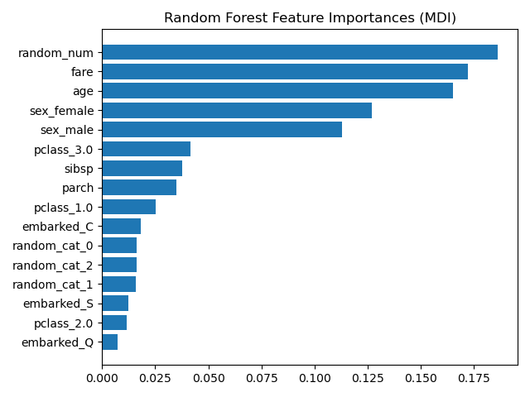
Features Important
www.viettel.com.vn

Slide 28
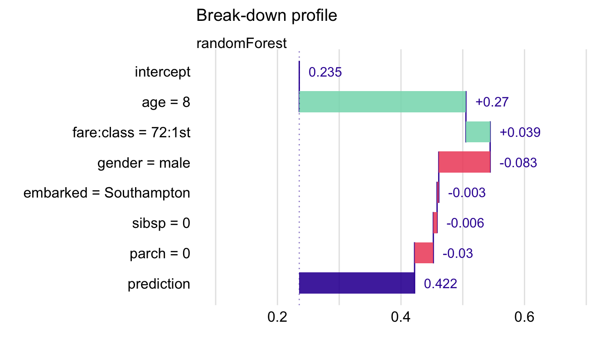
Titanic Dataset using LIME
Break-down plot with interactions for the random forest model for the Titanic data.
www.viettel.com.vn

Slide 29
Deploy with Python
www.viettel.com.vn

