Slide 1
EXTREME GRADIENT BOOSTING
Extreme Gradient Boosting
and large-scale optimization
Phạm Quang Hưng | Data Scientist | BU Telco New

Slide 2
Table of Contents
1
Gradient Boosting Trees
The traditional Gradient Boosting Trees algorithm, the foundation of XGBoost.
4
XGBoost Optimization
How is XGBoost designed for large datasets?
2
XGBoost Main Ideas
Implementation of XGBoost on a small dataset.
5
XGBoost Implementation
Important hyperparameters when implementing in Python.
3
XGBoost Mathematical Details
Mathematical details of the algorithm.

Slide 3

1
Gradient Boosting Trees

Slide 4


Review of Gradient Boosting Trees
Initial prediction
Root
Leaf
Leaf
Leaf
Root
Leaf
…….
Leaf
Leaf
Root
Leaf
Leaf
Leaf

Slide 5
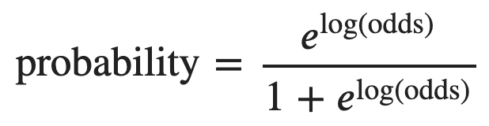
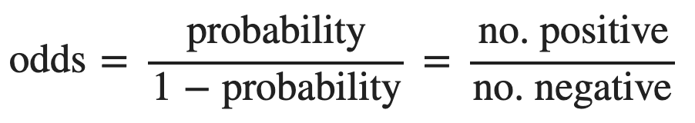
Important keywords
Is an additive model
Contains a sequence of weak learners
The next tree is built upon pseudo residuals made by previous ones
Each weak learner is scaled by eta, the learning rate
Is designed for predicting continuous values
For classification problems, GBM predicts probability indirectly using log(odds)
(Logistic function)

Slide 6
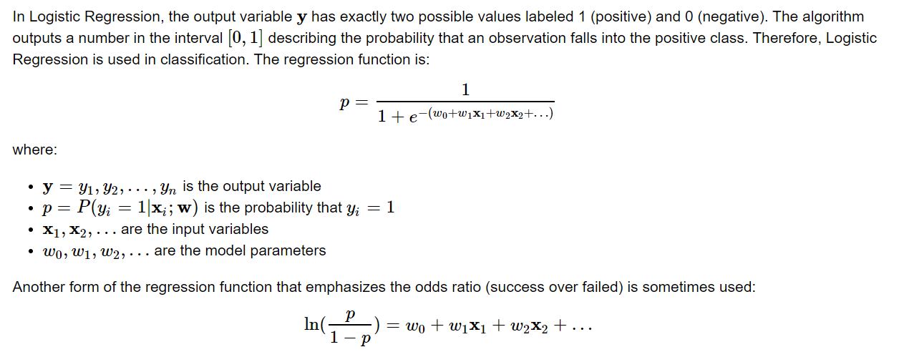
Logistic Regression

Slide 7
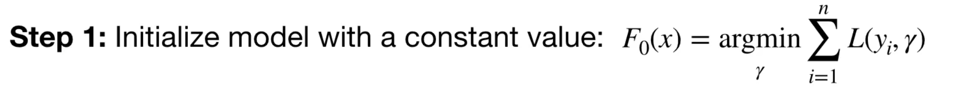
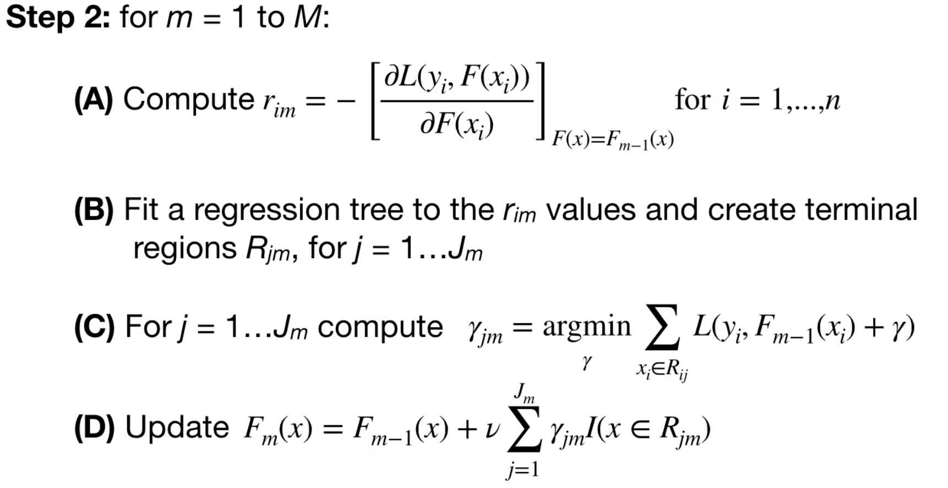
GBT algorithm

Slide 8
The GBM killer
XGBoost is an enhanced version of GBM, dominating Kaggle competitions, especially for tabular data. Some advantages of XGBoost are:
Good performance
Built-in function for handling missing data
Effective tree pruning to prevent overfitting
Can run parallelly
Can utilize GPU

Slide 9
2
XGBoost Main Idea

Slide 10
Regression dataset
7.5
6.5
Initial prediction = 0.5
Effectiveness (y)
-7.5
-10.5
Dosage (x)

Slide 11
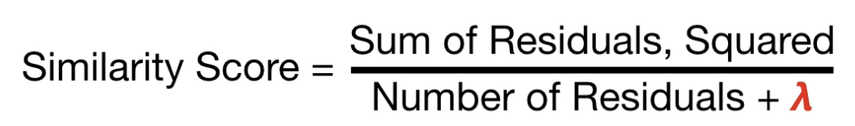
Building the first tree
= 0
(regularization parameter)
= 1
o1, o2, o3, o4
Similarity = 4
o1, o2, o3, o4
Similarity = 3
x > 15
x < 15
x > 15
x < 15
o2, o3, o4
Similarity = 14
o1
Similarity = 110
o2, o3, o4
Similarity = 10
o1
Similarity = 55
x < 30
x > 30
x < 30
x > 30
o2, o3
Similarity = 98
o4
Similarity = 56
o2, o3
Similarity = 65
o4
Similarity = 28

Slide 12
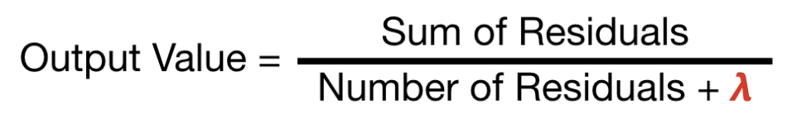
Calculating output values
= 0
= 1
o1, o2, o3, o4
o1, o2, o3, o4
x > 15
x < 15
x > 15
x < 15
o2, o3, o4
o1
Output = -10
o2, o3, o4
o1
Output = -5
x < 30
x > 30
x < 30
x > 30
o2, o3
Output = 7
o4
Output = -8
o2, o3
Output = 5
o4
Output = -4

Slide 13
Make predictions
0.5
Root
Leaf
Leaf
Leaf
Root
Leaf
…….
Leaf
Leaf
Root
Leaf
Leaf
Leaf

Slide 14
Final prediction
Initial prediction = 0.5
Effectiveness (y)
Dosage (x)

Slide 15
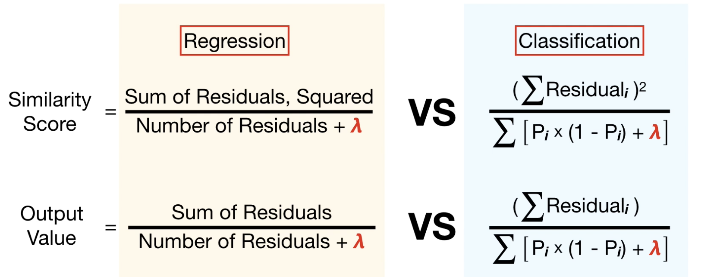
Comparison of Similarity score and Output value

Slide 16
3
XGBoost Mathematical Details

Slide 17
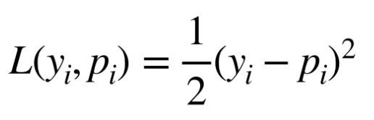
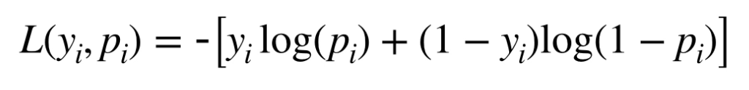
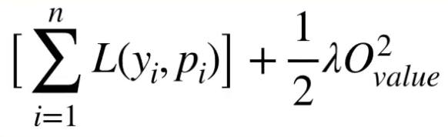
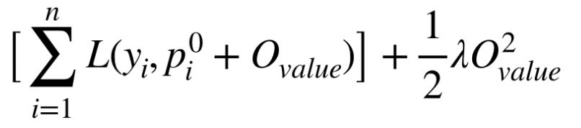
Loss functions
Loss function for Regression:
Loss function for Classification:
Objective function:
Total loss quantity
L2 Regularization
(For L1 Regularization, replace square with absolute value)

Slide 18


Taylor approximation
The Taylor series of a real or complex-valued function f(x) that is infinitely differentiable at a real complex number a is the power series:
$$ln⁡(x+1)$$

Slide 19
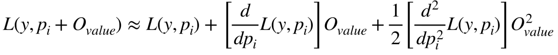
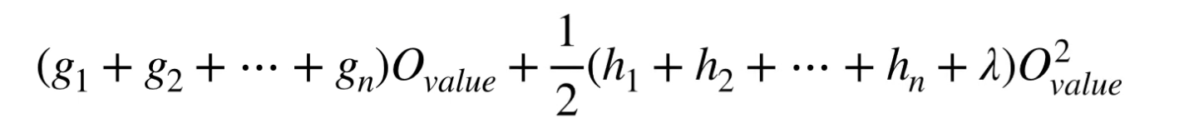
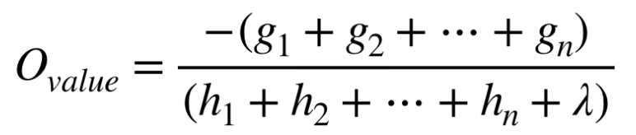
Total loss quantity
(Second order Taylor approximation)
First order derivative
Denoted, g (Gradient)
Second order derivative
Denoted, h (Hessian)
Plug the approximation into the objective function, then solve do some algebraic transformation, we end up with this expression.
To find Output value that minimizes this, we take the derivative with respect to O and let it equal 0.
After solving for O, the result is:

Slide 20
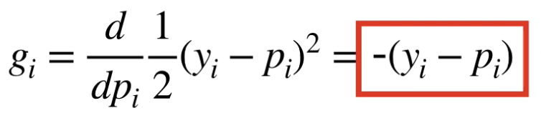
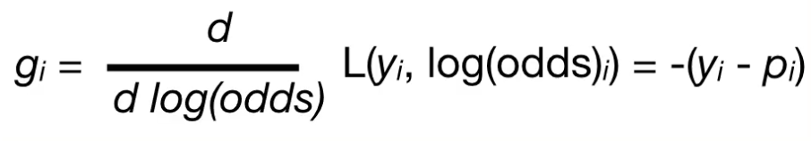
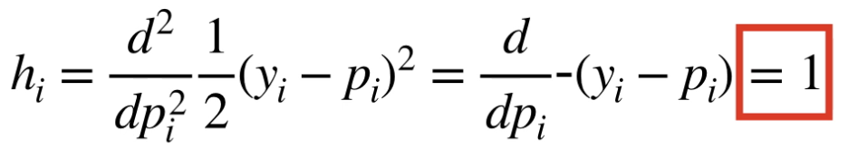
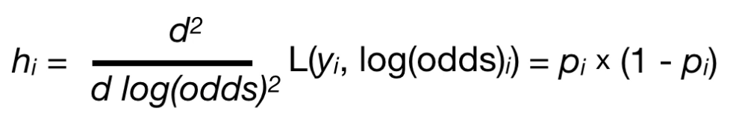
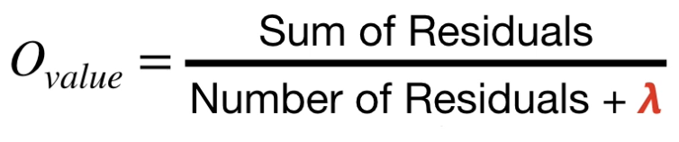
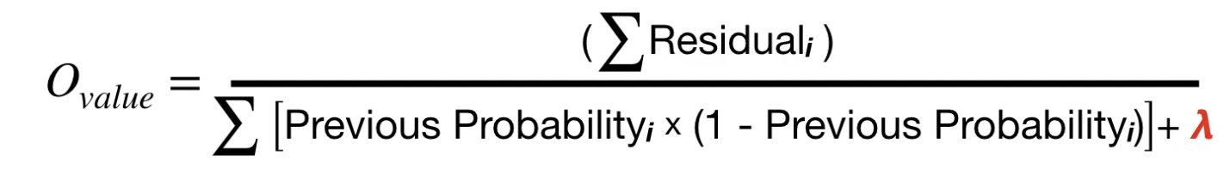
Compute the output value
Loss function for Regression:
Loss function for Classification:

Slide 21
4
XGBoost Optimization

Slide 22
Approximate split-finding
Instead of using a greedy algorithm to search for every split value, we calculate the quantiles as the search space. This reduces a lot of computation time, however this will ignore the optimal split most of the time, so the result is an approximatation.

Slide 23
Parallel learning
The nature of XGBoost is still a sequence of trees; and the later tree is trained on the error made by previous ones. So there is no way trees can be train independently and parallelly. The parallel implementation of XGBoost is done by assigning subsets of rows into different computers.
x | y
13 | 50
45 | 75
10 | 43
... | ...
x | y
13 | 50
... | ...
x | y
45 | 75
... | ...
x | y
10 | 43
... | ...
x | y
... | ...
... | ...

Slide 24
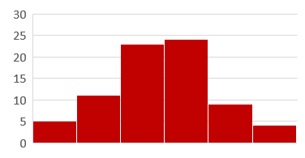
Weighted quantile sketch
The quantile sketch algorithm combine values in each computer to make an approximate histogram, as well as approximate quantiles. This is the input for approximately finding the optimal split.
x | y
13 | 50
... | ...
x | y
45 | 75
... | ...
x | y
10 | 43
... | ...
x | y
... | ...
... | ...

Slide 25
Weighted quantile sketch
This method also gives weights to each observation, equals to the denominator of the output formula without lambda, or simply the sum of Hessians. This simple classification problem illustrates the effect of weights:
The weight of 6 observations consecutively are given by:
w = p(1 – p)
The values are: 0.16, 0.09, 0.09, 0.16, 0.24, 0.24.
If not using the weights, the quantiles shoud be:
(1, 2), (3, 4), (5, 6)
where each quantile has 2 observations
When taking weights into account, the quantiles should be:
(1, 2), (3, 4), (5), (6)
where the weights of the quantiles are: 0.25, 0.25, 0.24, 0.24

Slide 26
Sparsity-aware finding
(sorted)
x | y | r
5 | -5 | -5.5
10 | -7 | -7.5
21 | 7 | 6.5
25 | 8 | 7.5
Fit a regression tree
(-5.5, -7.5, 6.5, 7.5)
Branch with higher information gain is selected as the default branch.
From now on, all missing values will go to this branch.
x | y
25 | 8
5 | -5
10 | -7
null | -3
21 | 7
null | -2
(-5.5)
(-3.5, -2.5)
(-7.5, 6.5, 7.5)
Gain_{left} = Similarity_{left} + Similarity_{right} - Similarity_{parent}
(-5.5, -7.5, 6.5, 7.5)
(-5.5)
(-7.5, 6.5, 7.5)
(-3.5, -2.5)
x | y | r
null | -3 | -3.5
null | -2 | -2.5
Gain_{right} = Similarity_{left} + Similarity_{right} - Similarity_{parent}

Slide 27
Cache-aware access
Speed
Cache Memory
CPU
Allocate an internal buffer in each thread, fetch the gradient statistics into it, and then perform accumulation in a mini-batch manner. This prefetching changes the direct read/write dependency to a longer dependency and helps to reduce the runtime overhead when number of rows in the is large.
Cache awareness is achieved by choosing the optimal size of the block (generally 2¹⁶).
Main Memory
Hard Drive
Memory

Slide 28
Out-of-core computation
When the dataset is too large for both Cache and Main memory, then at least some of it must be stored on the hard drive. Because reading and writing from Hard Drive is super slow, XGBoost tries to minimize the actions by compressing the data. Even thought CPU must have some time decompressing data from the Hard Drive, it is still faster than letting Hard Drive read the data.
Spending a little bit of CPU time uncompressing the data, we advoid a lot of time accessing the Hard Drive.
Also, when there is more than 1 Hard Drive, XGBoost uses sharding technique to speed up access by spliting the data so that each Hard Drive will receive a unique set of observations.

Slide 29
GPU accelaration
XGBoost supports fully distributed GPU training using Dask. A dask cluster consists of three different components: a centralized scheduler, one or more workers, and one or more clients which act as the user-facing entry point for submitting tasks to the cluster. When using XGBoost with dask, one needs to call the XGBoost dask interface from the client side.
The performance of running prediction, is sensitive to number of blocks. When number of partitions is large and each of them have only small amount of data, the overhead of calling predict becomes visible. On the other hand, if not using GPU, the number of threads used for prediction on each block matters. Right now, xgboost uses single thread for each partition. If the number of blocks on each workers is smaller than number of cores, then the CPU workers might not be fully utilized.

Slide 30
5
XGBoost Implementation

Slide 31
DMatrix
XGBoost provides a way to convert our training and testing data into DMatrix. DMatrix is an optimized data structure that provides better memory efficiency and training speed. The best part is that converting a dataset into DMatrix is really easy.
Some data formats supported by Dmatrix:
Numpy’s arrays
Scipy’s sparse matrices
Pandas’ dataframes
.txt files
.csv files
DMatrix does not support categorical features. They are required to be encoded to numerical values first.

Slide 32
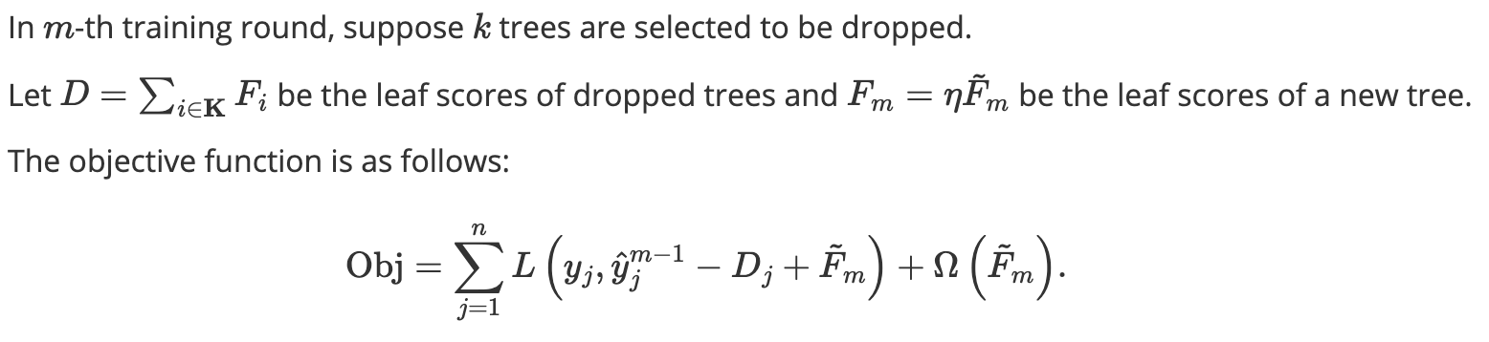
XGBoost’s boosters
The booster parameter indicates which type of weak learner is being used at each iteration.
“gbtree” (default)
A normal tree at each step.
“gblinear”
A weighted sum of linear models.
“dart”
Inspired by dropout technique from Deep Neural Net. Early trees are significant and later added ones are unimportant, so this technique prevents overfitting.

Slide 33
Grow policy
The grow_policy parameter controls how new nodes are added to the tree:
“depthwise” (default)
The split is done on closest nodes to the root. This is the behavior of normal trees.
“lossguide”
Split at nodes with highest loss change.
This option usually goes with another stopping criteria, max_leaves.

Slide 34
Column sub-sampling strategies
colsample_bytree
Sub-sampling is done once every new tree is contructed (like Random Forest)
colsample_bylevel
Sub-sampling is done once every new tree is contructed
colsample_bynode
Sub-sampling is done once every new tree is contructed
Notice that these 3 parameters can be stacked up/used cumulatively

Slide 35
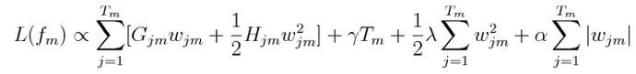
Regularization
reg_lambda, L2 regularization term on weights
reg_alpha, L1 regularization term on weights
Regularization is a quantity added to the loss function, to prevent overfitting. This is widely known as in some variants of Linear Regression:
Lasso Regression (L1 only)
Ridge Regression (L2 only)
Elastic Net (both L1 and L2)
Model performace does not change much when lambda and alpha changes. Thus, their values are usually set to be powers of 10, where the power ranges from -5 to 5.

Slide 36
Objective functions
The type of learning task and the related objective function is specified by objective. The argument has the format: “{learning_task}:{objective_function}”
Some popular objective functions are:
“reg:squarederror”
Regression with squared loss
“reg:squaredlogerror”
Regression with squared log loss 1/2[log(pred+1)−log(label+1)]2. — All input labels are required to be greater than -1
“binary:logistic”
Logistic regression for binary classification, output probability
“multi:softmax”
Set XGBoost to do multiclass classification using the softmax objective

Slide 37
Evaluation metrics
eval_metric specifies evaluation metrics for validation data, a default metric will be assigned according to objective (rmse for regression, and logloss for classification, mean average precision for ranking)
User can add multiple evaluation metrics, remember to pass the metrics in as list of parameters pairs instead of map, so that latter eval_metric won't override previous one.
For regression: rmse, rmsle, mae, mape, mphe
For binary classification: logloss, error (aka accuracy), error@t (t is a specific threshold), auc, aucpr
For multi-class classsification: mlogloss, merror, auc

Slide 38
Continuous training
XGBoost allows a model can be trained continuously on an existing one. XGBoost feeds data to all previous trees to calculate residuals in order to constructing new trees in the sequence.
New data
Dataset
xgb.model
New model
XGBRegressor.train(
params,
dataset
)
XGBRegressor.train(
params,
dataset_new,
xgb_model=“xgb.model”
)

Slide 39
Questions?
Write something about your main title here

