Slide 1
SECURITY OF MACHINE LEARNING
11/2021
Hientx7

Slide 2


Nội dung chính
01
Learn about vulnerabilities of machine learning
02
Explore existing defense techniques
www.viette.vn

Slide 3
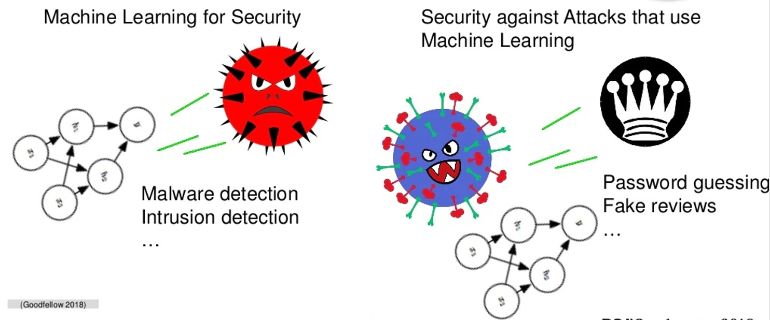
Machine Learning and Security

Slide 4
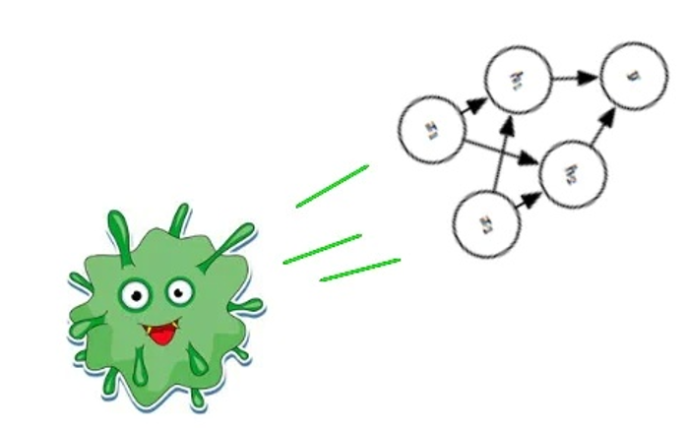
Security of Machine Learning

Slide 5
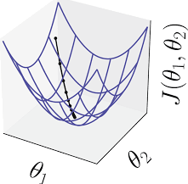
Most Traditional Machine Learning: Optimization

Slide 6
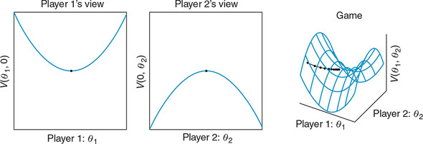
Adversarial Machine Learning: Game Theory

Slide 7
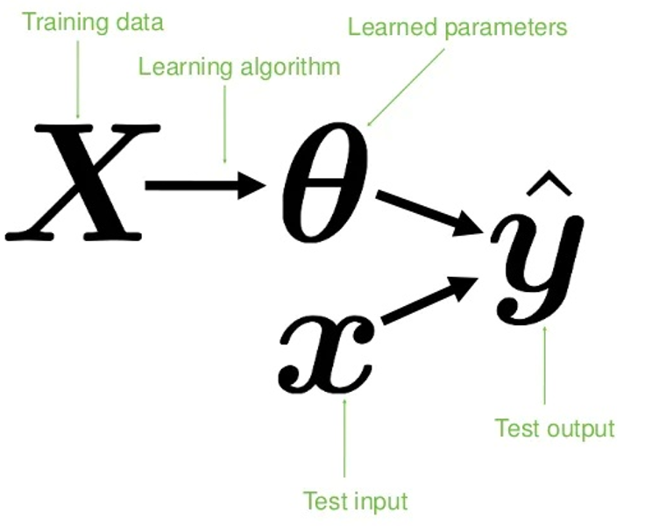
Machine Learning Pipeline

Slide 8
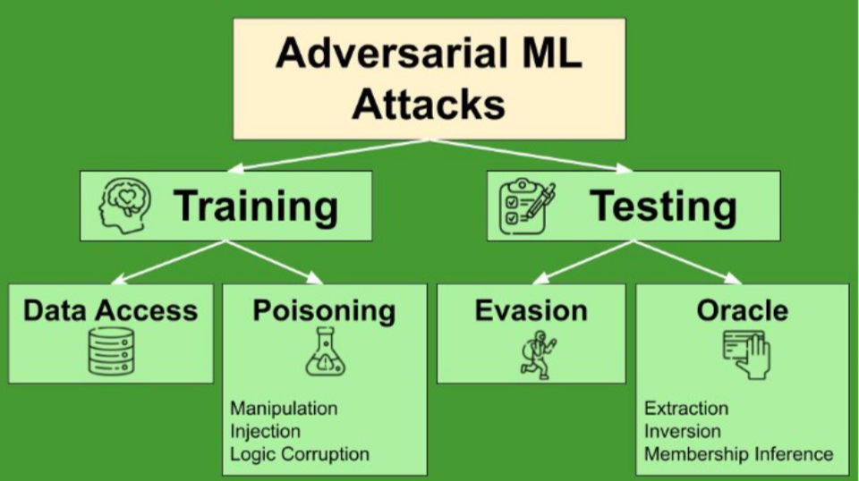
Method attacks

Slide 9
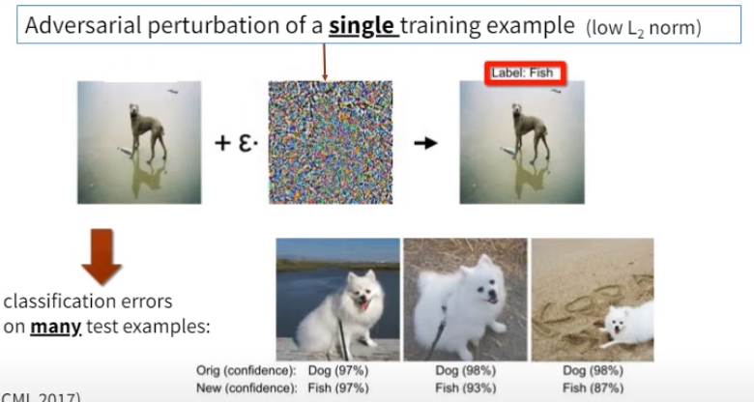
Training attacks: Poisoning

Slide 10
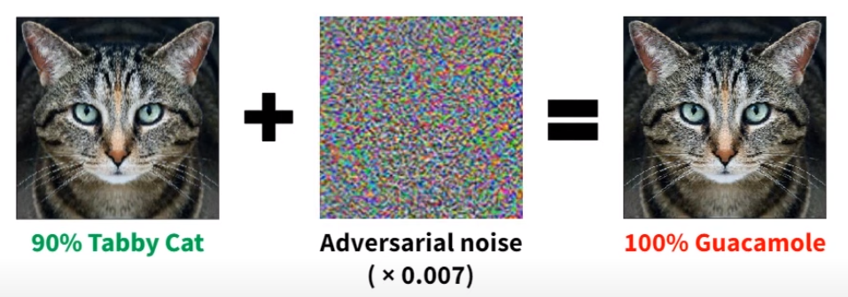
Inference Attacks: Evasion
Adversarial example

Slide 11
How to find adversarial examples: FGSM
Fast Gradient Sign Method (FGSM)
Gradient-based evasion attack
Projected Gradient Descent (PGD)
Carlini and Wagner (C&W) attack
Adversarial patch attack

Slide 12
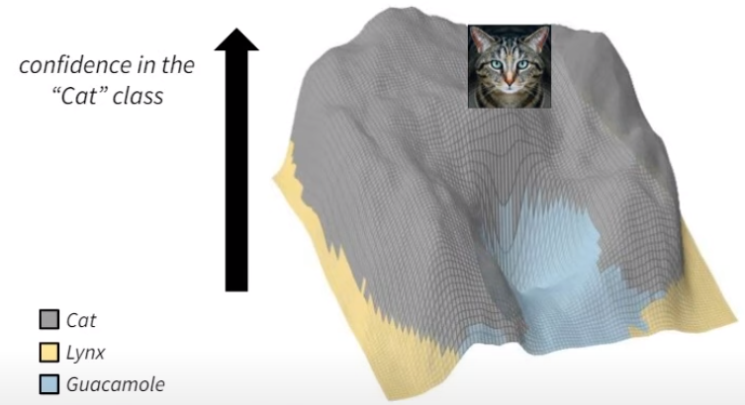
How to find adversarial examples: FGSM

Slide 13
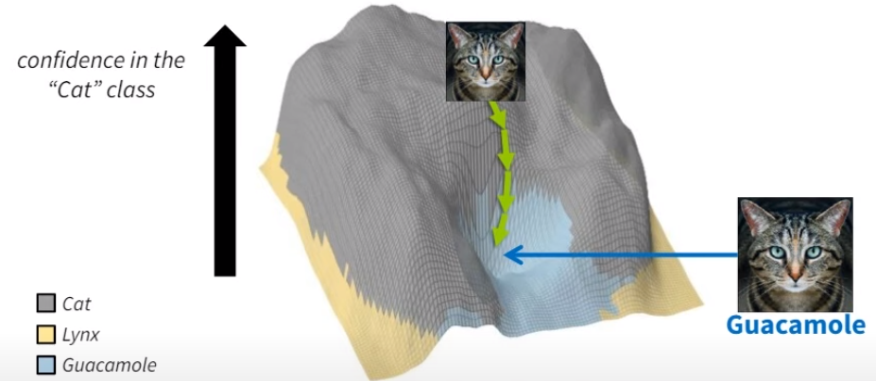
How to find adversarial examples: FGSM

Slide 14
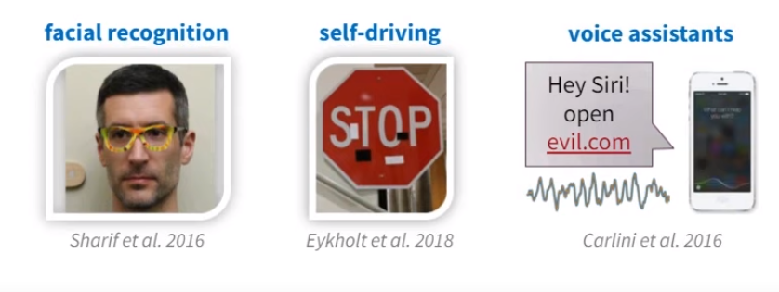
Adversarial examples are everywhere

Slide 15
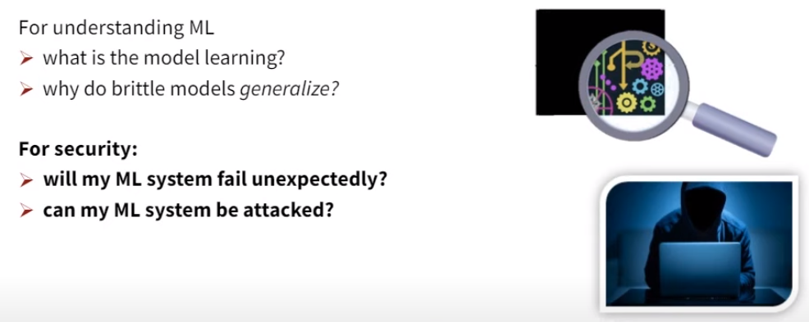
Why do adversarial examples matter?

Slide 16
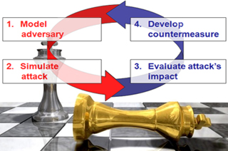
Defense

Slide 17
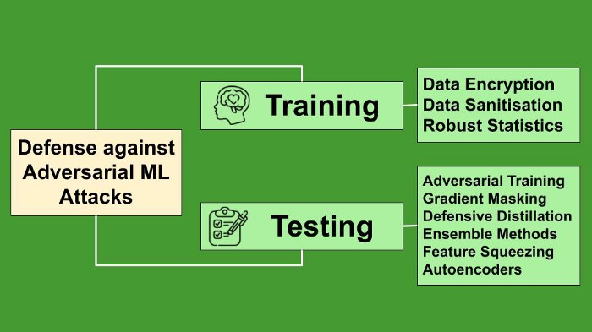
Mechanisms

Slide 18
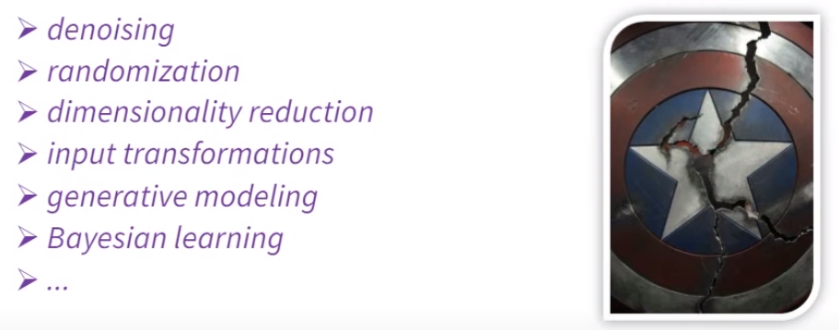
Most proposed defenses are broken

Slide 19
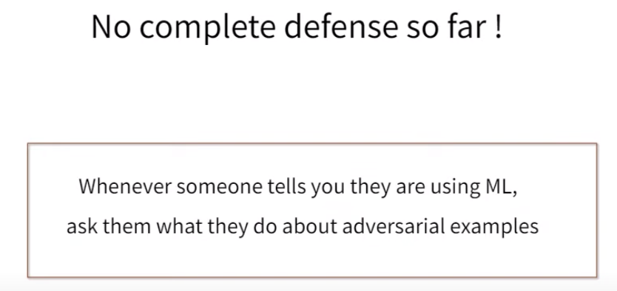

Slide 20

Adversarial robustness toolbox
Adversarial Robustness Toolbox (ART) is a Python library for Machine Learning Security. ART provides tools that enable developers and researchers to evaluate, defend, certify and verify Machine Learning models and applications against the adversarial threats of Evasion, Poisoning, Extraction, and Inference. ART supports all popular machine learning frameworks (TensorFlow, Keras, PyTorch, MXNet, scikit-learn, XGBoost, LightGBM, CatBoost, GPy, etc.), all data types (images, tables, audio, video, etc.) and machine learning tasks (classification, object detection, speech recognition, generation, certification, etc.)

Slide 21
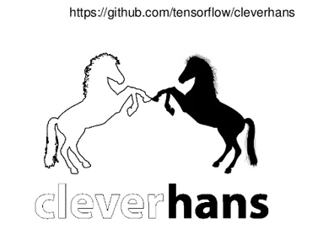
Cleverhans
Ian Goodfellow and Nicolas Papernot

Slide 22
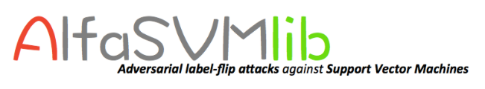
ALFASVMLib
ALFASVMLib is an open-source Matlab library that implements a set of heuristic attacks against Support Vector Machines (SVMs). The goal of such attacks is to maximally compromise the SVM's classification accuracy by mislabeling a given fraction of training samples. They are indeed referred to as adversarial label flip attacks, and can be also considered a form of worst-case label noise.

Slide 23
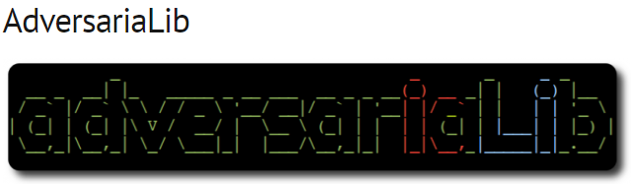
AdversariaLib

Slide 24
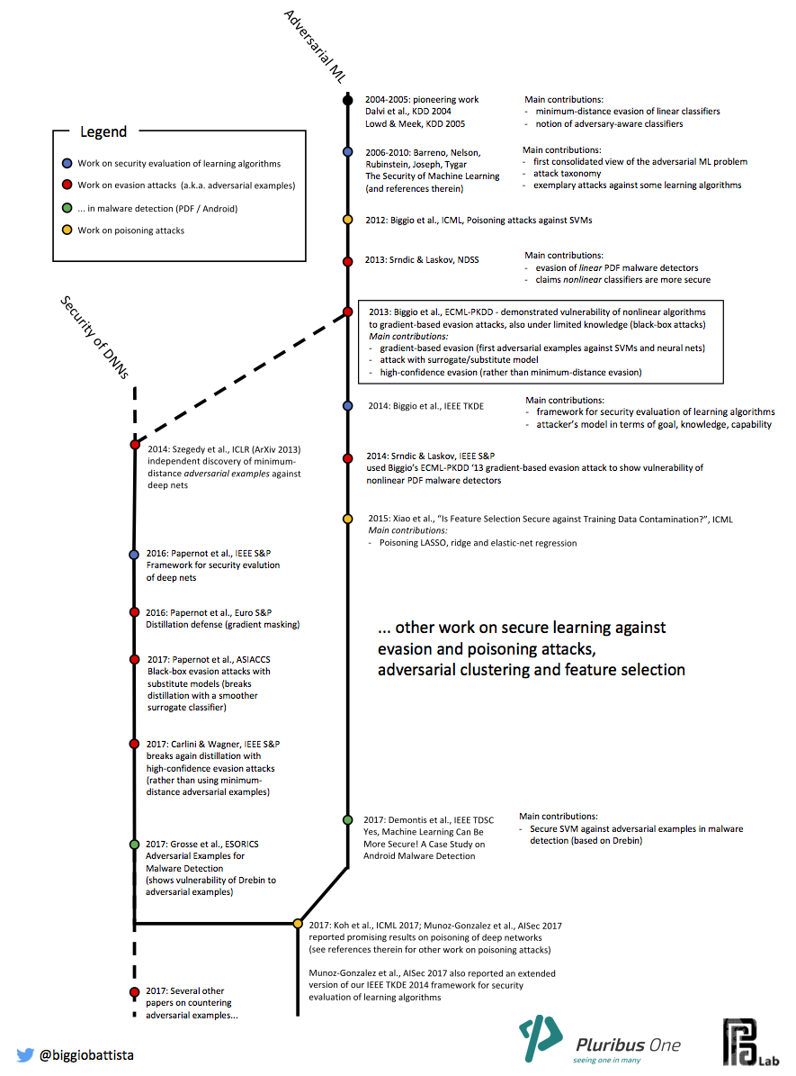
Wild Patterns: Ten Years After the Rise of Adversarial Machine Learning
https://arxiv.org/abs/1712.03141

Slide 25
REFRENCE
Nicolas Papernot, Patrick McDaniel, Arunesh Sinha, and Michael Wellman. SoK: Towards the Science of Security and Privacy in Machine Learning. In IEEE European Symposium on Security and Privacy, 2018
Kianpour, Mazaher; Wen, Shao-Fang (2020). "Timing Attacks on Machine Learning: State of the Art". Intelligent Systems and Applications. Advances in Intelligent Systems and Computing
Goodfellow, Ian; McDaniel, Patrick; Papernot, Nicolas (25 June 2018). "Making machine learning robust against adversarial inputs". Communications of the ACM
Understanding Black-box Predictions via Influence Functions, Pang Wei Koh, Percy Liang
Accessorize to a Crime: Real and Stealthy Attacks on State-of-the-Art Face Recognition, Mahmood Sharif , Sruti Bhagavatula , Lujo Bauer , Michael K. Reiter, 2016.
Webinar with Dan Boneh - Hacking AI: Security & Privacy of Machine Learning Models
Security and Privacy of Machine Learning, Ian Goodfellow,

Slide 26
THANK YOU <3

